Slide 1
Percent buried volume (%V_{bur})
Five slides about…

Slide 2
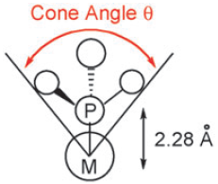
Steric parameters for phosphines
Reproduced from Clavier, H. and Nolan, S.P. Chem. Commun. 2010, 46, 841 with permission from The Royal Society of Chemistry.
http://dx.doi.org/10.1039/B922984A
Notes:
Toleman’s cone angle is a classic parameter, but it has limitations.
While useful for simple, tertiary phosphines, it is not as useful for more complicated ligands.
Cone angles work for monophosphines but can not be used for bisphosphines.

Slide 3
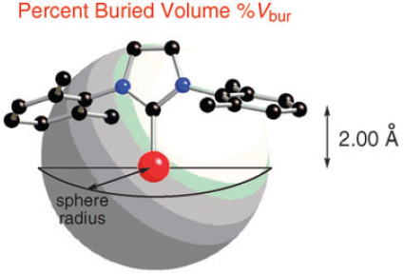
Percent buried volume (%V_{bur})
3.5 Å
Reproduced from Clavier, H. and Nolan, S.P. Chem. Commun. 2010, 46, 841 with permission from The Royal Society of Chemistry.
Reproduced from Clavier, H. and Nolan, S.P. Chem. Commun. 2010, 46, 841 with permission from The Royal Society of Chemistry.
http://dx.doi.org/10.1039/B922984A
Notes:
Initially developed for N-heterocyclic carbenes (NHC) ligands, can also be applied to phosphines.
A sphere with a radius of 3.5 Å about a metal center is considered.
The amount of this sphere occupied by the ligand is the %V_{bur}.

Slide 4
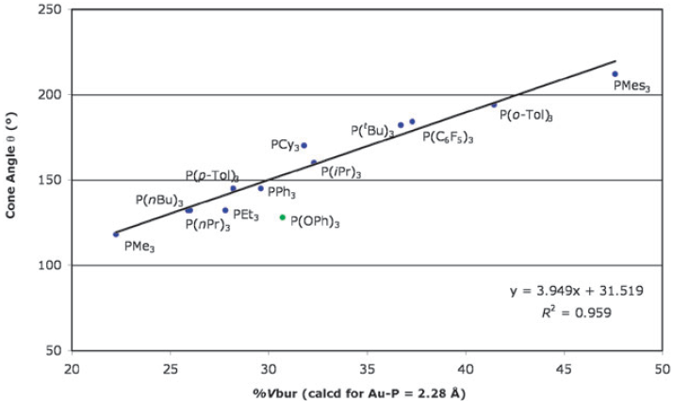
Comparison of cone angle and %V_{bur} in Au(PR₃)Cl complexes
Reproduced from Clavier, H. and Nolan, S.P. Chem. Commun. 2010, 46, 841 with permission from The Royal Society of Chemistry.
http://dx.doi.org/10.1039/B922984A
Notes:
Good agreement with cone angles for monophosphines.
Can be used for NHC ligands.
Can be used for bidentate phosphines.

Slide 5
Performing calculations
Start with a crystal structure
The R factor should be less than 7%
Save in Cartesian coordinate format (.xyz)
Edit as needed in a text editor
Keep only ligand atoms and the metal center
Convert the metal center to an H atom
Convert ‘unusual’ atoms in ligand to C atoms
Make sure the total atom count is correct
Order is not important
Save the file
Notes:
While other formats are possible, I have found the xyz format to be the easiest to edit.

Slide 6
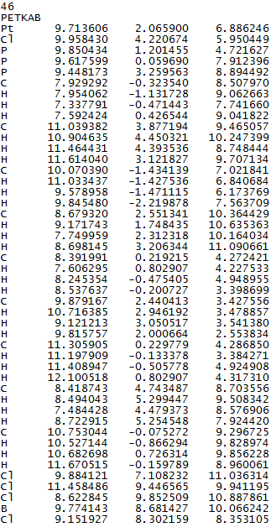
Example – [Pt(PMe₃)₃Cl][BCl₄]
The.xyz file in text reader
46 = number of atoms
PETKAB is CCDC name
Notes:
Structure from: J.P.H. Charmant, C. Fan, N.C. Norman, P.G. Pringle; Dalton Trans. 2007, 114.
The cif file is available from the CCDC for free at http://webcsd.ccdc.cam.ac.uk/teaching_database_demo.php
This calculation is for one of the trimethylphosphine groups.

Slide 7
Step 1: Remove [BCl₄⁻]

Slide 8
Step 2: Change Pt to H

Slide 9
Step 3: Remove Cl ligand

Slide 10
Step 4: Remove two PMe₃ ligands

Slide 11
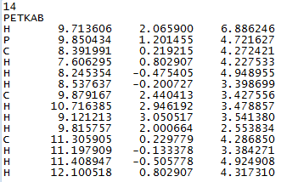
Step 5: Identify the important atoms
Coordinated atom (2)
Atoms for axis definition (3, 7, 11)
Remember to save the file

Slide 12
Step 6: Perform the calculation
https://www.molnac.unisa.it/OMtools/sambvca.php
Use of the SambVca website in this video is with permission of Professor Luigi Cavallo
(click screen twice to start video)

Slide 13
References
Clavier, H. and Nolan, S.P. Chem. Commun. 2010, 46, 841.
Poater, A.; Cosenza, B.; Correa, A.; Giudice, S.; Ragone, F.; Scarano, V.; Cavallo, L. Eur. J. Inorg. Chem. 2009, 1759.

