Slide 1
4 Slides About:
Electrocatalysis
Created by Matt Whited, Jillian Dempsey, Mike Norris, Abby O'Connor, and Anne Ryter, and posted on VIPEr on July 19, 2012, Copyright 2012. This work is licensed under the Creative Commons Attribution-NonCommercial-ShareAlike License. To view a copy of this license visit http://creativecommons.org/about/license/

Slide 2
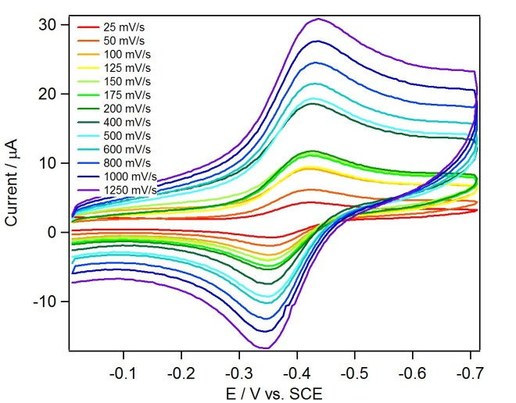
Cyclic Voltammetry Refresher
A complex that can be reversibly oxidized/reduced shows symmetric “duck-shaped” curves for reduction (potential decreasing) and oxidation (potential increasing)
Potential
Co(II)→ Co(I)
Time
CV involves a linear potential sweep and provides a reading of
current versus applied potential
Co(II)←Co(I)
Figure adapted from Valdez et al.,
PNAS, DOI:10.1073/pnas.1118329109
Notes:
Cyclic voltammetry is a useful method for probing the electrochemical properties of molecules (esp. inorganic ones with readily accessible redox couples). The basic experiment involves a linear ramp of potential versus time like linear sweep voltammetry, with the distinction that you move back and forth between two potentials (see potential vs. time plot). A variety of scan rates can be used, corresponding to a different slope for the lines in the potential vs. time plot.
The readout shows current flowing vs. applied potential (versus a reference, SCE in this case). When an electron transfer process occurs (reduction of the metal complex at the cathode or oxidation at the anode), current flows and a bump in the plot is observed. Note that the duck-like shape of the plot (where the peak cathodic current and peak cathodic current are not observed at the same potential) is due to mass transport issues at the electrode.
For a nice reversible one-electron transfer (like the Co(II)/Co(I) couple here), symmetric reduction and oxidation waves are observed.

Slide 3
Electrochemical Reactions
If a complex undergoes an irreversible chemical reaction after reduction or oxidation, then a return wave is not observed. This is known as an EC mechanism, since the Electrochemical step is followed by a Chemical reaction.
E
C
Ex: L_{n}Co^{III}–Cl + e– [L_{n}Co^{II}–Cl]– L_{n}Co^{II} + Cl–
Co(III)→ Co(II)
no Co(III)←Co(II) return wave
Notes:
As we know, not all complexes are equally happy after being reduced or oxidized. Often, the reduced/oxidized species will undergo a chemical reaction at some rate.
In this case, when a Co(III) chloride is reduced to a Co(II) chloride anion, the resulting complex is unstable with respect to chloride dissociation. Since the Co(II) complex undergoes a chemical reaction after reduction (an EC mechanism), the original Co(II) chloride anion is not around anymore when the sweep is reversed and so no current is measured for its oxidation. This leads to a “goose-” or “slug-type” shape. It is possible that oxidation of the chemically generated species would be observed at more positive potential (assuming it doesn’t all diffuse away from the electrode or react further), but that is not observed in this case and is beyond the scope of this LO.

Slide 4
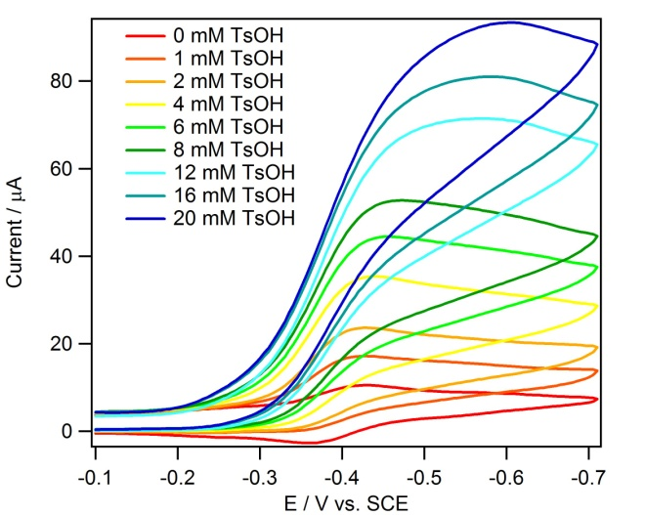
Electrocatalytic Reactions
If an electrochemically oxidized or reduced complex undergoes a chemical reaction that regenerates the starting material, a catalytic response may be observed.
Co(II)→ Co(I)
Since protons are involved in the reaction, the electrochemical response (proportional to reaction rate) increases as the acid concentration increases
Notes:
Now let’s put the pieces together. If the electrochemically generated species (a reduced cobalt complex in this case) can undergo a reaction that regenerates the original complex, then we’ll see a catalytic response. The wave will grow much larger than any other redox events in the CV because the same complexes are being reduced over and over as they react with protons to generate hydrogen and regenerate the original Co(II) complex.
In this figure, it is important to note that the measured current increases as the acid concentration increases. This is simple kinetics: protons are involved in the rate-limiting step of the reaction we observe, so an increase in proton concentration leads to a greater measured current due to increased rate of reaction. If we’re really sophisticated, then we can determine the order of the reaction in [H⁺], but that is also beyond the scope of this LO.

Slide 5
Electrocatalysis and Overpotential
Electrocatalysts will normally operate at the same potential where they are reduced or oxidized, but this may overshoot the required thermodynamic potential for the reaction:
Thermodynamic potential for reduction of TsOH in acetonitrile: –0.24 V vs. SCE
Complex | E⁰ (Co^{II/I}) (V vs. SCE) | k (M^{–1}∙s^{–1})
Co(dmgBF₂)₂(CH₃CN)₂ | –0.55 V | 7000
Co(dmgBF₂)(dpgBF₂)(CH₃CN)₂ | –0.37 V | 900
Co(dpgBF₂)(CH₃CN)₂ | –0.28 V | 200
only 40 mV overpotential!!
Note that catalysts with smaller overpotential typically operate less efficiently!!
This is a common problem for a set of electrocatalysts operating by the same mechanism.
Notes:
As you may have noted in the previous slide, catalysis occurs at the same place where Co(II) is reduced to Co(I). This is no coincidence, since electron transfer sets off the catalytic cycle. However, this means that catalysis will occur at a potential that is defined by the catalyst and not by the thermodynamics of proton reduction.
The “overpotential” basically describes the extra applied potential required to pull off the reaction relative to the thermodynamic requirements. Any extra applied potential is generally lost as heat. For this series of catalysts, the tetraphenyl version looks great in terms of overpotential (40 mV is quite small), but note that the rate constant stinks. This is also no coincidence, as the sentence at the bottom of the slide indicates. Normally, across a series of catalysts that operate by the same mechanism, the ones with greater overpotentials will react much faster because they end up with a ton of excess energy at their disposal for carrying out catalysis.

