Slide 1
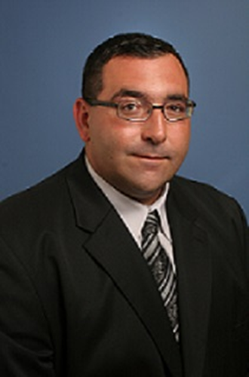
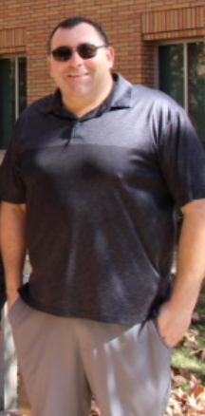




Exploring a non-traditional path in STEM:
Dr. Vincent Lavallo

Slide 2



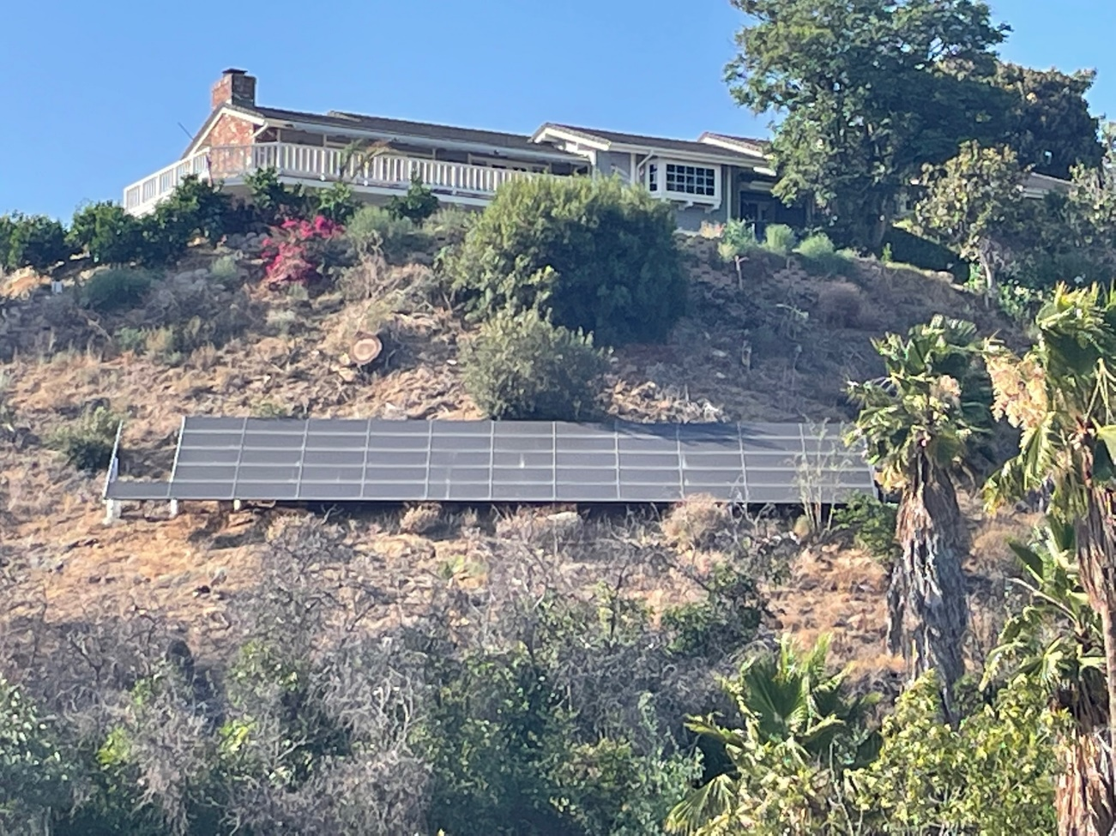
An Unconventional Route
B.S.
B.A.
Chemistry
4 years
5 years
+
P.I. - Guy Bertrand
Focus: Carbenes
X
Professor
of Chemistry
Ph.D.
Chemistry
2.5 years
P.I. - Guy Bertrand
Focus: T.M. Catalysis, Carbenes
Postdoc w/ Robert Grubbs
Focus: Exploratory Iron Chemistry/Catalysis

Slide 3
Discussion Questions - Website Navigation
Directions: Individually, please take 5 minutes and navigate through Dr. Lavallo’s website using the tabs at the top of the page (https://faculty.ucr.edu/~vincentl/index.html). Afterwards, break into groups of 3-4 and discuss the following questions:
How did you navigate this website?
Where did you find the contact information?
What types of molecules does Dr. Lavallo work with?
What research topics does Dr. Lavallo investigate?
How many publications does he have on his website? How many post-tenure?
Where does the research funding come from? What current funding sources does he have?
What does Dr. Lavallo do in the community?
How many graduate students and undergrads are in his lab?
How could you contact Dr. Lavallo?
Notes:
First, allow the students to individually navigate through each of the tabs of Dr. Lavallo’s website (5 minutes). Then, break the students into groups of 3-4 and allow them to answer the discussion questions. After 15-20 minutes, lead a class discussion based on the questions above.

Slide 4
Answers to the Discussion Questions
How did you navigate this website?
  Systematically clicked on each tab and read the relevant information
Where did you find the contact information?
  The tabs that say “Vincent Lavallo” and “Contact”
What types of molecules does Dr. Lavallo work with?
  Carboranes, carbenes, metal catalysts
What research topics does Dr. Lavallo investigate?
  Synthetic inorganic chemistry, catalysis, electrolytes, radical chemistry
How many publications does he have on his website? How many post-tenure?
  36 publications, 17 post-tenure
Where does the research funding come from? What current funding sources does he have?
  Mostly from government agencies like the National Science Foundation (NSF), DARPA. Others include awards, ACS and Lawrence Livermore National Security.
What does Dr. Lavallo do in the community?
  High School Outreach programs providing research experience to interested students
How many graduate students and undergrads are in his lab?
  6 Graduates and 0 undergrads (as of June 2022)
How could you contact Dr. Lavallo?
  Email, phone
Notes:
Answers may need to be updated as the website evolves. These are up to date as of June, 2020. First, allow the students to individually navigate through each of the tabs of Dr. Lavallo’s website (5 minutes). Then, break the students into groups of 3-4 and allow them to answer the discussion questions. After 15-20 minutes, lead a class discussion based on the questions above.

Slide 5

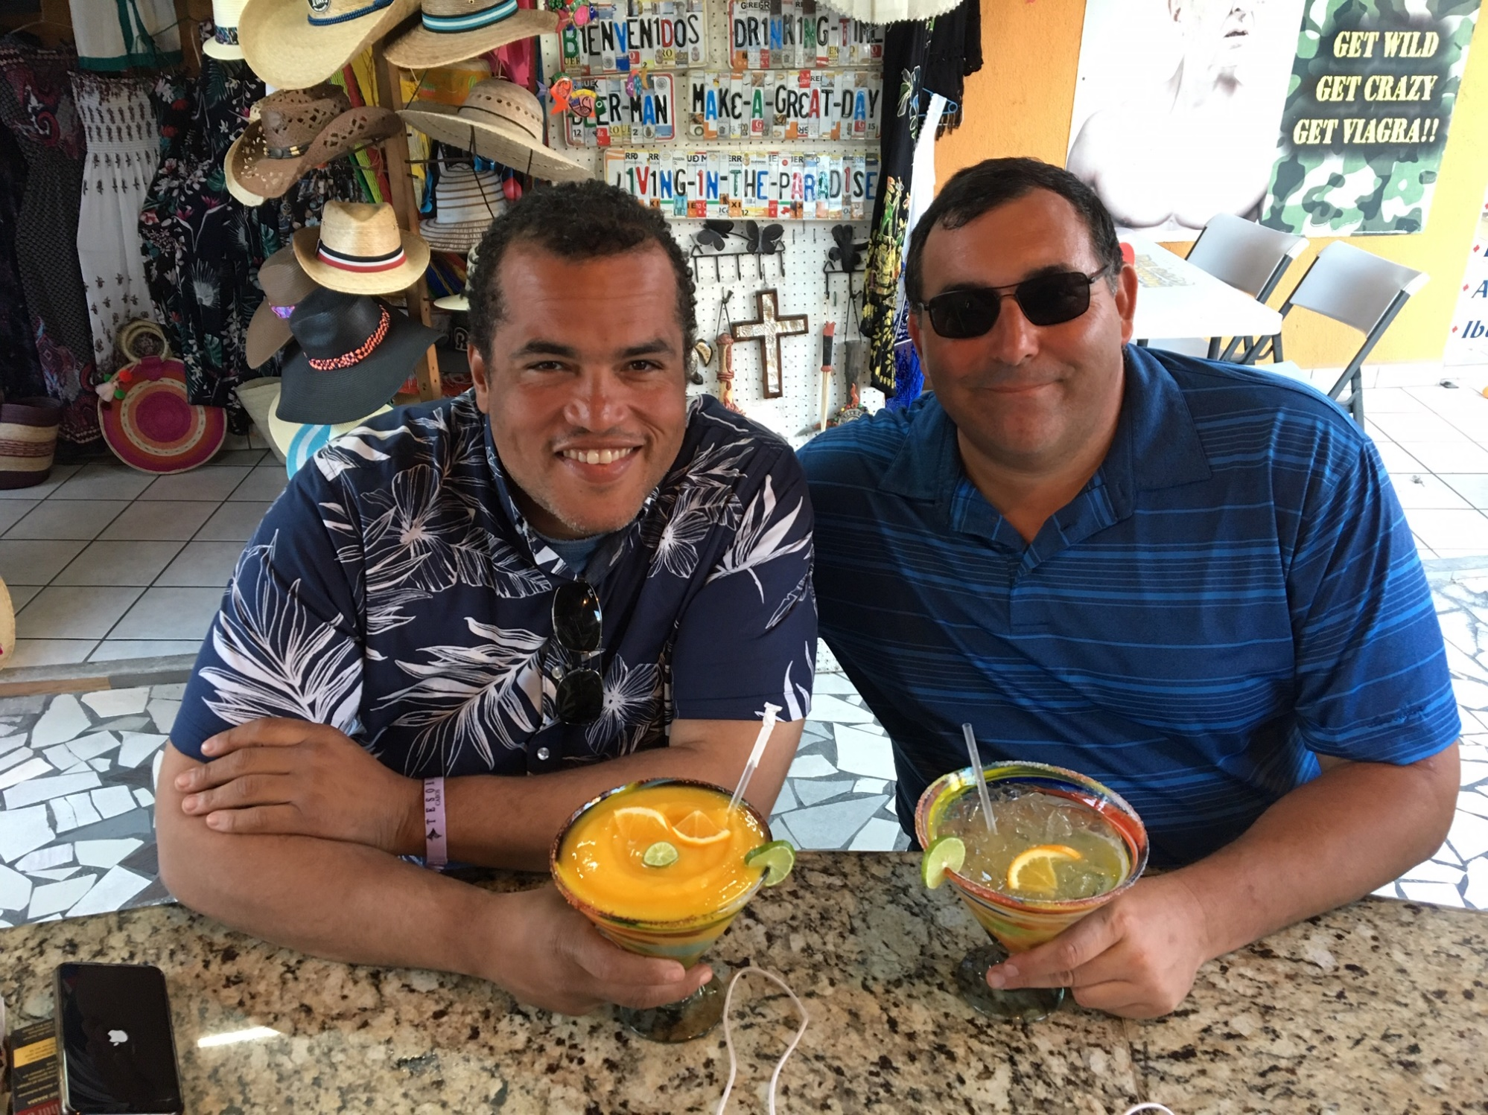
Dr. Lavallo and his visiting scholar and friend, Hosea Nelson
(Professor of Chemistry, Caltech)

