Slide 1
Pre-Modern Chemistry:
A Brief World History
Created by Shirley Lin, United States Naval Academy (lin@usna.edu) and posted on VIPEr (www.ionicviper.org) on June 19, 2020. Copyright 2020. This work is licensed under the Creative Commons Attribution Non-commercial Share Alike License. To view a copy of this license visit https://creativecommons.org/licenses/by-nc-sa/4.0/.

Slide 2
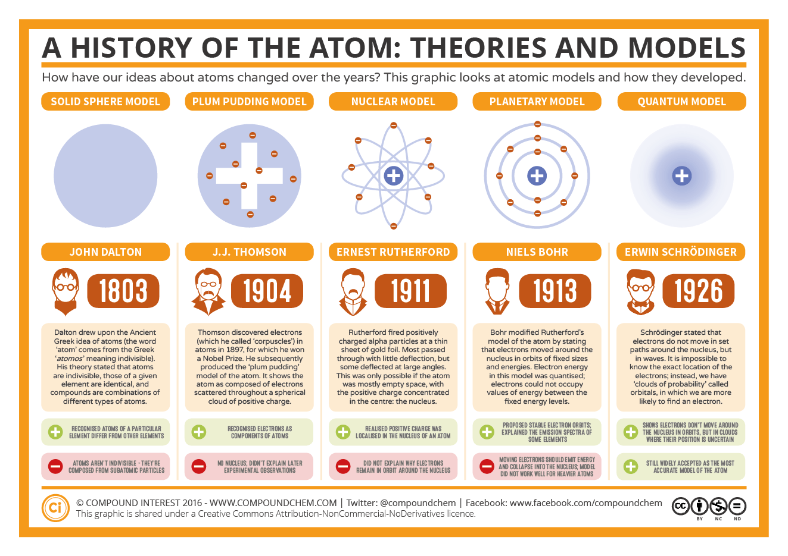
https://www.compoundchem.com/2016/10/13/atomicmodels/Accessed 21 MAY 2019.
Notes:
Modern chemistry has adopted the model that uses atoms and molecules to explain how matter behaves. This model was evolved over more than a century and has endured because it successfully explains many of our observations of the physical world. This Compound Chem figure lists the 5 chemists who influenced the development of the atomic model.
In the next slide, we will examine the geographical origins of these 5 scientists.

Slide 3
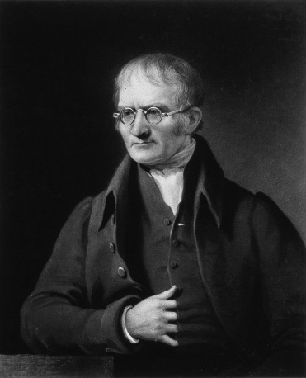

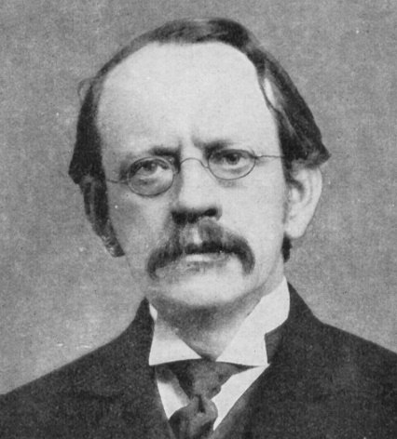
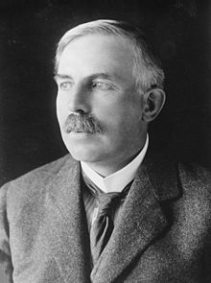
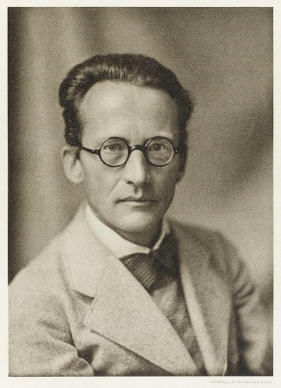
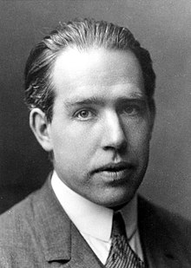
Dalton, Thomson, Rutherford
Schrodinger
Bohr
Notes:
Dalton, Thomson and Rutherford were British. Rutherford’s nationality was New Zealander but he was a British citizen born to British parents and lived in England for half his life.
Bohr was from Denmark
Schrodinger was from Austria
According to this map, it may appear that chemistry is entirely a European/Western science that was practiced by privileged, white men. While the development of modern atomic theory took place in Europe, in fact chemistry was being practiced all around the world for centuries/millenia before that.

Slide 4
“If I have seen further it is by standing on the shoulders of Giants.”
-Isaac Newton, 1675 (paraphrasing Bernard of Chartes)
https://en.wikipedia.org/wiki/Standing_on_the_shoulders_of_giants Accessed 19 JUN 2020
Notes:
The achievements of Dalton, Thomson, Rutherford, Bohr, and Schrodinger did not take place in vacuum where chemistry did not exist before. Various forms of chemistry had been practiced for centuries throughout the world and certainly would have influenced these scholars.

Slide 5
Technologies That Use Chemistry
Metallurgy
Ceramic-making
Fermentation
  beer brewing
  wine-making
Soap-making
Medicinal plant extracts
Fiber/material processing
  dyeing
  tanning
Food processing (e.g. cooking, preserving)
Notes:
The practice of chemistry is not limited to using the atomic/molecular model. This is a list of technologies that involve chemistry and chemistry techniques that do not require invoking the atomic model.
The following slides outline some of the chemistry practices and achievements in non-Western parts of the world. There are undoubtedly many more examples that were carried out by indigenous peoples in all areas of the world that are not known due to lack of records from those times.

Slide 6
Atomism
380 BCE: Democritus (Greece) and Kanada (India) postulate the existence of indivisible, indestructible particles (“atomos”)
https://en.wikipedia.org/wiki/History_of_chemistry#cite_note-ephotos-5. Accessed 21 MAY 2019.
Notes:
The idea of the existence of atoms was formulated centuries before Dalton, Thomson, Rutherford, Bohr, and Schrodinger further developed the modern model.

Slide 7
Ancient World
360 BCE: Theorizing of primary “elements” (stoichaeia): air, water, earth, fire, metal
https://en.wikipedia.org/wiki/History_of_chemistry#cite_note-ephotos-5. Accessed 21 MAY 2019.
Notes:
Multiple civilizations (Mayan, Greek, Indian, Chinese) described the physical world using the theory of elements.

Slide 8
Africa
Egypt
“al-kemi” = the black land
Dyeing, leather tanning
Medicinal plants
Fermented beverages
https://hssonline.org/resources/teaching/teaching_nonwestern/teaching_nonwestern_africa/ Accessed 21 MAY 2019.
Notes:
The term chemistry comes from al-kemi.
One of the oldest known examples of early human chemistry is a 100,000-year-old ochre-processing workshop in South Africa. Ochre is a type of pigment derived from ferric acid, sand, and clay. (https://en.wikipedia.org/wiki/History_of_chemistry#cite_note-ephotos-5 Accessed 19 JUN 2020)

Slide 9
The Middle East
700-900 BCE:
Jābir ibn Ḥayyān (Geber) “father of chemistry”
Muhammad ibn Zakariya al-Razi (Rhazes)
Techniques: Distillation, crystallization, extraction
Elements: arsenic, sulfur, antimony, bismuth, mercury
Compounds: ethanol, sulfuric acid, citric acid, acetic acid, tartaric acid
https://en.wikipedia.org/wiki/Jabir_ibn_Hayyan. Accessed 21 MAY 2019.
https://en.wikipedia.org/wiki/Muhammad_ibn_Zakariya_al-Razi#Alchemy. Accessed 21 MAY 2019.
Notes:
It may be interesting for students to realize that the common lab techniques still used and taught today were developed before the common era.
Both scientists were Arab/Persian from the Islamic Golden Age.
The works of Jābir ibn Ḥayyān total 3000 articles and treatises. The exact identity of the author(s) of these works is not known.
Muhammad ibn Zakariya al-Razi is also noted for his contributions to medicine.

Slide 10
India
1800 BCE
Iron-working
300 BCE – 200 CE
High-quality steel
“By the sixth century the Hindus were far ahead of Europe in industrial chemistry; they were masters of calcinations, distillation, sublimation, steaming, fixation, the production of light without heat, the mixing of anesthetic and soporific powders, and the preparation of metallic salts, compounds and alloys.”
https://en.wikipedia.org/wiki/History_of_metallurgy_in_the_Indian_subcontinent. Accessed 21 MAY 2019.

Slide 11
China
~200 BCE
qi (“matter-energy”)
li (natural order)
9th Century CE: gunpowder
https://en.wikipedia.org/wiki/Fireworks#History. Accessed 21 MAY 2019.
https://en.wikipedia.org/wiki/History_of_gunpowderAccessed 21 MAY 2019.
https://hssonline.org/resources/teaching/teaching_nonwestern/teaching_nonwestern_china/. Accessed 21 MAY 2019.
Notes:
“By the Han dynasty (206 BC – 220 AD) comprehensive cosmological views of the universe had been developed by the Daoists based on a few universal principles: yin and yang complementarity, the relations and correspondences of wu xing (the five phases of the universe: wood, fire, earth, metal, and water), together with notions of qi (vital force, or “matter-energy”) and li (natural order, or organizing principle).”
(https://hssonline.org/resources/teaching/teaching_nonwestern/teaching_nonwestern_china/. Accessed 21 MAY 2019.)
To me, the idea of natural order foreshadows the development of the periodic table while the idea of “matter-energy” evokes thermochemistry.
Gunpowder (black powder) is the first chemical explosive to be developed. It is composed of sulfur, charcoal (carbon), and saltpeter (KNO₃). The development of gunpowder enabled other significant advances in warfare (guns, artillery) as well as non-military applications (fireworks, explosives for mining and tunneling).

Slide 12
The Americas
Medicinal chemistry: anaesthetics, analgesics (aspirin), antibiotics
Metallurgy and electroplating (100-700 CE)
Rubber-making (1400 BCE)
https://en.wikipedia.org/wiki/List_of_inventions_and_innovations_of_indigenous_Americans. Accessed 21 MAY 2019.

Slide 13
Modern Chemistry is Global
Notes:
While modern atomic theory was the product of chemists from Europe/the Western world, the use of this theory and the practice of modern chemistry has grown to be worldwide. These scientific principles and ideas are taught to students across the globe and chemistry research from every continent is being published and advancing the field each day. Professional chemical societies

