Slide 1
Five Slides about
X-ray Photoelectron Spectroscopy (XPS)
Created by Sophia Hayes (Washington University, hayes@wustl.edu), Sarah St. Angelo (Dickenson College, stangels@dickenson.edu), Kathy Van Heuvelen (Harvey Mudd College, vanheuvelen@g.hmc.edu), and Megan E. Strayer (The Pennsylvania State University, strayerme@gmail.com), and posted on VIPEr (www.ionicviper.org) on June 27, 2013. Copyright Sophia Hayes 2013. This work is licensed under the Creative Commons Attribution-NonCommerical-ShareAlike 3.0 Unported License. To view a copy of this license visit http://creativecommons.org/about/license/.

Slide 2
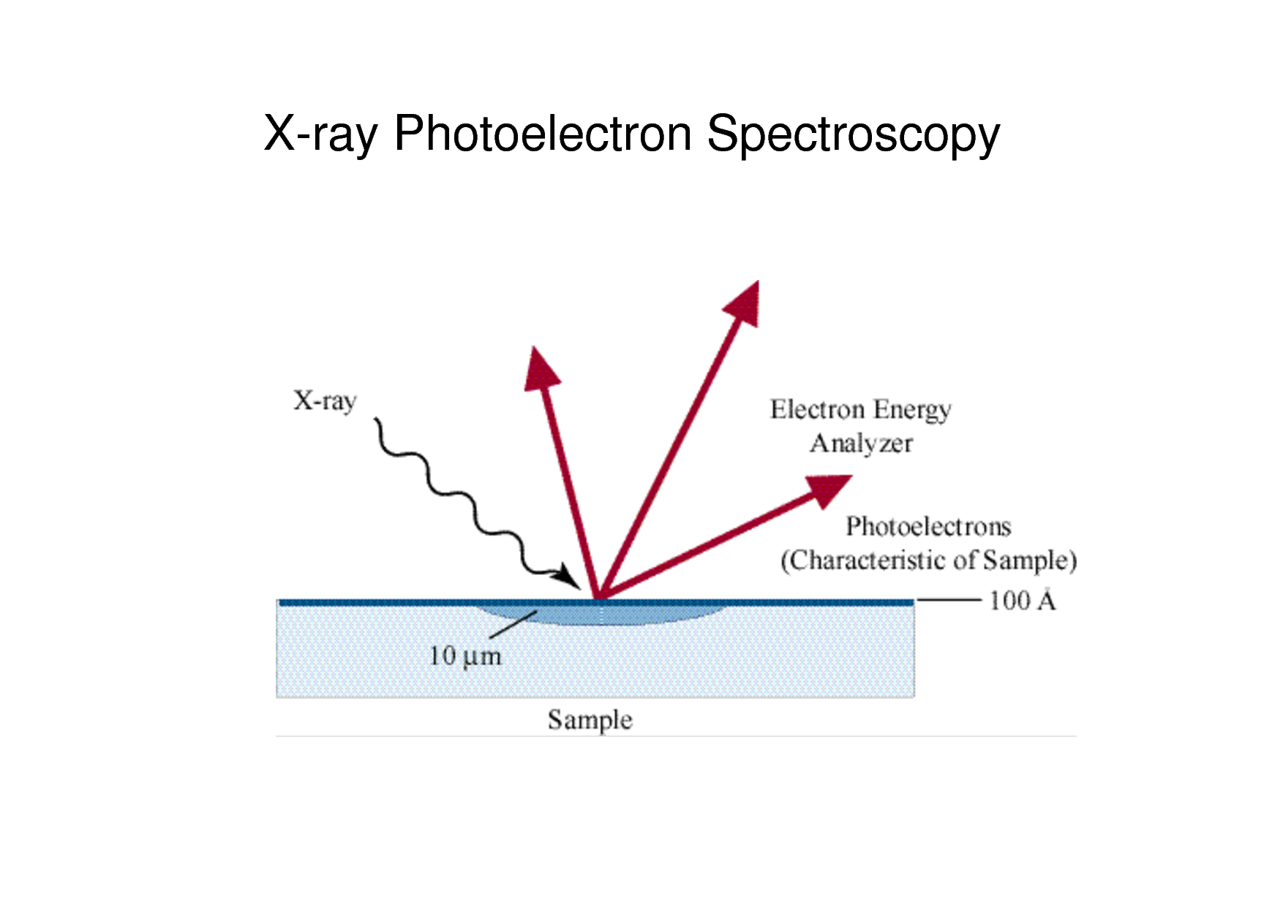
Principle behind XPS
http://www.docstoc.com/docs/12282407/4-XPS-or-ESCA-2009-revised-B

Slide 3
What can you do with
XPS?
XPS is typically thought of as a chemical identification tool—one of the tool that is especially useful for surfaces.
Photoelectrons are emitted from a sample after irradiation with x-rays.
The binding energy of the photoelectrons are recorded by a detector. Both the binding energy, and the intensity of the peak, allow for a variety of characteristics to be determined:
  Which element(s) are present?
  What is the oxidation state—to what is the element bound, locally?
  The quantity of the element present.
Applications:
  Thin film characterization, identifying elements from Li through U (but not H and He)
  Applicable to a wide range of solid materials (but not liquids or gases)
  Quantitative analysis, even as a function of depth (“profiling”)

Slide 4
What are some fun facts about XPS?
Pros
  Detection limits: 0.01 to 1 at%
  Resolution (lateral): 10um - mm
  Resolution (depth): 10 – 200 A
Cons
  XPS is an ultra-high vacuum technique; samples must be non-volatile.

Slide 5
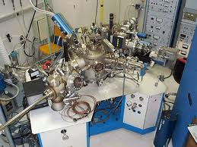
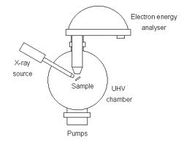
XPS Hardware
Image courtesy of:
http://www.inkdating.com/xps2.htm
http://www.chem.qmul.ac.uk

Slide 6
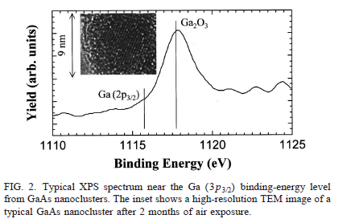
Typical XPS Data
XPS spectra are diagnostic of elements and oxidation states.
Shown is a spectrum of an oxidized gallium species, showing the presence of Ga³⁺ and the absence of Ga metal (at the 2p_{3/2} line)
Figure adapted from Dinh, L.N.; Hayes, S.E. et al. “GaAs nanostructures and films deposited by a Cu-vapor laser” App Phys. Lett. 1999, 75, 2208-2210.

