Slide 1
5 Slides About
Localized surface plasmon resonances (LSPRs) and gold nanoparticles
Created by Sarah St. Angelo (Dickenson College, stangels@dickenson.edu), Sophia Hayes (Washington University, hayes@wustl.edu), Gregory A. Moehring (Monmouth University, gmoehrin@monmouth.edu), Libbie Pelter (Purdue University Calumet, pelterl@purduecal.edu), Megan E. Strayer (The Pennsylvania State University, strayerme@gmail.com), and Katherine Van Heuvelen (Harvey Mudd College, vanheuvelen@g.hmc.edu) and posted on VIPEr (www.ionicviper.org) on June 27, 2013. Copyright Megan E. Strayer 2013. This work is licensed under the Creative Commons Attribution-NonCommerical-ShareAlike 3.0 Unported License. To view a copy of this license visit http://creativecommons.org/about/license/.
Notes:
Created by Sarah St. Angelo (Dickenson College, stangels@dickenson.edu), Sophia Hayes (Washington University, hayes@wustl.edu), Gregory A. Moehring (Monmouth University, gmoehrin@monmouth.edu), Libbie Pelter (Purdue University Calumet, pelterl@purduecal.edu), Megan E. Strayer (The Pennsylvania State University, strayerme@gmail.com), and Katherine Van Heuvelen (Harvey Mudd College, vanheuvelen@g.hmc.edu) and posted on VIPEr (www.ionicviper.org) on June 27, 2013. Copyright Megan E. Strayer 2013. This work is licensed under the Creative Commons Attribution-NonCommerical-ShareAlike 3.0 Unported License. To view a copy of this license visit http://creativecommons.org/about/license/.

Slide 2
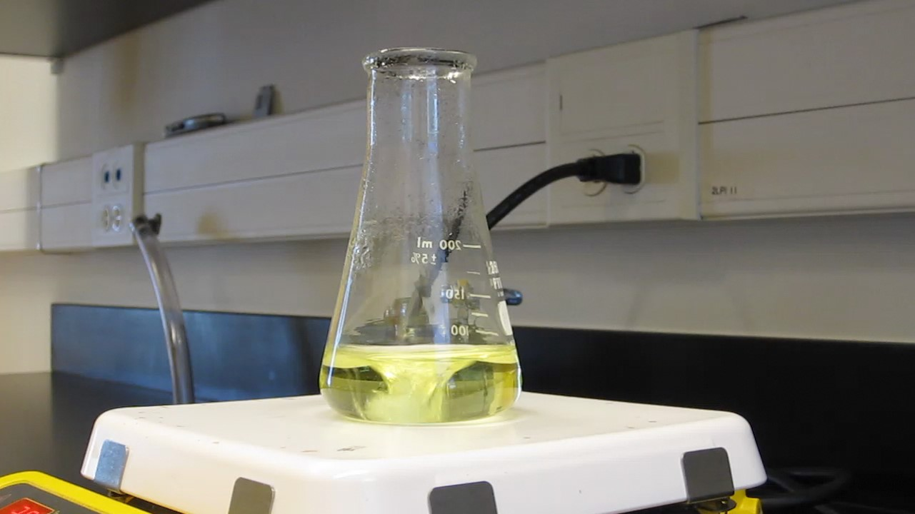
HAuCl₄ in aqueous solution is the precursor for Au nanoparticles
For a video of the reduction of HAuCl₄ with sodium citrate:
https://www.youtube.com/watch?v=mRcq8omtLBw&feature=youtu.be
Notes:
Gold nanoparticles in the flask have a diameter of ~13 nm. They were prepared by reduction of HAuCl4 with sodium citrate. This sample is the same as the one in the associated video, just with a little longer time elapsed.

Slide 3

Au colloid after reaction completed—where does the color come from?
Notes:
Gold nanoparticles in the flask have a diameter of ~13 nm. They were prepared by reduction of HAuCl4 with sodium citrate. This sample is the same as the one in the associated video, just with a little longer time elapsed.

Slide 4
Localized surface plasmon resonances and nanoparticle color
Electrons in metal nanoparticles can be perturbed by electromagnetic (EM) radiation
EM radiation can displace the electrons, causing oscillations of the electrons around metal nanoparticles
The oscillations of electrons “absorb” the parts of the EM spectrum that generate the oscillations
+ + +
+ +
- -
- - -
+ + +
+ +
- -
- - -
Propagating Electromagnetic Radiation
Adapted from Willets & Van Duyne Annu.Rev.Phys.Chem. 2007, 58:267-297
Notes:
The cartoon represents the same metal nanoparticle (NP) or 2 nanoparticles experiencing a propagating electromagnetic field.
As the EM field passes through the NP(s), the delocalized electrons in the metal are displaced away from the NP(s), but they are not removed from the particles. The electromagnetic restoring force and the propagating EM radiation induces a coherent oscillation of the electrons that is called a localized surface plasmon resonance.
For larger particles or bulk metal, surface plasmons propagate and are not localized near where they are generated.
The referenced paper is a good reference for introduction as well as learning about specific techniques and testing examples.

Slide 5
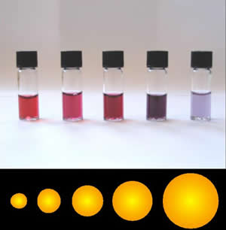
Localized surface plasmon resonances and nanoparticle color
For spherical gold NPs, the color varies from red to purple as diameter increases
Nanoparticle attributes that affect LSPR energies
Composition
Size
Shape
Image by Aleksandar Kondinski is licensed under the Creative Commons Attribution-Share Alike 3.0 Unported, 2.5 Generic, 2.0 Generic and 1.0 Generic license.
Notes:
Gold nanoparticles provide many examples in the chemical literature or on various websites.

Slide 6
Localized surface plasmon resonances and nanoparticle color
Spherical gold nanoparticles have LSPRs that red shift with increasing diameters.
Longer wavelengths of light are able to excite the LSPR of larger nanoparticles—therefore larger nanoparticles absorb longer wavelengths of light. The LSPR wavelength shifts to the right as nanoparticles grow.
Extinction
400 600 800 1000 1200
Wavelength, nm
Notes:
NOTE: The spectra shown are drawn and are not actual data. They represent the kind of changes in UV-vis-(NIR) spectra that are observed when spherical Au nanoparticles have increasing (left to right, short to long wavelengths) diameters.
Extinction is used on the y-axis instead of Absorbance because light is not absorbed by a typical, molecular process. Additionally, some light is scattered which appears in the UV-vis-(NIR) as “absorbance”. Absorbance is often used as an equivalent term as Extinction, but the processes of removing light from the beam path are different.

