Slide 1
5(or 6)* slides about Biophysical Techniques
This slide show created by Sheila Smith, University of Michigan- Dearborn (sheilars@umich.edu) and posted on VIPEr (www.ionicviper.org) on July 13, 2014. It was specifically prepared for the IONiC/VIPEr workshop Bioinorganic Applications of Coordination Chemistry held at Northwestern University July 13-18, 2014. This work is licensed under the Creative Commons Attribution Non-commercial Share Alike License. To view a copy of this license visit http://creativecommons.org/about/license/.
*(not counting this one)
Notes:
This slide show created by Sheila Smith, University of Michigan- Dearborn (sheilars@umich.edu) and posted on VIPEr (www.ionicviper.org) on July 13, 2014. It was specifically prepared for the IONiC/VIPEr workshop Bioinorganic Applications of Coordination Chemistry held at Northwestern University July 13-18, 2014. This work is licensed under the Creative Commons Attribution Non-commercial Share Alike License. To view a copy of this license visit http://creativecommons.org/about/license/.

Slide 2
Disclaimer: this presentation is by no means complete. It was prepared specifically for the 2014 IONiC/VIPEr workshop Bioinorganic Applications of Coordination Chemistry, held at Northwestern University July 13-18,2014. It contains one slide each about 6 techniques that were specifically related to the topics of that workshop. Many other techniques exist. Much more information is available about each technique. I’ve tried to include some good references in the Notes for each slide. Feel free to use what you like and discard what you don’t (which is the Creative Commons way…).
*(or this one)

Slide 3
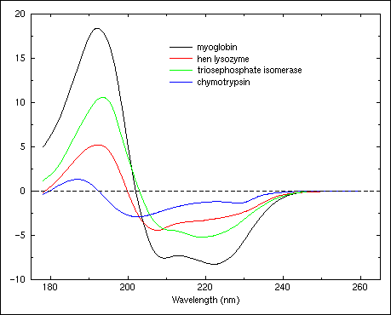
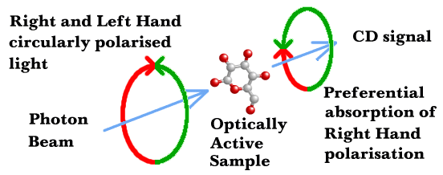
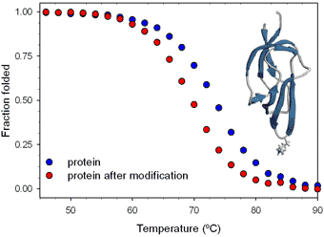
Circular Dichroism (CD)
In CD spectroscopy, a sample is exposed to circularly polarized light. If the sample is chiral, then this light will be absorbed differently depending on its polarization.
http://www.cryst.bbk.ac.uk/PPS2/course/section8/ss_960531_AFrame_60.gif
http://web.nmsu.edu/~kburke/Instrumentation/CD1.html
If lcp and rcp , are absorbed equally, then the resultant light passing through the sample is simply linearly polarized light and you get a normal UV-vis spectrum²
If lcp and rcp are absorbed differently,
then the result will be elliptically polarized light.
The resultant spectrum is recorded as a change in ellipticity, Δε which gives a measure of the chirality of the sample, and can show subtle changes in conformation upon the interaction of various samples.³
http://www.fbs.leeds.ac.uk/facilities/cd/
Notes:
Lcp= left-circularly polarized light and rcp=right circularly polarized light; unfortunately, historically, this has been defined both from the point of view of the source and from the point of view of the receiver. The right hand rule can be applied but you have to choose a p.o.v..
an achiral sample will have a CD spectrum for both polarizations identical to a normal UV-Vis spectrum
This has been used to measure protein folding; alpha helices and beta sheets have very different chirality vs. random coil. Combing this technique with a change in Temperature, one can measure the “melting” temperature of proteins, the temperature at which they unfold, and from that information infer or derive information regarding protein stability. Of course, this technique is also widely applicable to small molecules as well as to proteins.
One modification of CD spectroscopy that has been particularly useful is the addition of magnetic fields; this is called MCD (Magnetic Circular Dichroism). Nicolai Lehnert has made an excellent presentation on this technique (including CD) at the 3rd Bioinorganic Workshop in 2014 at PSU. This is available at http://live.libraries.psu.edu/Mediasite/Play/3bc2c6f9110947db8ec4f807784e83c91d?catalog=8376d4b2-4dd1-457e-a3bf-e4cf9163feda.

Slide 4
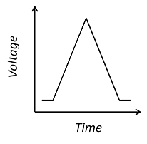
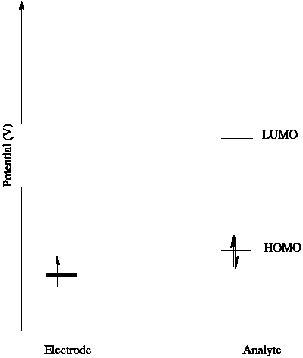
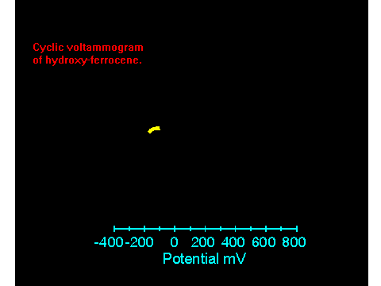
Electrochemistry- Cyclic Voltammetry
A controlled electrical potential is applied¹ via an electrode and a potentiostat. Until the change in potential for the electron moving to the analyte (or from the analyte in the case of an oxidation) is favorable, no change is seen, but once the electron transfer is favorable a current is observed.
The resulting voltammogram resembles a “duck” and gives the energy of the orbitals involved in the electron transfer (at the average of the forward and reverse wave). The peak to peak separation is ~60²mV for a 1 e- electrochemically reversible system. Chemical reversibility means that once you turn around, your sample is still present to be re-oxidized or reduced; in this case, the peak heights³ of the forward and reverse peak should be the same.
http://web.nmsu.edu/~kburke/Instrumentation/BAS_volt.html
Notes:
¹ I have shown a triangular waveform, typical for cyclic voltammetry but there are other waveforms that can provide different information about your system.
² This is the 0.0591/n from the log form of the Nernst equation. It is due to the overpotential that results from several factors including the need for the electron to tunnel through the double layer solution to the analyte, and the diffusion rate of the analyte. In protein electrochemistry, since diffusion is so slow, some biomolecules are tethered to the electrode by chemical or electrostatic means. This will reduce the peak to peak separation in these cases.
³ or the area under the curve, more exactly.
a final note: us old-timers still put the reduction on the right side of the origin, so as with any graphical technique, watch your axes.
Additional References: My favorite generalist text on electrochemistry is Electrochemistry for Chemists, 2nd Edition
Donald T. Sawyer, Andrzej Sobkowiak, Julian L. Roberts
ISBN: 978-0-471-59468-0
528 pages
October 1995
If you have a whole day to spend on protein electrochemistry, let Professor Fraser Armstrong teach your class. http://live.libraries.psu.edu/Mediasite/Play/be541100e6fd439ca9c1ae3fcdb62e981d?catalog=8376d4b2-4dd1-457e-a3bf-e4cf9163feda. (This is a recording of his talk at the 3rd Bioinorganic Workshop at Penn State University , 2014.

Slide 5
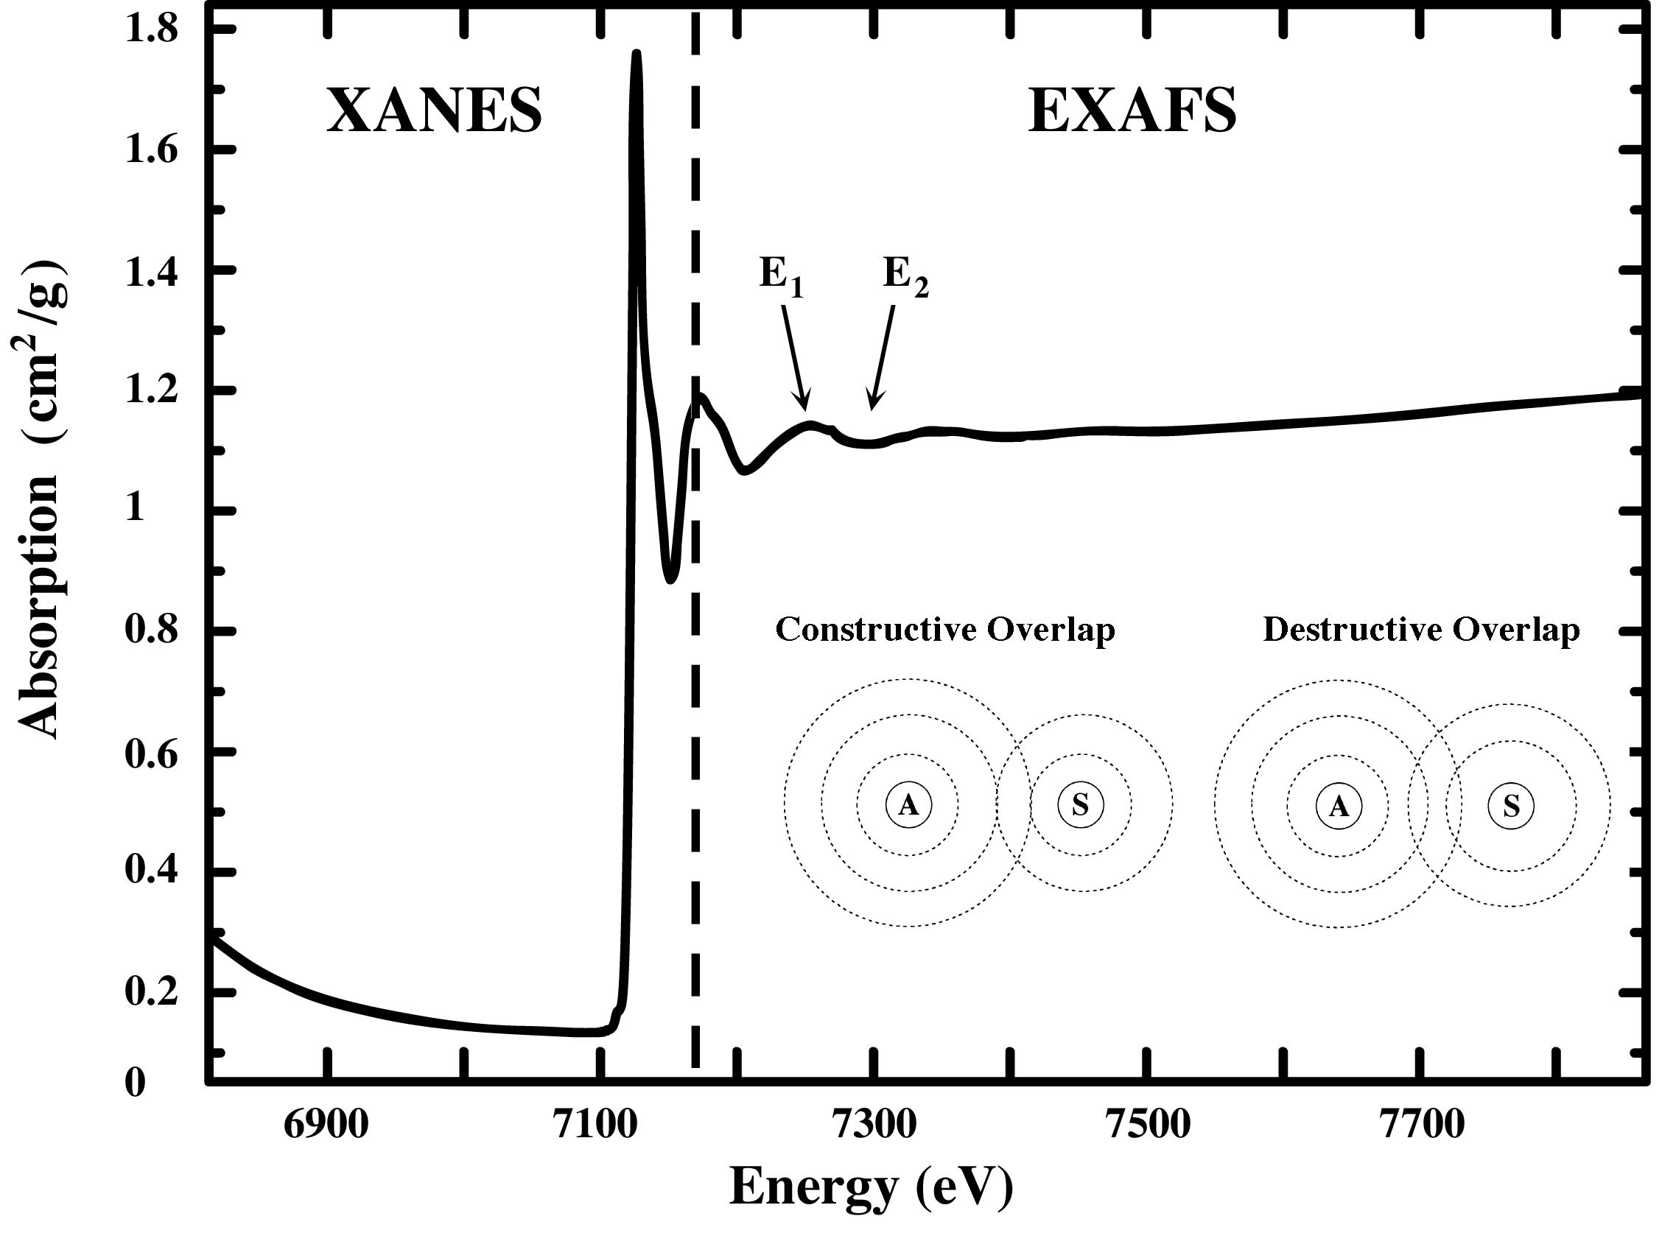
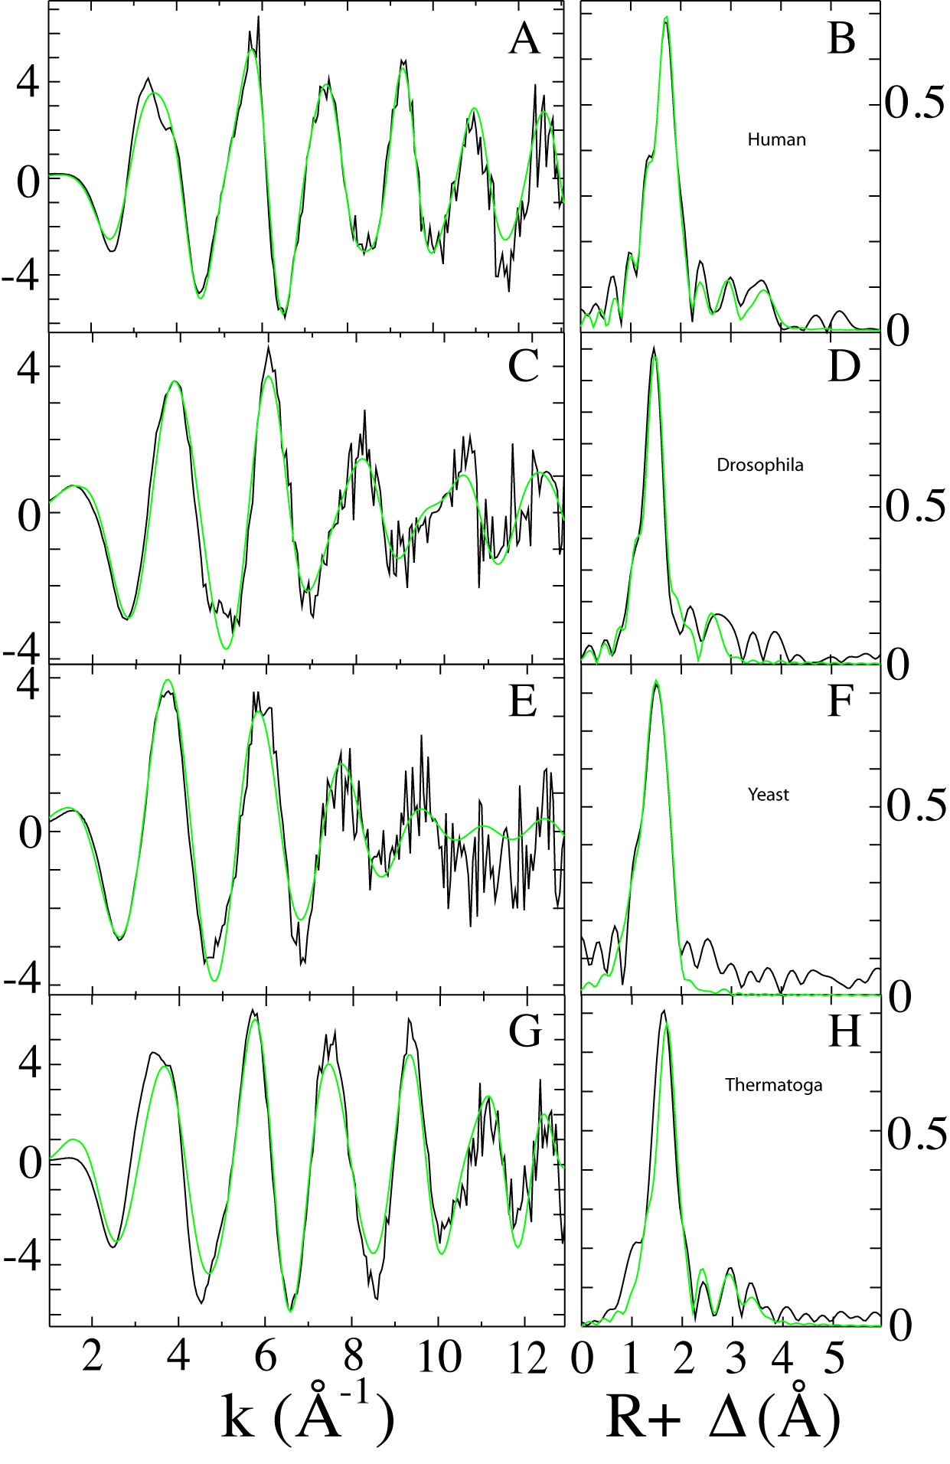
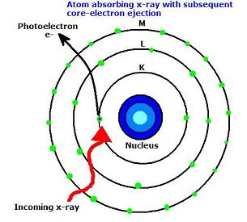
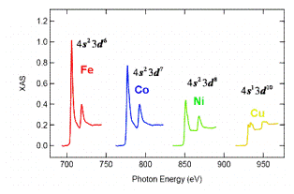
X-ray Absorption Spectroscopy (XAS)
EXAFS
Data courtesy of Timothy Stemmler
XANES
http://chemwiki.ucdavis.edu/Physical_Chemistry/Spectroscopy/X-ray_Spectroscopy/XAS:_Theory
In XAS, a very powerful beam of x-rays is applied to the sample, energetic enough to eject (or promote) the core electrons from an atom.¹
Data courtesy of Timothy Stemmler⁶
http://140.110.201.35/djhuang/research_xas.html
There are two regions of really useful data in the XAS spectrum. The first is the XANES.² The XANES provides a fingerprint of how much energy is required to excite the core electrons. Since this energy will depend on the effective nuclear charge, different atoms have very different fingerprint regions in the XANES. In some cases it can also differentiate between different oxidation states of a particular center.³
In the EXAFS⁴, as the electrons relax back down, the neighboring nuclei interfere. The oscillations in the frequencies of this region can identify the neighboring ligands and the bond distances.⁵
Notes:
This energy is on the order of keV, and can only be provided by a synchrotron source.
X-ray Absorption Near Edge Spectrum.
For example, Cu⁺ (d⁹) has a tell-tale heartbeat where a core electron is excited into the one available slot in the d orbitals; this signal is energetically just below the absorption edge.
X-ray Absorption Fine Structure
These data are typically fit by simulation, and helped along by knowledge of what should be in the region of the center of interest. The technique is very good at distinguishing between elements in different periods, i.e. O vs S, but not so good at elements in the same period, i.e. O vs N. This is a bit unfortunate since so many ligands involve O or N coordination. Fortunately, the presence of the second N in the Histidine center makes that ligand easy to identify.
For example, the data in the top row of this figure show 2 O/N ligands at a distance of 2.01Å and 4 O/N ligands at a distance of 2.12 Å from an iron center in the iron chaperone protein frataxin.

Slide 6
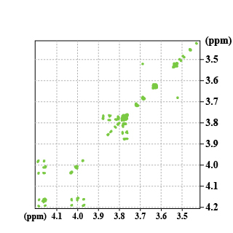
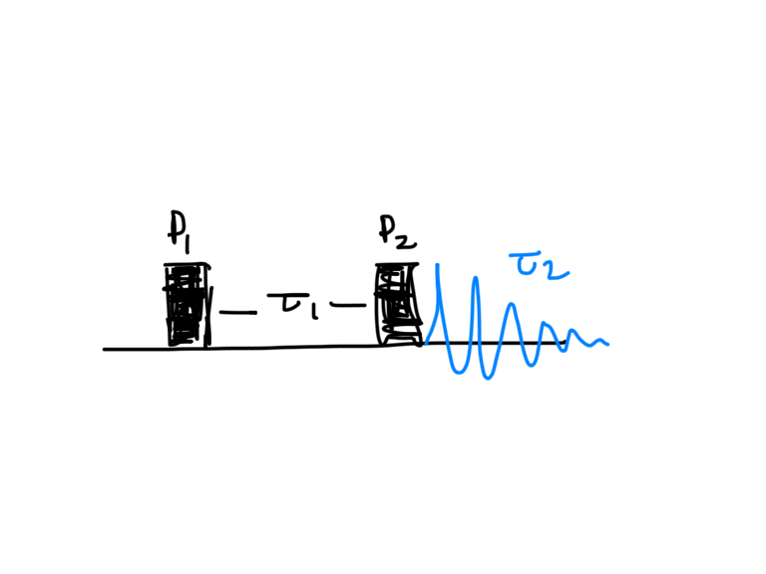
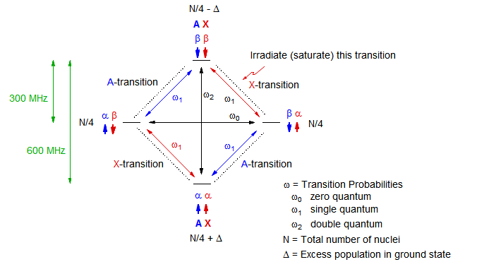
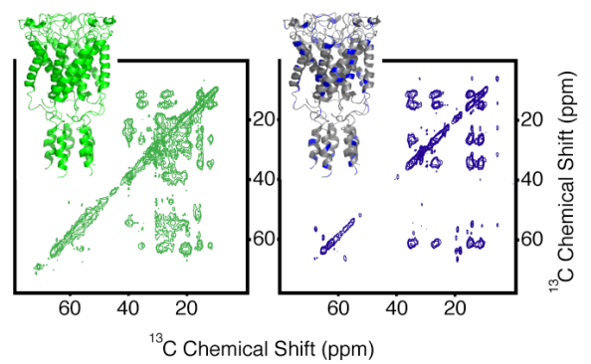
2D- NMR
Pulsed NMR¹, allows for resolution of the myriad peaks in a large biomolecule, and for insight into the communication between various atoms in a sample (allowing for 3-D structural information).
http://rmn2d.univ-lille1.fr/rmn2d_en/co/chapitre3_1_3_en.html
This is the pulse sequence for a 2D COSY (¹H-¹H COrrelated SpectrocopY)²
These techniques use the Nuclear Overhauser Effect³ or NOE to examine the electronic communication between neighboring nuclei in a magnetic field.
http://www.chem.wisc.edu/areas/reich/nmr/08-tech-02-noe.htm⁴
Data is fitted by simulation, with knowledge of the primary structure. Cross-peaks in the spectrum can give distances and angles between nuclei.
http://www.ibpc.fr/UMR7099/themes/theme4/theme4-exemplesen.htm
Notes:
1. As opposed to CW or continuous wave/ spectra. All modern instruments are pulsed instruments; they can “simulate” a CW spectrum by using the right pulse sequence.
2. I love this description of 2 D NMR that I adapted from http://www.cryst.bbk.ac.uk/PPS2/projects/schirra/html/2dnmr.htm:
1. Do something to the nuclei: magnetize, saturate, polarize,etc
2. let them relax (the fancy word is precess), which they will do at different rates depending on environment etc.
3. do something else to the nuclei (mixing)
detect the result
There are lots of different pulse sequence, with great names… for some reason the development of these acronyms inspired a lot of geeks in the NMR community to try out new pulse sequences just to get the privilege of naming them. There’s NOESY, and ROESY, and SECSY and TOCSY; I’m especially fond of INADEQUATE. You can do both homonuclear and heteronuclear 2-D NMR (although you often have to enrich your samples with spin-active nuclei (eg ¹⁵N), which can be difficult for natural samples.
Great article about Overhauser can be found at http://www.physics.purdue.edu/about_us/history/Albert_W_Overhauser.shtml. The 2002 Nobel Prize in Chemistry went to Kurt Wutrich for showing that NOE could be used with 2D NMR to solve the 3D solution structures of large biomolecules
I found this to be an excellent short tutorial on the NOE.

Slide 7
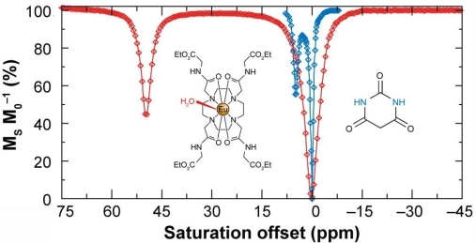
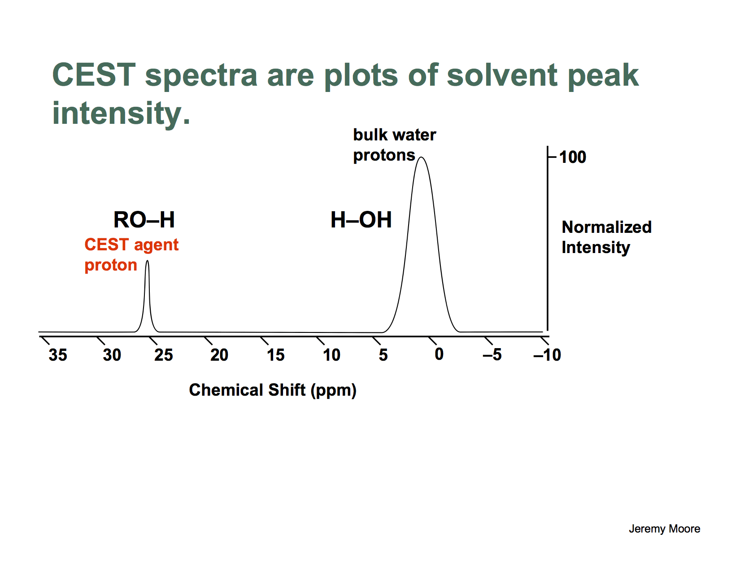
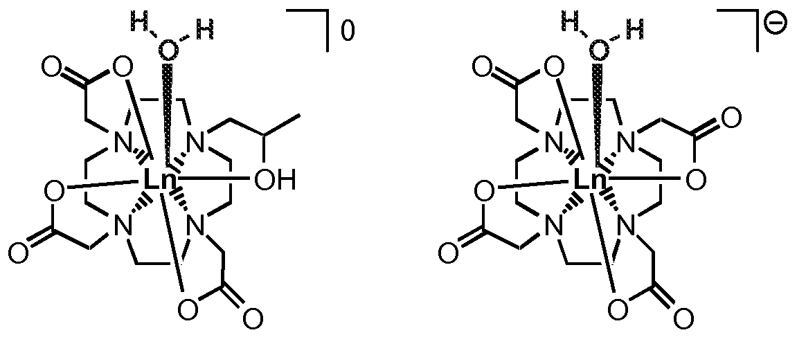
Chemical Exchange Saturation Transfer (CEST)
http://openi.nlm.nih.gov/detailedresult.php?img=3086609_thnov01p0083g11&req=4
CEST is an advance in MRI technology that opens the doorway to using diamagnetic imaging agents. In CEST (and ParaCEST), solvent protons¹ (of which there are many) can exchange with the bound solute protons of an agent. Chemical exchange via ligand substitution reactions can carry induced magnetization along with it. Thus the protons of an imaging agent can be magnetized and the magnetization transferred to the protons in the bulk sample. In ParaCEST, you have the added advantage of a paramagnetic shift that moves the imaging agents proton signal far up- or down-field, away from that of the bulk protons allowing cleaner saturation of the agent protons. CEST does not replace more traditional T1 and T2 agents²
3
The design of CEST agents is a beautiful problem in classical coordination chemistry. Many factors must be considered.
Complex dissociation (for toxicity); K_{D}⁴
Number of Bound water ligands⁵
Exchange kinetics of water ligands⁶
Permeability in tissue⁷
http://www.google.com/patents/WO2009060403A2?cl=en
Notes:
1. There are a LOT of exchangeable protons in biological organisms. Perhaps this would be a good point at which to ask your students to brainstorm about what types of biomolecules and therefore tissues have exchangeable protons in them. The answer is, of course, almost everything. Proteins, lipids, nucleic acids, sugars and all of the tissues constructed of these building blocks. The signals for these protons all fall within a pretty narrow range of about 20 ppm. Paramagnetic shift reagents can move these protons outside of this range, making detection easier.
One slide does not allow for a complete explanation of MRI, but here are some excellent resources for further reading.
http://www.cis.rit.edu/htbooks/mri/
2. Magn Reson Med. 2011 Apr;65(4):927-48. doi: 10.1002/mrm.22761. Epub 2011 Feb 17. Chemical exchange saturation transfer (CEST): what is in a name and what isn't?
T1 and T2 refer to relaxation times of paramagnetic samples. These are the same T1 and T2 factors referred to in NMR spectroscopy.
In my (amateurish)opinion, the best way to think about the different types of imaging agents is all as part of a bag of tricks. Each is useful for different types of problems and many can be used in conjunction with each other to solve really complicated imaging problems.
3. The images in this animation were created by Jeremy Moore, a former graduate student (now at Intel) in the group of Professor Matthew Allen of Wayne State University, and are used with permission.
4.This factor embodies both the thermodynamics and the kinetics of ligand exchange , which for most inorganic chemists is among the first topics learned in regards to coordination chemistry.
5. This factor has made the rare earth metals a very appealing starting point because of the large coordination sphere which allows multiple water ligands to be bound to a single center. However, even first row transition metals can be useful CEST reagents, and these are associated with fewer problems with toxicity. Paramagnetic Lanthanides are also useful as ParaCEST reagents, because of the paramagnetic shift.
6. Of course, if the water ligands bound to the contrast agent don’t exchange in a reasonable timeframe, contrast is lost, and the reagent is unsuccessful. This is the Goldilocks dilemma; the exchange can’t be too slow or too fast, it has to be “just right”, and “just right” depends on the strength of the magnet, the magnitude of the shift, etc.
7. Finally, administration of the reagents must be a consideration. Most lanthanide complexes aren’t soluble at low pH and thus have to be administered by IV, but the agents also must be able to gain access to the tissues that need to be imaged.

Slide 8
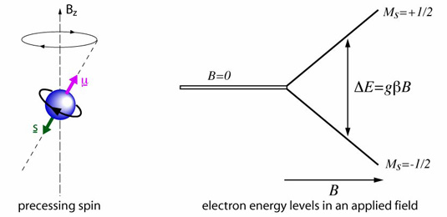
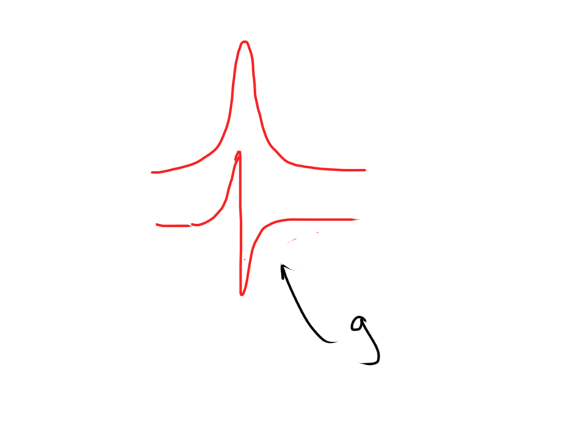
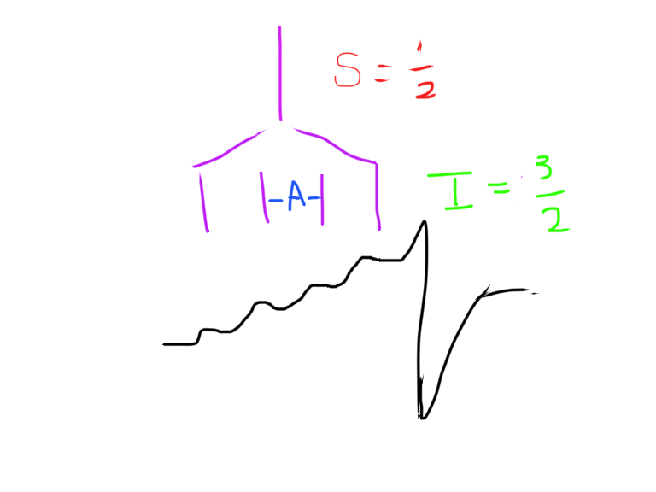
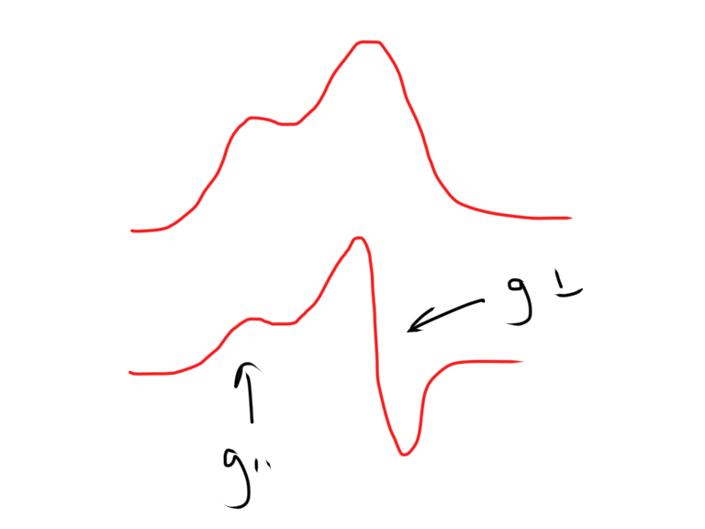
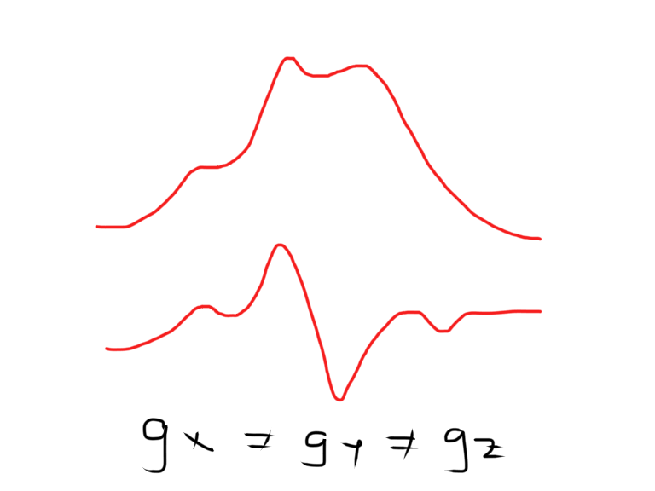
Electron Paramagnetic Resonance
When the nuclei in the neighborhood of the unpaired spins have I≠1/2, this sets up electron-nuclear hyperfine coupling, splitting the EPR signal even further into 2I+1 signals.⁶ This can often be helpful in diagnosing the atoms involved in a paramagnetic center. For, example since, copper has I=3/2, a signal with four hyperfine lines screams “copper” in an EPR spectrum.
Magnetic radiation is applied to a sample to induce an electron spin “flip”¹
When the energy of the field matches the energy of the transition, the energy is absorbed and a spin flip occurs. The g value is characteristic of the system. This is an absorbance, but EPR data is typically displayed as a derivative plot.
Recall that every atom surrounding the unpaired spin has moving electrons; moving electrons=current, and where there is a current there is a magnetic field. These small magnets add and subtract from the field of the instrument to affect the g value.³If the environment surrounding the unpaired spin is asymmetric, the signal is split.
Isotropic, g_{x}=g_{y}=g_{z}²
http://www.st-andrews.ac.uk/~mmwave/epr/what-is-epr/
Axial, g_{x}=g_{y}≠g_{z}⁴
Rhombic, g_{x}≠g_{y}≠g_{z}⁵
Notes:
¹Therefore this technique is only applicable to systems with at least one unpaired spin. Fortunately, many transition metal systems have non-zero S. For example, Cu(II) is d⁹, with one upe, S=1/2. Copper II gives beautiful diagnostic EPR signals, and copper I is silent.
It is a common misconception that only systems with S=1/2 have EPR signals. This is not true, but the EPR signals of integer spin systems is much more complicated to sort out. Many Integer spin systems like iron-sulfur clusters have been characterized using EPR.
²Isotropic signals are what you get when the environment surrounding the unpaired electron is perfectly symmetrical. This doesn’t happen very often… maybe in a few radical systems, which have very sharp isotropic lines.
³If this were not true, then all samples would have exactly the same EPR signal, and EPR would cease to be a useful tool for characterization.
^{4 T}hese are usually labeled g_{II} and g⊥ . This might be common for a metal center in a heme environment, with axial ligands to the protein.
⁵ Rhombic geometry is the most common in proteins, since typically even if the ligands are mostly the same, the geometry is distorted from a perfect octahedron, for example. BUT, keep in mind the the separation between the different g values may be small which will lead to overlap of the signals.
⁶ This is very similar to NMR splitting and I have had a lot of success teaching this technique to undergrads by reminding them of this point. Of course, that only works if they were taught the underlying quantum involved in NMR splitting instead of just memorizing an n+1 rule.
It is important to note that most of a protein sample is EPR silent, so EPR is a great technique for being able to see the tree for the forest. It focuses only on the region in which the center an unpaired spin is located; conveniently, this is often the active site of an enzyme.
Pretty much everything, I talked about on this slide was based on simple continuous wave EPR. There is a LOT of information available in the hyperfine, and the g-values. Usually, this data is sorted about by simulations and models. As with NMR, more powerful magnets allow greater separation between overlapping signals. Also, similar to NMR, there are more advanced pulsed techniques that focus more on the hyperfine- techniques like ENDOR and HYSCORE (2D- EPR) which can be used to identify coordinating ligands more specifically.
For more reading, the classic text is Electron Spin Resonance by Wertz and Bolton. The section in Drago is also helpful.
Art van der Est of Brock University has given an excellent presentation as part of the 2014 3rd Bioinorganic Workshop which is posted at http://live.libraries.psu.edu/Mediasite/Play/fb4765f1c3a644a8a39269de0375a7ed1d?catalog=8376d4b2-4dd1-457e-a3bf-e4cf9163feda.
Stefan Stoll of UWash- Seattle has a similar lecture on Pulsed EPR from the same workshop at http://live.libraries.psu.edu/Mediasite/Play/53e5ec901d214a7faadb5093e9d592601d?catalog=8376d4b2-4dd1-457e-a3bf-e4cf9163feda

