Slide 1
5-ish Slides About Bridging Hydrides and [Cr(CO)₅HCr(CO)₅]⁻¹
Dr. Kyle A Grice
DePaul University

Slide 2
Bridging Hydrides
M-H-M interactions are 3-center-2 electron interactions.
Formally, you can think of it as sharing 1 electron to each metal. (In the ionic counting method, hydride is a 2e⁻ donor)
Commonly seen in B₂H₆ (diborane)
The bridging interaction stabilizes reactive fragments by donating some electron density from the hydride to a metal that really wants another ligand.
Fundamentally, MO theory is the best way to see why the bridging interaction is stabilizing.

Slide 3
[Cr(CO)₅HCr(CO)₅]⁻¹ Synthesis and Literature
SciFinder gives dozens of references involving this species. It has been studied for many decades.
From JACS 1966, 88, 367-368:
NMR shows hydride at -19.5 ppm
X-ray Crystal structure shows D_{4h} geometry (hydride wasn’t observed)

Slide 4
Electron Counting for [Cr(CO)₅HCr(CO)₅]⁻¹
Cr(0), d⁶, 18e⁻ complex
Air-stable
Commercially available
Cr(0), d⁶, 18e⁻ complex
Can be formed from Cr(CO)₅²⁻ and proton source
Cr(0), d⁶, 16e⁻ fragment
Not isolable,
Very reactive
Can be thought of as a combination of the two fragments above
Average of Cr(-1), d⁷, 17e⁻ per Cr.
Bridging hydride stabilizes reactive 16e⁻ fragment

Slide 5
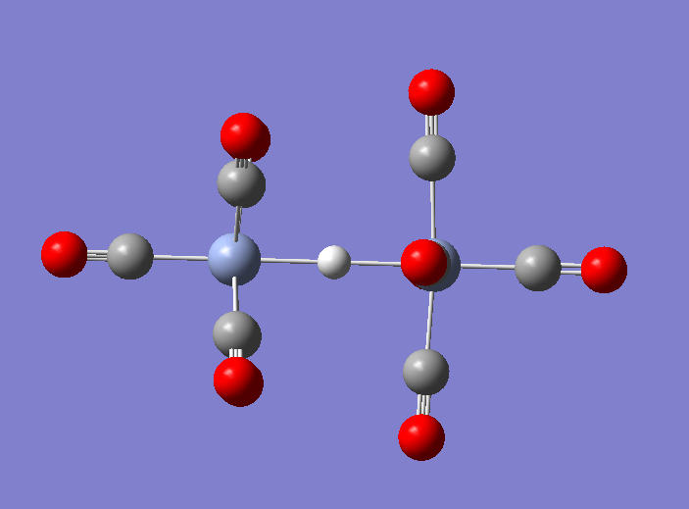
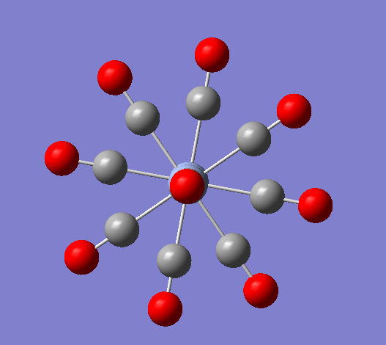
DFT Calcs of [Cr(CO)₅HCr(CO)₅]⁻¹
Moderate-level calculation: Gas phase, B3LYP/6-31G(d) for C, O, H and LANL2DZ for Cr. Optimization and frequency calculation to verify that its at the bottom of a well in a potential energy surface.
Appears to be D_{4d} symmetry, later I could try to calc D₄h geometry too.

Slide 6
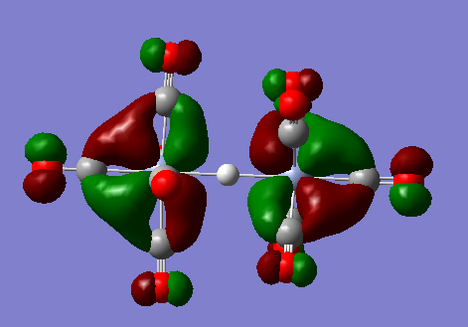
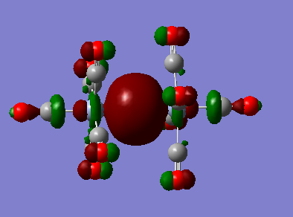
Frontier Orbitals
Highest Occupied Molecular Orbital (HOMO) is two degenerate orbitals related to M-C bonding (back-bonding to C-O antibonding orbitals)
A pair of orbitals below that are similar.
None show Cr-H interactions
The HOMO-6 (the 6th orbital below the HOMO) involves the hydride. It looks like d_{z2} from each metal overlapping with the H 1s orbital

Slide 7
Possibilities for further DFT exploration
Try solvation and different DFT functionals and basis sets
Look at D_{4h} symmetry and rotation around M-H-M axis
Look at intermediates for synthesis and get reaction energies
Examine Mo and W analogues
Some more advanced DFT work has been done if you are curious to read more: JACS, 2005, 127, 16494-16504, Inorg. Chim. Acta 2005, 358, 1442-1452, and J. Phys. Chem. A 2001, 105, 11134.

