Slide 1
“Five” Slides About: Multiple Bonds
Coordination Chemistry
Created by Rebecca Eikey, Chestnut Hill College, eikeyr@chc.edu and posted on VIPEr on 10/26/2023, Copyright Rebecca Eikey, 2023. This work is licensed under the Creative Commons CC BY-NC License. To view a copy of this license visit http://creativecommons.org/about/licenses/

Slide 2
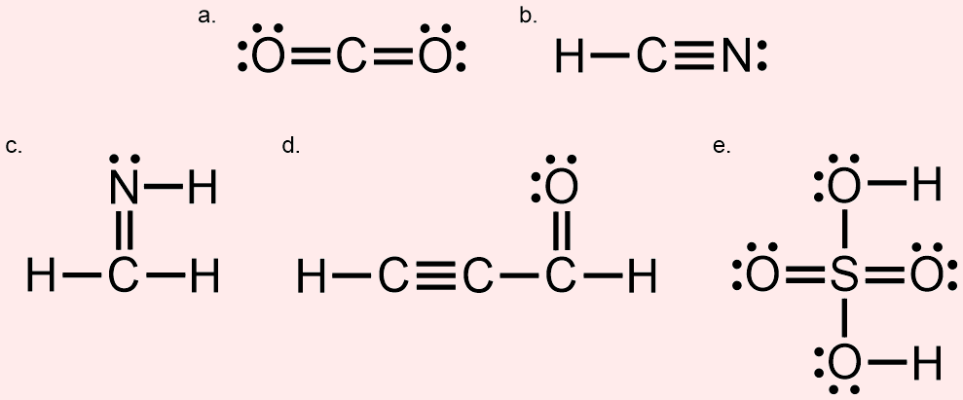
Multiple Bonds
We see double, and triple bonds are fairly common for the main group elements.
What about the transition metals?
They can form multiple bonds between metal centers.
They can also form multiple bonds to ligands.
This Photo by Unknown Author is licensed under CC BY-SA-NC

Slide 3
Bonds Between Transition Metals
Evidence of transition metals forming bonds between metal atoms was observed in the late 1950s. Since then, more have been created.
Bond Order = 1
Bond Order = 2
Images By R. Eikey - Own work, CC BY-NC

Slide 4
Multiple Between Transition Metals
In the early 1960s, F. Albert Cotton and associates provided evidence that [Re₂Cl₈]²⁻ ion contained a quadruple bond between the metal centers.
This was something never seen before.
Since then, many quadruple bonded transition metal complexes have been created (Re, W, Cr, Mo, Tc) .
Bond Order = 3
Bond Order = 4
Images By R. Eikey - Own work, CC BY-NC
Notes:
Cotton, F. A.; Harris, C. B. (1965). "The Crystal and Molecular Structure of Dipotassium Octachlorodirhenate(III) Dihydrate, K2[Re2Cl8]·2H2O". Inorg. Chem. 4 (3): 330–333. doi:10.1021/ic50025a015.

Slide 5
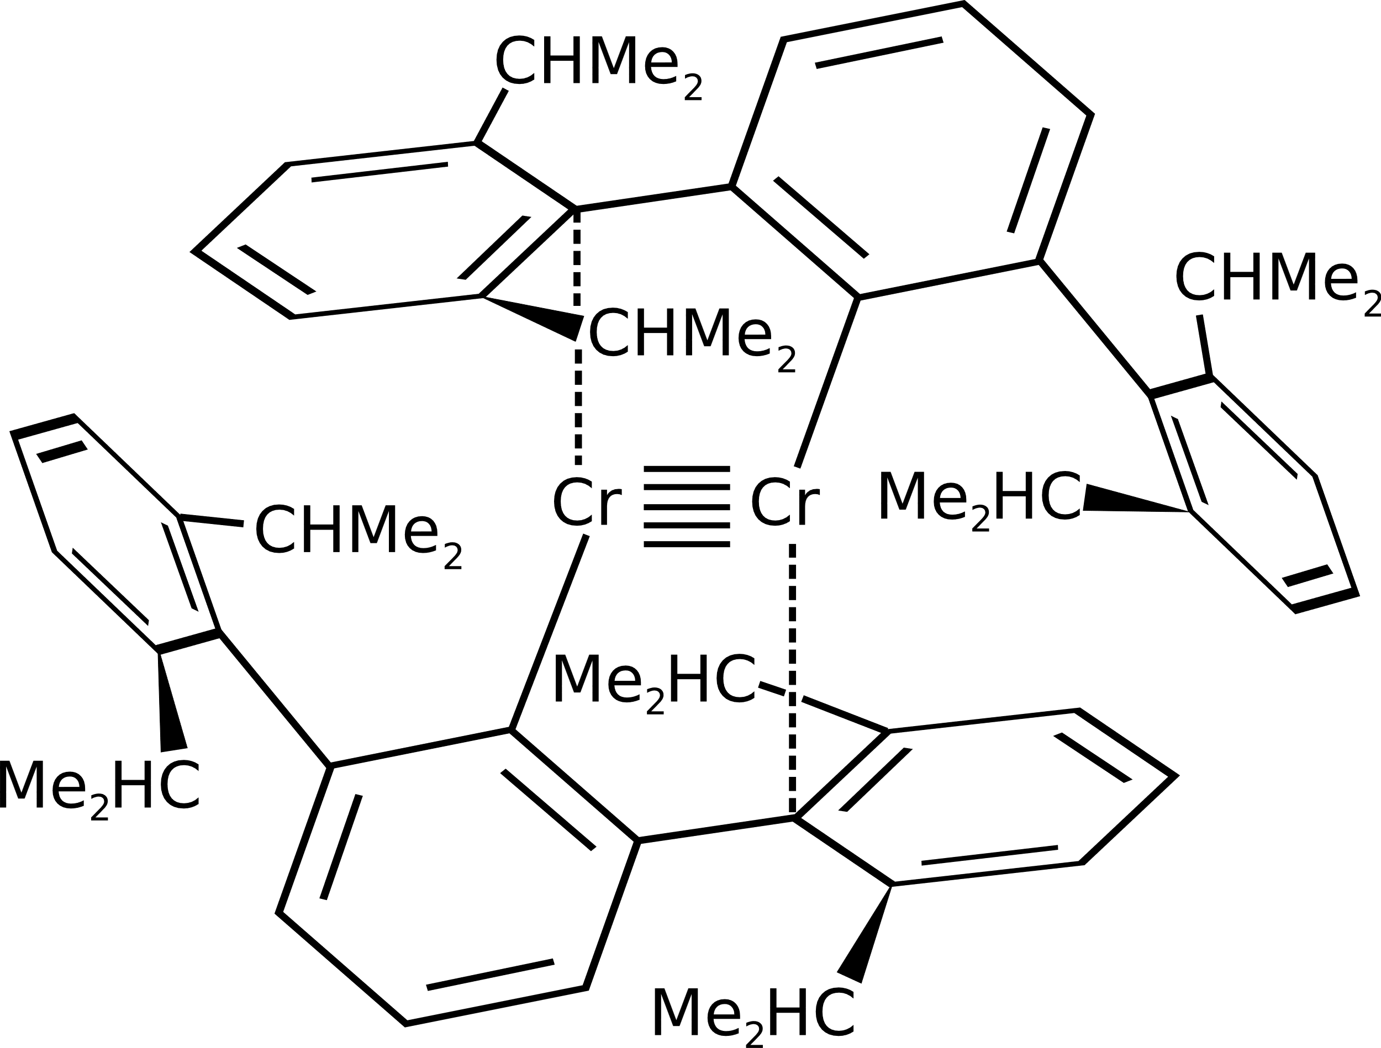
Quintuplet Bond Between Chromium Atoms
First reported in 2005 by Philip P. Power and associates.
The chromium dimer exists as air- and moisture-sensitive dark red crystals that are stable up to 200 °C.
The quintuplet bond between the chromium centers is stabilized by the bulky ligands.
Bond Order = 5
Image By Benrr101 - Own work, Public Domain, https://commons.wikimedia.org/w/index.php?curid=11594650
Notes:
Nguyen, Tailuan; Sutton, Andrew D.; Brynda, Marcin; Fettinger, James C.; Long, Gary J.; Power, Philip P. (2005). "Synthesis of a Stable Compound with Fivefold Bonding Between Two Chromium(I) Centers". Science. 310 (5749): 844–847. https://www.science.org/doi/10.1126/science.1116789

Slide 6
Sextuple Bonds Between Transition Metals
Maxing out at 6 bonds?
Theoretically, the limit is a bond order of 6.
Evidence for sextuple bonds in Mo₂ and W₂ at low temperatures.
Mo Mo
Image By R. Eikey - Own work, CC BY-NC
Notes:
Roos, Björn O.; Borin, Antonio C.; Laura Gagliardi (2007). "Reaching the Maximum Multiplicity of the Covalent Chemical Bond". Angew. Chem. Int. Ed. 46 (9): 1469–72. doi:10.1002/anie.200603600
Kraus, D.; Lorenz, M.; Bondybey, V. E. (2001). "On the dimers of the VIB group: a new NIR electronic state of Mo2". PhysChemComm. 4 (10): 44–48. doi:10.1039/b104063b

Slide 7
Transition Metals & Multiple Bonds to Ligands
Multiple bonds can form between transition metals and ligands.
The bond orders observed are greater than 1.
The complexes with these types of ligands may behave as catalysts (carbenes) or are the reactive intermediate (oxos) in various reactions.
Bond Order = 2 | Bond Order = 3
M=O oxo (sp²) M=O-R alkoxide (sp²) M=CRR’ carbene M=NR imido (sp²) M=S sulfido | M≡O 0xo (sp) M≡O-R alkoxide (sp) M≡CR carbyne M≡N nitride M≡N-R imido (sp) Where R = a carbon group (Ph or CH₃ or etc) and M = metal

Slide 8
Multiple Bonds to Ligands
Carbene
Nitrido
Imido
Carbyne
Images By R. Eikey - Own work, CC BY-NC

Slide 9
Grubb’s Catalyst
2005 Nobel Prize in Chemistry
Applications for later generations include:
  Repairing microcracks on space shuttle hulls:
    Catalyst reacts with dicyclopentadiene in capsules (ROMP)
  Bullet-proof materials
    Polymer of dicyclopentadiene impenetrable to 9-mm bullets
1st Generation (1992)
Dicyclopentadiene
Images By R. Eikey - Own work, CC BY-NC

Slide 10
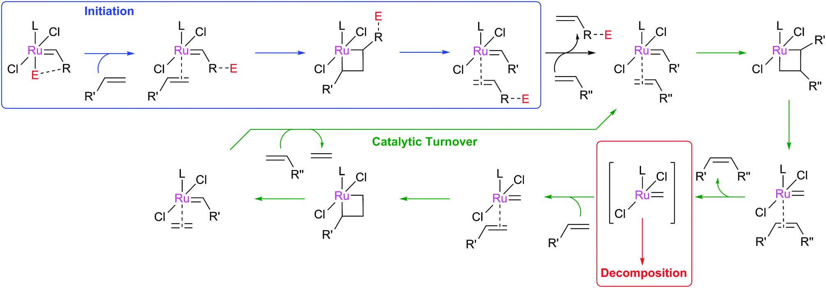
Ru-catalyzed Olefin Metathesis
Pre-catalysis initiation creates an active 14e- ruthenium species.
[2+2]cycloaddition
The design of Z-selective catalysts has been intentional.
This Photo is licensed under CC BY
Understanding reasons for decomposition has been another area of focus.
Notes:
Nelson, D.J., Manzini, S., Urbina-Blanco, C.A., Nolan, S. P., “Key processes in ruthenium-catalysed olefin metathesis,“ Chem. Commun., 2014, 50, 10355-10375. DOI: 10.1039/C4CC02515F
https://pubs.rsc.org/en/content/articlehtml/2014/cc/c4cc02515f

