Slide 1
Percent buried volume (%V_{bur})
Five slides about…

Slide 2
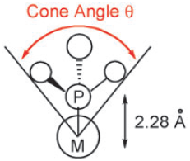
Steric parameters for phosphines
Reproduced from Clavier, H. and Nolan, S.P. Chem. Commun. 2010, 46, 841 with permission from The Royal Society of Chemistry.
http://dx.doi.org/10.1039/B922984A
Notes:
Toleman’s cone angle is a classic parameter, but it has limitations.
While useful for simple, tertiary phosphines, it is not as useful for more complicated ligands.
Cone angles work for monophosphines but can not be used for bisphosphines.

Slide 3
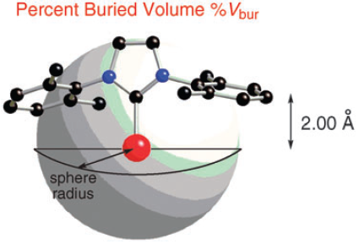
Percent buried volume (%V_{bur})
3.5 Å
Reproduced from Clavier, H. and Nolan, S.P. Chem. Commun. 2010, 46, 841 with permission from The Royal Society of Chemistry.
Reproduced from Clavier, H. and Nolan, S.P. Chem. Commun. 2010, 46, 841 with permission from The Royal Society of Chemistry.
http://dx.doi.org/10.1039/B922984A
Notes:
Initially developed for N-heterocyclic carbenes (NHC) ligands, can also be applied to phosphines.
A sphere with a radius of 3.5 Å about a metal center is considered.
The amount of this sphere occupied by the ligand is the %V_{bur}.

Slide 4
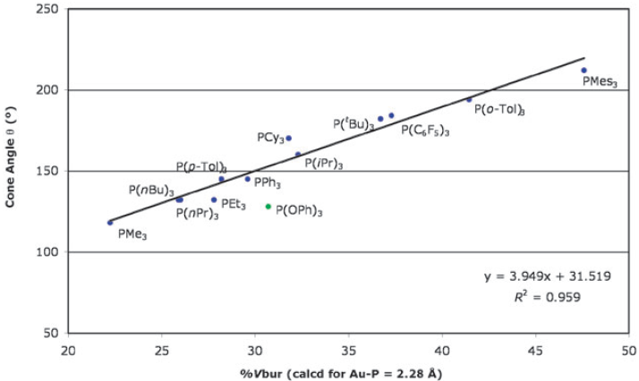
Comparison of cone angle and %V_{bur} in Au(PR₃)Cl complexes
Reproduced from Clavier, H. and Nolan, S.P. Chem. Commun. 2010, 46, 841 with permission from The Royal Society of Chemistry.
http://dx.doi.org/10.1039/B922984A
Notes:
Good agreement with cone angles for monophosphines.
Can be used for NHC ligands.
Can be used for bidentate phosphines.

Slide 5
Performing calculations
Start with a crystal structure
The R factor should be less than 7%
If there is a large number in the file name this might cause troubles
Upload the file to the site and run through the calculations
Notes:
I have had this happen where it isn’t the actual name of the file that causes the problem it is in trying to read the cif. I have gotten around this by saving the cif as an .xyz file and the editing the name in the second line to remove the number using a text editor.

Slide 6
References
Clavier, H. and Nolan, S.P. Chem. Commun. 2010, 46, 841.
Poater, A.; Cosenza, B.; Correa, A.; Giudice, S.; Ragone, F.; Scarano, V.; Cavallo, L. Eur. J. Inorg. Chem. 2009, 1759.

