Slide 1
Five Slides about Cyclic Voltammetry
-Chip Nataro
Department of Chemistry
Lafayette College

Slide 2
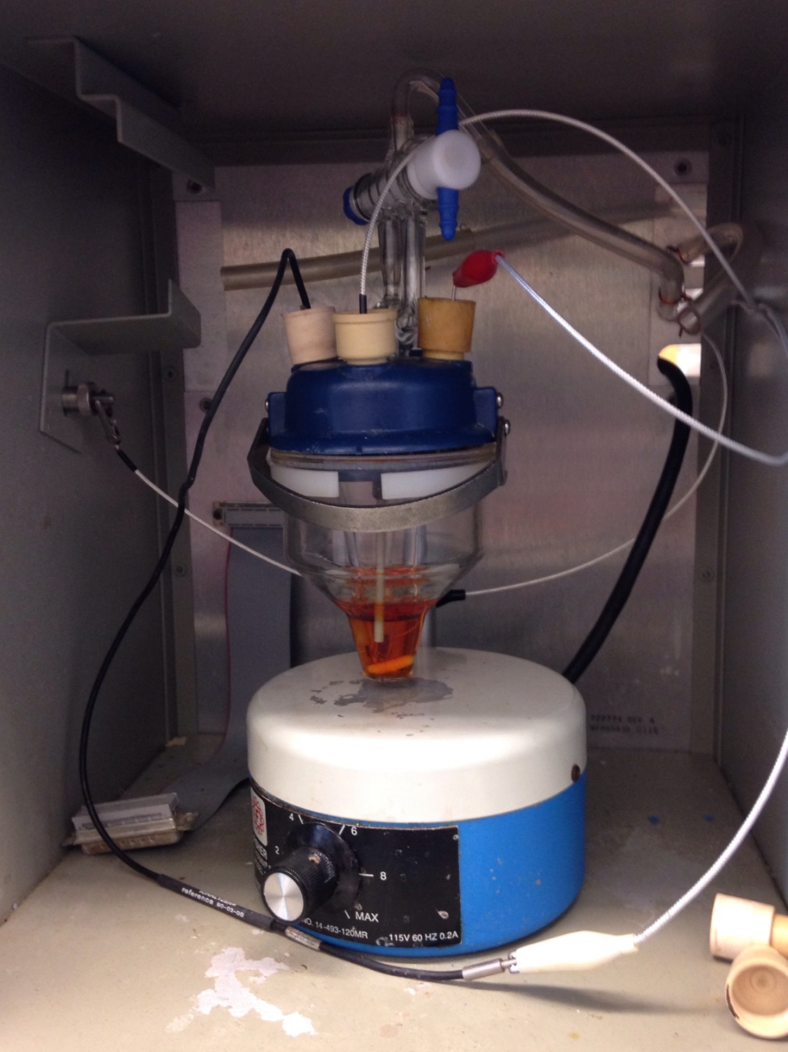

Experimental Setup
Reference
electrode
Working
electrode
Auxiliary
electrode
Notes:
This is a typical 3-electrode setup.
For my experiments the solvent is typically an organic solvent with a low dielectric constant.
The solution contains the following.
Supporting electrolyte: a souble ionic compound such as [NBu₄][PF₆] that is 0.1 M.
Analyte: the compound of interest that is 1.0 mM.
The solution should be stirred with inert gas bubbled through it prior to use. During scans the solution should not be agitated because the experiment is based upon diffusion of the compound to and from the electrode.
The auxiliary or counter electrode is a platinum wire.
The working electrode is where the action takes place and can be a variety of substances but glassy carbon, gold and platinum are most common.
The reference electrode is typically Ag/AgCl separated from the solution by a frit. Ag/AgCl is not the best reference so it is common to add ferrocene (FcH) or decamethylferrocene (Fc*) at the end of the experiment as an internal reference.

Slide 3
Experimental Control
Chemical
  Solvent
  Supporting electrolyte
  Concentrations
Environmental
  Temperature
  Atmosphere
Conditions
  Initial, switching and final potentials
  Scan rate
  Number of sweeps
  Electrodes

Slide 4
Cyclic Voltammetry
Potential
E_{1/2}
Time

Slide 5
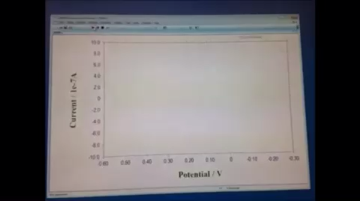
Cyclic Voltammetry

Slide 6
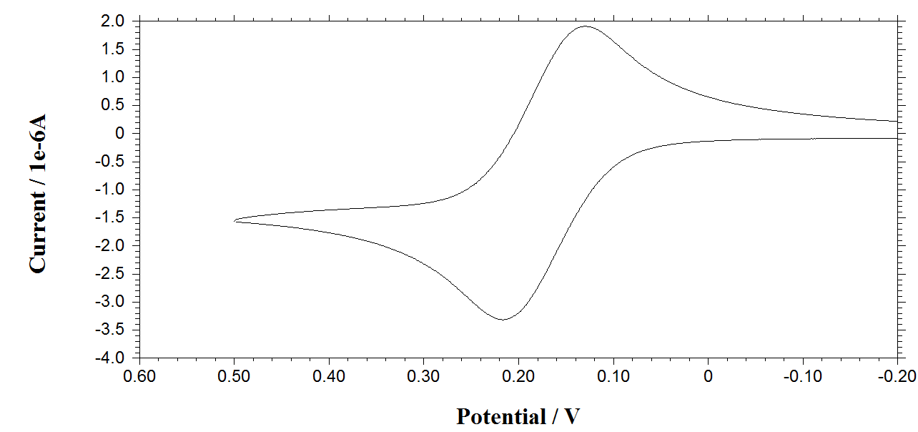
Ferrocene?

Slide 7
Reference Electrodes
Saturated calomel electrode (SCE)
Standard hydrogen electrode (SHE)
Silver/Silver (I)
  Ag/AgCl (aq)
  Ag/AgNO₃ (non-aq)
  Ag pseudo-reference
  Add ferrocene as an internal reference

Slide 8
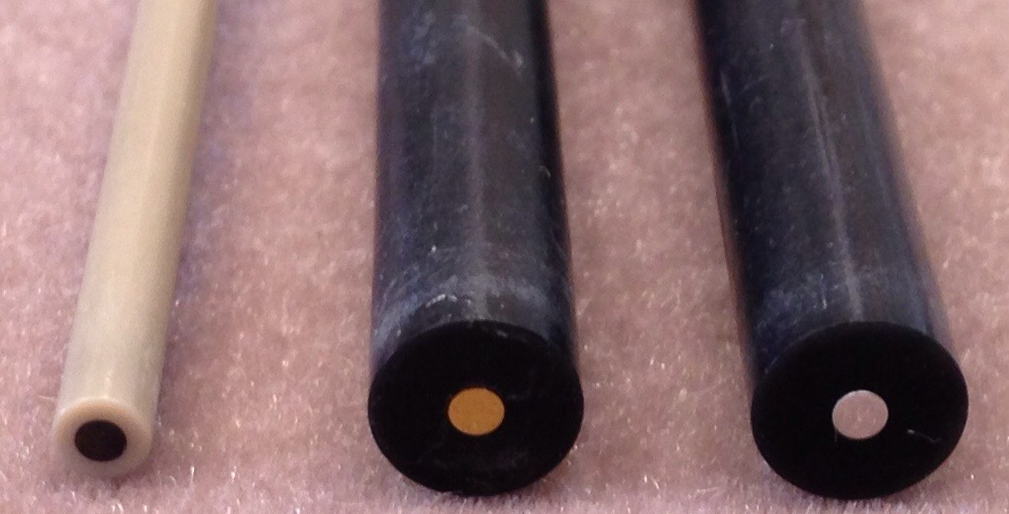
Working Electrodes

Slide 9
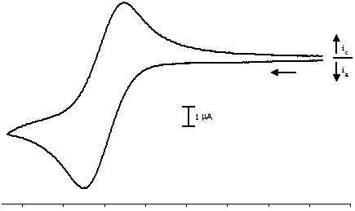
Cyclic Voltammetry
i_{pc}
i_{c}
i_{a}
i_{pa}
1 μA
i_{pc} | ≈ 1
i_{pa}
0.20
0.10
0.00
-0.10
-0.20
-0.30
-0.40
-0.50
-0.60
Potential (V vs. FcH^{0/+})
Notes:
The CV is typically shown a current vs. potential.
This is an oxidation, reductions would similar but in the opposite direction.
This is the ‘American’ version of a CV with increasing positive potential to the left.
The scale must be indicated.
The direction of the scan must be indicated.
Zero current must be shown.
The reference for the horizontal axis should be indicated, in this case it is vs. FcH^{0/+}.
What exists at the electrode surface in this oxidation?
Initially the reduced (red) form.
After passing the redox potential it is the oxidized (ox) form which will diffuse away.
After the switching potential it is still the ox form.
After passing back over the redox potential the red form will be present.
So why the duck shape?
The diffusion rate of the oxidized and reduced species are different.
The currents are different because of the presence of the oxidized species and the diffusion of ox away from the electrode surface and the diffusion of red to the electrode surface.
The reversible CVs are of ferrocene.
The peak currents (i_{pa} and i_{pc}) are taken from the baseline and ideally the ratio should be approximately 1.
The scale must be indicated.
The direction of the scan must be indicated.
Zero current must be shown.
The reference for the horizontal axis should be indicated, in this case it is vs. FcH^{0/+}.
In a Nernstian system the peak separation should be 57 mV.
In organic solvents the typical separation is typically larger, around 90 mV in CH₂Cl₂ is common.

Slide 10
Electrochemical Mechanisms
Chemically and electrochemically reversible

Slide 11
Cyclic Voltammogram
i_{c}
i_{a}
1 μA
0.20
0.10
0.00
-0.10
-0.20
-0.30
-0.40
-0.50
-0.60
Potential (V vs. FcH^{0/+})
13

Slide 12
Electrochemical Mechanisms
Chemically and electrochemically reversible
Chemically irreversible
14

Slide 13
Cyclic Voltammogram
?
C. Nataro, A.N. Campbell, M.A. Ferguson, C.D. Incarvito, A.L. Rheingold, J. Organomet. Chem. 2003, 673, 47.
15
Notes:
Insert Figure 4 from this paper

Slide 14
Electrochemical Mechanisms
Chemically and electrochemically reversible
Chemically irreversible
Chemically reversible
16
Notes:
Activity – Get 6 people to stand in a line. Walk down the line shaking hands. Turn around. Go back through the line but have the middle two join hands.

Slide 15
Cyclic Voltammograms
?
C. Nataro, A.N. Campbell, M.A. Ferguson, C.D. Incarvito, A.L. Rheingold, J. Organomet. Chem. 2003, 673, 47.
17
Notes:
Insert Figure 1 from this paper

Slide 16
Electrochemical Mechanisms
Chemically and electrochemically reversible
Chemically irreversible
Chemically reversible
Quasi-reversible
18
Notes:
Activity – Get 6 people to stand in a line. Walk down the line shaking hands. Turn around. Go back through the line high five people instead.

Slide 17
Cyclic Voltammogram
F.N. Blanco, L.E. Hagopian, W.R. McNamara, J.A. Golen, A.L. Rheingold, C. Nataro, Organometallics 2006, 25, 4292.
19
Notes:
Insert Figure 2 from this paper

Slide 18
Additional Sources
Geiger, W. E. Organometallics 2008, 26, 5738.
Mabbott, G. A. J. Chem. Educ. 1983, 60, 697.
Van Benschoten, J. J.; Lewis, J. Y.; Heineman, W. R.; Roston, D. A.; Kissinger, P. T. J. Chem. Educ. 1983, 60, 772.
Geiger, W. E. in Laboratory Techniques in Electroanalytical Chemistry, 2nd Ed., Kissinger, P. T., Heineman, W. R. Eds.; Marcel Dekker, Inc.: New York, 1996, 683.

