Slide 1
Advanced Bonding
Ligand Group Orbitals

Slide 2
Symmetry of objects
What can you do to the following shapes so they are indistinguishable before and after?

Slide 3
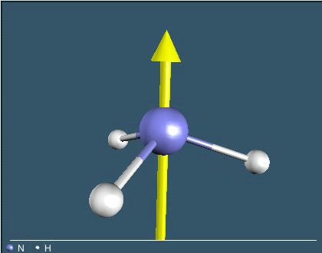
Partial list of operations
Proper rotation (C_{n})
  Define an axis and rotate counterclockwise
  360/n is how many º the rotation is
  Example – NH₃

Slide 4
Partial list of operations
Reflection (σ)
  Pass a mirror plane through an object
  Types of mirror planes
    Horizontal (σ_{h}) – perpendicular to the PA
    Vertical (σ_{v}) – contains PA passes through outer atoms
    Dihedral (σ_{d}) – contains PA misses outer atoms

Slide 5
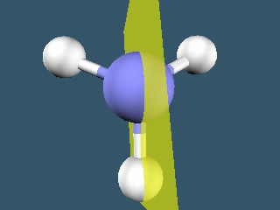
Example – NH₃

Slide 6
Partial list of operations
Improper rotation (S_{n})
  n have same meaning as proper rotations
  Rotate by n along an axis
  Reflect perpendicular to that axis
  Can be coincidental with a proper rotation axis
  Not of major concern for us

Slide 7
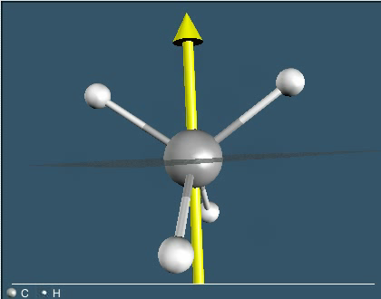
Example – CH₄

Slide 8
Point groups
Set of symmetry operations that describes a molecule
Mathematical treatment of groups

Slide 9
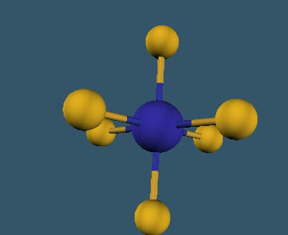
Is the molecule of low symmetry?
Perpendicular C₂’s?
C₁, C_{s}, C_{i}
Is the molecule of high symmetry?
T_{d}, O_{h}, C_{∞v}, D_{∞h}, I_{h}
Highest-order rotation axis (C_{n})
C or S_{n} groups
D groups
σ_{h}?
D_{nh}
σ_{d}?
σ_{h}?
C_{nh}
σ_{v}?
S_{2n}?
D_{nd}
D_{n}
C_{nv}
S_{2n}
C_{n}
Yes
No
C₁ – No symmetry
C_{s} – Just a mirror plane
C_{i} – Just an inversion center
High symmetry groups typically have many symmetry operations
Consider SF₆

Slide 10
For practice
Determine the point group for…
NH₃
Cyclopropane

Slide 11
Is the molecule of low symmetry?
Perpendicular C₂’s?
C₁, C_{s}, C_{i}
Is the molecule of high symmetry?
T_{d}, O_{h}, C_{∞v}, D_{∞h}, I_{h}
Highest-order rotation axis (C_{n})
C or S_{n} groups
D groups
σ_{h}?
D_{nh}
σ_{d}?
σ_{h}?
C_{nh}
σ_{v}?
S_{2n}?
D_{nd}
D_{n}
C_{nv}
S_{2n}
C_{n}
Yes
No

Slide 12
For practice
Determine the point group for…
NH₃
C_{3v}
Cyclopropane
D_{3h}

Slide 13
How does this relate to bonding?
Draw a Lewis structure and assign VSEPR geometry
Assign a point group to the molecular geometry
Determine the VB hybrid orbitals for the electronic geometry of the central atom
Use the VB hybrid orbitals as generator functions
Generate the Ligand Group Orbitals (LGOs) by combining the ligand σ-orbitals to obtain an orbital with the same symmetry as the generator function
Assign symmetry labels to the LGOs from the character table by matching the label of the generator function

Slide 14
Consider BH₃
Draw the Lewis structure
  B has 3 valence electrons
  H has 1 valence electron
The molecular geometry is?
AX₃ – trigonal planar
.
.
.
.
H
B
H
.
.
H
What is the point group?

Slide 15
Is the molecule of low symmetry?
Perpendicular C₂’s?
C₁, C_{s}, C_{i}
Is the molecule of high symmetry?
T_{d}, O_{h}, C_{∞v}, D_{∞h}, I_{h}
Highest-order rotation axis (C_{n})
C or S_{n} groups
D groups
σ_{h}?
D_{nh}
σ_{d}?
σ_{h}?
C_{nh}
σ_{v}?
S_{2n}?
D_{nd}
D_{n}
C_{nv}
S_{2n}
C_{n}
Yes
No
D_{3h}

Slide 16
Hybrid orbitals
The electron geometry is AX₃E₀
This is an electron deficient molecule
From General Chemistry – sum X and E
  2 – sp
  3 – sp²
  4 – sp³
  5 – sp³d
  6 – sp³d²

Slide 17
Generator functions
Considering the boron atom
We need to assign axes
An abbreviated character table
y
D_{3h} | Orbital
A₁′ | s
A₂′
E′ | p_{x}, p_{y}
A₁′′
A₂′′ | p_{z}
E′′
A₁′
E′
x
z
E′
A₂′′

Slide 18
LGO’s
A₁′
E′
E′
A₂′′

Slide 19
Constructing the MO diagram
B
BH₃
3 H
A₁′ (σ∗)
E′ (σ∗)
E′ (σ∗)
E′
E′
A₂′′
A₂′′ (nb)
E
A₁′
E′
E′
A₁′
E′ (σ)
E′ (σ)
A₁′ (σ)
Notes:
Emphasize that the E’ orbitals are degenerate.
Because of the nodes in the E’ orbitals they are less bonding and therefore higher in energy than A₁’.

Slide 20
Orbital pictures
A₁′ (σ∗)
E′ (σ∗)
E′ (σ∗)
A₂′′ (nb)
E′ (σ)
E′ (σ)
A₁′ (σ)

Slide 21
Let’s try water
Draw the Lewis structure
What is the molecular geometry?
What is the point group?
..
..
AX₂ – bent based on tetrahedral

Slide 22
Is the molecule of low symmetry?
Perpendicular C₂’s?
C₁, C_{s}, C_{i}
Is the molecule of high symmetry?
T_{d}, O_{h}, C_{∞v}, D_{∞h}, I_{h}
Highest-order rotation axis (C_{n})
C or S_{n} groups
D groups
σ_{h}?
D_{nh}
σ_{d}?
σ_{h}?
C_{nh}
σ_{v}?
S_{2n}?
D_{nd}
D_{n}
C_{nv}
S_{2n}
C_{n}
Yes
No
C_{2v}

Slide 23
Generator functions
What’s the electron geometry?
What is the hybridization on oxygen?
Assign axes
AX₂E₂
sp³
z
x
y

Slide 24
Which generator function?
C_{2v} | Orbital
A₁ | s, p_{z}
A₂
B₁ | p_{x}
B₂ | p_{y}
A₁
A₁
B₁
B₂
 |  | Can interact with
Generator | Symmetry | Ligands | Lone pair
s | A₁ | Yes | Yes
p_{z} | A₁ | Yes | Yes
p_{y} | B₂ | No | Yes
p_{x} | B₁ | Yes | No
Are there any that cannot interact with the H atoms?
Notes:
Emphasize that the s and p_{z} are different.
The node of the p_{x} occurs where the lone pair should be so it can’t be the lone pair.

Slide 25
LGO’s
A₁′
A₁
B₁
B₂

Slide 26
Constructing the MO diagram
O
H₂O
2 H
B₁ (σ∗)
A₁ (σ∗)
A₁
B₁
A₁
B₁
B₂
B₂ (lp)
E
A₁ (lp)
B₁ (σ)
A₁
A₁ (σ)

Slide 27
Hypervalency – PF₅
Draw the Lewis structure
What is the molecular geometry?
What is the point group?
AX₅ – trigonal bipyramidal

Slide 28
Is the molecule of low symmetry?
Perpendicular C₂’s?
C₁, C_{s}, C_{i}
Is the molecule of high symmetry?
T_{d}, O_{h}, C_{∞v}, D_{∞h}, I_{h}
Highest-order rotation axis (C_{n})
C or S_{n} groups
D groups
σ_{h}?
D_{nh}
σ_{d}?
σ_{h}?
C_{nh}
σ_{v}?
S_{2n}?
D_{nd}
D_{n}
C_{nv}
S_{2n}
C_{n}
Yes
No
D_{3h}

Slide 29
Generator functions
What’s the electron geometry?
What is the hybridization on phosphorus?
Assign axes
AX₅E₀
sp³d
z
x
y

Slide 30
Generator functions
D_{3h} | Orbital
A₁′ | s, d_{z2}
A₂′
E′ | p_{x}, p_{y}
A₁′′
A₂′′ | p_{z}
E′′
A₁′
E′
E′
A₂′′
A₁′

Slide 31
LGO’s
A₁′
E′
E′
X
A₂′′
A₁′
Notes:
But the d orbital on P is not energetically accessible.

Slide 32
Constructing the MO diagram
P
PF₅
5 F
A₂′′ (σ*)
E′′ (σ*)
E′′ (σ*)
A₁′ (σ*)
E′′
E′′
A₂′′
A₁′
E
A₁′ (nb)
A₁′
A₂′′
E′′
E′′
A₁′
A₂′′ (σ)
E′′ (σ)
E′′ (σ)
A₁′ (σ)
Notes:
Emphasize that the E’ orbitals are degenerate.
Because of the nodes in the E’ orbitals they are less bonding and therefore higher in energy than A₁’.

