Slide 1
Geometry Indices
Anthony L. Fernandez
Merrimack College
Created by Anthony L. Fernandez, Merrimack College, fernandeza@merrimack.edu and posted on VIPEr (www.ionicviper.org) on 12 January 2018, Copyright Anthony L. Fernandez, 2018. This work is licensed under the Creative Commons Attribution-NonCommercial-ShareAlike License. To view a copy of this license visit http://creativecommons.org/about/license/.

Slide 2
Geometries of Transition Metal Complexes
Transition metals centers exhibit a wide variety of coordination numbers and their complexes adopt a wide range of geometries.
The most common coordination numbers of transition metal centers are 4, 5, and 6.
  Transition metal centers with 6 ligands most commonly adopt an octahedral geometry.
  Four- and five-coordinate metal centers exhibit limiting geometries, but also adopt distortions of these structures quite readily.
Geometry indices have been developed so that four- and five-coordinate geometries can be quantitatively described.

Slide 3
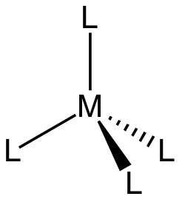
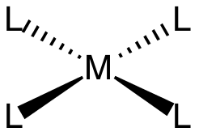
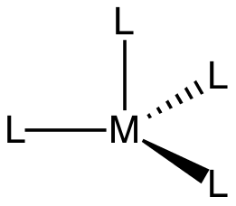
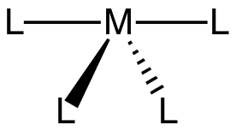
Four-coordinate Geometries
For four-coordinate metal complexes, tetrahedral and square planar geometries are commonly observed.
As metals transition between these two geometries, there are several structures that can be considered distortions of these geometries - see-saw (or compressed tetrahedron, left) and triangular pyramid (right).

Slide 4




Bond Angles in Different Geometries
 | Tetrahedral | Trigonal pyramid | Seesaw | Square planar
L₁-M-L₂ | 109.5° | 90° | 90° | 90°
L₂-M-L₃ | 109.5° | 120° | 120° | 90°
L₃-M-L₄ | 109.5° | 120° | 90° | 90°
L₁-M-L₄ | 109.5° | 90° | 180° | 90°
L₁-M-L₃ | 109.5° | 90° | 90° | 180°
L₂-M-L₄ | 109.5° | 120° | 90° | 180°

Slide 5
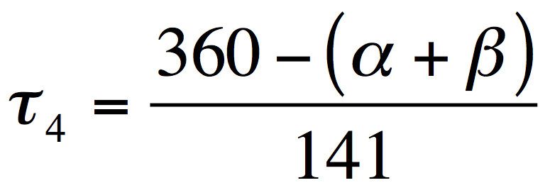
Geometry Index (𝜏₄)
Houser and co-workers developed a geometry index that can be used to quantitatively describe the geometry adopted by four-coordinate complexes.
In a four-coordinate complex, there are 6 angles formed by the four M-L bonds. The two largest angles, α and β, are used to determine the 𝜏₄ value.
𝜏₄ (tetrahedron) = 1
𝜏₄ (square planar) = 0
Yang, L.; Powell, D. R.; Houser, R. P. Dalton Trans. 2007, 955–964.

Slide 6
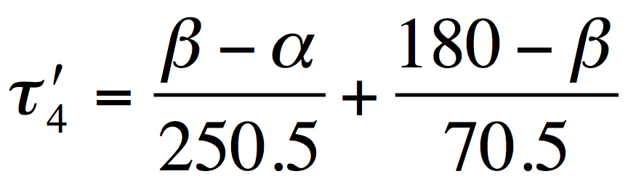
Geometry Index (𝜏₄′)
Okuniewski and co-workers developed a geometry index that can be used to quantitatively describe the geometry adopted by four-coordinate complexes. This geometry index was created to allow for the easier differentiation between four-coordinate structures.
In a four-coordinate complex, there are 6 angles formed by the four M-L bonds. The two largest angles, α and β (where β > α), are used to determine the 𝜏₄′ value.
𝜏₄′ (tetrahedron) = 1
𝜏₄′ (square planar) = 0
Okuniewski, A.; Rosiak, D.; Chojnacki, J.; Becker, B. Polyhedron 2015, 90 (C), 47–57.

Slide 7
Bond Angles in Different Geometries
 | β (largest angle) | α (2nd largest angle) | 𝜏₄ | 𝜏₄′
Tetrahedral | 109.5° | 109.5° | 1.00 | 1.00
Trigonal pyramidal | 120° | 120° | 0.85 | 0.85
Seesaw | 180° | 90° | 0.64 | 0.36
Seesaw | 180° | 109.5° | 0.50 | 0.28
Seesaw | 180° | 154.4° | 0.18 | 0.10
Seesaw | 180° | 170° | 0.07 | 0.04
Square planar | 180° | 180° | 0.00 | 0.00

Slide 8
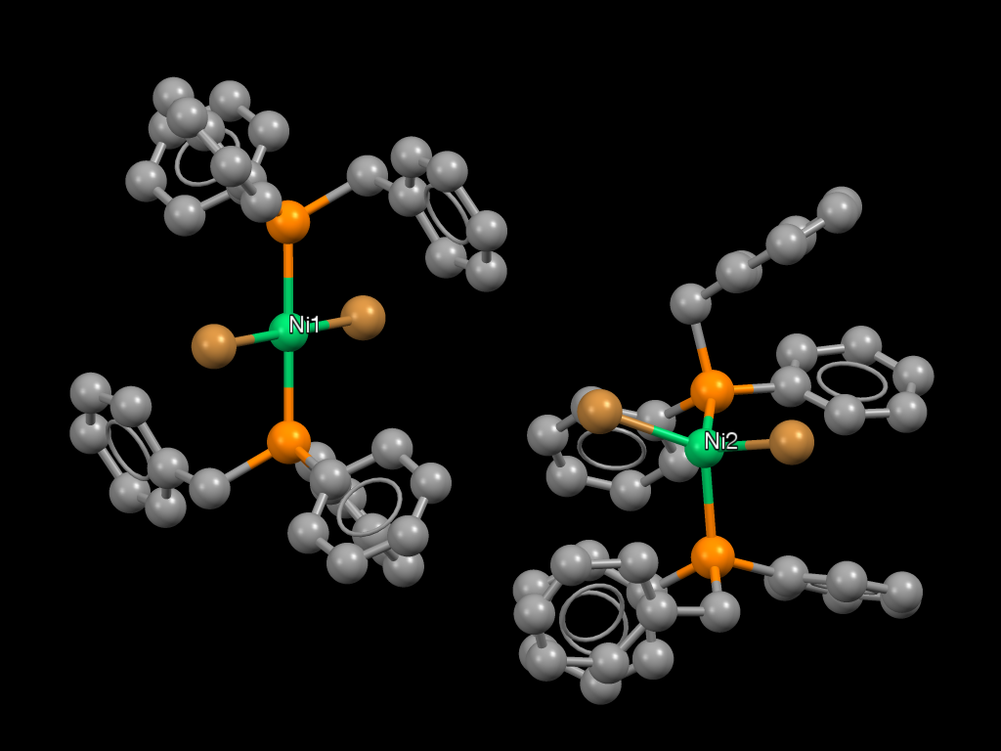
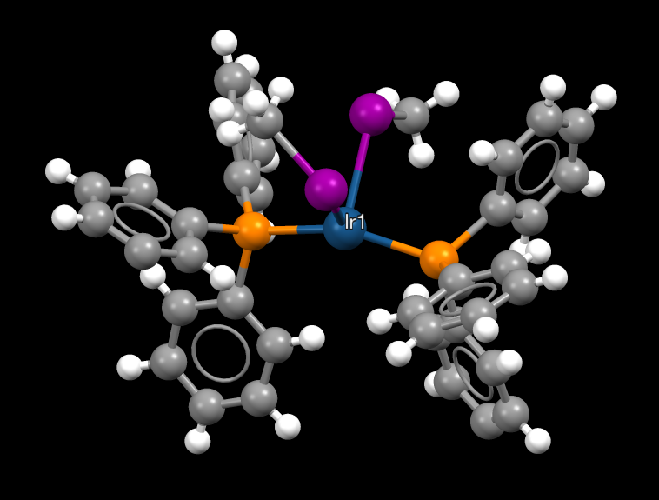
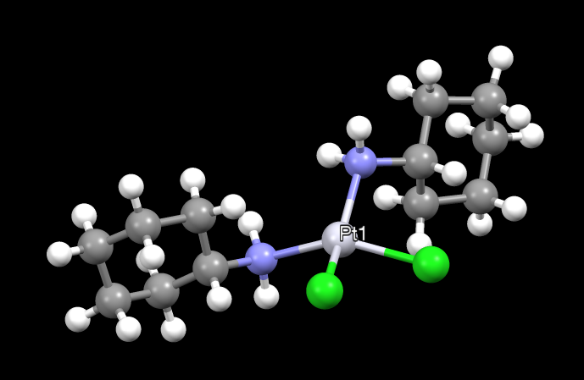
Calculation of 𝜏₄ and 𝜏₄′ - Examples
The structures shown below can be found in the Teaching Subset of Mercury, which is freely available from the CCDC.
The angles were measured in Mercury and the two largest angles are listed below each structure.
FUJLAX
CCXAPT
DBBZPN
Ni1
β = 180.0°
α = 180.0°
𝜏₄ = 0
𝜏₄′ = 0
Ni2
β = 119.6°
α = 118.7°
𝜏₄ = 0.86
𝜏₄′ = 0.86
β = 150.6° α = 150.6°
𝜏₄ = 0.42
𝜏₄′ = 0.42
β = 156.6° α = 102.6°
𝜏₄ = 0.71
𝜏₄′ = 0.55

Slide 9
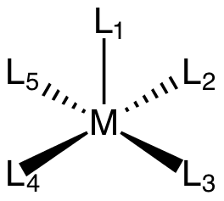
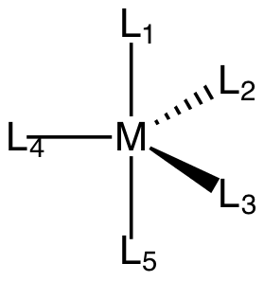
Bond Angles in Different Geometries (CN = 5)
 | Square pyramidal | Trigonal bipyramidal
L₁-M-L₂ | 90° | 90°
L₁-M-L₃ | 90° | 90°
L₁-M-L₄ | 90° | 90°
L₁-M-L₅ | 90° | 180°
L₂-M-L₃ | 90° | 120°
L₂-M-L₄ | 180° | 120°
L₂-M-L₅ | 90° | 90°
L₃-M-L₄ | 90° | 120°
L₃-M-L₅ | 180° | 90°
L₄-M-L₅ | 90° | 90°
Square pyramidal
Trigonal bipyramidal

Slide 10
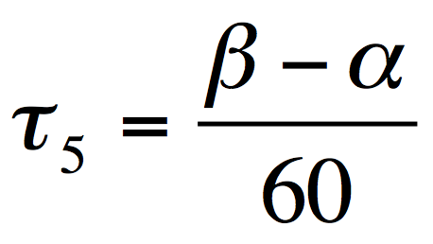
Geometry Index (𝜏₅)
Addison, Reedijk, and co-workers developed a geometry index that can be used to quantitatively describe the geometry adopted by five-coordinate complexes.
In a five-coordinate complex, there are 10 angles formed by the five M-L bonds. The two largest angles, α and β (where β > α), are used to determine the 𝜏₅ value.
𝜏₅ (trigonal bipyramidal) = 1
𝜏₅ (square pyramidal) = 0
Addison, A. W.; Rao, T. N.; Reedijk, J.; van Rijn, J.; Verschoor, G. C. J. Chem. Soc., Dalton Trans. 1984, 1349–1356.

Slide 11
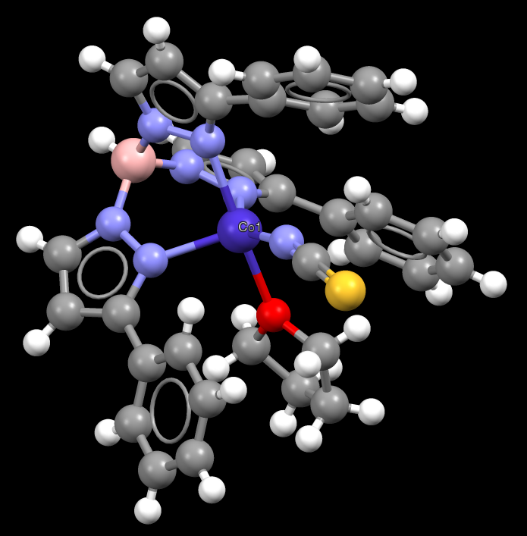
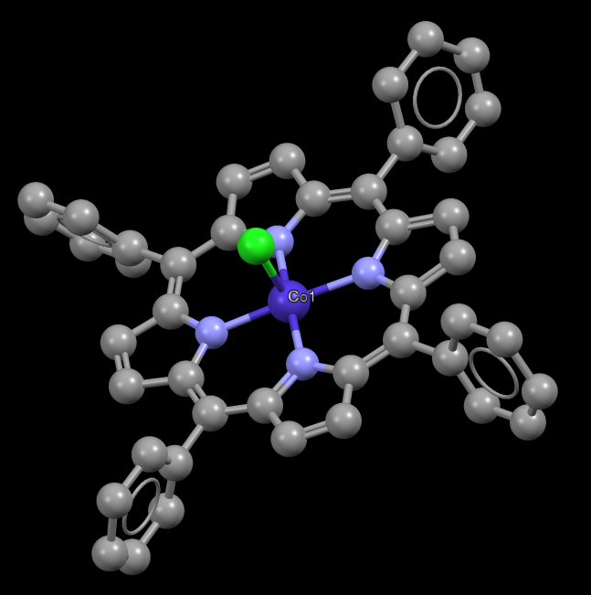
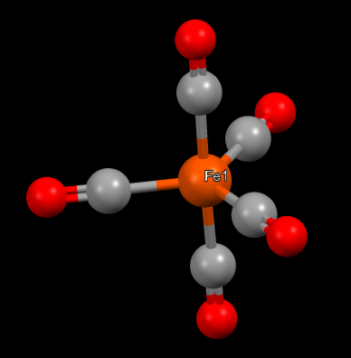
Calculation of 𝜏₅ - Examples
The structures shown below can be found in the Teaching Subset of Mercury, which is freely available from the CCDC.
The angles were measured in Mercury and the two largest angles are listed below each structure.
FOJBOV01
DOXCAU
CTPOCO
β = 176.4° α = 122.0°
𝜏₅ = 0.91
β = 175.0° α = 145.0°
𝜏₅ = 0.50
β = 176.8° α = 176.8°
𝜏₅ = 0

