Slide 1

Advanced Chemdraw
Created by S. Chantal E. Stieber, California State Polytechnic University Pomona (sestieber@cpp.edu) and posted on VIPEr (www.ionicviper.org) on February 11, 2019. Copyright S. Chantal E. Stieber, 2019. This work is licensed under the Creative Commons Attribution-NonCommercial-ShareAlike 3.0 Unported License. To view a copy of this license visit http://creativecommons.org/about/license/.

Slide 2
Advanced ChemDraw
Insert image of Chemdraw user interface from page 4 of the Chemdraw 16.0 user manual.
Chemdraw 16 user manual

Slide 3
Advanced ChemDraw
Drawing Complex 3-D Structures:
Target complex:
Insert image of dirhodium complex from upper right in Scheme 1 in Sanford paper DOI: 10.1021/acs.organomet.8b00400
Mantell, M. A.; Kampf, J. W.; Sanford, M. Improved Synthesis of [CpRRhCl2]2 Complexes, Organometallics, 2018, DOI: 10.1021/acs.organomet.8b00400

Slide 4
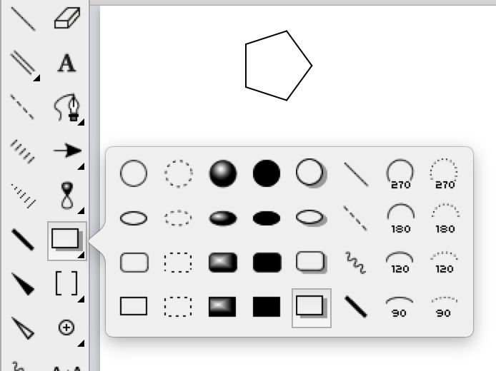
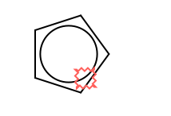
Advanced ChemDraw
Insert image of dirhodium complex from upper right in Scheme 1 in Sanford paper DOI: 10.1021/acs.organomet.8b00400
Drawing Complex 3-D Structures:
Start with the ligands that you will distort:

Slide 5
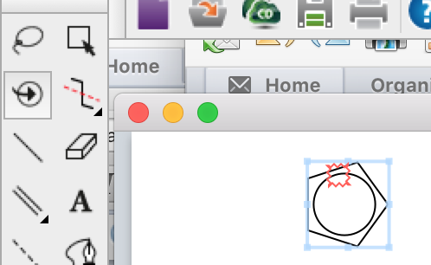
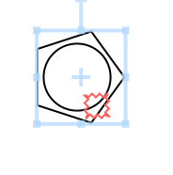
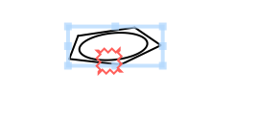
Advanced ChemDraw
Insert image of dirhodium complex from upper right in Scheme 1 in Sanford paper DOI: 10.1021/acs.organomet.8b00400
Drawing Complex 3-D Structures:
Select the whole ligand:
Distort it in 3-D

Slide 6
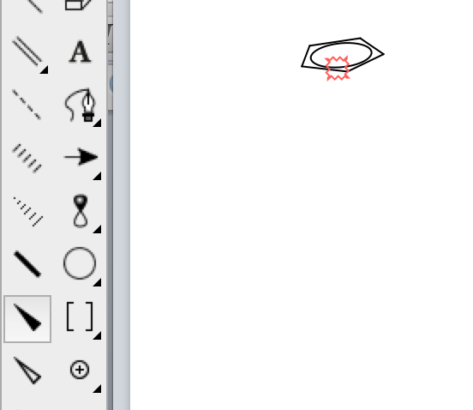

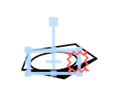
Advanced ChemDraw
Insert image of dirhodium complex from upper right in Scheme 1 in Sanford paper DOI: 10.1021/acs.organomet.8b00400
Drawing Complex 3-D Structures:
Add shading:
Adjust the circle as needed:

Slide 7
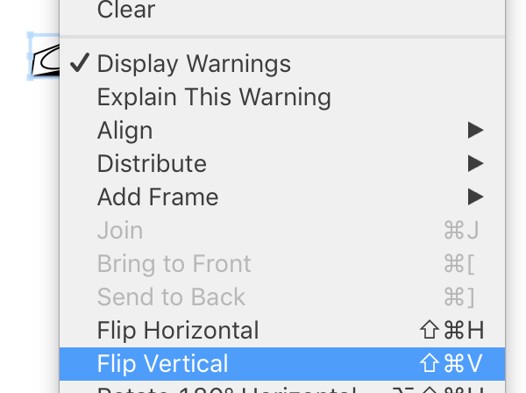
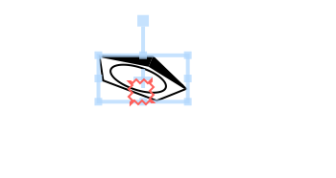
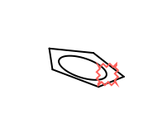
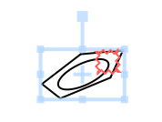
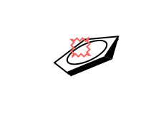
Advanced ChemDraw
Insert image of dirhodium complex from upper right in Scheme 1 in Sanford paper DOI: 10.1021/acs.organomet.8b00400
Drawing Complex 3-D Structures:
Copy/paste first ring
Flip vertically to make second ring:
Remove wedges, rotate, and add shading

Slide 8
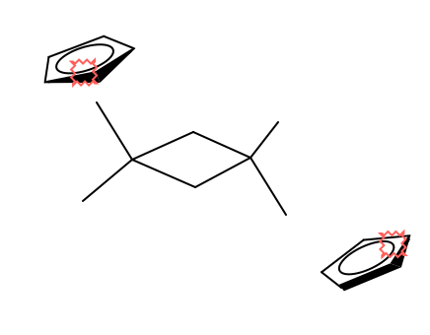
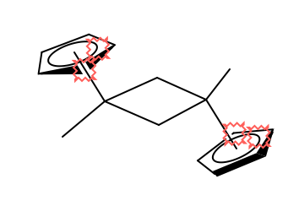
Advanced ChemDraw
Insert image of dirhodium complex from upper right in Scheme 1 in Sanford paper DOI: 10.1021/acs.organomet.8b00400
Drawing Complex 3-D Structures:
Build the rest of the structure:
Notice the bond is in front of the top left ring

Slide 9
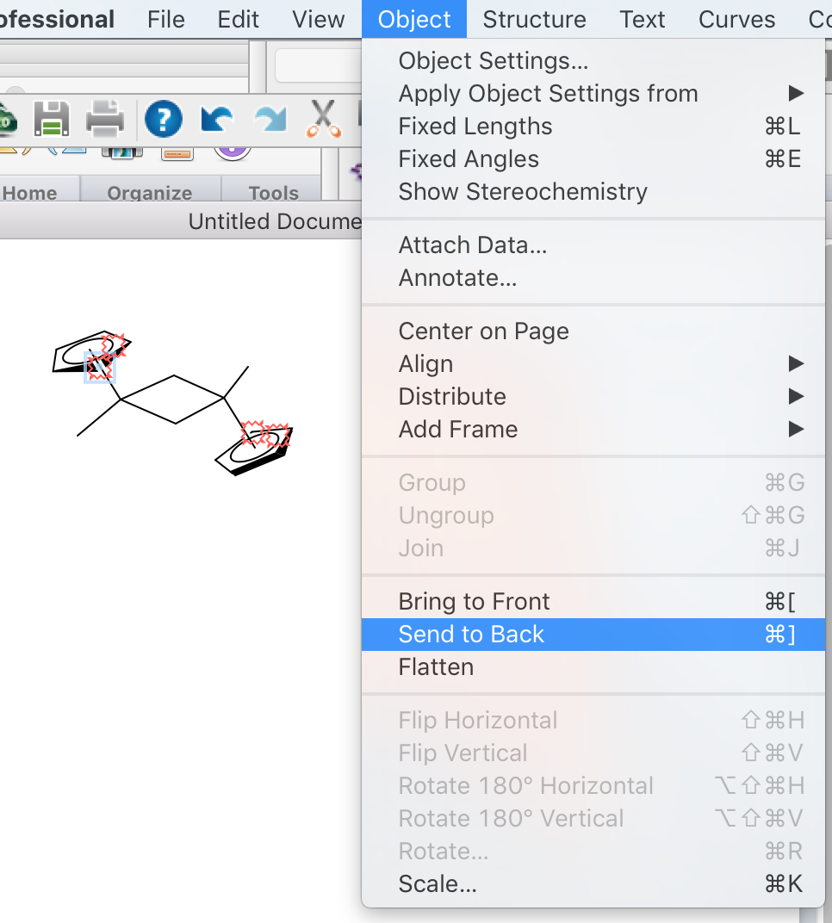
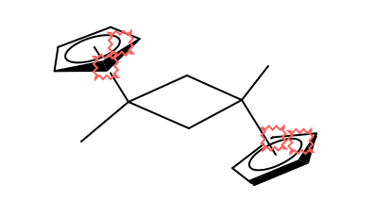
Advanced ChemDraw
Insert image of dirhodium complex from upper right in Scheme 1 in Sanford paper DOI: 10.1021/acs.organomet.8b00400
Drawing Complex 3-D Structures:
Highlight the bond that’s in front
Send to back:

Slide 10
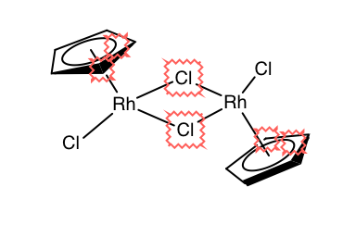
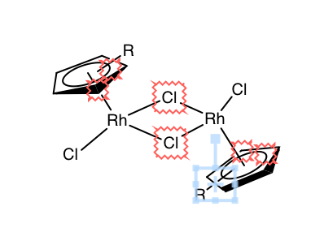
Advanced ChemDraw
Insert image of dirhodium complex from upper right in Scheme 1 in Sanford paper DOI: 10.1021/acs.organomet.8b00400
Drawing Complex 3-D Structures:
Add atom names using text function
Add R groups using bonds and text labels

Slide 11
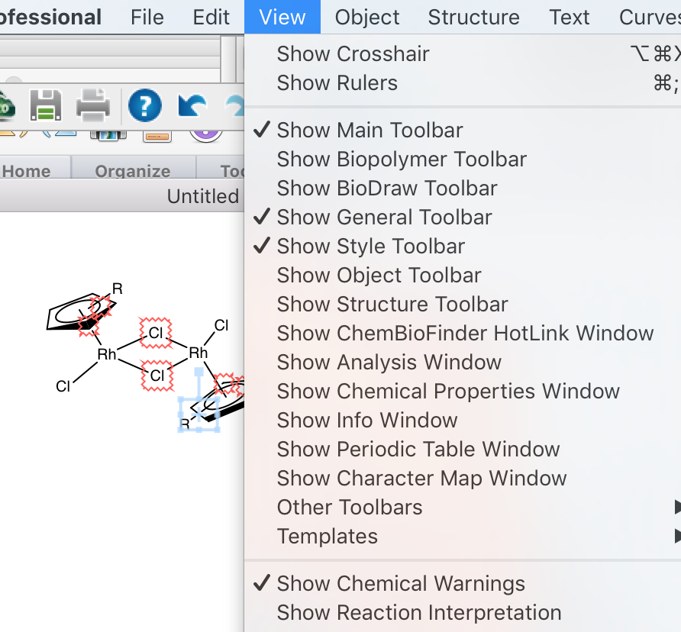
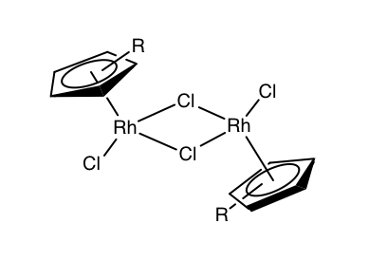
Advanced ChemDraw
Insert image of dirhodium complex from upper right in Scheme 1 in Sanford paper DOI: 10.1021/acs.organomet.8b00400
Drawing Complex 3-D Structures:
Remove chemical warnings

Slide 12
Advanced ChemDraw
Drawing Reaction Schemes:
Make sure everything is lined up
Target:
Insert image of reaction scheme above table 1 in Schmidt paper
DOI: 10.1021/jacs.8b06881
Lardy, S. W.; Schmidt, V. A. “Intermolecular Radical Mediated Anti-Markovnikov Alkene Hydroamination Using N‐Hydroxyphthalimide,” J. Am. Chem. Soc. 2018, 10.1021/jacs.8b06881

Slide 13
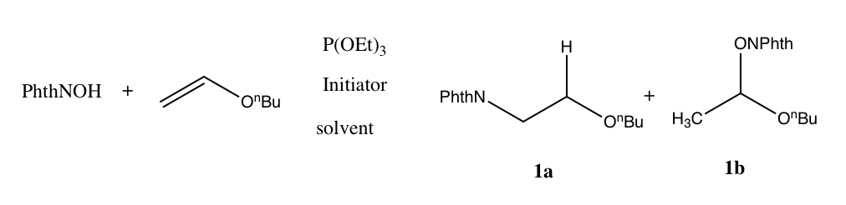
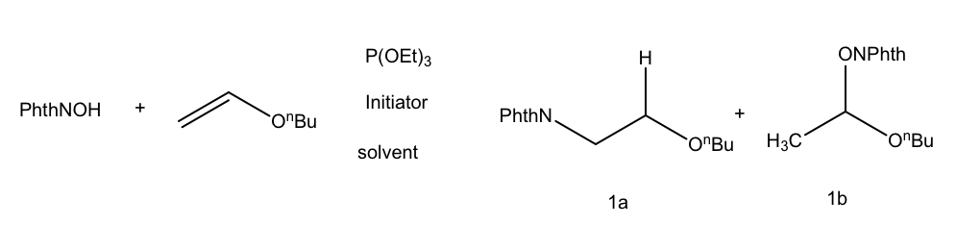
Advanced ChemDraw
Drawing Reaction Schemes:
Target:
Draw components first
Notice the different fonts.
Highlight everything and make the font consistent (Arial 10)
Insert image of reaction scheme above table 1 in Schmidt paper
DOI: 10.1021/jacs.8b06881

Slide 14
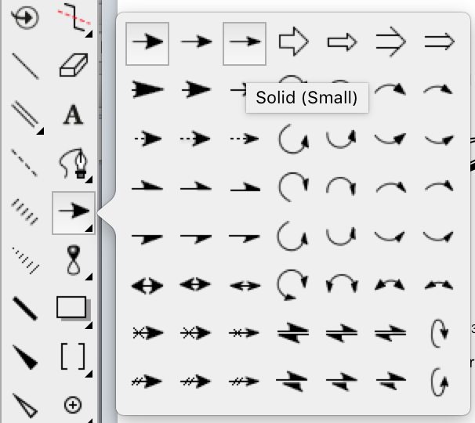
Advanced ChemDraw
Drawing Reaction Schemes:
Target:
Add the arrow
Insert image of reaction scheme above table 1 in Schmidt paper
DOI: 10.1021/jacs.8b06881

Slide 15
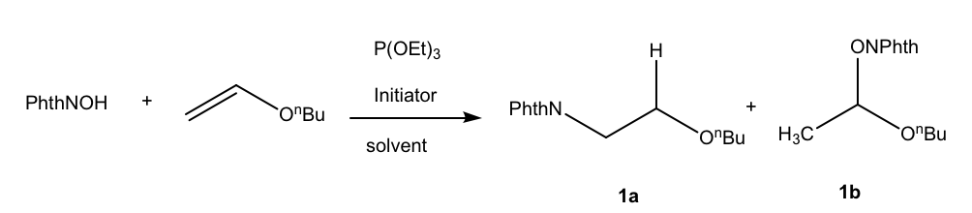
Advanced ChemDraw
Drawing Reaction Schemes:
Target:
Add the arrow
Insert image of reaction scheme above table 1 in Schmidt paper
DOI: 10.1021/jacs.8b06881

Slide 16
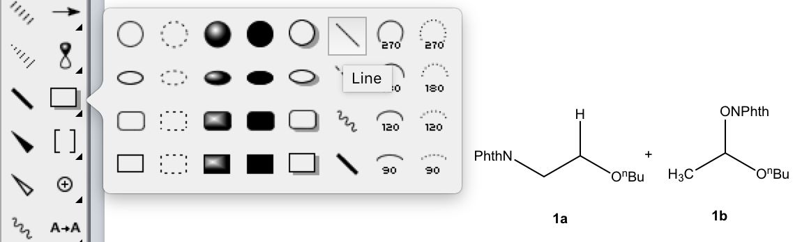
Advanced ChemDraw
Drawing Reaction Schemes:
Target:
Line everything up
  It helps to use a guideline that you will later delete
Insert image of reaction scheme above table 1 in Schmidt paper
DOI: 10.1021/jacs.8b06881

Slide 17
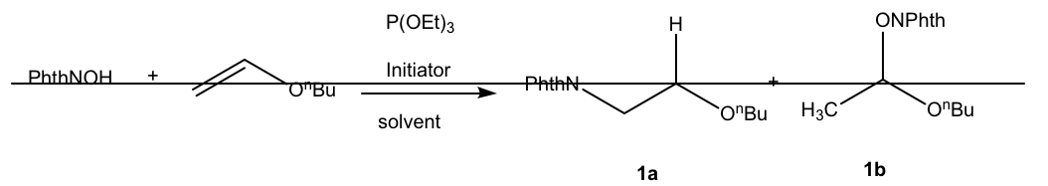
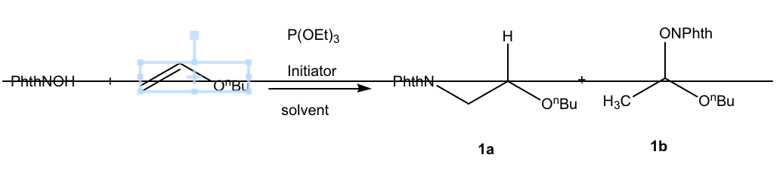
Advanced ChemDraw
Drawing Reaction Schemes:
Target:
Line everything up
  It helps to use a guideline that you will later delete
Drag all components so they are centered on the line
  The blue boxes show a center point
Insert image of reaction scheme above table 1 in Schmidt paper
DOI: 10.1021/jacs.8b06881

Slide 18
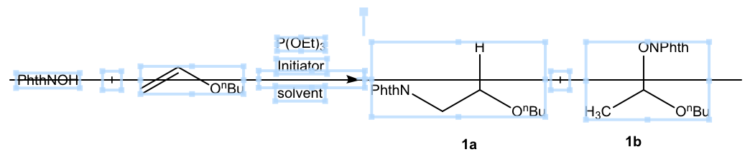
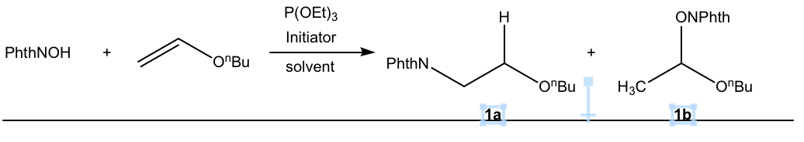
Advanced ChemDraw
Drawing Reaction Schemes:
Target:
See how all components are now centered around the line
Move the guideline and use it to line up your labels
Insert image of reaction scheme above table 1 in Schmidt paper
DOI: 10.1021/jacs.8b06881

Slide 19
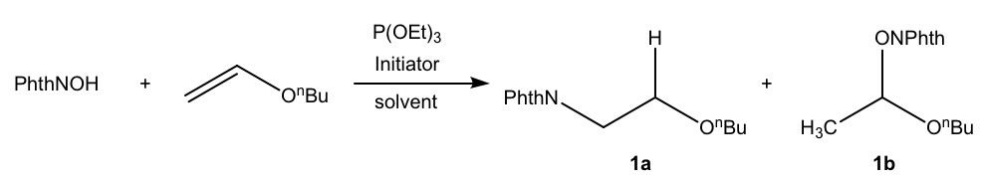
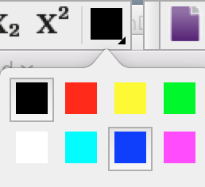
Advanced ChemDraw
Drawing Reaction Schemes:
Target:
Remove the guideline
You can change colors and boldness of specific labels
Insert image of reaction scheme above table 1 in Schmidt paper
DOI: 10.1021/jacs.8b06881

Slide 20
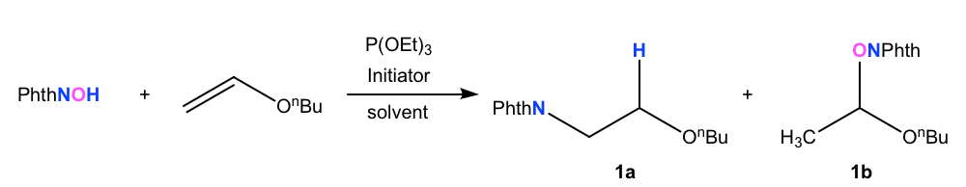
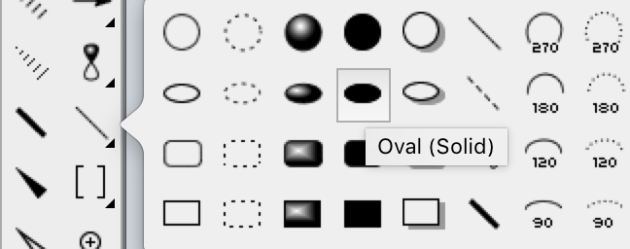
Advanced ChemDraw
Drawing Reaction Schemes:
Target:
You can change colors and boldness of specific labels
Finally, add the highlights using a shape
Insert image of reaction scheme above table 1 in Schmidt paper
DOI: 10.1021/jacs.8b06881

Slide 21
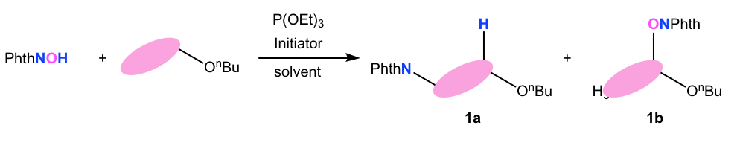
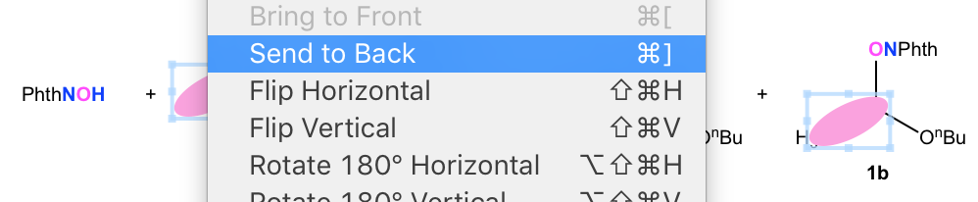
Advanced ChemDraw
Drawing Reaction Schemes:
Target:
Finally, add the highlights using a shape
Send the shapes to the back by right clicking
Insert image of reaction scheme above table 1 in Schmidt paper
DOI: 10.1021/jacs.8b06881

Slide 22
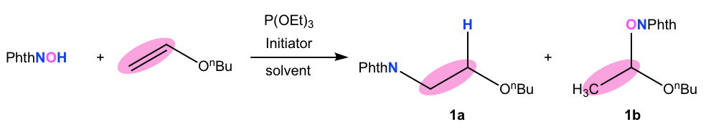
Advanced ChemDraw
Drawing Reaction Schemes:
Target:
And you are finished
Insert image of reaction scheme above table 1 in Schmidt paper
DOI: 10.1021/jacs.8b06881

Slide 23
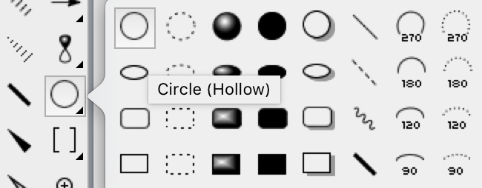
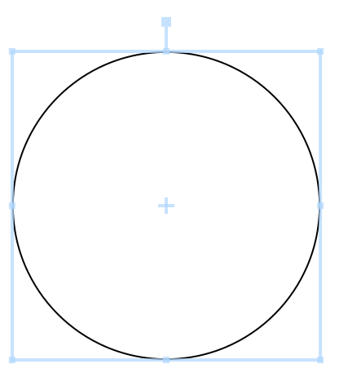
Advanced ChemDraw
Drawing Catalytic Cycles (example with 3 components):
Start with a circle template

Slide 24
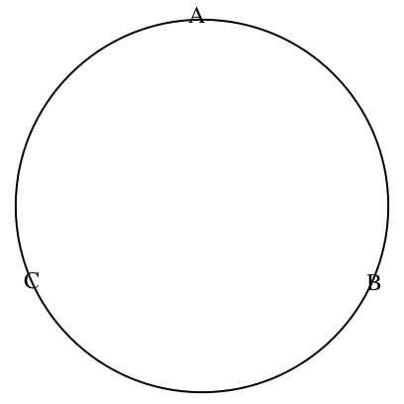
Advanced ChemDraw
Drawing Catalytic Cycles (example with 3 components):
Add your 3 components

Slide 25
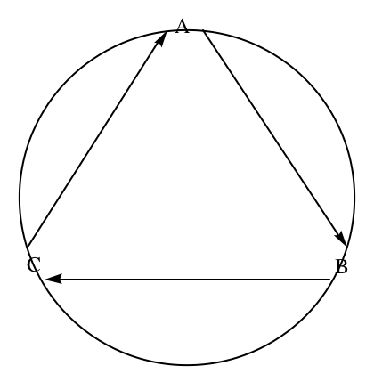
Advanced ChemDraw
Drawing Catalytic Cycles (example with 3 components):
Draw straight arrows between 3 components

Slide 26
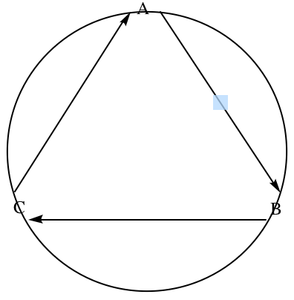
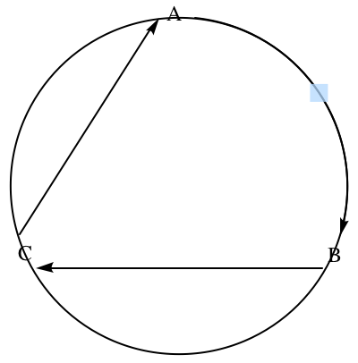
Advanced ChemDraw
Drawing Catalytic Cycles (example with 3 components):
Bend the arrows
  Hold over the arrow, and click/drag the center dot
  Drag until the arrow is inline with the circle

Slide 27
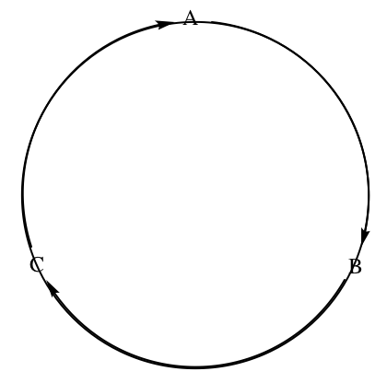
Advanced ChemDraw
Drawing Catalytic Cycles (example with 3 components):
Bend the arrows
  Continue with other arrows

Slide 28
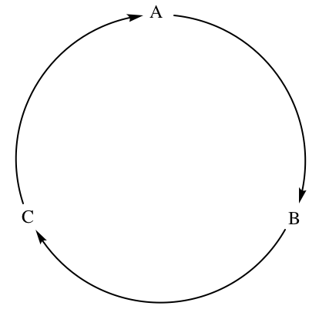
Advanced ChemDraw
Drawing Catalytic Cycles (example with 3 components):
Remove circle template
Now, the cycle can be finished by adding reagents

