Slide 1

Anion Coordination Chemistry: Parallels to Transition Metal Chemistry
Honoring ACS Award in Inorganic Chemistry, 2021
Kristin Bowman-James, University of Kansas
This presentation was created in March 2021 by Hilary Eppley (DePauw University, heppley@depauw.edu) and Shirley Lin (Naval Academy, lin@usna.edu) , and posted on VIPEr on March 11, 2021, Copyright 2021. This work is licensed under the Creative Commons Attribution-NonCommercial-ShareAlike License. To view a copy of this license visit https://creativecommons.org/licenses/by-nc-sa/4.0/

Slide 2
Macromolecular, Supramolecular and Nanoscale (MSN) Chemistry
Required for ACS-certified bachelor’s degrees
Topics that are on the list for MSN and related to this presentation
Supramolecular inclusion complexes
Impact of non-covalent interactions in determining key properties and behaviors
https://www.acs.org/content/dam/acsorg/about/governance/committees/training/acsapproved/degreeprogram/macromolecular-supramolecular-nanoscale-supplement.pdf
Notes:
The ACS CPT 2015 guidelines requires content in macromolecular, supramolecular, and nanoscience (MSN) topics. Non-covalent interactions and coordination are specifically identified as areas that could be included in the coverage. Supramolecular chemistry encompasses a wide variety of systems of which molecular recognition is one.

Slide 3
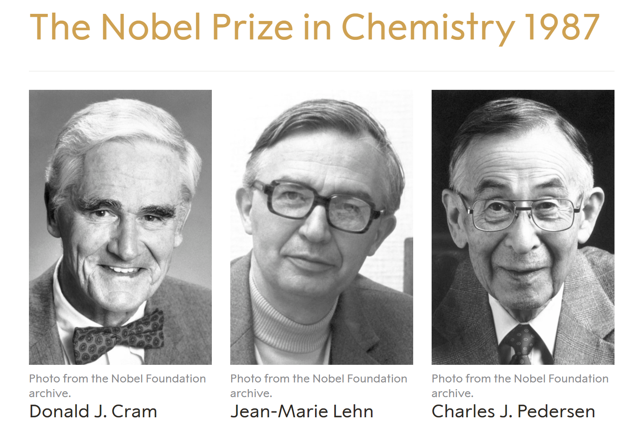
Supramolecular Host-Guest Chemistry
“….for their development and application of molecules with highly selective structure-specific interaction, i.e. molecules that can “recognize” each other and choose with which other molecules they will form complexes.”
https://www.nobelprize.org/prizes/chemistry/1987/summary/: accessed 3 MAR 2021
Notes:
The field of supramolecular chemistry is still fairly young. Three researchers in this area were recognized with the Nobel Prize in chemistry in 1987. These pioneers defined the salient features of host-guest chemistry. The main principles behind synthesizing molecular hosts is to create a rigid space or cavity that can completely encircle a guest atom/molecule and/or create a concave, rigid space where a guest can be partially surrounded.

Slide 4
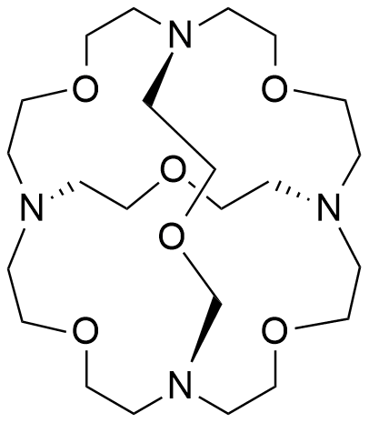
Anion Recognition
Historical development of anion binding: cryptands
With 4 eq. HCl, Cl⁻ ⊂ TH₄⁴⁺ is formed
K > 10⁴
Chloride vs bromide selectivity > 1000
T (tricycle)
https://pubs.acs.org/doi/10.1021/ja00436a066; accessed 3 MAR 2021
Notes:
One of the earliest examples of anion recognition involved this cryptand T by Lehn. As the figure on the slide shows, a cryptand creates a 3-D space inside that can completely encircle a guest, in this case an anion. When the authors added 4 eq. of HCl, the nitrogens on the cryptand were protonated and a chloride occupied the interior. The stability constant K_{s} for chloride was on the order of 10⁴ (determined by an ion selective electrode). Host T was highly selective for chloride versus bromide due to the size of the rigid cavity.
It is worth introducing a notation appearing on this slide that students might not be familiar with. When X ⊂ Y is written, this means that atom/ion/molecule X is a guest within host molecule Y.

Slide 5




Transition Metal Coordination Chemistry Terminology
Werner: Primary: charge Secondary: (donor groups) valences
Binding modes: Monodentate Bidentate Tridentate
Geometry:
Primary: Co³⁺
Secondary: 6 donor groups
NH₃
Notes:
We are used to thinking about concepts of primary (charge) and secondary valences (#donors) in transition metal coordination complexes, as well as binding modes (denticity) and geometry. We can apply similar ideas to anion coordination.

Slide 6


Analogy between Coordination Chemistry and Anion Binding
Metal coordination by ligand Anion coordination by H-bond
Covalent interaction
Ligand donates electrons to the M
Non-covalent (supramolecular) interactions
  H-bonding
  Electrostatic interactions
Anion “donates” electrons to the H
Comparison developed by Bowman-James!
Sort of “reverse” of regular metal coordination chemistry
Notes:
This slide shows the similarity and differences between ligand-metal coordination and ligand-anion coordination. Note that the electron pair donor is the ligand in the case of a coordination complex and the anion in the case of anion coordination.

Slide 7
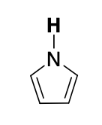
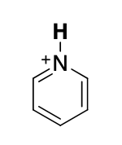
Anion Coordination Chemistry: Charge on the “ligand”
Neutral Cationic
Notes:
Most common charges on the ligand-like anion coordination system are neutral (left) and cationic (right)

Slide 8
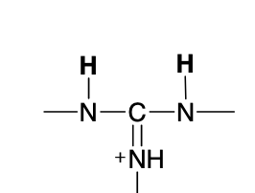
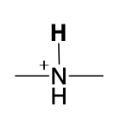
Binding modes of H-bond donor “ligands”
etc….
“Monodentate” “Bidentate”
Single H-bond Two H-bonds
Notes:
Each N-H---X⁻ interaction is relatively weak so successful strategies for anion recognition often utilize multiple interactions through the synthesis of polydentate ligands

Slide 9
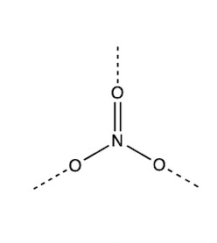
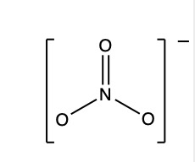
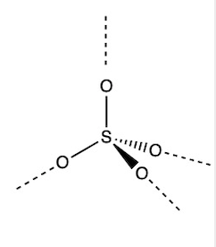
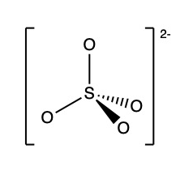
Topology of the anion: different anions have different shapes and therefore bind to different ligands selectively
Spherical Cl–
Trigonal planar
Tetrahedral
Notes:
A key feature of successful anion recognition by a ligand is to match the shape and direction of the H-bond acceptors to the H-bond donors of the ligands. Examples are shown on the following slides.

Slide 10
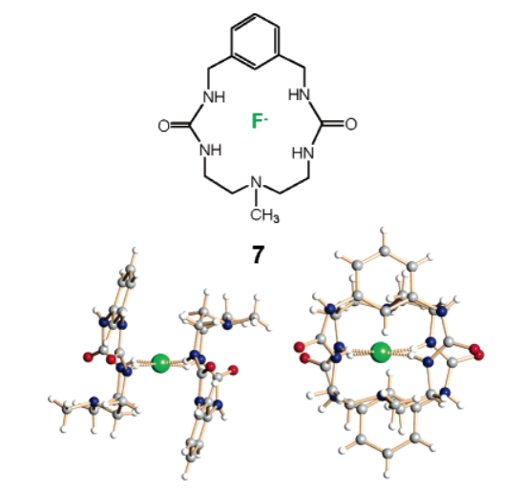
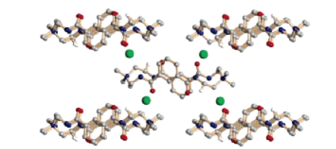
Examples
Monodentate interaction with chlorides (green)
Tetradentate “sandwich” interaction with square planar F–
Reprinted with permission from Bowman-James, K. Acc. Chem. Res. 2005, 38, 8, 671–678.. Copyright 2005 American Chemical Society.
Notes:
In the first example, a simple “monodentate” H-bonding interaction with the chloride anions allow self-assembly of the larger structure into a 2D arrangement.
In the second example, the geometry enforces a rare square planar (not a generally good geometry for sp³ F⁻!) “sandwich” (sort of like the Cp’s around Fe in ferrocene-imagine turning the whole thing by 90°) arrangement for the H-bonding interaction with the F- ion. Each side donates two H-bonds to the F–.

Slide 11
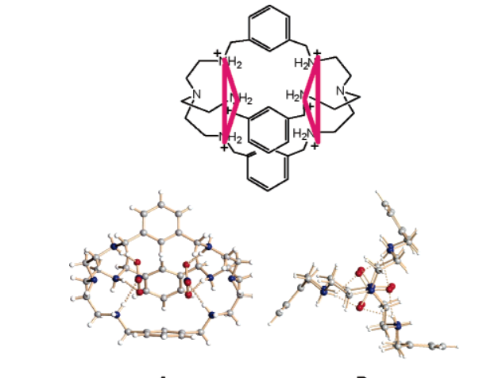
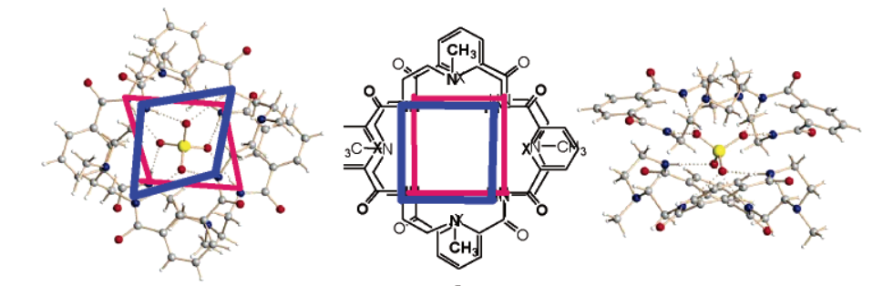
Examples
Ditopic ligands can bind anions at two separate sites on the ligand
8-coordinate interaction with SO₄²⁻
Ditopic tridentate interaction with NO₃–
Reprinted with permission from Bowman-James, K. Acc. Chem. Res. 2005, 38, 8, 671–678.. Copyright 2005 American Chemical Society.
Notes:
In the first example, the four oxygens of the SO₄²⁻ each interact through 2 hydrogen bonds, for a total of 8 interactions (hence 8-”coordinate”). The squares allow you to visualize the H-bonding atoms more easily in this complicated structure.
In the second, the ligand bridges two trigonal planar nitrates through two sites (ditopic) on the ligand.

Slide 12
Applications of Anion Coordination
Many anions have high hydration energies
As charge goes up, hydration energies increase, so binding mostly related to charge--hard to be specific if outside the “normal” order
  NO₃⁻ −300 kJ mol⁻¹
  SO₄²⁻ −1090 kJ mol⁻¹
  PO₄³⁻ −2765 kJ mol⁻¹
SO₄²⁻ Problematic for vitrification (glass formation) in nuclear waste - want to remove it See: https://pubs.acs.org/doi/10.1021/acs.cgd.0c00411
Designing ligands for appropriate coordination geometries can allow more selective binding of anions
Notes:
Coulomb’s law is in charge of much of what happens in aqueous solution, so it is difficult to bind sulfate from solution because it wants to be hydrated (in the aqueous solution) so much because of its high hydration energy. In order to bind anions selectively, Bowman-James’ group designs “ligands” that have the correct topology to bind to anions that would be less favored for binding under normal circumstances. With a specific urea ligand shown in the linked paper, sulfate binds more strongly than competing ions because it is encapsulated by the macrocyclic urea ligand where other anions bind in less favorable modes.

