Slide 1
An introduction to batteries!
Created by Abby R. O’Connor, The College of New Jersey (oconnora@tcnj.edu) and posted on VIPEr on January 2021. Copyright Abby R. O’Connor, 2021. This work is licensed under the Creative Commons Attribution-NonCommercial-ShareAlike License. To view a copy of this license visit http://creativecommons.org/licenses/by-nc-sa/4.0/

Slide 2
Learning Goals
Students should be able to:
  Describe the history of the lithium ion battery
  Describe how a lithium ion works
  Sketch the basic features of a lithium ion battery
  Discuss the contributions of Whittingham, Goodenough and Yoshino to the 2019 Nobel Prize in chemistry and commercialization of the lithium ion battery
  Compare and contrast advantages and disadvantages of lithium ion batteries

Slide 3
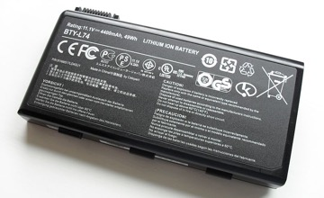

Lithium ion battery history
Concept developed by Stanley Whittingham while studying at Stanford and improved upon idea at Exxon
  During oil crisis in 1970 – Exxon turned to renewables quickly looking for means to store energy
  Continues research in this area – director for NE center for chemical energy storage out of Binghamton
John Goodenough improved the cathode material for the lithium ion battery in 1980
  Continues research in the area at UT-Austin
Akira Yoshino at Asahi Kasei improved the anode material
These seminal discoveries lead to commercialized battery by Sony and Asahi Kasei in 1991
2019 Nobel Prize awarded to Whittingham, Goodenough, Yoshino
https://www.nobelprize.org/uploads/2019/10/advanced-chemistryprize2019.pdf
Kristoferb, CC BY-SA 3.0 <https://creativecommons.org/licenses/by-sa/3.0>, via Wikimedia Commons
Adam Baker, CC BY 2.0 <https://creativecommons.org/licenses/by/2.0>, via Wikimedia Commons

Slide 4
Lithium ion battery – how it works
Image of Whittingham, Goodenough, Yoshino
cartoon drawing,
https://www.theguardian.com/science/2019/oct/09/nobel-prize-in-chemistry-awarded-for-work-on-lithium-ion-batteries
Niklas Elmehed/Royal Swedish Academy of Sciences
IMAGE of Lithium ion battery FROM thermofisher blog
https://www.thermofisher.com/blog/microscopy/uc-san-diego-works-to-build-batteries-of-the-future/
Watch: https://www.youtube.com/watch?v=jgfceqwqUec
Popular because
1. Lightweight
2. Highest energy density
3. Rechargeable
4. Fast charge
5. Long lifetime
Oxidation (at anode)
Reduction (at cathode)
Cool video!
https://www.energy.gov/eere/articles/how-does-lithium-ion-battery-work
Ecell = 2-4 V
https://www.thermofisher.com/blog/microscopy/uc-san-diego-works-to-build-batteries-of-the-future/

Slide 5
Lithium ion battery Whittingham work
First to demonstrate the use of a metal chalcogenide, MX₂, (compounds with element from group 16 of periodic table) at cathode
Anode lithium metal, electrolyte LiPF₆ in propylene carbonate
No large-scale commercialization
  Lithium metal anode was an issue, flammable
  TiS₂ cathode material reactive with air, expensive
Anode reaction, oxidation (-3.0V)
Cathode reaction, reduction
Ecell ~ 2.5V
Johan Jarnestad/The Royal Swedish Academy of Sciences, CC0, via Wikimedia Commons
https://www.nature.com/articles/d41586-019-02965-y
Advanced information. NobelPrize.org. Nobel Media AB 2020. <https://www.nobelprize.org/prizes/chemistry/2019/advanced-information/>

Slide 6
Lithium ion battery - Goodenough work
Built upon Whittingham’s work and improved the cathode in 1980
Proposed use of metal oxide as the metal support – increased E_{cell} to 4V, electrolyte LiBF₄ in propylene carbonate
Metal oxide used CoO₂
  Li cations associate and dissociate in layers of CoO₂ without
  much lattice expansion
Yielded a more powerful battery
Jarnestad/The Royal Swedish Academy of Sciences, CC0, via Wikimedia Commons
Ered = -3.0V, anode, oxidation
Ered = 0.9V, cathode, reduction
Ecell = Ecat – Eanode
Ecell = 0.9V –(-3.0V) = 4V
Advanced information. NobelPrize.org. Nobel Media AB 2020. <https://www.nobelprize.org/prizes/chemistry/2019/advanced-information/>

Slide 7
Lithium ion battery – Yoshino work
https://en.wikipedia.org/wiki/Lithium-ion_battery
Claus Ableiter, CC BY-SA 4.0 <https://creativecommons.org/licenses/by-sa/4.0>, via Wikimedia Commons
Improved the anode design by utilizing a carbon-based support to intercalate the lithium ions
  Petroleum coke – carbon
  Avoids a lithium metal anode
  Safer
Allowed for battery to be commercialized
First patent in 1991 by Sony
Johan Jarnestad/The Royal Swedish Academy of Sciences, CC0, via Wikimedia Commons
Advanced information. NobelPrize.org. Nobel Media AB 2020. <https://www.nobelprize.org/prizes/chemistry/2019/advanced-information/>

Slide 8
Lithium ion battery issues and future
Future
  Lithium-air battery
  Different metal oxides at the cathode
  Replace Li with more benign, cheaper
  metal ions
Disadvantages
  Cost
  Low temperature tolerance
  Safety!
  Special circuiting to prevent cell
  degradation and runaway reactions
Metal air batteries present and future
Andy Brunning
https://cen.acs.org/energy/energy-storage-/Periodic-Graphics-Metal-air-batteries/97/i42
Lithium ion battery catch fire image from
Andy Brunning
https://cen.acs.org/articles/94/i45/Periodic-graphics-Li-ion-batteries.html?utm_
https://www.annualreviews.org/doi/10.1146/annurev-chembioeng-061010-114116

Slide 9
Learning Goals
Students should be able to:
  Explain how batteries are used to store extra energy
  Describe features of different types of electric vehicles
  Recognize the differences between hybrid and all-electric vehicles
  Assess the advantages and disadvantages of different electric vehicles

Slide 10
Grid energy storage
Large scale storage of energy for when there is an abundance of electricity and it is cheap!
Due to varying nature of renewable energy it needs to be stored
Batteries used – size not an issue, what is critical is cost per energy unit ($/W), good efficiencies
Stored as chemical energy and converted to electricity as needed for house, buildings, etc
Earn money – if you expend more energy then you generated extra goes to the power grid
Applications – lithium ion and flow batteries
  Lithium not the future due to safety, cost, and short operating life
  Lead batteries too heavy
  Flow batteries important to the future!
Other ways to store energy – thermal energy storage, pumped hydro storage
https://www.energy.gov/energysaver/buying-and-making-electricity/hybrid-wind-and-solar-electric-systems

Slide 11

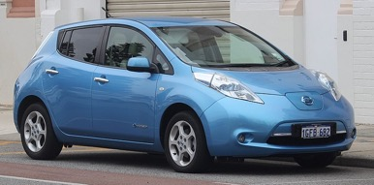
Electric vehicles – history, story
Electric vehicles have been around since 1800s
  Expanded growth in early 1900s
  Use dwindled with development of gasoline powered cars
Electric vehicles are based on using a battery to convert chemical energy to mechanical energy
Interest in electric cars occurred with gas shortages in 1970s and increased interest again in 1990s with sustainability push
  1970s – electric cars couldn’t compete, slow and needed to be charged every 40 miles
  1990s– clear air act increased interest to develop electric cars to compete with gas-powered vehicles
3% of new cars purchased are electric, could grow to 7% by 2021
Benefits – lower carbon emissions, better fuel economy, tax credits
Three types of vehicles
  Hybrid
  Plug-in hybrid
  All-electric
Leaf
Tesla
Vauxford, CC BY-SA 4.0 <https://creativecommons.org/licenses/by-sa/4.0>, via Wikimedia Commons
EurovisionNim, CC BY-SA 4.0 <https://creativecommons.org/licenses/by-sa/4.0>, via Wikimedia Commons
https://www.energy.gov/articles/history-electric-car
https://en.wikipedia.org/wiki/List_of_modern_production_plug-in_electric_vehicles

Slide 12
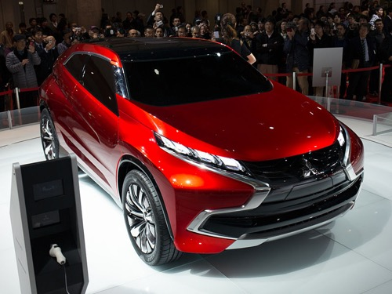
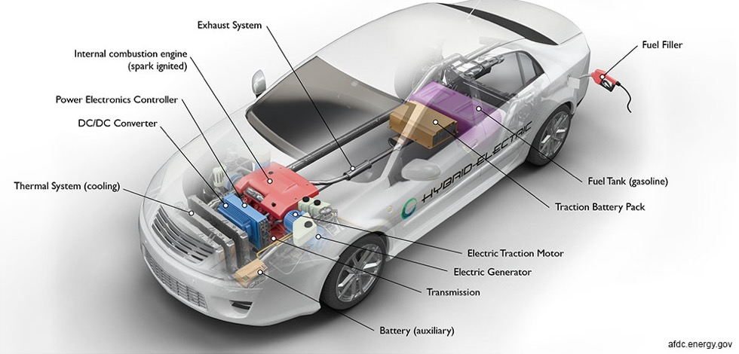
Hybrid electric vehicles - HEV
Combination approach – uses gas engine and electric motor
First hybrid in US 1999 – Honda insight, now 36 different hybrid models sold
Toyota Prius, transformed hybrid vehicles, first mass produced hybrid, 1997
Electricity comes from separate battery pack
Gas engine and regenerative braking charges the battery
Morio, CC BY-SA 3.0 <https://creativecommons.org/licenses/by-sa/3.0>, via Wikimedia Commons
https://commons.wikimedia.org/wiki/File:Mitsubishi_Concept_XR-PHEV_front-right_2013_Tokyo_Motor_Show.jpg
https://en.wikipedia.org/wiki/List_of_modern_production_plug-in_electric_vehicles
https://www.energy.gov/articles/history-electric-car
Notes:
Regenerative braking works by the battery storing the kinetic energy lost when a car brakes by storing it in the battery (basically a reserve of energy for the car)
In a traditional car, the energy released by braking would be lost as heat to the surroundings
In concert with an electric motor – which serves as a generator the stored mechanical energy is converted into electrical energy to power the car
Good resource: (https://driving.ca/column/how-it-works/how-it-works-regenerative-braking)

Slide 13
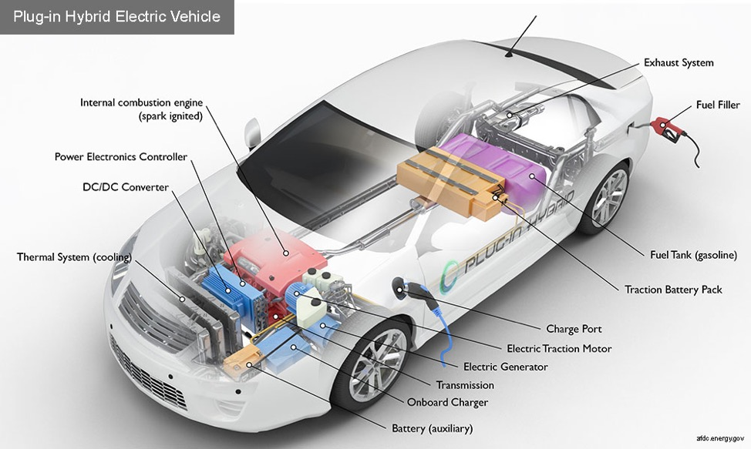
Plug-in hybrid electric vehicles (PHEV)
Combination approach using electric motor and gas engine
Battery used to power electric motor and it is charged by plug-in means in addition to gas engine and regenerative braking
23 models available in the US
Larger batteries vs hybrid – go more
miles before charge
Mariordo (Mario Roberto Durán Ortiz), CC BY-SA 3.0 <https://creativecommons.org/licenses/by-sa/3.0>, via Wikimedia Commons
https://en.wikipedia.org/wiki/List_of_modern_production_plug-in_electric_vehicles
https://afdc.energy.gov/vehicles/electric_basics_phev.html

Slide 14
All-electric vehicle (EV)
Electric motor run by a battery
Charge battery by plugging in
  Battery – Lithium ion battery packs consisting from 100s to 1000s of cells
Big player - Tesla
  Tesla motors start up – 2006 developed luxury electric car that could go 200 miles on a charge
  2010 Tesla 465 million dollar loan from DOE to manufacture electric cars (paid loan back quickly and early!)
Plug-in and regenerative braking used to charge battery
  Plug-in: relies on electricity we get from fossil fuel burning, varies by region
“Zero” tailpipe emissions
https://afdc.energy.gov/vehicles/electric_basics_ev.html
https://www.energy.gov/articles/history-electric-car

Slide 15
Learning Goals
Students should be able to:
  Define redox flow batteries
  Outline the design features of a redox flow battery
  Compare and contrast a redox flow battery to traditional battery

Slide 16
Redox flow batteries (RFB)
Limitations to current technology: Lithium ion batteries are too expensive for long term, large scale energy storage, can’t store enough energy, pose fire risk
Alternate – redox flow battery
  Battery that uses a redox active molecule in a fluid to store energy
  Chemical energy converted to electrical energy
  Operate like fuel cell – recharge with more fluid solution
  Electrodes are catalysts for e-chem reactions
  Decouple power and energy densities
  Rechargeable
Many different electrolyte fluids, common V
Plagued by solubility, stability issues, poor energy
density, need large electrodes and separators which
drives up cost
Include Figure 1 from
Li, et. al J. Phys. Chem. Lett. 2013, 4, 1281-1294.
https://www.pnnl.gov/main/publications/external/technical_reports/PNNL-21174.pdf
https://www.intechopen.com/books/redox-principles-and-advanced-applications/redox-flow-batteries-fundamentals-and-applications

Slide 17
Redox flow batteries (RFB) - design
Pieces – Electrolyte solution [charge carrier(s) (catholyte/anolyte), solvent, supporting electrolyte], 2 electrodes to catalyze the redox reactions, separator (membrane)
Electrolyte – solvent
  Aqueous – limited window for e-chem for energy
  density
  Non-aqueous - Organic – wider window, vary
  solubility, diverse platform of molecules
External storage of electrolyte pumped
through cell
Charge carriers – organic and inorganic
molecules
  Single molecules, clusters
  The d-orbitals – tune redox, ligand tune solubility, stability
Use Figure 6 from:
Dunn, Kamath, Tarascon Science 2011, 334, 928-935.
https://science.sciencemag.org/content/334/6058/928/F6

