Slide 1
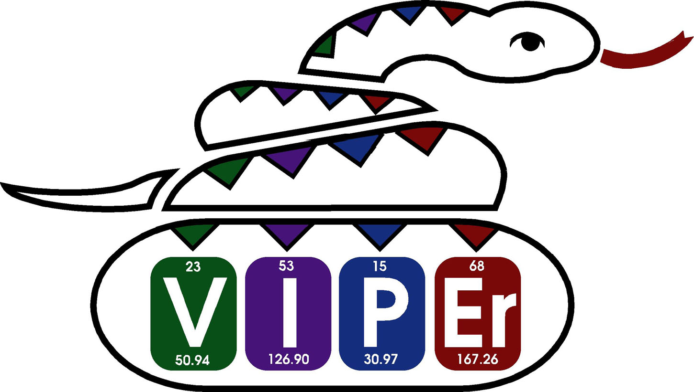
Cadmium Carbonic Anhydrase (CdCA)
Sustaining Life Using a Toxic Metal Ion
Notes:
These five slides explore the unusual synergy of an enzyme and a metal ion never before found to have a positive biological impact. The result was surprising indeed, so I thought it worth the trouble to report this to the wider inorganic community.

Slide 2
Cadmium in Biological Systems
Group 12 metal ions are considered essential (Zn²⁺) or toxic (Cd²⁺ and Hg²⁺) to biological systems
Typically, Cd²⁺ ion presence in biological systems triggers glutathione (pictured below) and metallothionein sequestration
Notes:
As a person who has studied cadmium ion toxicology, and how chelating agents rescue cells from cadmium ion induced cell death as potential treatments for heavy metal intoxication (i.e. improvements on chelation therapy), I felt it important to set the scene for the biological role of 2/3s of the group 12 metal ions.
There are many good articles on the essential roles zinc ions play in biological systems such as http://dx.doi.org/10.1021/ar00034a005. Basically these roles exploit the Lewis acid properties this ion exhibits in chemical reactions – it is the only metal ion that appears in all classes of enzymes and it also has a structural role in transcription factors.
Most importantly in the context of this LO, the introduction of the reference (1) below gives a detailed description of the biological response humans make to the incursion of cadmium ions that up until this time had had no known positive biological role. Basically glutathione (shown on this slide) is first produced by cells to bind up heavy metal ions such as this one before the resulting complex is transported through the blood to the liver where it is subsequently bound to metallothionein, a second and more structurally complex natural chelating agent. The cadmium-metallothionein complex is transported to the kidney where it is filtered and reabsorbed as cadmium ions free of metallothionein that may reside for 10-30 years or be excreted in the urine. Subsequent kidney damage results.
(1) Judkins M.K., Humphries P.S., Craig P.R. (2014) Evaluation of chelators administered to rescue human bone cells from cadmium toxicity. BIOS 85(1): 57-66. http://dx.doi.org/10.1893/0005-3155-85.1.57

Slide 3
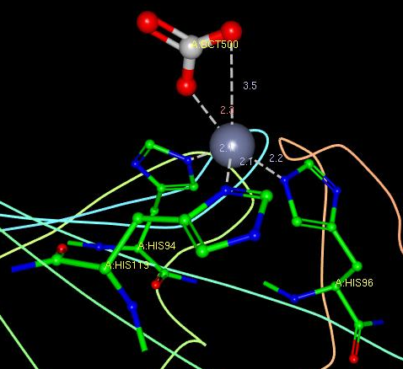
Carbonic Anhydrases
Catalytic metalloproteins that interconvert CO₂ and H₂O to HCO₃⁻ and H⁺
Used in animals to transport CO₂ out of muscles and maintain blood pH balance
Used by plants to concentrate CO₂ prior to photosynthesis
Typically the active site comprises a tetrahedrally coordinated Zn²⁺ ion surrounded by three histidine residues and one aqua or bicarbonato ligand
Figure generated from PDB file 1CAM using Ligand Explorer
Notes:
Carbonic Anhydrase is an important enzyme that catalyzes the inter-conversion of carbon dioxide and water to bicarbonate and hydrogen ions. The reference (2) below is to a LO created by Elizabeth Jamieson at Smith College. In this five slides about LO entitled “Metals in Biological Systems – Who? How? And Why?”, please look at the third slide and associated notes page to get a good sense of the catalytic cycle of the enzyme with a zinc ion in the active site.
The picture on this slide was generated having accessed the protein database (www.pdb.org) and looking up the crystal structure encoded as “1CAM”. The structure viewer is called “Ligand Explorer” and it is important to note that it is Java dependent. It is a useful exercise to explore the structural representation yourself – make sure that the “Metal Interaction” box within Ligand Explorer is checked for it to show the ligands coordinated to the metal in the active site of the metalloprotein. More help is available at http://www.pdb.org/pdb/staticHelp.do?p=help/viewers/ligandExplorer_viewer.html
In an effort to rationalize which protein amino acid residues bind the zinc ion, one can invoke Hard Soft Acid Base (HSAB) theory. This empirically derived theory basically states that in a relative sense Lewis acids (metal ions) prefer to bind Lewis bases (ligand donor atoms) of similar charge density. Zn²⁺ (relative to Cd²⁺) is hard, so will prefer to bind to histidine (nitrogen donor atom) more than to cysteine (sulfur donor atom).
(2) https://www.ionicviper.org/five-slides-about/metals-biological-systems-who-how-and-why

Slide 4
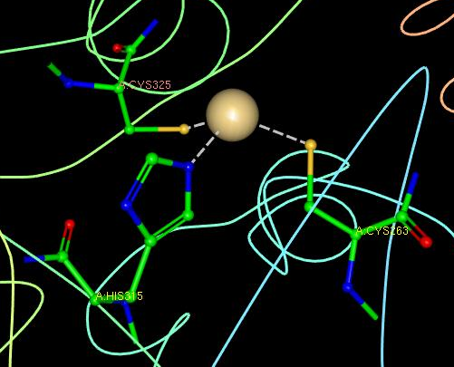
CdCAs in Marine Phytoplankton
Oceanic environment of diatoms is Zn²⁺ deficient
Some diatom CAs have adapted to incorporate Cd²⁺ in place of Zn²⁺ based on bioavailability
In accordance with HSAB theory, to accommodate the comparatively soft acid Cd²⁺, the CA “ligand” now incorporates cysteine in place of two of the histidine residues
Figure generated from PDB file 3BOB using Ligand Explorer
Notes:
Marine diatoms are unicellular eukaryotes that are a common type of phytoplankton (algae). To undergo photosynthesis, they must have sufficient carbon dioxide. This is produced through the Carbonic Anhydrase catalyzed conversion of carbonic acid present in the ocean (HCO₃⁻ + H⁺). Unfortunately the quantities of Zn²⁺ ions in the ocean are so low that to survive such diatoms need to resort to Cd²⁺ ions to do the job.
The reference (3) below exemplifies how one such diatom species has evolved to allow for Cd²⁺ ions to replace Zn²⁺ ions in the active site of the enzyme. Again invoking HSAB theory, it is not surprising that the active site of this protein contains two cysteine residues in place of histidine, because the lower charge density of Cd²⁺ vs. Zn²⁺ ions suggests that cadmium ions are softer than zinc ions.
(3) Xu, Y., Feng, L., Jeffrey, P.D., Shi, Y., Morel, F.M. (2008) Structure and metal exchange in the cadmium carbonic anhydrase of marine diatoms. Nature 452: 56-61. http://dx.doi.org/10.1038/nature06636

Slide 5
Summary
HASB theory is exemplified by CA “ligands” that adapt to accommodate alternate active site metal ions (Zn²⁺ vs. Cd²⁺)
Tetrahedrally coordinated active sites persist for CAs:
  Zn²⁺ = 3 histidine residues and aqua or bicarbonato ligands
  Cd²⁺ = 1 histidine and 2 cysteine residues, and aqua or bicarbonato ligands
The resulting CAs are sufficiently robust to prevent metal ion release and subsequent toxicity

