Slide 1
Objective – Be Safe in the Lab
Become familiar with Globally Harmonized System
  Chemical Labels
  Safety Data Sheets
Understand
  Chemicals you work with
  How to protect yourself
  How to protect the environment
  Institutional chemical waste management
Safety is job one
Created by Alice Lenthe, Villanova University (alice.lenthe@villanova.edu) and posted on VIPEr (www.ionicviper.org) on September 16, 2016, Copyright Alice Lenthe 2016. This work is licensed under the Creative Commons Attribution Non-commercial Share Alike License. To view a copy of this license visit http://creativecommons.org/about/license/.

Slide 2
Sources of Data
Globally Harmonized System
Labels
Safety Data Sheets
ALL CHEMICAL CONTAINERS MUST BE LABELED!!
Safety is job one
Created by Alice Lenthe, Villanova University (alice.lenthe@villanova.edu) and posted on VIPEr (www.ionicviper.org) on September 16, 2016, Copyright Alice Lenthe 2016. This work is licensed under the Creative Commons Attribution Non-commercial Share Alike License. To view a copy of this license visit http://creativecommons.org/about/license/.

Slide 3
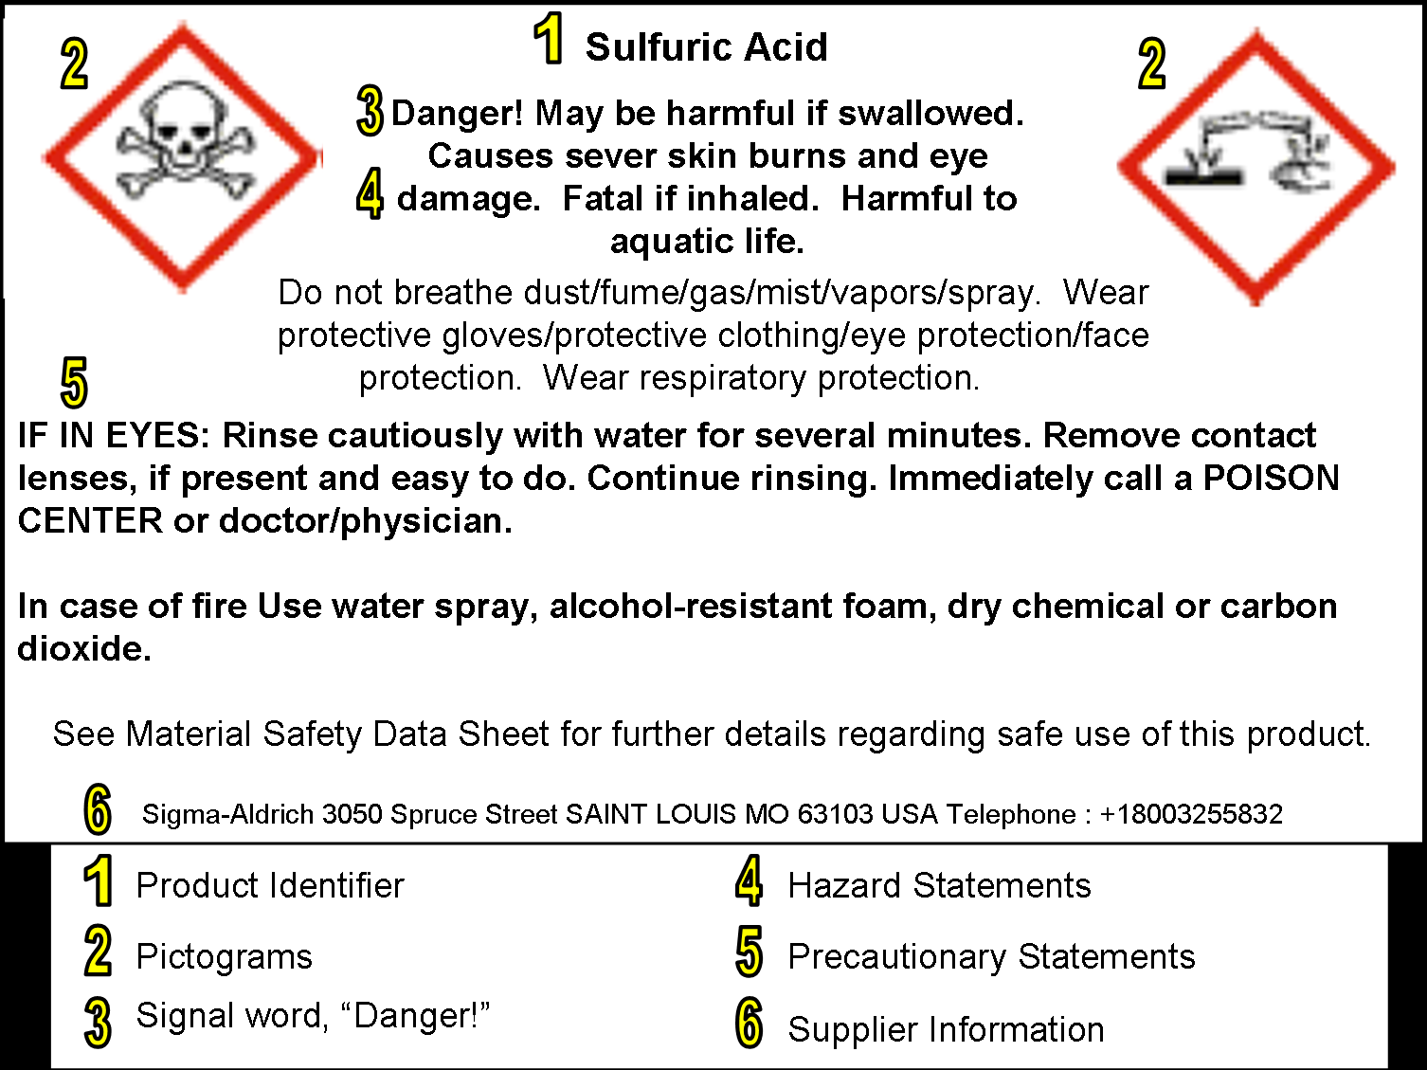


2
Hazard statement
2
Identifier
Signal Word
Precautionary statement
Pictograms
Safety is job one
Created by Alice Lenthe, Villanova University (alice.lenthe@villanova.edu) and posted on VIPEr (www.ionicviper.org) on September 16, 2016, Copyright Alice Lenthe 2016. This work is licensed under the Creative Commons Attribution Non-commercial Share Alike License. To view a copy of this license visit http://creativecommons.org/about/license/.

Slide 4
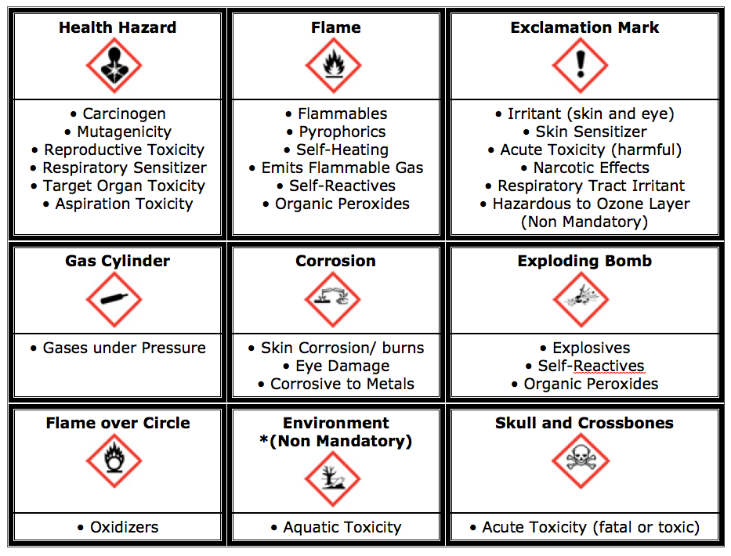
Safety is job one
Created by Alice Lenthe, Villanova University (alice.lenthe@villanova.edu) and posted on VIPEr (www.ionicviper.org) on September 16, 2016, Copyright Alice Lenthe 2016. This work is licensed under the Creative Commons Attribution Non-commercial Share Alike License. To view a copy of this license visit http://creativecommons.org/about/license/.

Slide 5
Signal Words
Danger : more severe hazard
Warning: less severe hazard
Not required for lowest hazard
Caution: currently used by EPA
Safety is job one
Created by Alice Lenthe, Villanova University (alice.lenthe@villanova.edu) and posted on VIPEr (www.ionicviper.org) on September 16, 2016, Copyright Alice Lenthe 2016. This work is licensed under the Creative Commons Attribution Non-commercial Share Alike License. To view a copy of this license visit http://creativecommons.org/about/license/.

Slide 6
Accessing SDS’s
Provide institution-specific instructions for accessing safety data sheets
Safety is job one
Created by Alice Lenthe, Villanova University (alice.lenthe@villanova.edu) and posted on VIPEr (www.ionicviper.org) on September 16, 2016, Copyright Alice Lenthe 2016. This work is licensed under the Creative Commons Attribution Non-commercial Share Alike License. To view a copy of this license visit http://creativecommons.org/about/license/.

Slide 7
Safety Data Sheets
Sections 1 – 8, General
Sections 9 – 11 and 16, Other Technical and Scientific Information
Sections 12 – 15, Globally Harmonized System (GHS)
Safety is job one
Created by Alice Lenthe, Villanova University (alice.lenthe@villanova.edu) and posted on VIPEr (www.ionicviper.org) on September 16, 2016, Copyright Alice Lenthe 2016. This work is licensed under the Creative Commons Attribution Non-commercial Share Alike License. To view a copy of this license visit http://creativecommons.org/about/license/.

Slide 8
General
Chemical identification and recommended uses
Hazards of the chemical and warning information
Ingredients
First aid
Fire fighting
Response to spills, leaks, etc.
Safe handling and storage
Exposure limits, engineering controls, PPE
Safety is job one
Created by Alice Lenthe, Villanova University (alice.lenthe@villanova.edu) and posted on VIPEr (www.ionicviper.org) on September 16, 2016, Copyright Alice Lenthe 2016. This work is licensed under the Creative Commons Attribution Non-commercial Share Alike License. To view a copy of this license visit http://creativecommons.org/about/license/.

Slide 9
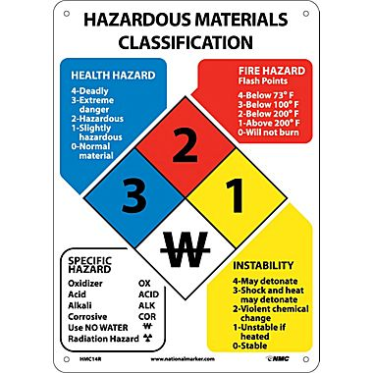
Safety is job one
Created by Alice Lenthe, Villanova University (alice.lenthe@villanova.edu) and posted on VIPEr (www.ionicviper.org) on September 16, 2016, Copyright Alice Lenthe 2016. This work is licensed under the Creative Commons Attribution Non-commercial Share Alike License. To view a copy of this license visit http://creativecommons.org/about/license/.

Slide 10
Other Technical and Scientific
Physical and chemical properties
Reactivity hazards and chemical stability
Toxicology
“Other” (last revision, etc.)
Safety is job one
Created by Alice Lenthe, Villanova University (alice.lenthe@villanova.edu) and posted on VIPEr (www.ionicviper.org) on September 16, 2016, Copyright Alice Lenthe 2016. This work is licensed under the Creative Commons Attribution Non-commercial Share Alike License. To view a copy of this license visit http://creativecommons.org/about/license/.

Slide 11
Helpful Definitions
Carcinogen – an agent that causes cancer
Mutagen – changes genetic material (DNA), causing a greater frequency of mutation
Teratogen – disturbs the development of a fetus or embryo
Pyrophoric – ignites spontaneously in air at < 55ºC (130ºF)
Safety is job one
Created by Alice Lenthe, Villanova University (alice.lenthe@villanova.edu) and posted on VIPEr (www.ionicviper.org) on September 16, 2016, Copyright Alice Lenthe 2016. This work is licensed under the Creative Commons Attribution Non-commercial Share Alike License. To view a copy of this license visit http://creativecommons.org/about/license/.

Slide 12
What is “safe”?
TLV TLV-TWA TLV-STEL TLC-C | Threshold Limit Value Time Weighted Average Short Term Exposure Limit Ceiling Limit | ACGIH | Level of exposure without health effects Average exposure based on 8 hours/day, 40 hours/week 15 minutes no more than 4 times/day with 60 minutes between Never exceeded
PEL | Permissable Exposure Limit | OSHA | Usually a time weighted average, most adapted from ACGIH and enforced by OSHA
REL | Recommended Exposure Limit | NIOSH | Recommended by NIOSH to OSHA as a PEL – not enforceable
TEEL TEEL-0 TEEL-1 TEEL-2 TEEL-3 | Temporary Emergency Exposure Limit | DOE | Emergency exposures, generally 1 hour No appreciable risk of health effects Mild transient health effects Irreversible or other serious health effects Life threatening health effects
TCLo | Toxic Concentration Low | N/A | Lowest published concentration documented to cause a toxic effect
LC50 | Lethal Concentration 50% | FDA | Concentration (in air or water) that kills 50% of test animals within 4 hours
LD50 | Lethal Dose 50% | FDA | Amount, per body weight, given all at once, kills 50% of test animals
Safety is job one
Created by Alice Lenthe, Villanova University (alice.lenthe@villanova.edu) and posted on VIPEr (www.ionicviper.org) on September 16, 2016, Copyright Alice Lenthe 2016. This work is licensed under the Creative Commons Attribution Non-commercial Share Alike License. To view a copy of this license visit http://creativecommons.org/about/license/.
Notes:
The TLV for chemical substances is defined as a concentration in air, typically for inhalation or skin exposure. Its units are in parts per million (ppm) for gases and in milligrams per cubic meter (mg/m³) for particulates such as dust, smoke and mist. There are TLVs for physical agents as well as chemical substances. TLVs for physical agents include those for noise exposure, vibration, ionizing and non-ionizing radiation exposure and heat and cold stress.
American Conference of Governmental Industrial Hygienists
National Institute of Occupational Safety and Health
Oral LD50 for nicotine in rats: 50 mg/kg

Slide 13
GHS Information (not mandatory)
Impact to the environment
Proper disposal, recycling of the chemical and the container
Information required for compliant shipping/transportation
Applicable regulatory information
Safety is job one
Created by Alice Lenthe, Villanova University (alice.lenthe@villanova.edu) and posted on VIPEr (www.ionicviper.org) on September 16, 2016, Copyright Alice Lenthe 2016. This work is licensed under the Creative Commons Attribution Non-commercial Share Alike License. To view a copy of this license visit http://creativecommons.org/about/license/.

Slide 14
Personal Protective Equipment (PPE)
Long pants
Closed toe shoes
Gloves
Safety glasses or goggles
Lab coat
Apron
Safety is job one
Created by Alice Lenthe, Villanova University (alice.lenthe@villanova.edu) and posted on VIPEr (www.ionicviper.org) on September 16, 2016, Copyright Alice Lenthe 2016. This work is licensed under the Creative Commons Attribution Non-commercial Share Alike License. To view a copy of this license visit http://creativecommons.org/about/license/.

Slide 15
Environmental Considerations
Impact to organisms
Long term fate
  Persistence
  Degradability
  Bioaccumulative potential
  Mobility in soil
Safety is job one
Created by Alice Lenthe, Villanova University (alice.lenthe@villanova.edu) and posted on VIPEr (www.ionicviper.org) on September 16, 2016, Copyright Alice Lenthe 2016. This work is licensed under the Creative Commons Attribution Non-commercial Share Alike License. To view a copy of this license visit http://creativecommons.org/about/license/.

Slide 16
Managing Chemical Waste
At xxx University
  Reduce
  Reuse
  Recycle
  THEN dispose
Safety is job one
Created by Alice Lenthe, Villanova University (alice.lenthe@villanova.edu) and posted on VIPEr (www.ionicviper.org) on September 16, 2016, Copyright Alice Lenthe 2016. This work is licensed under the Creative Commons Attribution Non-commercial Share Alike License. To view a copy of this license visit http://creativecommons.org/about/license/.

Slide 17
At xxx University
Reduce – specifics on reduction measures
Reuse – specifics on reuse measures
Recycle – specifics on recycling measures
Dispose – specifics on disposal of trash, chemicals, and other waste materials
Safety is job one
Created by Alice Lenthe, Villanova University (alice.lenthe@villanova.edu) and posted on VIPEr (www.ionicviper.org) on September 16, 2016, Copyright Alice Lenthe 2016. This work is licensed under the Creative Commons Attribution Non-commercial Share Alike License. To view a copy of this license visit http://creativecommons.org/about/license/.

