Slide 1
Developing a rubric for a learning object
Joanne Stewart
Hope College
Organometallica 2016
Created by Joanne L. Stewart, Hope College (stewart@hope.edu) and posted on VIPEr (www.ionicviper.org) on July 8, 2016. Copyright 2016. This work is licensed under the Creative Commons Attribution-NonCommerical-ShareAlike 4.0 International License. To view a copy of this license visit http://creativecommons.org/about/license/.

Slide 2
5 reasons to use a rubric
Insert “5 reasons to use a rubric” from Katie Palacios on YouTube
https://www.youtube.com/watch?v=0zrLUM5CWWE

Slide 3
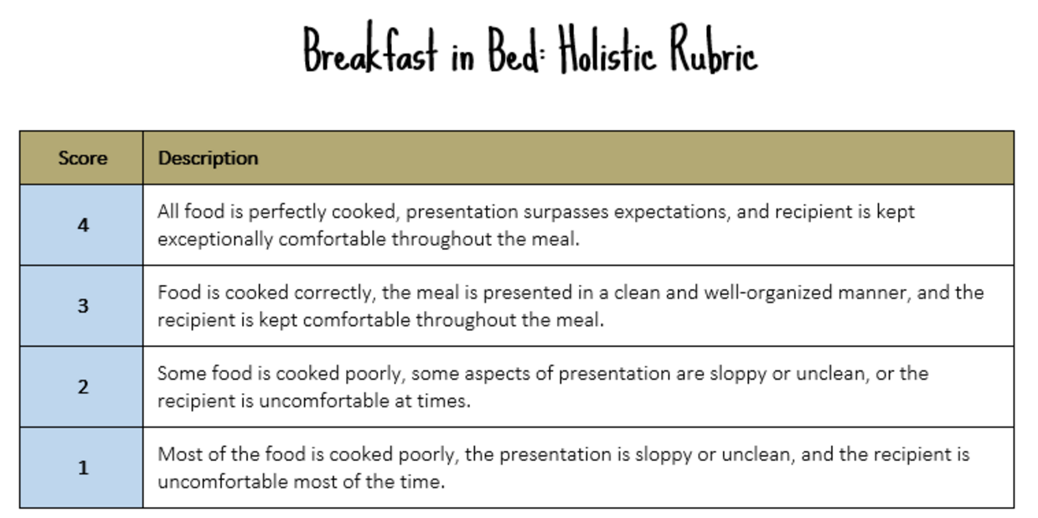
Types of rubrics
Holistic
Analytic
Single-point
“Know Your Terms: Holistic, Analytic, and Single-Point Rubrics” Posted on May 1, 2014 by Jennifer Gonzalez, http://www.cultofpedagogy.com/holistic-analytic-single-point-rubrics/

Slide 4
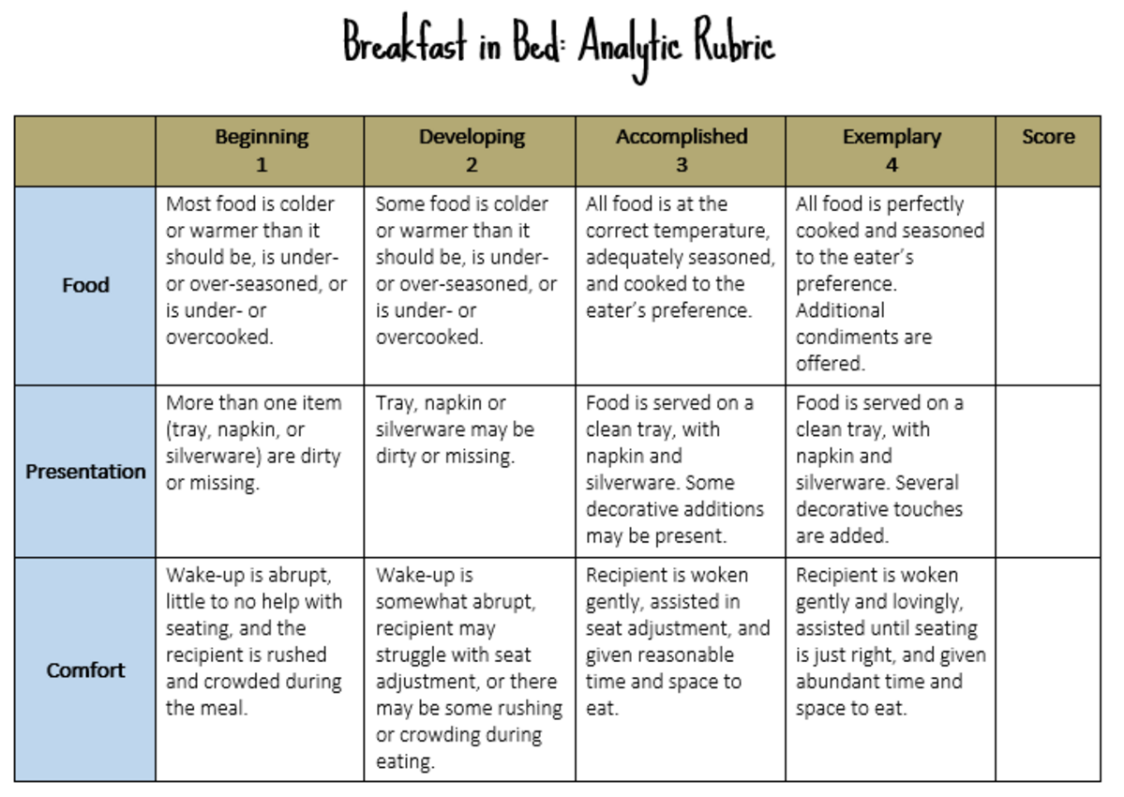
Types of rubrics
“Know Your Terms: Holistic, Analytic, and Single-Point Rubrics” Posted on May 1, 2014 by Jennifer Gonzalez, http://www.cultofpedagogy.com/holistic-analytic-single-point-rubrics/

Slide 5
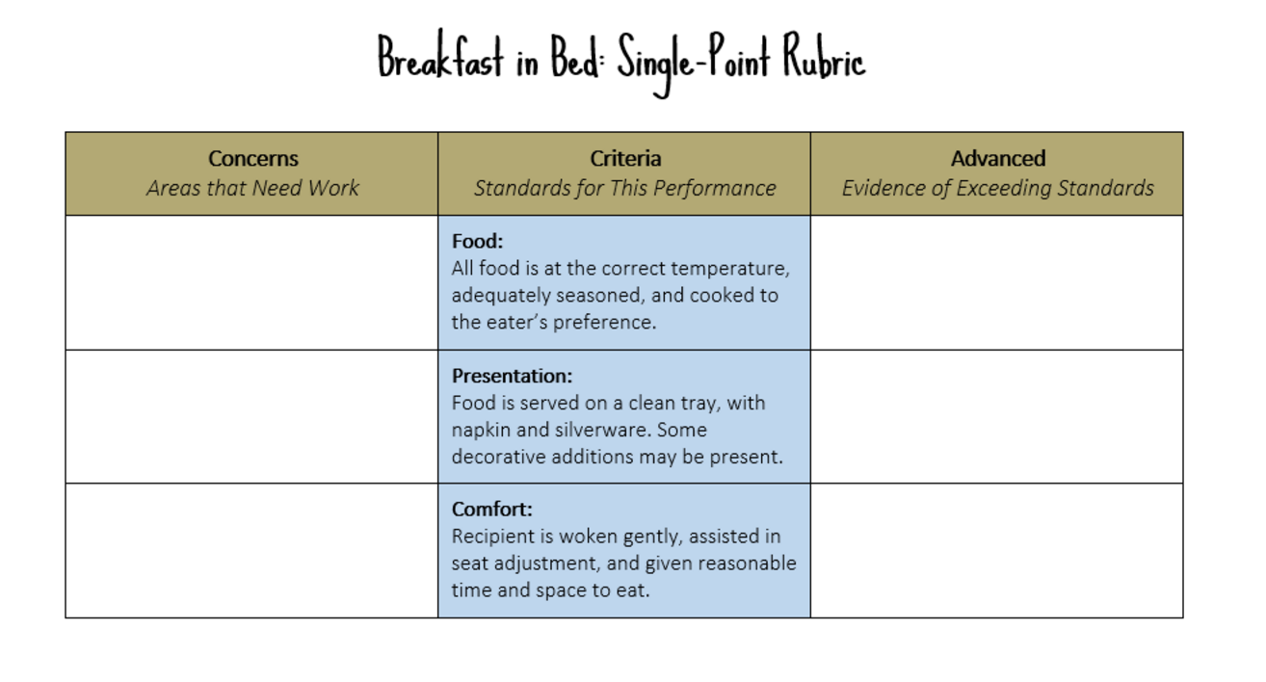
Types of rubrics
“Know Your Terms: Holistic, Analytic, and Single-Point Rubrics” Posted on May 1, 2014 by Jennifer Gonzalez, http://www.cultofpedagogy.com/holistic-analytic-single-point-rubrics/

Slide 6
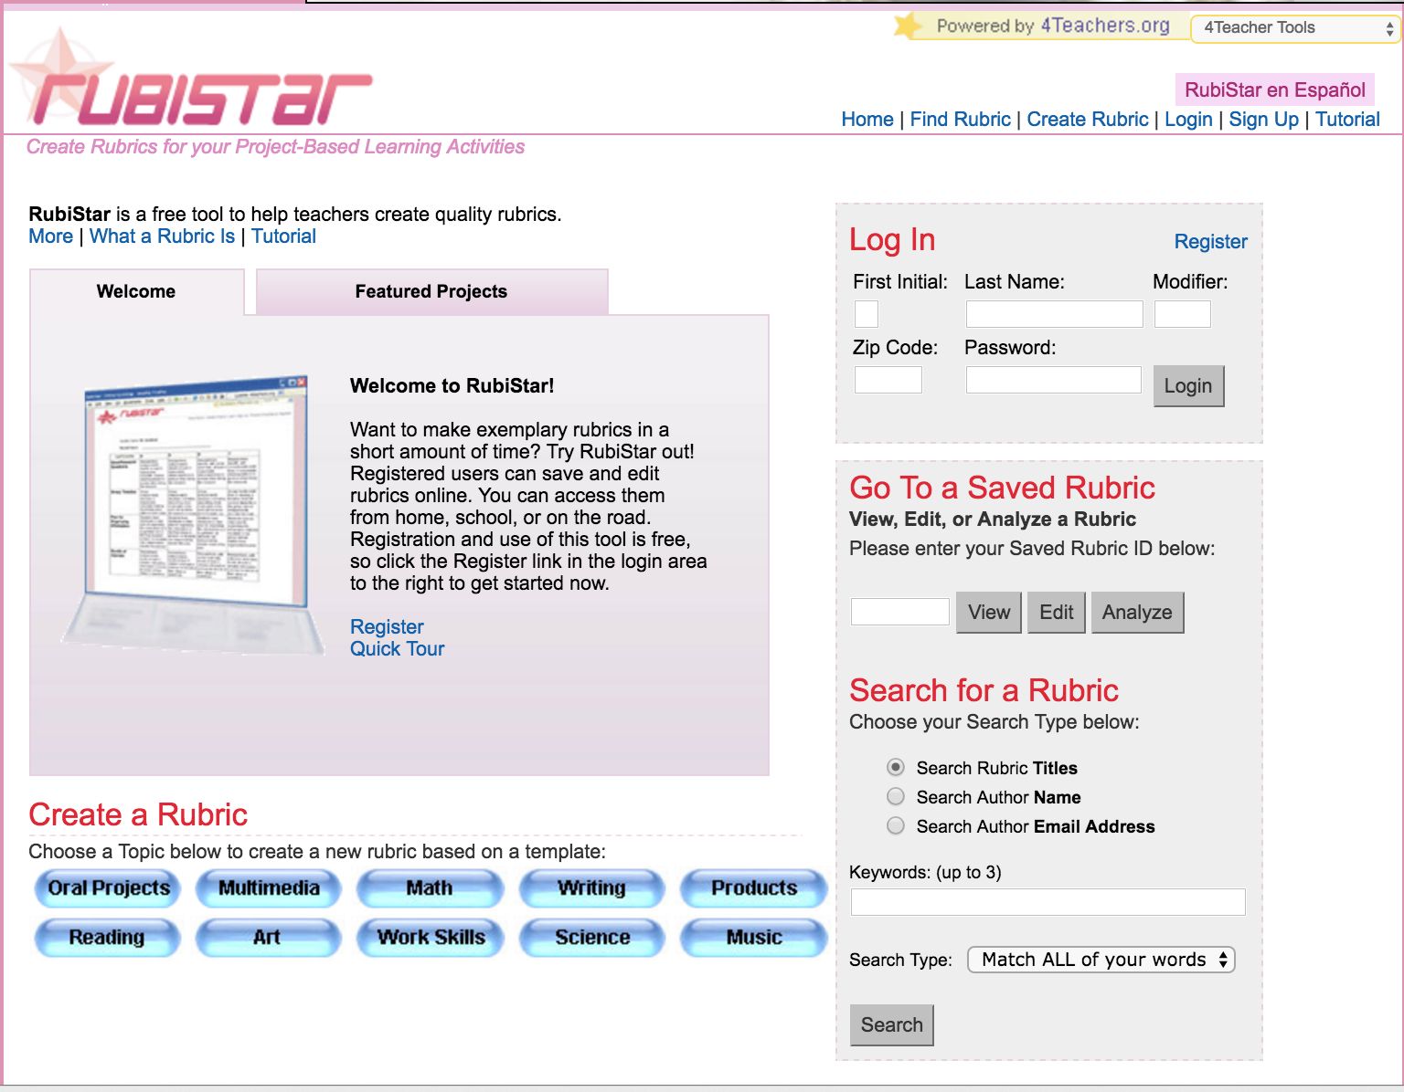
Lots of examples
URL:
rubistar.4teachers.
org
A rubric “articulates the expectations for an assignment by listing the criteria, or what counts, and describing levels of quality from excellent to poor.”

Slide 7
Developing a rubric for a literature discussion
1. Two reactions are shown on the first page of the paper. They are labeled (1) and (2) and referred to as eq 1 and eq 2 in the text. Determine the classification, valence number, ligand bond number, electron number and d^{n} count for the Ir containing reactants and products in these reactions.
Excellent (3) | Acceptable (2) | Needs work (1)
17-18 correct answers | 12-17 correct answers | Less than 12/18 correct answers
Notes:
Developing a rubric for quantitative problems is easy!

Slide 8
Developing a rubric for a literature discussion
7. There is a substantial amount of experimental and spectroscopic detail presented in this paper (Experimental Section). What are the infrared CO stretching frequencies, ν_{CO}, for compounds 9 and 16? From this data determine which ligand, Cp or Cp*, is more electron donating. Describe how you reached this conclusion.
Excellent (3) | Acceptable (2) | Needs work (1)
Identified CO stretches correctly, identified correct ligand, gave thorough explanation that 1) gave chemical reason for their choice being more electron donating, 2) explained how electron donation reduces CO stretching frequency | Identified CO stretches correctly, identified correct ligand, explanation connected CO stretch to electron donating property of ligand but either did not give chemical reason for choice or did not explain mechanism for change in frequency | Identified CO stretches correctly but did identify correct ligand nor provide correct explanation.
Notes:
Developing a rubric for conceptual problems can be challenging. Sometimes it can be helpful to “test” a question with students in order to see the range of answers you get. That way you can add scaffolding or clarifying language if many students seem to miss the point of the question. Developing a rubric is certainly an iterative process. You learn ways to improve it every time you use it.

Slide 9
Now you try!
Each group should develop a rubric for two of the remaining questions and enter it into the “Rubric for Chip’s literature discussion” sheet in the 2016 VIPEr workshop participants folder in Google Drive.
Excellent (3) | Acceptable (2) | Needs work (1)
Notes:
The best lesson we learned from doing this activity is that writing a rubric and writing an answer key are two different things. Some participants wrote their rubric and then realized that they wouldn’t be able to share it with students because it contained the answer. They went back and changed the language so that it described the EXPECTATIONS for a good answer instead of the answer itself.

Slide 10
Final Thoughts
Excellent (3) | Acceptable (2) | Needs work (1)
The reasons for using a rubric were described, examples of different rubrics were provided, the concept was applied to what we are learning at the workshop, we got to practice. | The reasons for using a rubric were described, but the examples didn’t relate well to my needs, the hands-on part was good but we didn’t have enough time. | The presenter seemed to have no idea what she was talking about, the examples had nothing to do with chemistry, and the hands-on part was a total waste of time.

