Slide 1
Six Slides about Polypropylene Stereochemistry and Identification by
¹³C NMR Spectroscopy
Shirley Lin
Department of Chemistry
United States Naval Academy
Created by Shirley Lin, United States Naval Academy. Posted on www.ionicviper.org on July 17, 2012.
Copyright Shirley Lin 2012. This work is licensed under the Creative Commons Attribution Non-commercial Share Alike License. To view a copy of this license visit http://creativecommons.org/licenses/by-nc-sa/3.0/

Slide 2
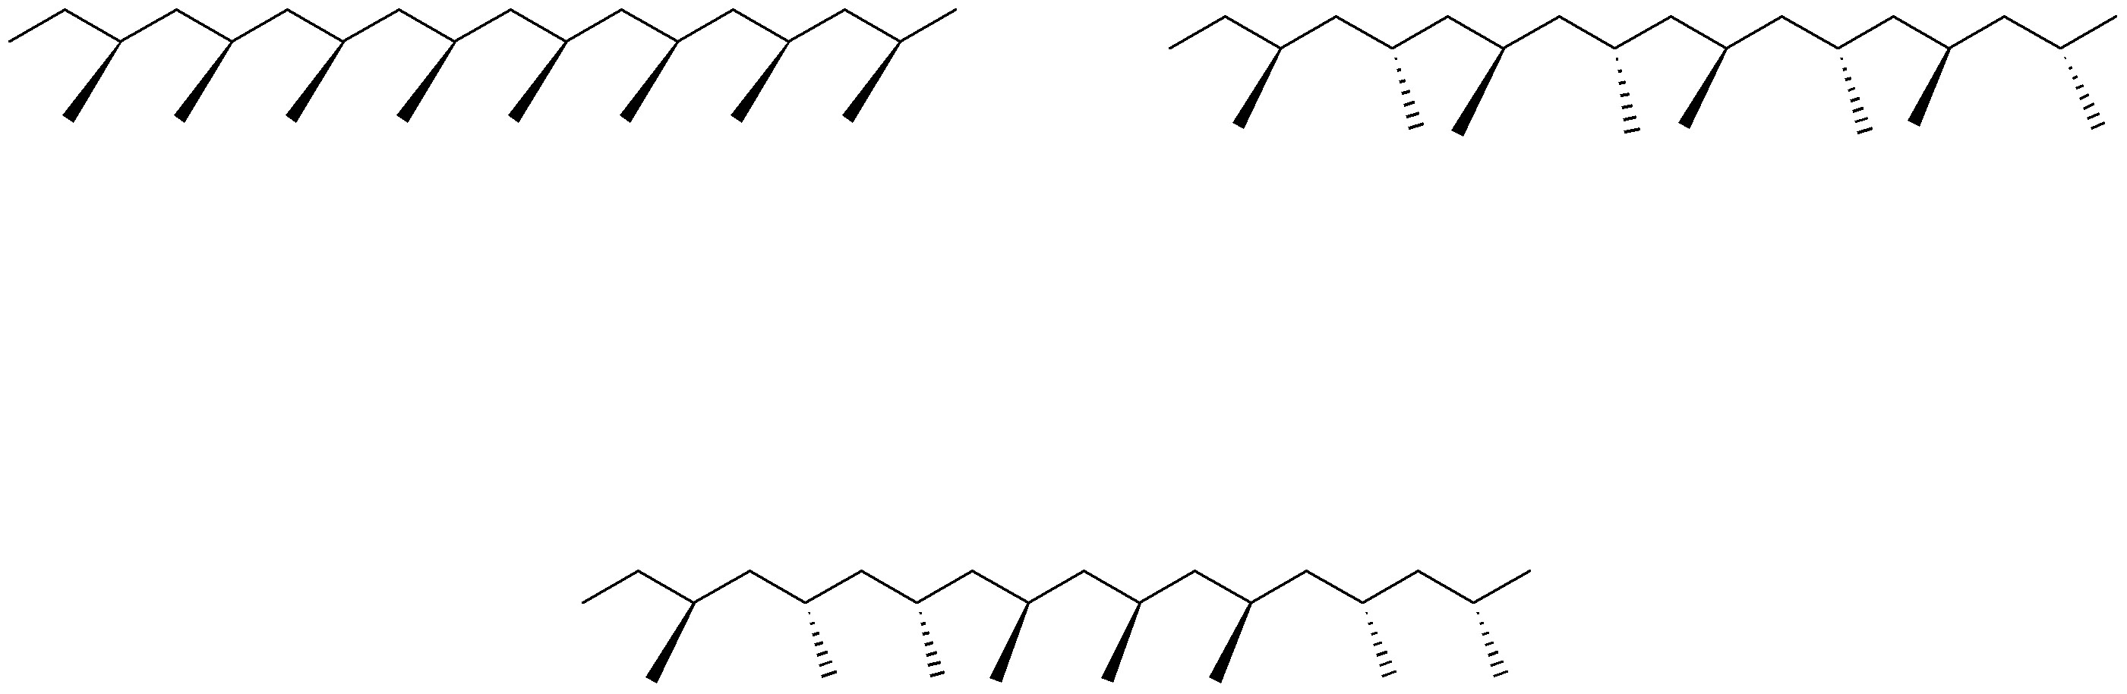
Stereochemistry of Polypropylene
isotactic – pendant methyl groups are on the same side of the polymer backbone
syndiotactic – pendant methyl groups alternate sides of the polymer backbone
atactic – pendant methyl groups are randomly arranged along polymer backbone

Slide 3
Stereochemistry Determines Properties
Relative stereochemistry of methyl groups in polypropylene
determines polymer properties
isotactic - crystalline
syndiotactic - crystalline
atactic - amorphous
Stereoregular arrangements of methyl groups produce crystalline polymer
Stereorandom arrangements of methyl group produce amorphous polymer

Slide 4
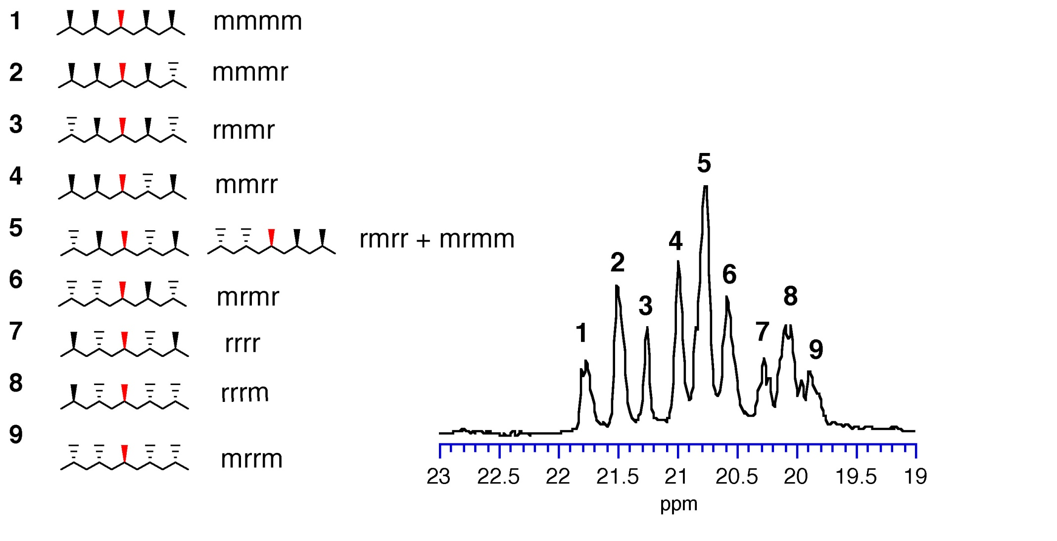
¹³C NMR Reveals Polymer Stereochemistry
On a high field NMR instrument, the chemical shift of the methyl groups on the polymer backbone is sensitive to the relative stereochemistry of its four nearest neighbors (two on each side).
m = meso (syn) r = racemo (anti)

Slide 5
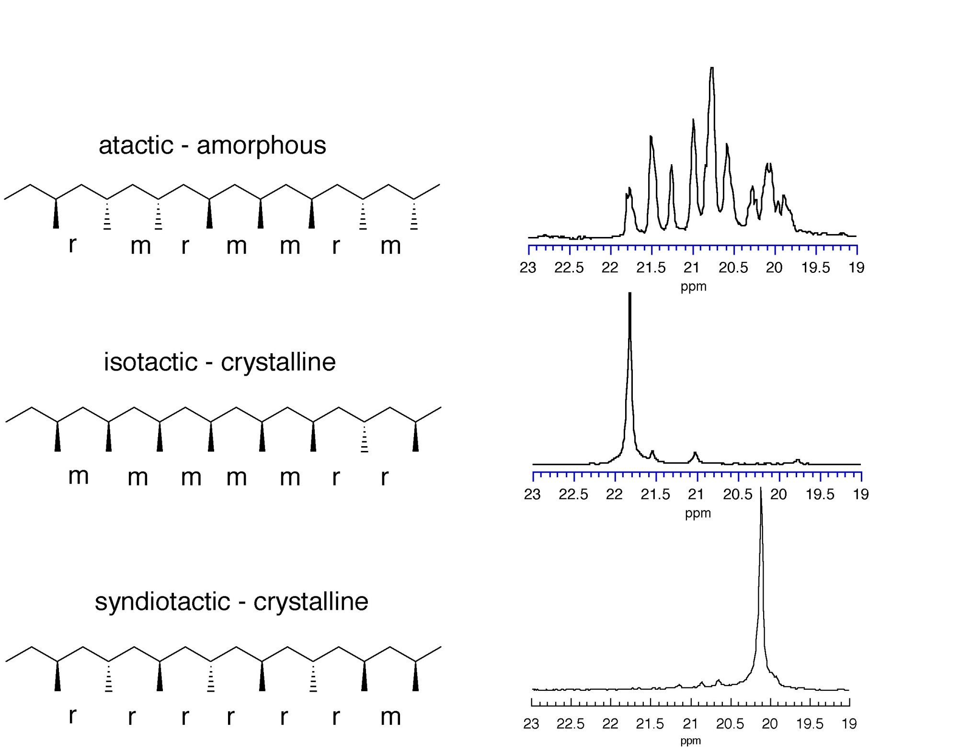
¹³C NMR Spectra of Various Polypropylenes

Slide 6
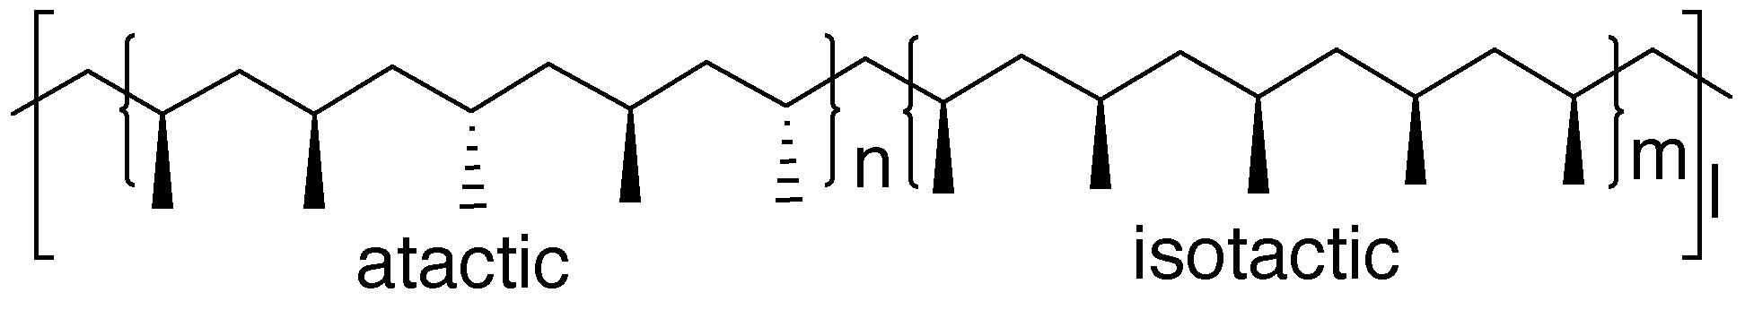
Elastomeric Polypropylene
• soft amorphous segments give flexibility
• crystalline segments provides crosslinking
Stereoblock structure can account for elastomeric properties;
isotactic segments can co-crystallize, atactic segments are amorphous
Challenge: What would the ¹³C NMR spectrum of the methyl region
of this polymer would look like?

Slide 7
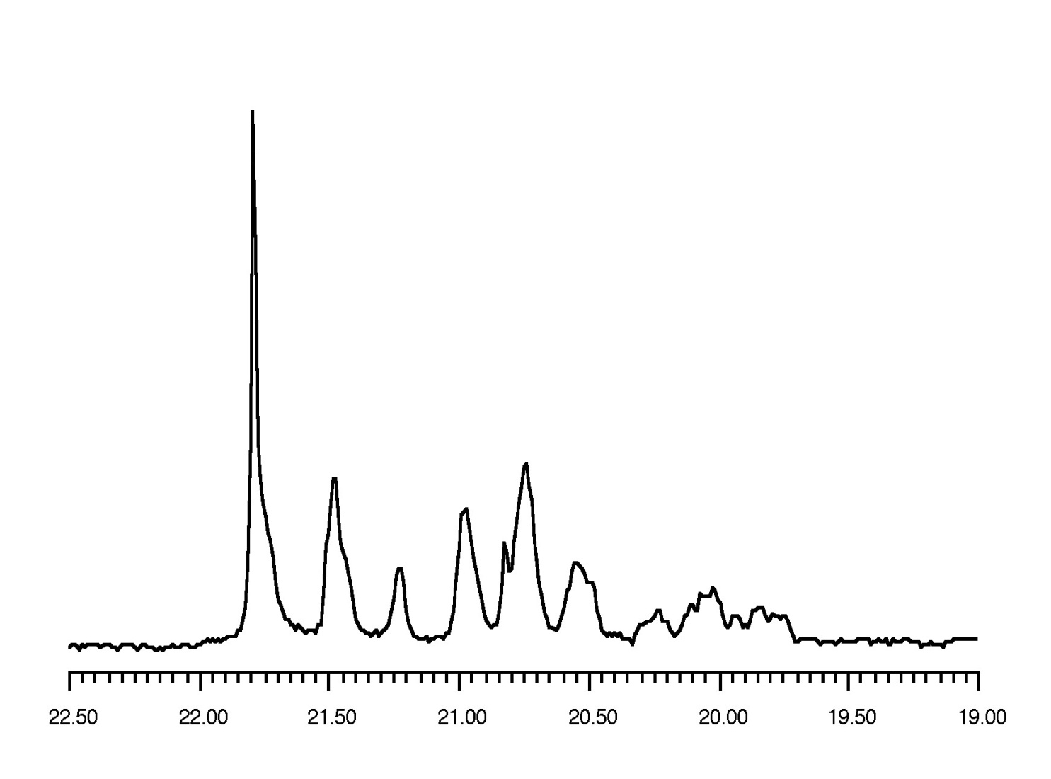
¹³C NMR of Isotactic-Atactic Stereoblock Polypropylene
All 10 pentads are observed but the [mmmm] pentad resonance is noticeably increased from what is observed for atactic PP (~ 5%)

