Slide 1
Fischer-Schrock Personality Type
Created by Adam R. Johnson, Harvey Mudd College (adam_johnson@hmc.edu) and posted on VIPEr on June 29, 2016. Copyright Adam R. Johnson, 2016. This work is licensed under the Creative Commons Attribution-NonCommercial-ShareAlike License. To view a copy of this license visit
http://creativecommons.org/licenses/by-nc-sa/4.0/
Notes:
Fisher and Schrock represent the worst‡ about the field of organometallics.
Fisher studied zero valent mid-late metal complexes in low (or zero) oxidation states with L type ligands such as [Cr(CO)6] and their reactions with nucleophiles was found to give Fisher carbenes (L-like in character). The heteroatom is important for synthesis and stabilization of the carbene.
Schrock, meanwhile, studied early metal complexes in high oxidation states with X type ligands such as Ta(Np)5 or Cp2TiMe2. Intramolecular deprotonation led to formation of Schrock Carbenes (X-like in character).
‡by worst, of course I mean best. The breadth of the field, the differences in early/late, anionic/neutral, etc, really is what makes organometallic chemistry interesting (and challenging!)

Slide 2
Fischer-Schrock Personality Type
Metal is Early/Late E/L
organoMetallic/Organometallic M/O
Metal Third row/Fourth(Fifth) row T/F
Ligands are X/L X/L
Other considerations:
You count electrons by Ionic, Covalent, or CBC method?
You do/do not function mostly by NMR
You are/are not mechanistic
Catalysis vs. stoichiometric reactions
“Glorified Main Group vs. partly-filled d-orbitals”
Must have M-C bond vs. Organometallics is a way of life
Notes:
This activity helps to emphasize the differences found in papers in the field of organometallics.
Identify Early or Late, Organo- or –Metallic, Third- vs. Fourth/Fifth row, and X or L as the primary ligand in the complexes. This is NOT a hard and fast rule, but helps you see the area of the field in which the PI is working. It is not a non-useful classification…
In addition to the four classifications we are using here, there are other considerations that differentiate organometallic chemists
How do we identify Early or late?

Slide 3
The d-block
Blue: Early
Red: Late
White:
Notes:
What about the middle?

Slide 4
The d-block
Blue: Early
Red: Late
White: ‘on time’
grey: “not a d-block element”
yellow: radioactive!
Notes:
"On-time" was described, to me, by Nancy Williams, who learned it from Karen Goldberg, who learned it from Bob Bergman…. The behavior of metals across the periodic table are quite different; based primarily whether or not the metal has d electons. Early metals are often found in high (or highest possible) OS with X/pi donor ligands, while late metals are often found in low (or even negative) OS with L/pi acceptor ligands. And on-time metals are anybody's guess.

Slide 5
Fischer-Schrock Personality Type
Metal is Early/Late E/L
organoMetallic/Organometallic M/O
Metal Third row/Fourth(Fifth) row T/F
Ligands are X/L X/L
Other considerations:
You count electrons by Ionic, Covalent, or CBC method?
You do/do not function mostly by NMR
You are/are not mechanistic
Catalysis vs. stoichiometric reactions
“Glorified Main Group vs. partly-filled d-orbitals”
Must have M-C bond vs. Organometallics is a way of life
Notes:
Of course, any complex could have a mixture of X or L ligands on it, so look to the most important ligands for the paper.
As for Organo- or –Metallic, the more organic papers tend to have large substrate/ reactivity tables and the PI cares more about making the organic groups, while the more metallic papers tend to have mechanistic/X-Ray crystallographic data and the PI cares more about the metal containing parts.
This division was really clarified for me, personally, when I took organometallics at MIT simultaneously from Schrock (M) and Buchwald (O). They described the same reaction at the same point in the semester, like this:
LnM(very complex organic fragment and arrow pushing reaction)
Vs.
(Very detailed ligand metal framework)R
Let's try some examples:

Slide 6
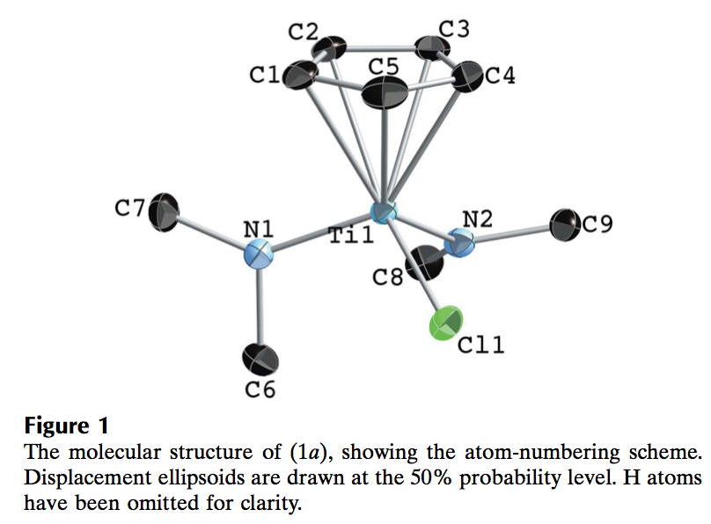
Early-Late E/L
Organometallic/organoMetallic O/M
Third row/Fourth(Fifth) row T/F
X ligands/L ligands X/L
Example:
A Cp ring
(η⁵-C₅H₅) = XL₂
NMe₂ (X or XL)
Chloride (X or XL)
EMTX
Notes:
This is Ti, very much an Early metal, and third row too
Since the X-Ray structure is shown in the abstract, you can almost safely assume organoMetallic
All ligands are anionic (though Cp is XL2) and Ti is in highest possible OS
This is EMTX

Slide 7
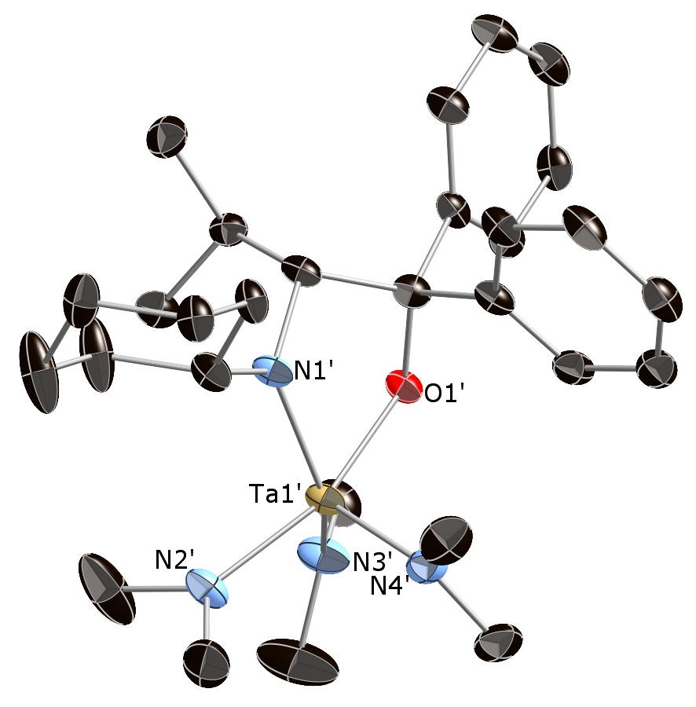
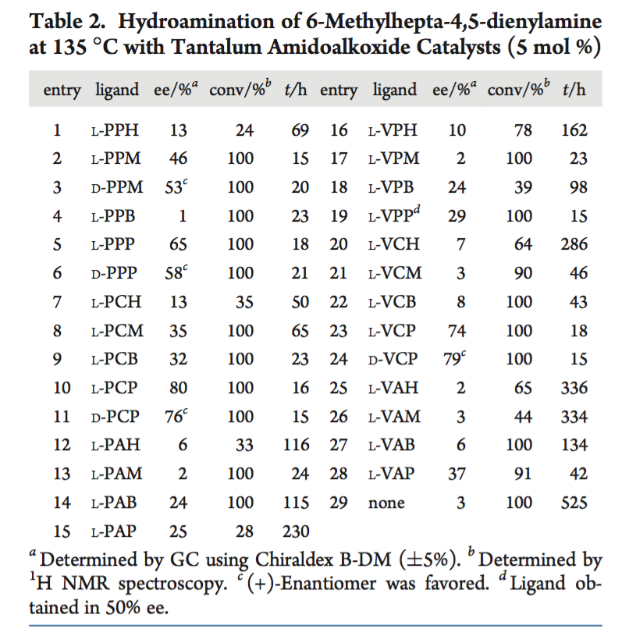
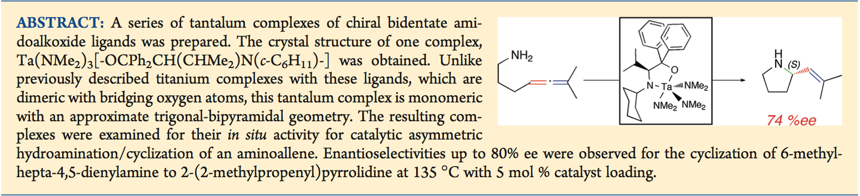
Mystery Guest
Early-Late E/L
Organometallic/organoMetallic O/M
Third row/Fourth(Fifth) row T/F
X ligands/L ligands X/L
EMFX
EOFX
Notes:
What about this paper?
Well, it's Tantalum, which is Early, and Fifth row
Ligands are definitely X (PI donors)
Is it Organo- or Metallic?
Hard to tell from the abstract. Is it more mechanistic or more substrate screen?
Ah, good old table 2 clarifies is. Clearly an organic substrate table of some sort….
EOFX
Wait… The figure… An X-Ray structure!
EMFX?
We'd have to ask the author to know for sure… (and it is in fact EMFX)

Slide 8
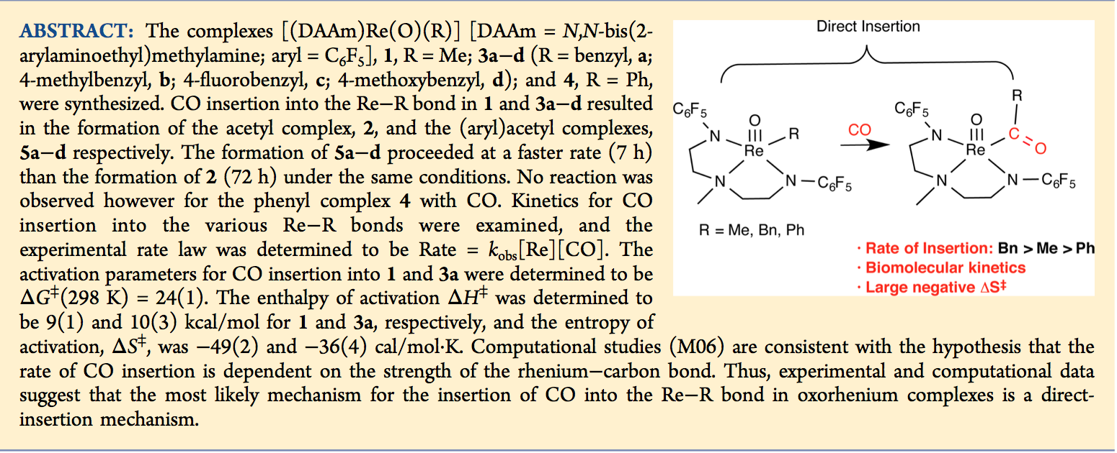
Ison
Early-Late E/L
Organometallic/organoMetallic O/M
Third row/Fourth(Fifth) row T/F
X ligands/L ligands X/L
Notes:
Ok, your turn. What do you think these following 4 papers are?

Slide 9
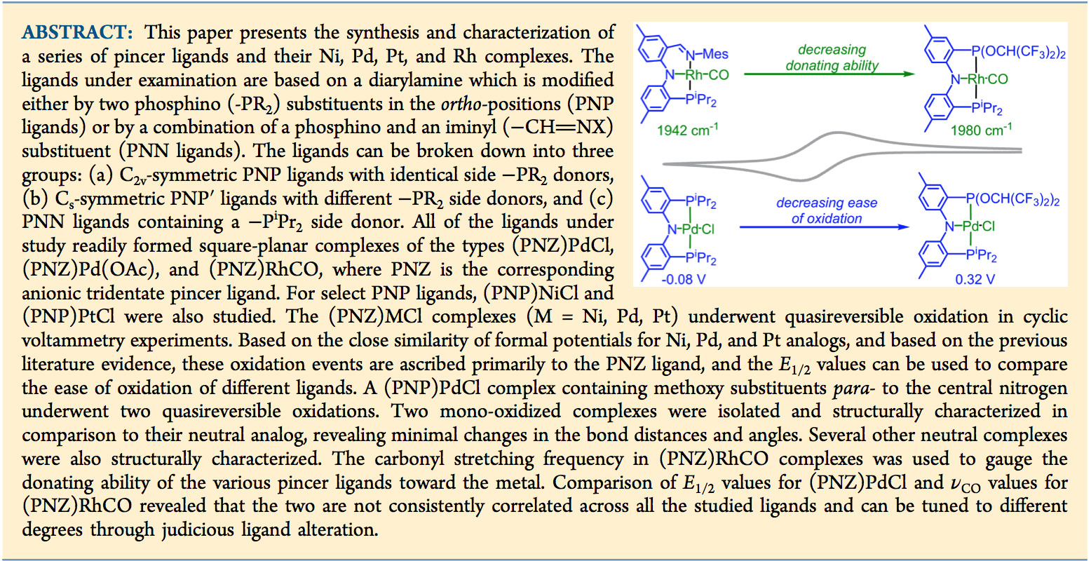
Ozerov
Early-Late E/L
Organometallic/organoMetallic O/M
Third row/Fourth(Fifth) row T/F
X ligands/L ligands X/L

Slide 10
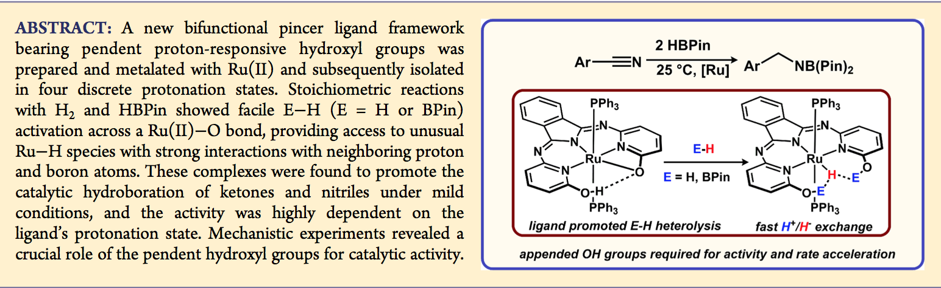
Szymczak
Early-Late E/L
Organometallic/organoMetallic O/M
Third row/Fourth(Fifth) row T/F
X ligands/L ligands X/L

Slide 11
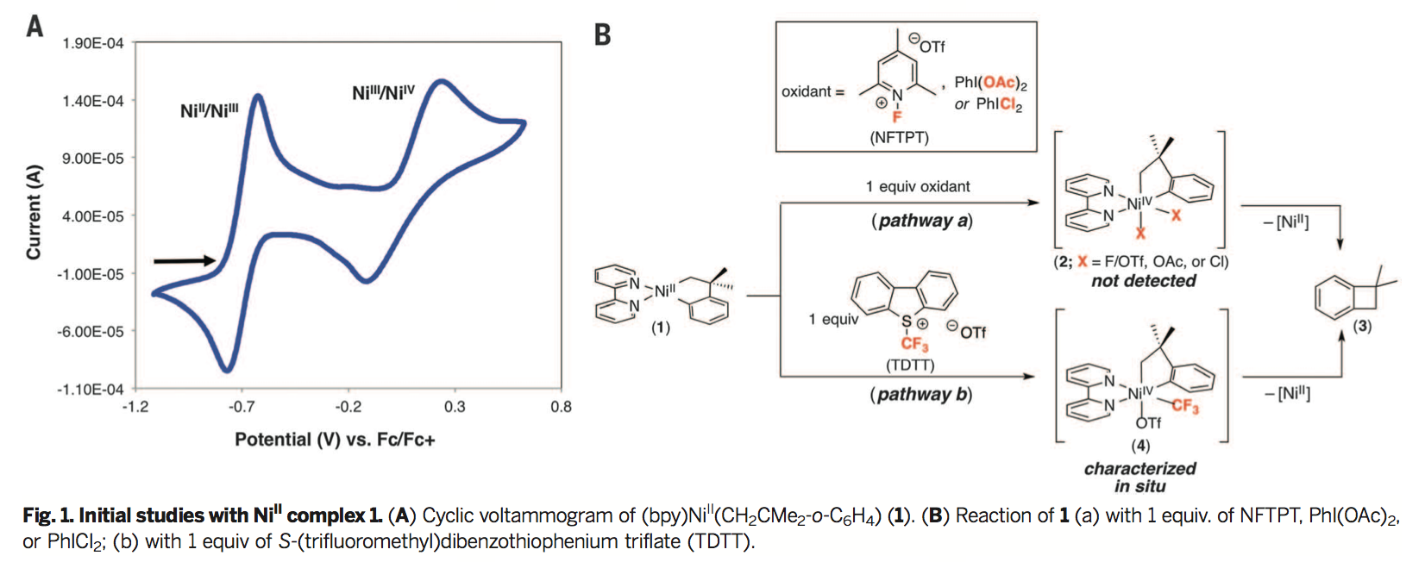
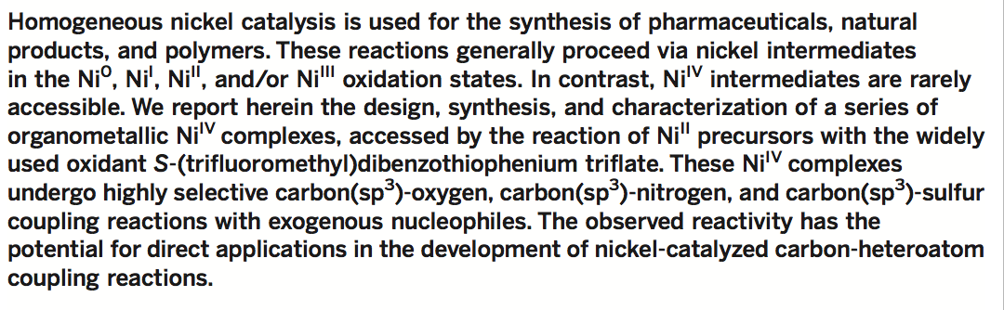
Sanford
Early-Late E/L
Organometallic/organoMetallic O/M
Third row/Fourth(Fifth) row T/F
X ligands/L ligands X/L

