Slide 1
Five Slides About:
Pulsed Gradient Spin Echo DOSY
Created by Jacob C. Lutter, Wayne State University (jclutter@umich.edu) and posted on VIPEr (www.ionicviper.org) on 09/23/2021. Copyright 2021. This work is licensed under the Creative Commons Attribution Non-commercial Share Alike License. To view a copy of this license visit https://creativecommons.org/licenses/by-nc-sa/4.0/.

Slide 2
Hydrodynamic (Stokes) Radius
Spherical approximation of size in solution (proteins, polymers, particles, molecules)
Measured using size exclusion
-or-
Diffusion of the particle or molecule
r_{H}
Notes:
The hydrodynamic (Stokes) radius is a spherical approximation of the size of a protein, polymer, or even molecule in solution.

Slide 3
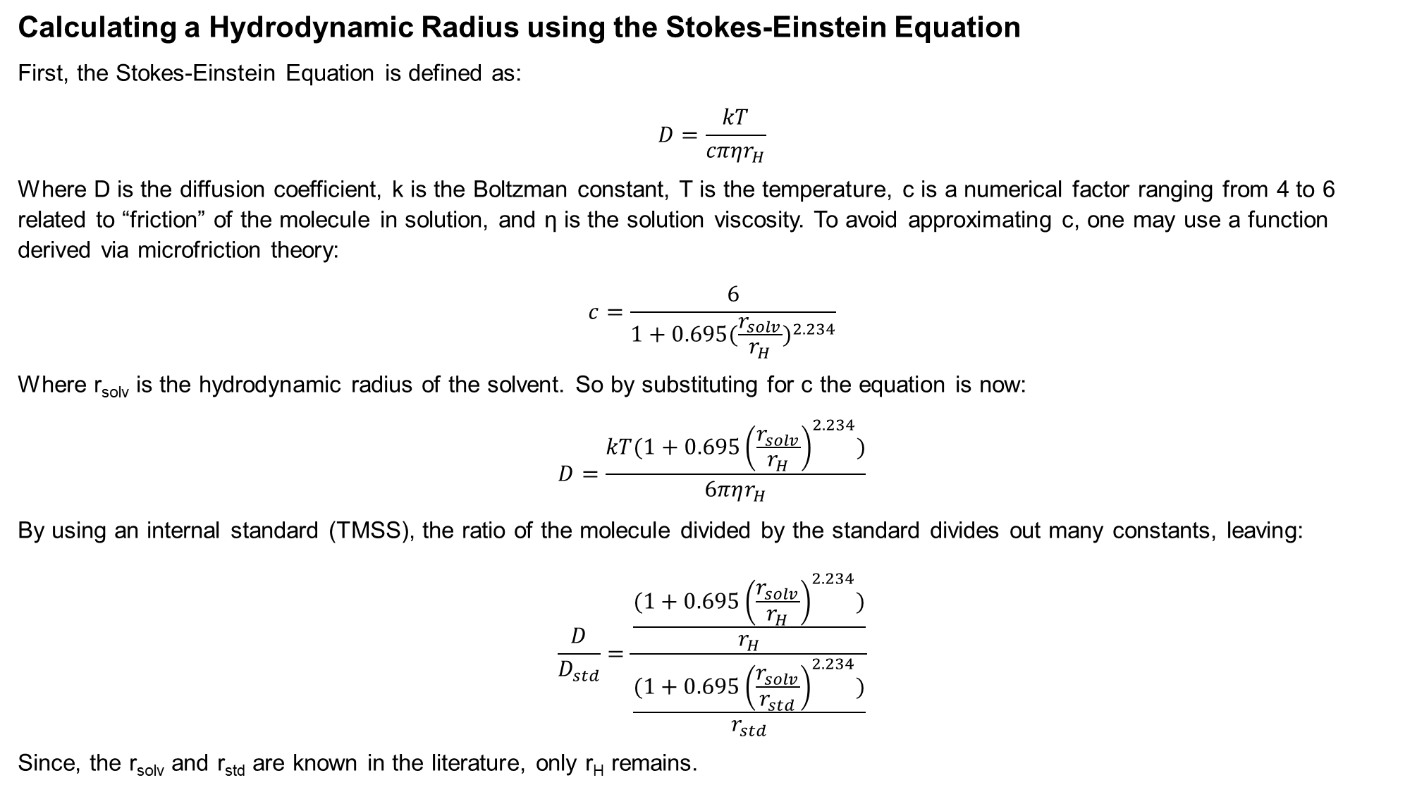
Calculating a Hydrodynamic Radius using the Stokes-Einstein Equation
First, the Stokes-Einstein Equation is defined as:
$$D=\frac{kT}{cπηr_{H}}$$
Where D is the diffusion coefficient, k is the Boltzman constant, T is the temperature, c is a numerical factor ranging from 4 to 6 related to “friction” of the molecule in solution, and η is the solution viscosity. To avoid approximating c, one may use a function derived via microfriction theory:
$$c=\frac{6}{1+0.695{(\frac{r_{solv}}{r_{H}})}^{2.234}}$$
Where r_{solv} is the hydrodynamic radius of the solvent. So by substituting for c the equation is now:
$$D=\frac{kT(1+0.695{\left(\frac{r_{solv}}{r_{H}}\right)}^{2.234})}{6πηr_{H}}$$
By using an internal standard (TMSS), the ratio of the molecule divided by the standard divides out many constants, leaving:
$$\frac{D}{D_{std}}=\frac{\frac{(1+0.695{\left(\frac{r_{solv}}{r_{H}}\right)}^{2.234})}{r_{H}}}{\frac{(1+0.695{\left(\frac{r_{solv}}{r_{std}}\right)}^{2.234})}{r_{std}}}$$
Since, the r_{solv} and r_{std} are known in the literature, only r_{H} remains.
Zuccaccia, D.; Macchioni, A. Organometallics 2005, 24 (14), 3476–3486.
Notes:
This walkthrough is from Appendix D of my doctoral thesis, the Organometallics reference gives the equations. Diffusion coefficients can be determined using PGSE-DOSY.

Slide 4
Side view of NMR Tube
PGSE Theory
TMSS
Insert Figure 1 from https://doi.org/10.1016/j.jinorgbio.2018.12.011
Top down view of NMR Tube
Notes:
Net magnetic moments for protons of a standard (tetrakis(trimethylsilyl)silane, TMSS, black arrows) and a species of interest (https://doi.org/10.1016/j.jinorgbio.2018.12.011, red arrows) align with the z-axis in the magnetic field.
90 degree pulse is applied
A magnetic gradient is applied and dephases the spin across the z-axis

Slide 5
Side view of NMR Tube
PGSE Theory
Insert Figure 1 from https://doi.org/10.1016/j.jinorgbio.2018.12.011
Top down view of NMR Tube
Notes:
A delay time allows the molecules to diffuse along the z-axis

Slide 6
Side view of NMR Tube
PGSE Theory
Insert Figure 1 from https://doi.org/10.1016/j.jinorgbio.2018.12.011
Top down view of NMR Tube
Notes:
4. A 180 degree pulse is applied
5. The magnetic gradient is reapplied

Slide 7
Side view of NMR Tube
PGSE Theory
Insert Figure 1 from https://doi.org/10.1016/j.jinorgbio.2018.12.011
Top down view of NMR Tube
Notes:
The gradient will “fix” the dephasing to an extent related to the diffusion rate of the molecule. Slower diffusion results in better rephasing and less signal attenuation. The experiment is repeated with stronger and stronger magnetic gradient strengths.

Slide 8
PGSE of an example in MeOH
Notes:
PGSE spectra of the TMSS and example compound (https://doi.org/10.1016/j.jinorgbio.2018.12.011). The TMSS is close to zero ppm, the rest of the peaks are from the compound.

Slide 9
PGSE may be fitted to an exponential decay to find the diffusion rate.
Insert Figure 1 from https://doi.org/10.1016/j.jinorgbio.2018.12.011
Notes:
Exponential decay curves can be fitted to PGSE data as a function of peak integral vs gradient strength. The standard TMSS is in black. Two protons from the compound located on the aromatic carbon between the carboxylates of isophthalate (iph) and the ethynyl proton of 4-ethynylsalicylhydroximate (eshi) show similar and less steep decay curves compared to TMSS in red and green. Thus, the compound is diffusing slower than TMSS. This data can be useful for determining hydrodynamic radii for compounds.

