Slide 1
Five Slides About: UV-Vis Spectroscopy and Tanabe-Sugano Diagrams
Sabrina G. Sobel
Hofstra University
Sabrina.G.Sobel@hofstra.edu
Created by Sabrina.G.Sobel, Hofstra University (Sabrina.G.Sobel@hofstra.edu) and posted on VIPEr (www.ionicviper.org) on March 8, 2014. Copyright Sabrina G. Sobel 2014. This work is licensed under the Creative Commons Attribution-NonCommerical-ShareAlike 3.0 Unported License. To view a copy of this license visit http://creativecommons.org/about/license/

Slide 2
d-Orbital Splitting in Transition Metal Complexes
Octahedral (O_{h}) symmetry: d-orbitals split into t_{2g} and e_{g} sets
Δ_{o} is the splitting energy, and is dictated by ligand field strength (see spectrochemical series)
Tetrahedral (T_{d}) symmetry: d-orbitals split into e and t₂ sets
Δ_{T} is always smaller than Δ_{o} since total ligand field strength is less
e_{g}
t_{2g}
Δ_{o}
t₂
e
CN⁻, CO > NO₂⁻, phen > bpy > SO₃²⁻ > NH₃ > NCS⁻ > H₂O > OH⁻ > F⁻ > Cl⁻ > SCN⁻ > Br⁻ > I⁻
Spectrochemical Series
Notes:
Tetrahedral and octahedral complexes are the most common. The discussion about using Tanabe-Sugano diagrams will be limited to octahedral complexes. Since the total ligand field in tetrahedral complexes is weaker, most tetrahedral complexes are high spin, or have a strong field ligand paired with a neutral metal atom, e.g. Ni(0). High spin vs. low spin is relevant for octahedral complexes, thus T-S diagrams are especially useful.

Slide 3
UV-Vis Spectroscopy of Transition Metal Complexes
Symmetry Rules:
  LaPorte: allowed transitions occur between orbitals of opposite symmetry WRT inversion (gerade (even) and ungerade (odd) in character tables)
  Spin Multiplicity: allowed transition occur when spin multiplicity is unchanged
d⁰ metal cations: charge-transfer transitions
  LaPorte allowed; ligand π* to metal d orbital
d¹ to d⁹ metal cations: d→d transitions
  LaPorte forbidden; same orbital type
d¹⁰ metal cations: no d→d transitions because the orbitals are filled

Slide 4
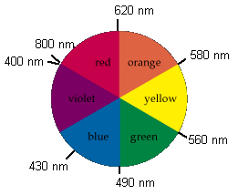
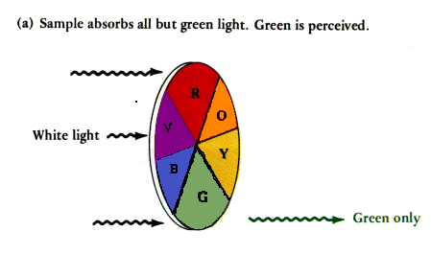
d → d Transitions and Color
TM complex (d¹ to d⁹) absorbs visible light
Transmitted light is opposite color to absorbed light
Energy of absorbed light is proportional to Δ
Strong field ligand: low nm
Weak field ligand: high nm
Example: Fe(phen)₃²⁺
  λ_{max} = 508 nm (green)
  Transmitted color: red-orange

Slide 5
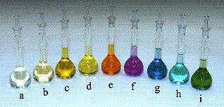
d → d Transitions and Color
Cobalt complexes with: (a) CN–, (b) NO₂–, (c) phen, (d) EN, (e) NH₃, (f) gly, (g) H₂O, (h) oxalate^{2–}, (i) CO₃^{2–}.
Complexes are arranged in order of decreasing Δ_{oct}
Color transmitted increases in energy from yellow → olive

Slide 6
Russell-Saunders Coupling
Review: http://wwwchem.uwimona.edu.jm/courses/RScoupling.html
Determining ground state of Transition Metal cations
  Draw d-orbitals and fill with # electrons for desired ion
  Calculate Spin Multiplicity = #unpaired electrons +1 = S
  Find maximum M_{L} (m_{l} = -2, -1, 0, 1, 2 for d orbitals) = L
  Ground state term: ^{S}L = ^{(step 2)}(Step 3)
Example: Cr(II); d⁴
  Orbital diagram
  4+1 = 5
  2+1+0+(-1) = 2 → D
  ⁵D is the ground state term
Spin-allowed transitions will be pentet to pentet
L : -2 -1 0 +1 +2
Notes:
If you are not familiar with spin multiplicity (S) and orbital angular momentum (L), please review the discussion provided in the link. The method shown here is for the free ion in a spherically symmetric electric field, an is the appropriate starting point for octahedral metal complexes. The free ion term will be reduced to the corresponding octahedral irreducible representations on the following slide.

Slide 7
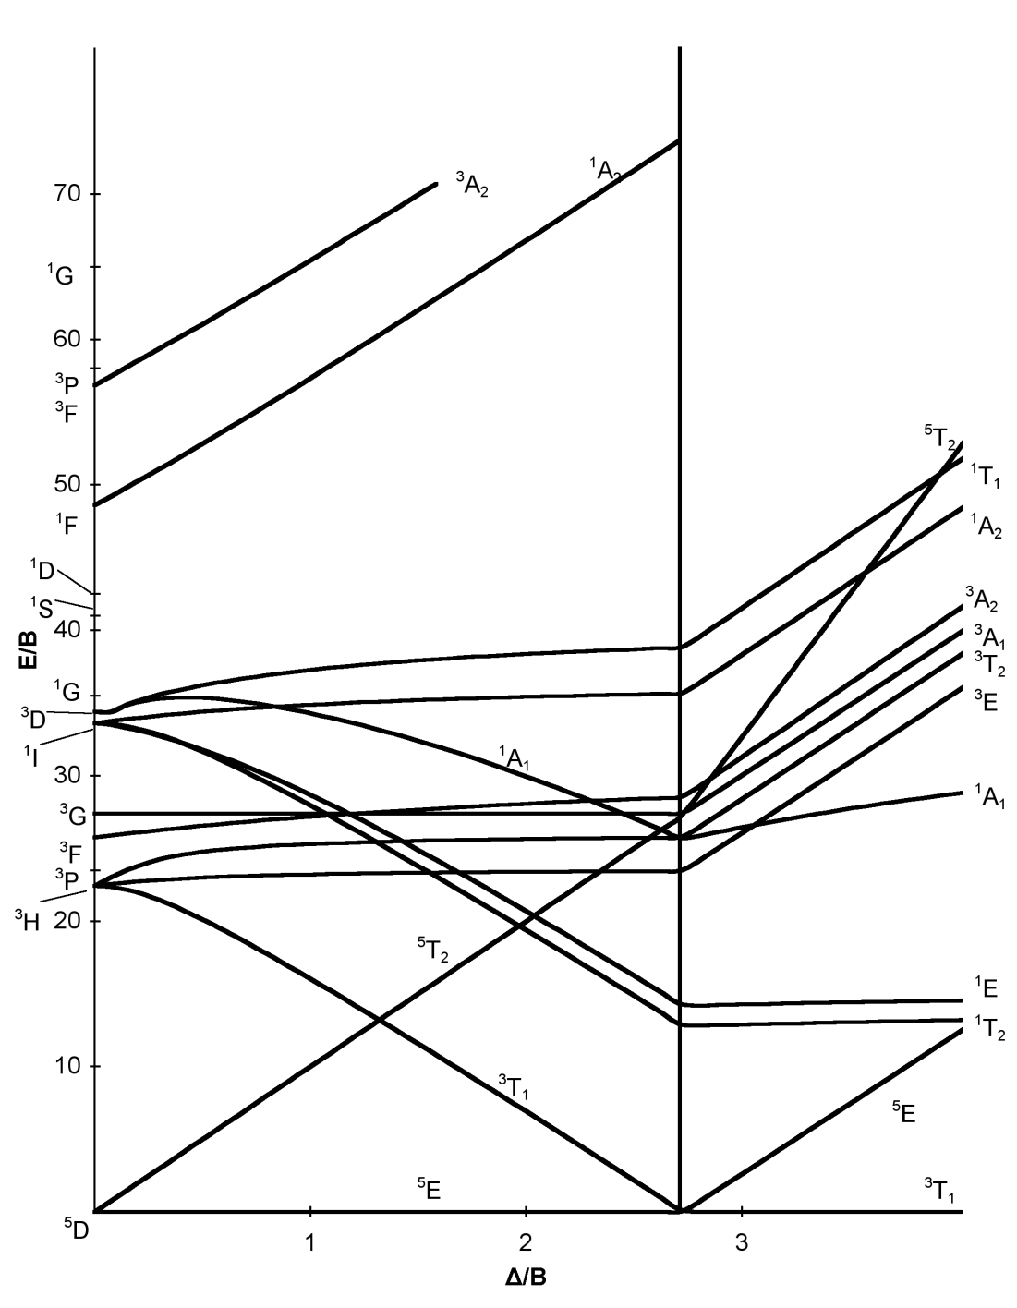
O_{h} Tanabe-Sugano Diagrams
Symmetry lowering from spherical to octahedral electrical field is applied to ground state and excited state terms
Relative energies of states are plotted against ligand field strength
Term | Degeneracy | States in an octahedral field
S | 1 | A_{1g}
P | 3 | T_{1g}
D | 5 | E_{g} + T_{2g}
F | 7 | A_{2g} + T_{1g} + T_{2g}
G | 9 | A_{1g} + E_{g} + T_{1g} + T_{2g}
H | 11 | E_{g} + T_{1g} + T_{1g} + T_{2g}
I | 13 | A_{1g} + A_{2g} + E_{g} + T_{1g} + T_{2g} + T_{2g}
d⁴ ion g.s.
O_{h} T-S Diagram for a d⁴ ion
Notes:
In the T-S diagram for a d⁴ ion, the relative energies of the excited states are plotted as a function of increasing ligand field strength. This diagram shows the change from high spin (4 unpaired electrons → S=5, pentet) to low spin (two unpaired electrons → S=3, triplet). Symmetry lowering is accomplished by using character tables to determine the symmetries of the different possible electron configurations in O_{h} symmetry. This is a well-established table that is used here.

Slide 8
O_{h} Tanabe-Sugano Diagrams
B = Racah Parameter; takes into account electron repulsion energy
X-axis: Δ/B
Y-axis: E/B
High spin vs. low spin
⁵D ³G
Spin allowed transitions:
  ⁵E to ⁵T₂ (UV-Vis range)
  ³T₁ to ³E (large energy gap!)
O_{h} T-S Diagram for a d⁴ ion
e_{g}
t_{2g}
[Cr(CH₃CO₂)₂(H₂O)]₂ is brick red; CrCl₂(H₂O)₄ is green
Notes:
Here, the direct application of the T-S diagram for a d⁴ ion to Cr(II) is shown. There are two possible scenarios: high-spin Cr(II) and low-spin Cr(II). For high-spin Cr(II), the splitting energy is smaller than the electron pairing energy, and the first spin-allowed transition is ⁵E → ⁵T₂. This typically occurs in the visible range, thus the two complexes that are mentioned have weak-field ligands, acetate, water and chloride. For the green CrCl₂(H₂O)₄, the visible absorption occurs in the red part of the visible spectrum; for the red [Cr(CH₃CO₂)₂(H₂O)]₂ complex, the absorption is in the green part of the visible spectrum. One can conclude that chloride is a weaker field ligand than acetate, and its d → d transition occurs closer to the origin in the T-S diagram.

Slide 9
Web Resources
http://wwwchem.uwimona.edu.jm/courses/RScoupling.html
http://chemwiki.ucdavis.edu/Inorganic_Chemistry/Crystal_Field_Theory/Tanabe-Sugano_Diagrams
http://wwwchem.uwimona.edu.jm/courses/Tanabe-Sugano/TScalcs.html
http://en.wikipedia.org/wiki/Tanabe%E2%80%93Sugano_diagram

