Slide 1
Five Slides About:
Transferrin
Christopher T. Bailey| Wells college, Aurora, New York
Created by Christopher T. Bailey, Wells College (cbailey@wells.edu) and posted on VIPEr (www.ionicviper.org) on July 23, 2014. Copyright Christopher T. Bailey, 2014. This work is licensed under the Creative Commons Attribution-NonCommerical-ShareAlike 3.0 Unported License. To view a copy of this license visit http://creativecommons.org/about/license/.

Slide 2
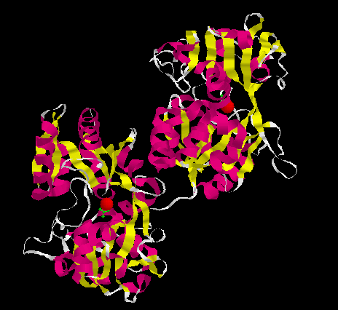
Five Slides About: Transferrin
The transferrins are a class of iron-binding and transport proteins found in vertebrates which include the ovo-, lacto-, and serum transferrins.
In addition to transporting iron from sites of absorption to sites of utilization and storage, serum transferrin also acts as an iron buffer, regulating the amount of free iron in the bloodstream.
Ovo- and lactotransferrin bind iron so as to remove that metal as a potential growth factor for fungi and bacteria.
Notes:
The ovo- and serum transferrins are quite similar structurally. The structure presented here is of ovotransferrin (1OVT); α-helices are shown in pink, β-sheets are shown in yellow, and random coil in white. The iron (shown here as red space-filling balls), and synergistic anion carbonate (seen in green) are discussed in later slides and so need not be discussed at this point.
Ovotransferrin, also known as conalbumin, is found in egg white. Lactoferrin is found in mammalian milk. As indicated, both act as antimicrobial agents, sequestering free iron which might be a growth factor for fungi and bacteria.
During iron transport by transferrin to cells, the ferrated protein binds at specific membrane-bound receptor sites for uptake into the cell. The transferrin receptor binds only ferrated transferrin and is able to differentiate between ferrated and non-ferrated transferrin due to the conformational change that takes place when iron binds to the protein (see below). The protein is brought into the cell via carrier mediated endocytosis and the iron released by a combination of lowered pH and the presence of iron-chelating agents.

Slide 3
Five Slides About: Transferrin
Structurally, the transferrins consist of a single polypeptide chain (MW ~80,000 Daltons) folded into two compact lobes, each of which possesses a high affinity iron binding site
Fe
Fe
Notes:
When an iron atom is bound to transferrin, the protein takes on a salmon color (λmax ~ 460nm). The apoprotein is effectively colorless at this wavelength. This difference is the basis for many kinetic experiments, particularly those examining the chelator-mediated release of iron.
There are slight differences in the iron-binding and release abilities between the two lobes, but those differences are likely not a concern here.

Slide 4
Five Slides About: Transferrin
Each lobe consists of two domains which form a pocket inside of which the iron binds.
Fe
Fe
Notes:
The two domains are connected by a “hinge” region (see next slide). I often use my hands to demonstrate this---imagine one of your hands in a sock puppet and “talking.” Iron (a small ball or marble) can only get in or out only when your hand is open.

Slide 5
Five Slides About: Transferrin
The two domains are connected by a hinge region, which allows the protein to “open” and “close”. Iron can be taken up or released only when the protein is in the “open” conformation.
Evidence for the “opening” and “closing” of the two lobes has been observed crystallographically. That is, the apo form is found in the “open” state, while the iron-loaded form is seen to be “closed.”
Fe
Fe
Notes:
The ferrated protein as shown is in the closed form; the apo form would be open. A crystal structure is available for the apo form of one of the two lobes (1TFA).

Slide 6
Five Slides About: Transferrin
The iron is bound to the protein via 2 Tyr, 1 His, and 1Asp residues.
One of the unique features of the transferrins is the requirement of a synergistic ion in order for the iron to bind. The iron and the anion bind concomitantly; neither binds without the other.
Physiologically the synergistic anion is carbonate, which binds in a bidentate manner. In the absence of carbonate, other specific organic anions can facilitate iron binding in vitro.
Asp
CO₃²⁻
His
Fe
Tyr
Tyr
Notes:
The synergistic anion also interacts with the protein, probably an arginine. This interaction may bring other ligands into correct positions, causing a conformational change within the protein and “locking” the iron in place.
One feature of all alternate anions is that they all contain a Lewis base near a carboxylate group (an example of an alternate anion is pyruvic acid). Interestingly, these alternate anions were first studied in the 1970’s prior to the availability of a crystal structure for transferrin. By examining the molecular geometry of the anions which allowed for iron binding and those which did not an approximate size of the anion binding pocket had been determined. This value held up very well when a crystal structure was obtained.

Slide 7
Five Slides About: Transferrin
Transferrin is of interest in the study of iron-overload disorders.
Transferrin normally keeps the amount of free-iron in the blood low, but it can become saturated with iron.
Iron chelates act by removing iron from transferrin in a soluble form which is then excreted. The protein can then bind additional iron and the process can be repeated.
Asp
CO₃²⁻
His
Fe
Tyr
Tyr
Notes:
One clinically important aspect of the iron binding affinity of transferrin is its role in the treatment of toxic iron overload. Iron overload is experienced as the result of a number of blood disorders, including the thalassemias. β-thalassemia, a genetic blood disorder, causes the production of ineffective hemoglobin, and thus ineffective red blood cells. This may result in anemia, which is treated with frequent blood transfusions. Progressive iron accumulation caused by these repeated blood transfusions is a common occurrence because there is no normal mechanism for excretion of excess iron. In such cases, the clinical method of reducing iron overload is chelation therapy. Chelators remove the iron which is bound to transferrin circulating in the blood and allow it to be excreted. Much has therefore been done to elicit the mechanism of chelator-mediated release of iron from transferrin. My own research looks at the effect of affinity-label anions (replacements for carbonate which allows iron to bind, but which also forms a covalent bond to the protein) on this mechanism.

