Slide 1
Five slides about Porphyrin UV-Vis
Created by Matthew Riehl, Bethany Lutheran College, matthew.riehl@blc.edu; Matthew Bork, Rockford University, MBork@rockford.edu. Copyright Riehl and Bork, 2019. This work is licensed under the Creative Commons Attribution-NonCommercial-ShareAlike 4.0 International (CC BY-NC-SA 4.0) License. To view a copy of this license visit https://creativecommons.org/licenses/by-nc-sa/4.0/

Slide 2
Learning Outcomes
The student will…
understand the porphyrin core structure, the numbering, and naming schemes of porphyrins
demonstrate that the porphyrin is aromatic, obeying the Hückel 4n+2 rule where n=4.
recognize the key features of the porphyrin UV-Vis spectra: the Soret Band and the Q-bands
qualitatively describe Gouterman’s four-orbital model to explain the spectra.

Slide 3
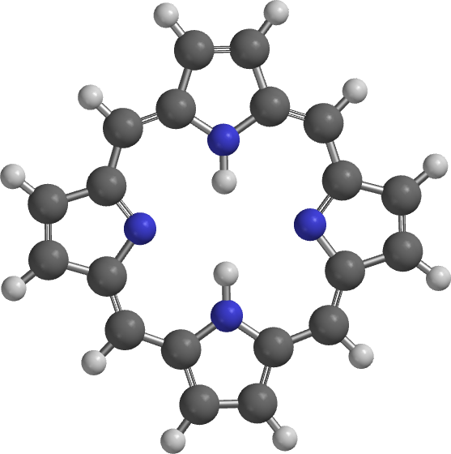
Porphyrin Structure and Numbering
The 20 carbon atoms that form the outer ring are numbered clockwise 1-20 as shown. The nitrogen atoms are 21-24.
Eight β positions are on the pyrrolic rings (2, 3, 7, 8, 12, 13, 17, 18).
Four meso positions are on the methine bridges (5, 10, 15, 20).

Slide 4
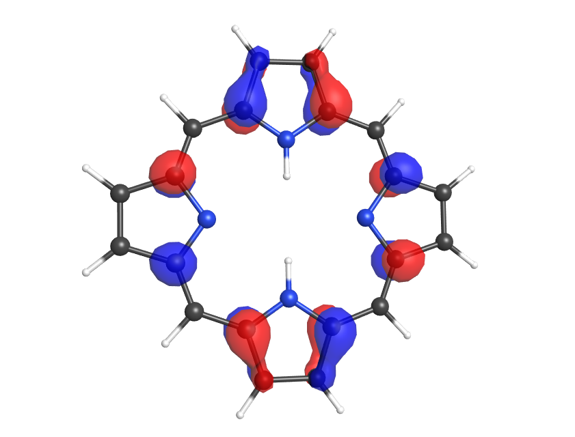
Porphyrin Aromaticity & MOs
Red bonds show one path for 18 electron Hückel aromaticity.
Other paths exist – none of the double bonds are simple localized bonds.
Molecular orbitals are consistent with a π-delocalized ring system.
Nine bonding MOs are filled by the 18 delocalized electrons.
In a simple model, both the HOMO and LUMO are degenerate pairs of orbitals.

Slide 5
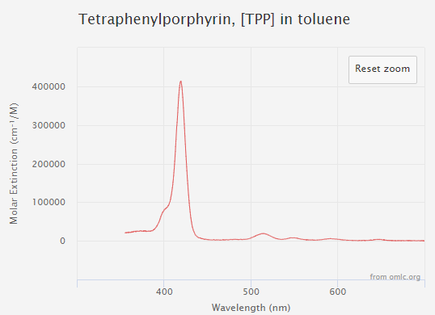
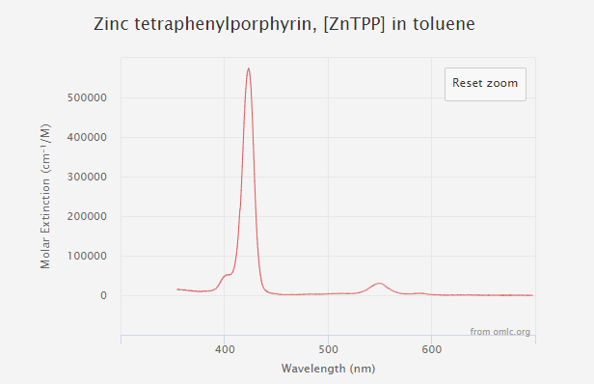
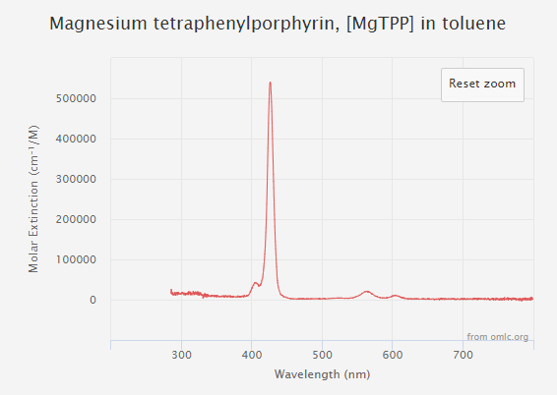
Porphyrin Spectra
Soret
Q-bands
Typical UV-Vis for three tetra-phenylporphyrins: H₂TPP, ZnTPP, and MgTPP
Soret band or B-band
  Named for J.-L. Soret who first described it in 1883.¹
  Occurs in the near-UV, exact position depends on nature of porphyrin
Q-bands
  Much smaller, in the visible region.
  Symmetrical metalloporphyrins typically have two bands,
  H₂TPP has four bands due to the reduced symmetry from interior hydrogens.

Slide 6
Gouterman’s four orbital model
Beginning in the late 1950’s Martin Gouterman developed a model to explain the absorption spectra of porphyrins.²⁻⁵ This model focused on four molecular orbitals: the two highest occupied molecular orbitals and the two lowest unoccupied molecular orbitals.
The model predicts four transitions between the HOMOs and LUMOs.
The number of bands observed depends on the degeneracy of the LUMOs but the intensity is more difficult to rationalize.
The Q-bands are much weaker in intensity, but are easily resolved.

Slide 7
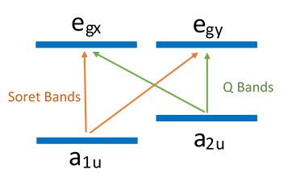
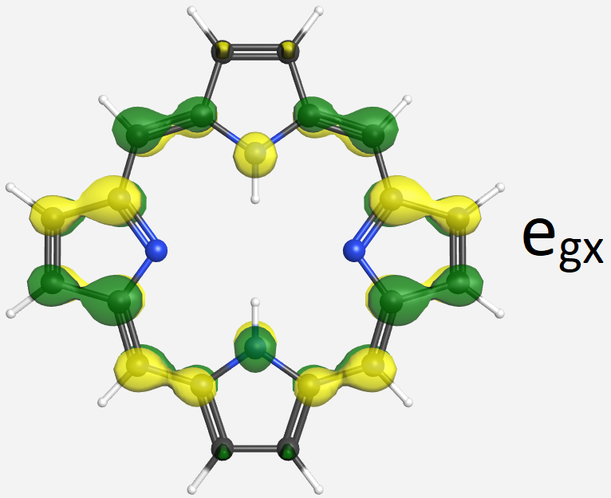
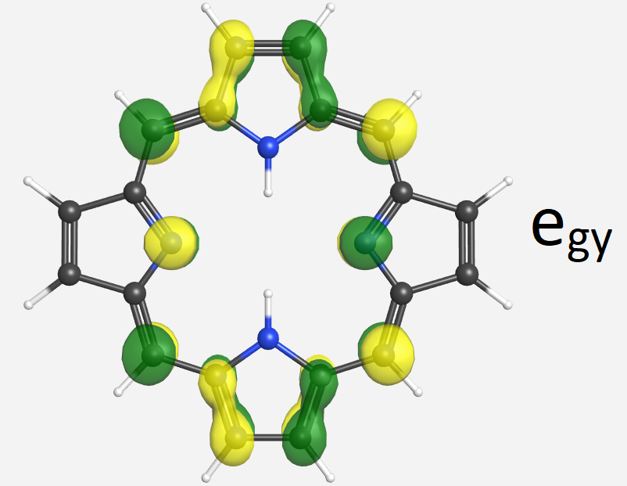
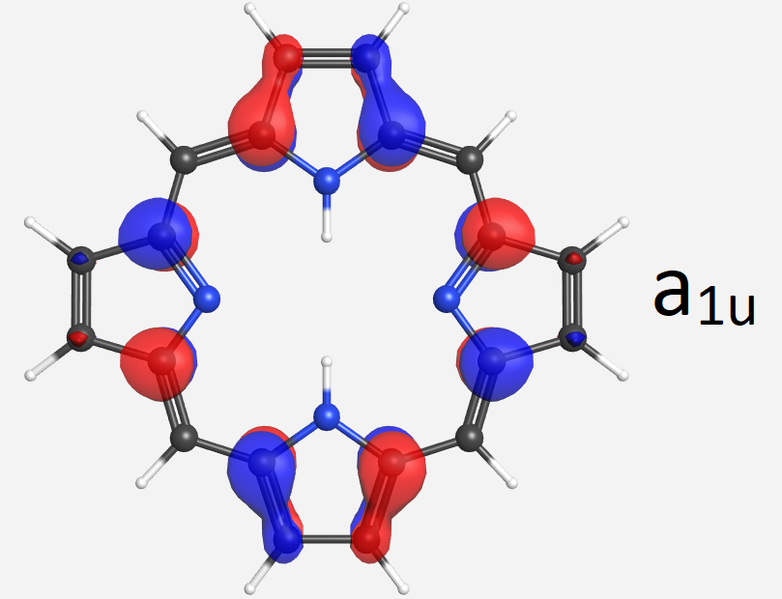
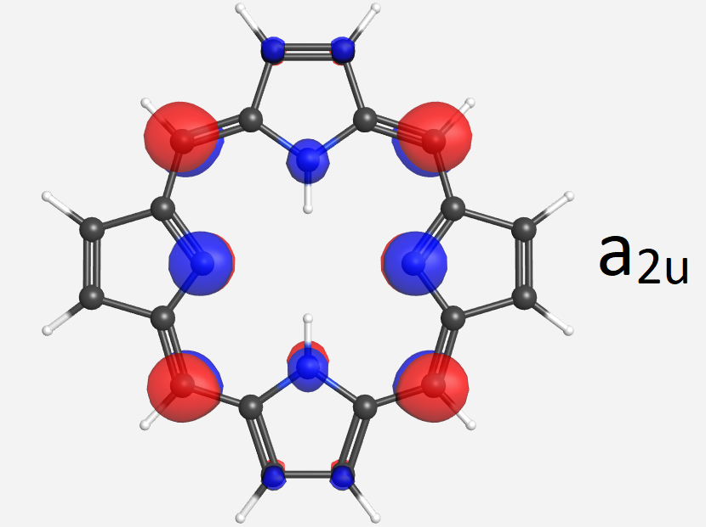
Gouterman
In a metalloporphyrin with D_{4h} symmetry,
  The four orbitals in Gouterman’s model are the HOMOs (a_{1u}, a_{2u}) and LUMOs (e_{gx}, e_{gy})
  The HOMOs are not degenerate, with the a_{1u} being at a lower energy.
    a_{1u}→e_{g} transitions give rise to the Soret bands
    a_{2u}→e_{g} transitions give rise to Q bands

Slide 8
Gouterman
The number of Q-bands is equal to twice the number of allowed transitions due to a vibrational component.
  The energy difference between two Q-bands is approximately equal to the energy of a vibrational transition.
  The lower energy Q-band is a 0-0 transition – from a ground vibrational state to a ground vibrational state
  The higher energy Q-band is a 0-1 transition – from a ground vibrational state to the first excited vibrational state.
Replacing a metal with two protons to obtain H₂TPP reduces the symmetry from D_{4h} to D_{2h}.
  This removes the degeneracy of the LUMO e_{g} orbitals and doubles the number of observed transitions.
  The Soret in H₂TPP can be resolved into two peaks at low temperature, but typically is observed as a single peak.

Slide 9
Gouterman
All of the HOMO-LUMO transitions are allowed, and a simple model predicts they should have nearly equal intensity.
However, orbital mixing occurs and leads to the drastic differences in intensities.
  In the a_{2u}→e_{g} transitions, the transition dipoles nearly cancel leading to the weak Q-absorptions observed.
  In the a_{1u}→e_{g} transitions, the transition dipoles reinforce, leading to the strong absorbance seen in the Soret band.

Slide 10
Questions:
What are the Soret and Q bands?
  Why is the Soret large and Q small?
  Why is there one Soret and four Q bands (H₂TPP) or two Q bands (MTPP)?
Electronic transitions between the HOMO and LUMO are responsible for the absorption spectra –
  What are the HOMO and LUMO for porphyrins?
  The transitions between HOMO and LUMO are allowed – why are the Soret and Q-bands so different?

Slide 11
References
Soret, J.-L., Comptes Rendus, 1883, 97, 1269–1270.
Gouterman, M., J. Chem. Phys., 1959, 30, 1139-1161.
Gouterman, M., J. Mol. Spectroscopy, 1961, 6, 138-163.
Gouterman, M., Wagnière, G. H., J. Mol. Spectroscopy, 1963, 11, 108-127.
Weiss, C., Kobayashi, H., Gouterman, M., J. Mol. Spectroscopy, 1965, 16, 415-450.

