Slide 1
Student Handouts
Refer to the instructor’s version of the “Inorganic Spectroscopy” presentation for facilitator notes regarding the use of these slides.
Created by Alycia M. Palmer, The Ohio State University (palmer.475@osu.edu) and posted on VIPEr (www.ionicviper.org) on April 25, 2014. Copyright Alycia M. Palmer 2014. This work is licensed under the Creative Commons Attribution Non-commercial Share Alike License. To view a copy of this license visit http://creativecommons.org/about/license/.

Slide 2
PhET sim conclusions
 | Microwave | Infrared | Visible | Ultraviolet
Effect on molecule
General rule to activity
X
✓
How do these generalizations change for molecules with metals?

Slide 3
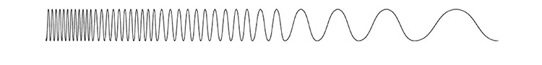
Electromagnetic Spectrum
High energy
Low energy
Short wavelength
Long wavelength

Slide 4
Energy of transitions

Slide 5
Lab 6
# vibrational modes _____
nitrite ion
nitrito
nitro
In general, the vibrational energy is _________ for the ligand compared to the free ion

Slide 6
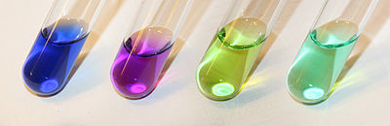
Ligand Field Theory
[Ni(NH₃)₆]²⁺
[Ni(en)₃]²⁺
[NiCl₄]²⁻
[Ni(H₂O)₆]²⁺
These ligands are colorless on their own, but each Ni²⁺ (d⁸) complex is colored.
Why?????

