Slide 1
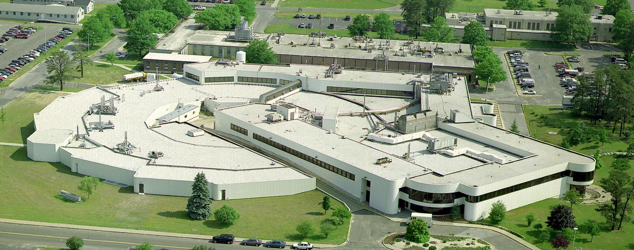
Introduction to Synchrotron Radiation
http://serc.carleton.edu/NAGTWorkshops/mineralogy/mineral_physics/synchrotron_facilities.html

Slide 2
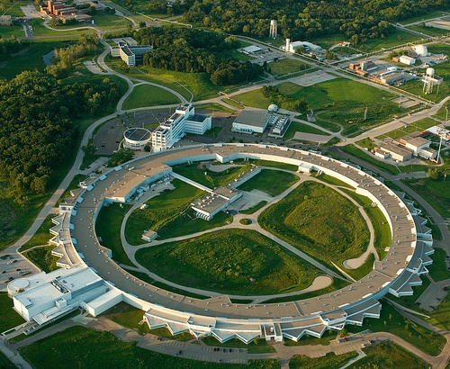
Synchrotron radiation
Produces high energy particles (protons, neutrons, electrons)
Particles produced in electron gun by a heated tungsten oxide cathode
Magnets and radio frequency accelerate particles in a circular path
Produces spectrum with broad wavelengths and strengths
http://www.aps.anl.gov/About/Welcome/
Notes:
Overall basic idea of synchrotron radiation:
High voltage electricity passes through cathode which is a tungsten-oxide disk which heats the disk. The disk continues to heat until electrons are emitted (about 1000 ºC for tungsten-oxide cathode). Once the electrons are emitted, they are attracted towards a neighboring screen which is pulsing positive charge and pulls the electrons away from the disk and begins their acceleration.
As a side note: The electricity used in the electron gun is 200,000 volts (Think of a car battery’s 12 V). Also, this technique is comparable to that which happened in a TV picture tube.
Synchrotron accelerates particles (protons, neutrons, or electrons) in a circular motion by the use of magnets and radio frequency. Magnet turns on and off to guide the electrons through the ring. As the particles move they continuously emit a spectrum of light with many wavelengths and strengths.

Slide 3
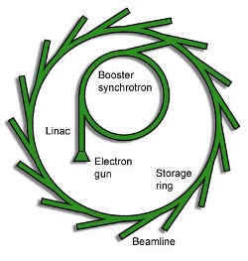
Where do the particles go?
Electron gun
Booster ring
Storage ring
Beamline
Optics cabin
Instrument
www.diamond.ac.uk
Notes:
Particles are generated in the electron gun, then are accelerated in the booster synchrotron (This is what was explained on the previous slide). Once the particles have sufficient energy, they are transferred to a storage ring where they can be stored up to about twelve hours. The particles are directed from the storage ring to the individual beamlines. Once at the beamline, the particle wavelength and strength can be manipulated by optical instruments to produce the type necessary for the instrument at that beamline, as well as the particular experiment being conducted on that beamline.

Slide 4
Breadth of techniques
Spectroscopy
Scattering
Hard x-ray spectroscopy
Metrology
Optics
Detector Calibrations
Soft x-ray spectroscopy
Hard x-ray diffraction
Hard x-ray scattering
Macromolecular crystallography
Soft x-ray scattering
Imaging
Hard x-ray imaging
Lithography
Soft x-ray scattering
https://beam.aps.anl.gov/pls/apsweb/beamline_display_pkg.technique_dir
Notes:
There are many, many techniques that are used at synchrotron facilities. The above list is the over arching types of measurement at Argonne National Lab in Illinois. There are numerous techniques under each subheading. For instance, under soft x-ray spectroscopy, specific techniques include: Magnetic circular dichroism, x-ray magnetic linear dichroism, x-ray photoemission spectroscopy. All the techniques available at Argonne National Lab can be found at the website listed on the slide and it may be interesting to bring the website up to show your class.

Slide 5
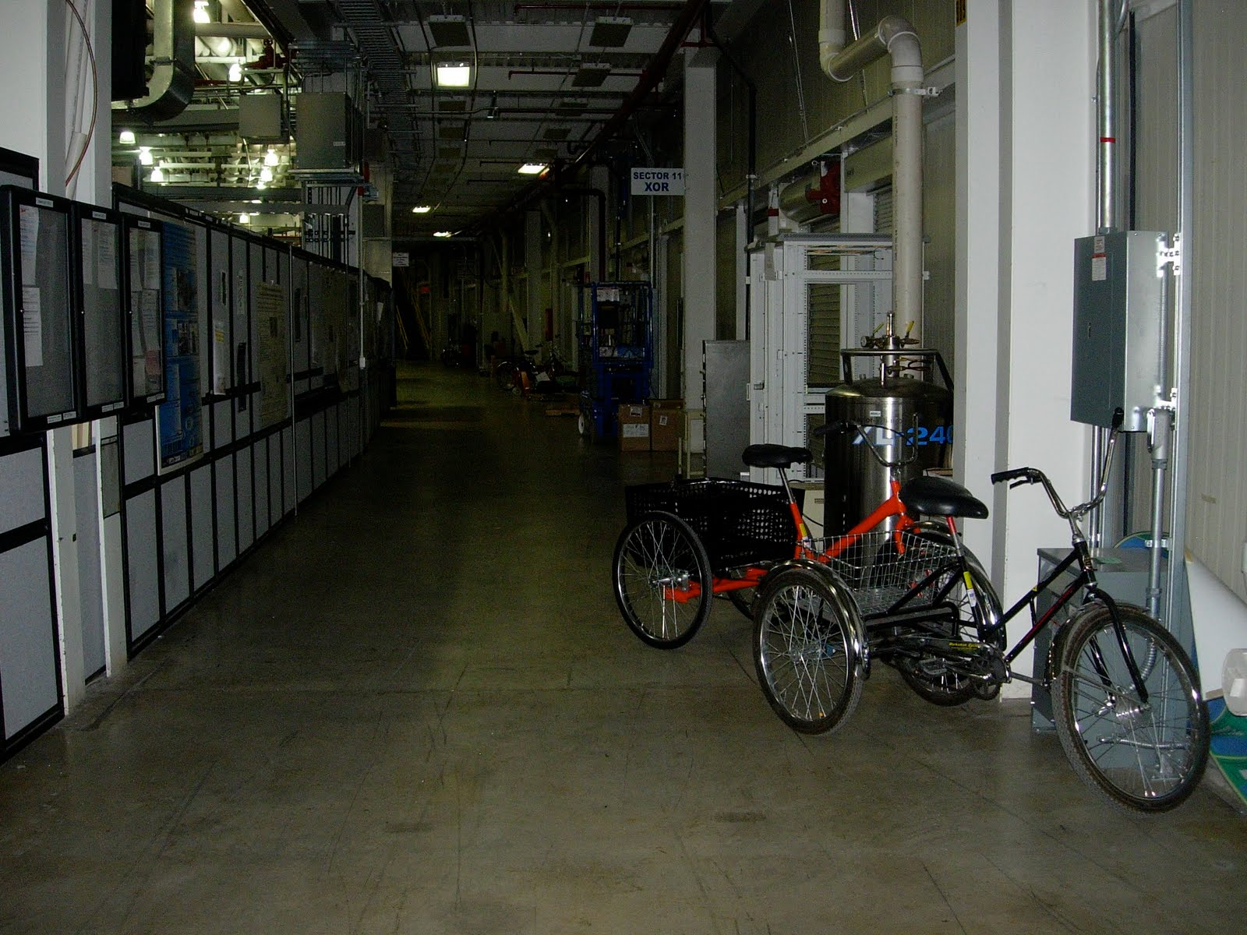
Is it worth it?
Advantages
Continuous spectrum
High flux
High brightness
High coherence
Better signal to noise ratio
Able to detect nanoscale materials
Disadvantages
Have proposal accepted
Travel to beamline
Beamline instability
Notes:
All of the advantages lead to the idea that you can detect nanoscale materials. For instance, small nanoparticles cannot be detected on a XRD that you may have at your home university, but you could use a higher energy source at a synchrotron facility to retrieve data using x-ray diffraction that will allow you track the nanoparticles with that technique.
At Argonne National Lab, they have tricycles that available for the pedestrians to get around the beamline!
While the instability of the beamline has greatly been reduced, it still goes down at times. When it goes down, it eat away many hours of your proposal time.

Slide 6

Where are synchrotrons in USA?
Notes:
Synchrotron radiation at:
Advanced light source (ALS) (Lawrence Berkeley National Laboratory)
Stanford Synchrotron Radiation Laboratory (SSRL) and Linac Coherent Light Source (LCLS) (Stanford Linear Accelerator Center
Synchrotron Radiation Center (SRC) (University of Wisconsin)
Advanced Photon Source (APS) (Argonne National Laboratory)
Cornell High-Energy Synchrotron Source (CHESS) (Cornell University)
National Synchrotron Light Source (NSLS) (Brookhaven National Laboratory)

