Slide 1
Introduction to Atom Economy and the Hydroamination Reaction
Created by Eugene Chong, University of Michigan (chongugn@umich.edu) and posted on (www.ionicviper.org ) on July 1, 2016.
Copyright Eugene Chong, 2016. This work is licensed under the Creative Commons Attribution Non-commercial Share Alike License. To view a copy of this license visit http://creativecommons.org/license/

Slide 2
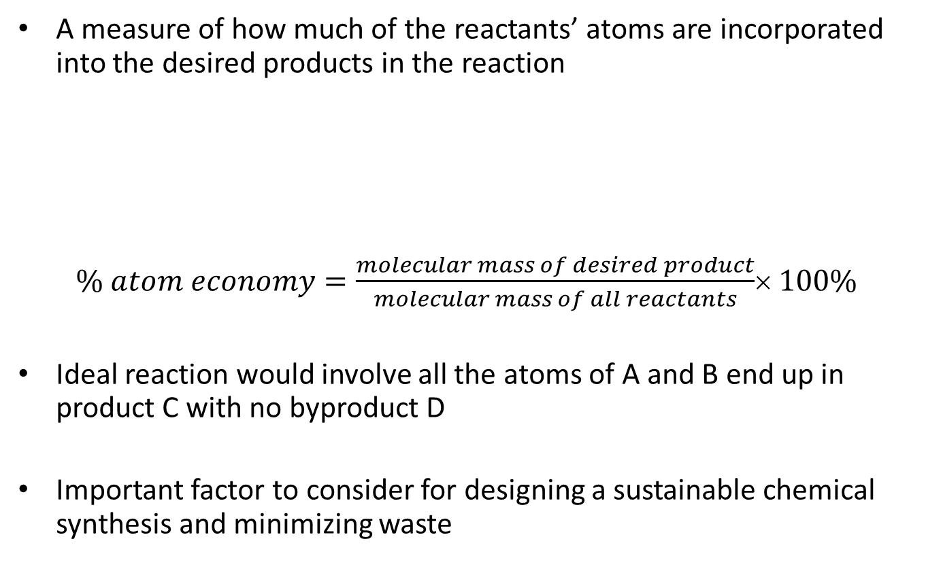
Atom Economy
A measure of how much of the reactants’ atoms are incorporated into the desired products in the reaction
$\% atom economy=\frac{molecular mass of desired product}{molecular mass of all reactants}$× 100%
Ideal reaction would involve all the atoms of A and B end up in product C with no byproduct D
Important factor to consider for designing a sustainable chemical synthesis and minimizing waste
Notes:
Atom economy is a good starting concept for undergraduate to appreciate and think about the efficiency of a reaction
Science 1991, 254, 1471.
Acc. Chem. Res. 2002, 35, 695.
https://www.acs.org/content/acs/en/greenchemistry/what-is-green-chemistry/principles/gc-principle-of-the-month-2.html (accessed 2016-06-28)

Slide 3

Case Study 1: Synthesis of Amines Using N-Alkylation
$\% atom economy=\frac{(191.27)}{(87.12 + 185.06)}$× 100% = 70%
This reaction is not efficient because 30% of starting material is lost (excluding the use of stoichiometric base for simplicity)
Notes:
Amines are industrially important (e.g., pharmaceuticals, agrochemicals). Here, SN2 reaction is demonstrated as it is a well-known reaction to undergraduates. The base can be such as NEt₃ (101.19 g/mol) to trap HBr byproduct. This would make the atom economy much lower (191.27 ÷ 373.37) x 100% = 51%

Slide 4
Introduction to Hydroamination
The addition of N–H bonds across unsaturated C–C bonds
Value-added amine products produced from readily available building blocks (simple amines and alkenes/alkynes)
Catalyst is used instead of stoichiometric base thereby minimizes waste
Notes:
One of top 10 challenges for catalysis: catalytic anti-Markovnikov addition of R₂N–H to olefins (Chem. Eng. News 1993, 71 (22), 23)
*note that the intermolecular hydroamination of alkyne is more well-established in the literature while the reaction with alkene is a challenge.
Alkene hydroamination will be used just to demonstrate the hydroamination concept herein.
Symmetrically substituted C–C pi bond used to avoid regioselectivity question and simplify the concept.
Comprehensive Review: Chem. Rev. 2008, 108, 3795

Slide 5

Case Study 2: Synthesis of Amines Using Hydroamination
$\% atom economy=\frac{(191.27)}{(87.12 +104.15)}$× 100% = 100%
Hydroamination is 100% atom economic; no byproduct is generated
Notes:
On the assumption of complete Anti-Markovnikov addition for simplicity. Catalyst is not included in the calculation as it is used in substoichiometric amounts and theoretically regenerated in the reaction.

Slide 6
Mechanistic Consideration
Addition of ammonia to ethylene is slightly exothermic
  ΔG° = -14.7 kJ/mol, ΔH° = -52.7 kJ/mol, ΔS° = -127.3 J/mol·K
However, coupling partners involved are both electron-rich sources; electrostatic repulsion between N lone pair and π bond leads to high activation barrier
Two strategies: activate the amine or alkene with a metal catalyst
Notes:
Chem. Rev. 1998, 98, 675
Taube, R. Applied Homogeneous Catalysis with Organometallic Compounds; 2nd ed.; Cornils, B. and Herrmann, W. A., Eds.; Wiley-VCH Verlag GmbH: Weinheim, Germany, 2002; Vol 1, pp 513− 524.

Slide 7
Selected Example 1: Amine Activation
Amine activation – early transition metal (e.g., Ti, Zr) that is highly electrophilic likes to bind “hard” N donor atoms
Classroom activity: describe the bonding interaction in M=NR using molecular orbitals (*hint: bond angle about N is linear)
Notes:
This is a very simplified model, mainly to highlight the concept.
For M = Ti, Zr, the precatalyst has less than 18 e- and is usually electrophilic (e.g., Ti(NMe₂)₄ , which is 16 e-). This allows external amine to coordinate to M and exchange with existing amido on the M. Dimethylamine is liberated as a gas, allowing equilibrium to shift to the right. Primary amines form imido complexes (secondary amines form amido). Amine nucleophilicity is reduced due to pi-bonding interaction to M; alkene can coordinate to electrophilic M center, and operates in a concerted [2+2] cycloaddition mechanism. In aminolysis step, amine coordinates to M, and M-C is cleaved by the proton from the amine.
Early work on Zr imido complexes and hydroamination: Organometallics 1993, 12, 3105.
Ti(NMe₂)₄ example: Org. Lett., 2005, 7, 1959.

Slide 8
Selected Example 2: Alkene Activation
Alkene activation – late transition metal (e.g., Pd, Pt) coordinates to C=C bond, making it susceptible to amine addition
Classroom activity: describe the bonding interaction between M and C=C using molecular orbitals
Notes:
This is a very simplified model, mainly to highlight the concept.
Use Dewar–Chatt–Duncanson model for M-alkene pi interaction for classroom activity
Some recent examples, see: J. Am. Chem. Soc. 2016, 138, 5805 and Organometallics 2016, 35, 113.

