Slide 1
Ligand Design for Selectivity and Complex Stability
Created by Daniel S. Kissel, Lewis University (kisselda@lewisu.edu) and posted on VIPEr on June 30, 2016. Copyright Daniel S. Kissel, 2016. This work is licensed under the Creative Commons Attribution-NonCommercial-ShareAlike License. To view a copy of this license visit
http://creativecommons.org/licenses/by-nc-sa/4.0/

Slide 2
What is Ligand Design?
“A ligand is more preorganized when it is more constrained to be in a conformation required to complex a metal ion.” –Donald J. Cram
Ligand design is an area of inorganic chemistry that involves the design and synthesis of ligands preorganized to achieve specific functions involving coordination complexes
This area involves the understanding and manipulation of several concepts in chemistry:
HSAB Theory
Chelation and chelate ring size effect
Neutral O-donor effect
Steric Focus
Organic synthesis

Slide 3
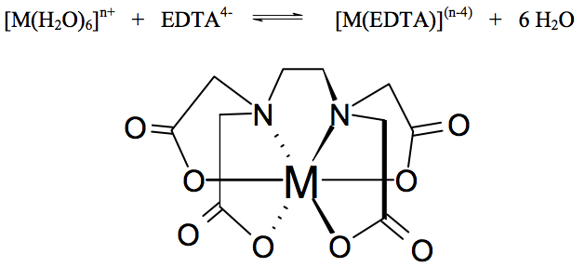
How to Assess a Ligand
Assessing the relative stability of a metal-ligand bond requires an understanding of binding equilibrium. Consider the reaction of EDTA with a metal ion M^{n+} to create an octahedral complex
[M(H₂O)₆]^{n+} + EDTA⁴⁻ [M(EDTA)]^{(n-4)} + 6 H₂O
In inorganic chemistry we use the log of this equilibrium constant to assess the relative binding strengths of ligands
So: K₁ = [M(EDTA)^{(n-4)}]__
[M(H₂O)₆^{n+}][EDTA⁴⁻]

Slide 4
HSAB Theory in Ligand Design
Ligands designed to complex harder metal ions can be designed using harder donor groups and ligands designed to complex softer metal ions can be designed using softer donor groups to increase selectivity
The hard alkali and alkaline earth metals, as well as the lanthanides, prefer harder O-donor anions
The transition metals are mostly soft or intermediate, and therefore prefer softer N-donor atoms
The heavier transition metals, such as gold, like sulfur
The heavier post-transition metals, such as Pb, Tl and Bi are capable of binding to a wide variety of donor atoms

Slide 5
HSAB Theory in Donor Atoms
HSAB theory can be used to manipulate discreet differences in different metal ions
M. Heitzmann, F. Bravard, C. Gateau, N. Boubals, C. Berthon, J. Pecaut, M.C. Charbonnel, P. Delangle, Inorganic Chemistry, 2009, 48, 246-256
M. P. Jensen, J. Alloys Cmpds.2000, 303-304, 137-145.
Notes:
Be sure to point out that increasing the soft character of the ligand by the addition of neutral N-donor groups increases selectivity for the softer actinide over the harder lanthanide. This, however, comes at the cost of complex stability as evidenced by the decrease in the logK values. (note: actinides are slightly softer than lanthanides because of the greater spatial expansion of the 5f vs. 4f atomic orbitals)

Slide 6
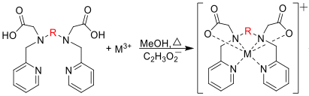
Chelation
Chelation comes from the latin word “chela,” which means “claw”
Chelation involves the formation of multiple bonds to donor atoms in a polydentate ligand
Chelation of a metal ion is stabilized by a more favorable entropic effect as opposed to coordination of monodentate ligands containing similar donor atoms

Slide 7
The Claw!!!!!!
Why is chelation preferred below?
[Cu(H₂O)₆]²⁺ + 4NH₃ [Cu(NH₃)₄(H₂O)₂]²⁺ logβ₄ = 12.6
[Cu(H₂O)₆]²⁺ + 2en [Cu(en)₂(H₂O)₂]²⁺ logβ₂ = 20.6
The formation of each complex is dependent of the ΔG value
ΔG = -RTlnK = ΔH – TΔS
Solving for lnK gives the Eyring Equation:
lnK = -ΔH/RT + ΔS/R (plot of lnK vs. 1/T gives a straight line)
Because ethylenediamine and ammonia are similar, ΔH will be similar
What about the change in entropy? Which is better? 5 reactants to 1 product, or 3 reactants to 1 product?

Slide 8
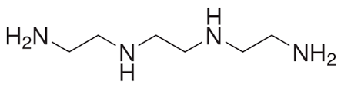
Inductive Effects
Consider the effect of chelation on Pd²⁺
logβ₄ NH₃ logK₁ trien
Pd²⁺ 26.0 39.4
trien
trien is preferred by 13.4 log units (10^{13.4} times more likely to bind)
The total number of molecules in an aqueous solution is approximately equal to the number of water molecules, and pure water has a concentration of 55.51 M
The entropy contribution to the chelate effect can be approximated by (n-1) log 55.51, where n = # of donor atoms
Here the entropic contribution is only 5.23, so what accounts for the extra 8.17 log units observed?
There are inductive effects from the ethylene bridges that give a more favorable enthalpy ΔH

Slide 9
Inductive Effects and Chelation
Enthalpic contributions are also observed in comparison of macrocyclic ligands to their open-chain analogues
analogue
cyclam
logK₁ Cu²⁺ 23.4 27.2
logK₁ Ni²⁺ 16.4 19.8
The extra stability observed in cyclam is due to restricted ligand mobility as well as inductive effects from the extra ethylene bridge
This effect is known as the macrocyclic effect

Slide 10
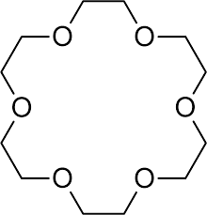
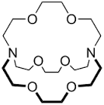
The Cryptate Effect
A cryptand containing 3 “strands” of donor groups that link neutral N-donors increases complex stability even more as a result of increased enthalpic and chelate effects.
18-crown-6
cryptand-2,2,2
logK₁ Pb²⁺ 6.8 12.0
This effect is best observed in larger metal ions with high coordination numbers

Slide 11
Chelate Ring Size Effect
Formation of 4 and 5-membered chelate rings is more favorable for complexes containing larger metal ions
Formation of 6-membered chelate rings is more favorable for complexes containing smaller metal ions
This is a geometric effect
Insert image of Figure 3 A, B, and C ONLY from Hancock, R. D. J. Chem. Educ., 1992, 69 (8), pg 617

Slide 12
Chelate Ring Size Effect in Action
logK₁ Cu²⁺ 18 22 26
logK₁ Pb²⁺ 13 12 7
Affinity for ligand increases for the smaller Cu²⁺ ion as chelate ring size increases
Affinity for ligand decreases for the larger Pb²⁺ ion as chelate ring size increases

Slide 13
Chelate Rings and O-donors
Addition of neutral O-donors to a polydentate ligands stabilizes the complexation of larger metal ions (especially ligands that form 5-membered chelate rings)
Neutral O-donors include: alcohols, ethers, esters, and amides
Addition of anionic O-donors to a polydentate ligands stabilizes the complexation of smaller, highly charged metal ions (harder acids)
Examples of charged O-donors include carboxylates, phenols and catechols (easily deprotonated alcohols)
logK₁ Ni²⁺ 7.4 6.6
logK₁ Pb²⁺ 5.0 7.6

Slide 14
Steric Focus
Steric focus can be accomplished by modifying a ligand backbone to restrict mobility and “focus” the ligand in a conformation favorable for metal ion complexation
Cyclohexyl backbone restricts rotation about the N—N ethylene bridge that reduces the preorientation energy requirement for binding
This “focuses” pendent arms in a conformation favorable for binding
Ogden, M. D.; Meier, G. P.; Nash, K. L. J. Solution Chem. 2012 41, 1–16.

