Slide 1
Chemical exchange saturation transfer (CEST): principles and imaging applications
This slide show was created by Justin Massing, Northwestern University (justin.massing@northwestern.edu) and posted on VIPEr (www.ionicviper.org) on July 17, 2014. This work is licensed under the Creative Commons Attribution Non-commercial Share Alike License. To view a copy of this license visit http://creativecommons.org/about/license/.

Slide 2
MR signal origin
B₀
z
M_{z}
x
y
(a)
(b)
(c)
B₀
M_{z}
M_{x}
B₁
(d)
(e)
(f)
Wilkinson, P. University Instrumentation Center, University of New Hampshire, Durham, NH. Powerpoint presentation, 2009.
Notes:
¹H possess nuclear spin. Application of an external magnetic field (B₀) results in spins aligning either with (red) or against (blue) B₀ (a). Furthermore, these spin states precess about B₀ similar to a gyroscope precessing about the Earth’s magnetic field. B/c alignment with B₀ is lower in energy, there exists a slight population excess (b), as defined by the Boltzmann distribution, resulting in bulk magnetization (M_{z}) aligned with B₀ (c). Disruption of this distribution through application of a radiofrequency pulse (B₁) equal to the Larmor frequency (d) causes the spins, and therefore M_{z}, to tilt into the plane (e) where the oscillating voltage generated from M_{x} precessing about B₀ may then be measured (f).

Slide 3
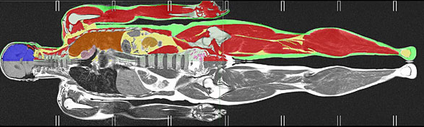
Relaxation mechanisms
Longitudinal relaxation
  Reestablishes equilibrium
  Rate = 1/T₁
Transverse relaxation
  Loss of M_{x}
  Rate = 1/T₂
B₀
M_{z}
M_{x}
London Evening Standard. http://www.thisislondon.co.uk/health/article-23719642-how-much-do-body-mots-tell-us.do (accessed Nov 2010)
Notes:
However, following this disruption, nuclear spins relax slowly back to equilibrium, eventually realigning M_{z} with B₀. This return to equilibrium is characterized by both longitudinal and transverse relaxation, with associated time constants T₁ and T₂ respectively. Because the human body is largely composed of water, and therefore protons, differences in T₁ and T₂ among tissues may be exploited through a variety of pulse sequences, forming the basis of contrast in MRI. Because signal intensity is determined by these relaxation mechanisms, agents capable of altering them provide a means to enhance contrast among tissues to a greater extent, illustrating the diagnostic capabilities of MR imaging.

Slide 4
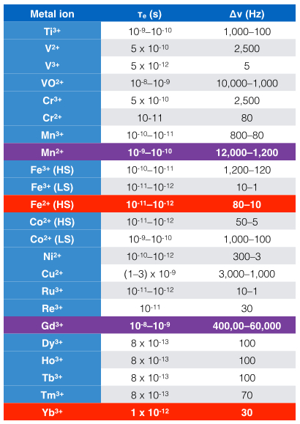
Paramagnetic properties of metal ions and ¹H NMR
Relaxation agents:
Slow electron spin relaxation (long τ_{s}) more in tune with proton Larmor frequency
Broad proton resonances
Shift agents:
Rapid electron spin relaxation (short τ_{s})
Sharp proton resonances that are highly shifted
Bertini, I.; Turano, P.; Villa, A. J. Chem. Rev.. 1993, 93, 2833-2932.
Notes:
B/c Gd(III) and Mn(II) exhibit long τ_{s} that are similar to the ¹H Larmor frequency, these agents effectively relax nearby water protons and therefore function as traditional MR imaging contrast agents. Paramagnetic shift agents, however, have more commonly found use in resolving closely spaced ¹H NMR signals.

Slide 5
Paramagnetic induced ¹H shifts
Pseudocontact shifts originate due to through-space dipolar interactions between unpaired electrons and the nucleus.
Contact shifts originate from through-bond interactions between unpaired electrons and the nucleus in question. This phenomenon is more significant for transition metals than for lanthanides owing to the increased covalent bonding between ligands and the valence d orbitals.

Slide 6
Chemical exchange saturation transfer (CEST)
(a)
(b)
(c)
RF
pulse
Chemical exchange
Pool B
Pool A
Pool B
Pool A
Pool B
Pool A
Sherry. A. D.; Woods, M. Annu. Rev. Biomed. Eng. 2008, 10, 391-411.
Notes:
A new approach to enhance tissue contrast has been recently reported. This technique originally made use of small diamagnetic molecules containing a proton exchange site (either –NH or –OH), which could undergo chemical exchange saturation transfer (CEST) with bulk water protons, thereby affecting their signal intensity indirectly. This process is best illustrated by considering a two pool system, where pool A represents bulk water protons and pool B contains the protons at the exchange site (a). Because both pools resonate at different frequencies, each may be selectively irradiated. Application of a radiofrequency pulse equal to the Larmor frequency of pool B alters the Boltzmann distribution of nuclear spins, resulting in saturation once the spins aligned with and against the field are equal (b). Because the two pools are in exchange, spins aligned with the field are transferred from pool A to pool B, while spins aligned against the field are transferred from pool B to pool A. Therefore, by selectively saturating the protons in pool B, the indirect saturation of pool A is possible, which is manifested as a decrease in the bulk water signal (c).

Slide 7
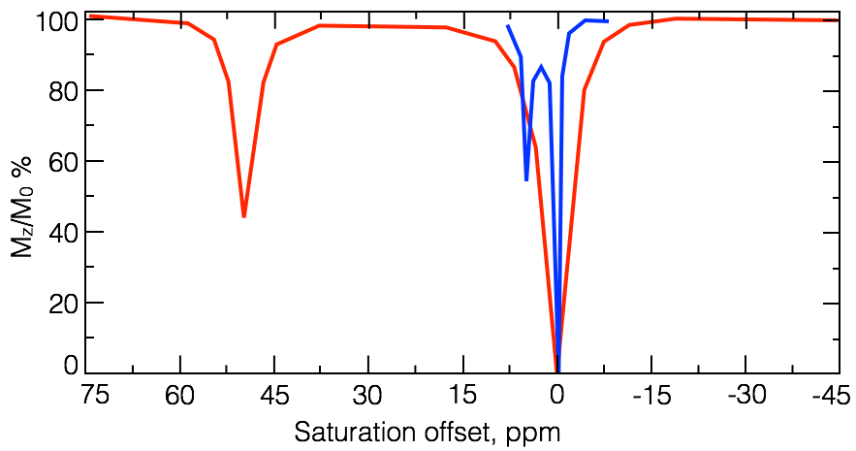
Diamagnetic v. paramagnetic CEST agents
k_{ex} ≤ Δω
Viswanathan, S.; Kovacs, Z.; Green, K. N.; Ratnakar, S. J.; Sherry. A. D. Chem. Rev.. 2010, 110, 2960-3018.
Notes:
In order for exchange to occur, certain criteria must be met. First, the rate of exchange (k_{ex}) must be no greater than the frequency difference between the two pools (Δω). This limitation has severe consequences in the case of exogenous diamagnetic compounds (blue), whose Δω are usually 5 ppm or less, requiring k_{ex}. In addition to these two pools exchanging with one another, previously mentioned relaxation modes are also possible (slide 2), further complicating the picture. If these competing pathways occur more rapidly than k_{ex}, than exchange is unlikely to occur. Another disadvantage of this class of agents is the fact that the small difference in frequency between the two pools may lead to unwanted direct saturation of the bulk water signal, especially since this signal tends to be broader in a biological setting. Therefore, a greater Δω is desirable not only to minimize unwanted direct saturation of bulk water, but to allow a more rapid exchange to occur to avoid competing relaxation mechanisms. An obvious means to increase Δω through the use of a paramagnetic center was quickly realized, taking advantage of previously reported complexes unsuitable as traditional MRI contrast agents (red), namely Ln³⁺ complexes with 1,4,7,10-tetraazacyclododecane-1,4,7,10-tetraacetamide (DOTAM), due to the slow exchange rate of the coordinated water.
The above spectrum is called a Z spectrum. It is generated by monitoring the bulk water signal as one selectively irradiates the sample at varying RF frequencies. Consider the red trace. RF irradiation at c. 50 ppm corresponds to the frequency at which the protons on Eu–OH₂ resonate. Thus, irradiation at this frequency results in a c. 60% decrease in the the bulk water signal. B/c irradiation at 0 ppm corresponds to the bulk water signal, we see it decrease by 100% due to direct saturation.

Slide 8
A redox-active CEST agent
Insert sections B and C of figure S3.
Insert figure 3a.
Tsitovich, P. B.; Spernyak, J. A.; Morrow, J. R. Angew. Chem. Int. Ed. 2012, 23, 5752–5756.
Notes:
Co³⁺ is diamagnetic, whereas Co²⁺ is paramagnetic. In the above Co²⁺ complex, the exchangable protons (blue) on the pyrazole are shifted downfield significantly (c. 146 ppm). RF irradiaiton at this frequency affords a decrease in the bulk water signal by c. 20%. Oxidation of this complex by O₂ yields a diamagnetic complex that is CEST inactive. Thus, redox environments may be monitored (tumor microenvironments are hypoxic, and therefore unable to reduce Co²⁺ back to Co³⁺).
1. [Co(TPT)]³⁺
2. [Co(TPT)]³⁺ and 0.25 eq. Na₂S₂O₄
3. [Co(TPT)]³⁺ and 0.38 eq. Na₂S₂O₄
4. [Co(TPT)]³⁺ and 0.50 eq. Na₂S₂O₄
5. [Co(TPT)]³⁺ and 0.75 eq. Na₂S₂O₄
6. [Co(TPT)]³⁺ and 1.0 eq. Na₂S₂O₄
7. [Co(TPT)]³⁺ and 1.25 eq. Na₂S₂O₄
8. [Co(TPT)]²⁺

