Slide 1
Shape & Polarity Review for General Chemistry II
Created by James Kirby, Quinnipiac University (james.kirby@quinnipiac.edu) and posted on VIPEr (www.ionicviper.org) on July 6, 2015.
Copyright James Kirby 2015. The work is licensed under the Creative Commons Attribution Non-commercial Share Alike License.
To view a copy of this license, visit http://creativecommons.org/about/license/.

Slide 2
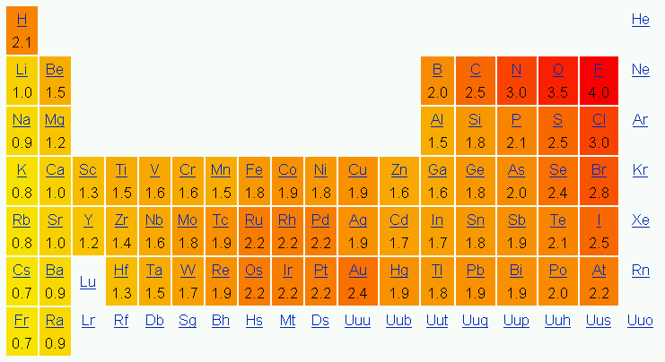
Q1: AsCl₃ is:
bent
pyramidal
T-shaped
trigonal planar
http://commons.wikimedia.org/wiki/File:Taula_peri%C3%B2dica_electronegativitat.png
Author: Joanjoc

Slide 3
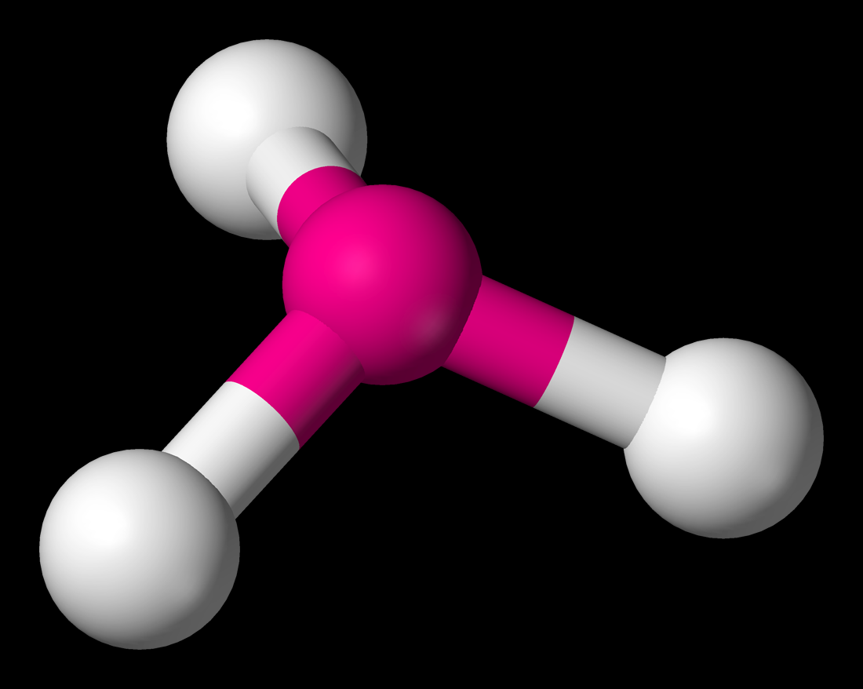
Figure by Benjah-bmm27 (Ben Mills)
http://commons.wikimedia.org/wiki/File:Pyramidal-3D-balls.png

Slide 4
Q2: The bonding in AsCl₃ is:
ionic
nonpolar covalent
polar covalent
http://commons.wikimedia.org/wiki/File:Taula_peri%C3%B2dica_electronegativitat.png
Author: Joanjoc

Slide 5
Q3: As a compound, AsCl₃ is:
ionic
nonpolar covalent
polar covalent

Slide 6
Q4: CI₄ is:
see-saw shaped
square planar
tetrahedral
trigonal planar
http://commons.wikimedia.org/wiki/File:Taula_peri%C3%B2dica_electronegativitat.png
Author: Joanjoc

Slide 7
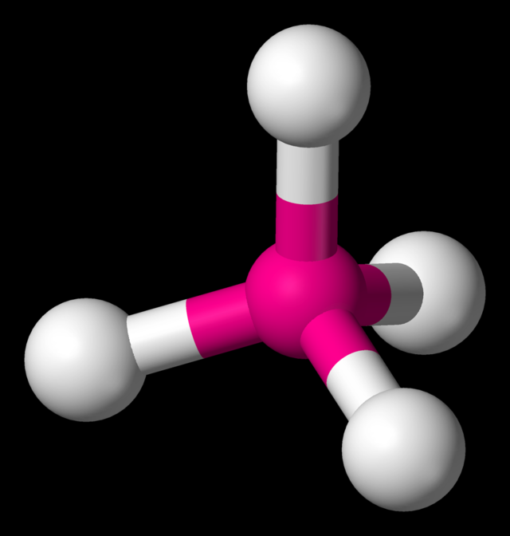
Figure by
Benjah-bmm27
(Ben Mills)
http://commons.wikimedia.org/wiki/File:Tetrahedral-3D-balls.png

Slide 8
Q5: The bonding in CI₄ is:
ionic
nonpolar covalent
polar covalent
http://commons.wikimedia.org/wiki/File:Taula_peri%C3%B2dica_electronegativitat.png
Author: Joanjoc

Slide 9
Q6: As a compound, CI₄ is:
ionic
nonpolar covalent
polar covalent

Slide 10
Q7: H₂O is:
bent
linear
see-saw shaped
trigonal planar
http://commons.wikimedia.org/wiki/File:Taula_peri%C3%B2dica_electronegativitat.png
Author: Joanjoc

Slide 11
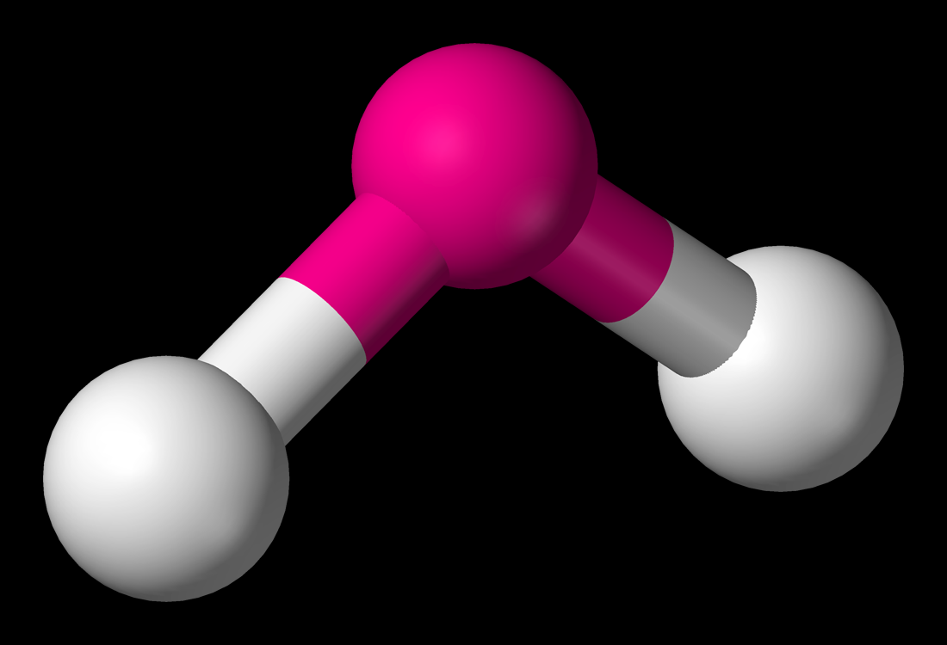
Figure by
Benjah-bmm27
(Ben Mills)
http://commons.wikimedia.org/wiki/File:Bent-3D-balls.png

Slide 12
Q8: The bonding in H₂O is:
ionic
nonpolar covalent
polar covalent
http://commons.wikimedia.org/wiki/File:Taula_peri%C3%B2dica_electronegativitat.png
Author: Joanjoc

Slide 13
Q9: As a compound, H₂O is:
ionic
nonpolar covalent
polar covalent

Slide 14
Q10: KrF₂ is:
bent
linear
see-saw shaped
trigonal planar
http://commons.wikimedia.org/wiki/File:Taula_peri%C3%B2dica_electronegativitat.png
Author: Joanjoc

Slide 15
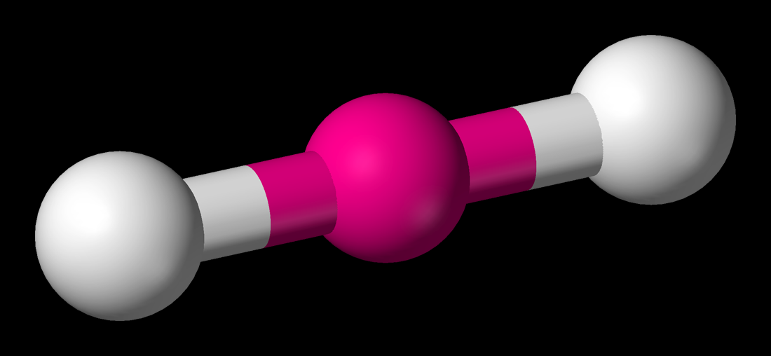
Figure by Benjah-bmm27 (Ben Mills)
http://commons.wikimedia.org/wiki/File:Linear-3D-balls.png

Slide 16
Q11: The bonding in KrF₂ is:
ionic
nonpolar covalent
polar covalent
http://commons.wikimedia.org/wiki/File:Taula_peri%C3%B2dica_electronegativitat.png
Author: Joanjoc

Slide 17
Q12: As a compound, KrF₂ is:
ionic
nonpolar covalent
polar covalent

Slide 18
Q13: PBr₅ is:
square planar
square pyramidal
trigonal bipyramidal
trigonal planar
http://commons.wikimedia.org/wiki/File:Taula_peri%C3%B2dica_electronegativitat.png
Author: Joanjoc

Slide 19
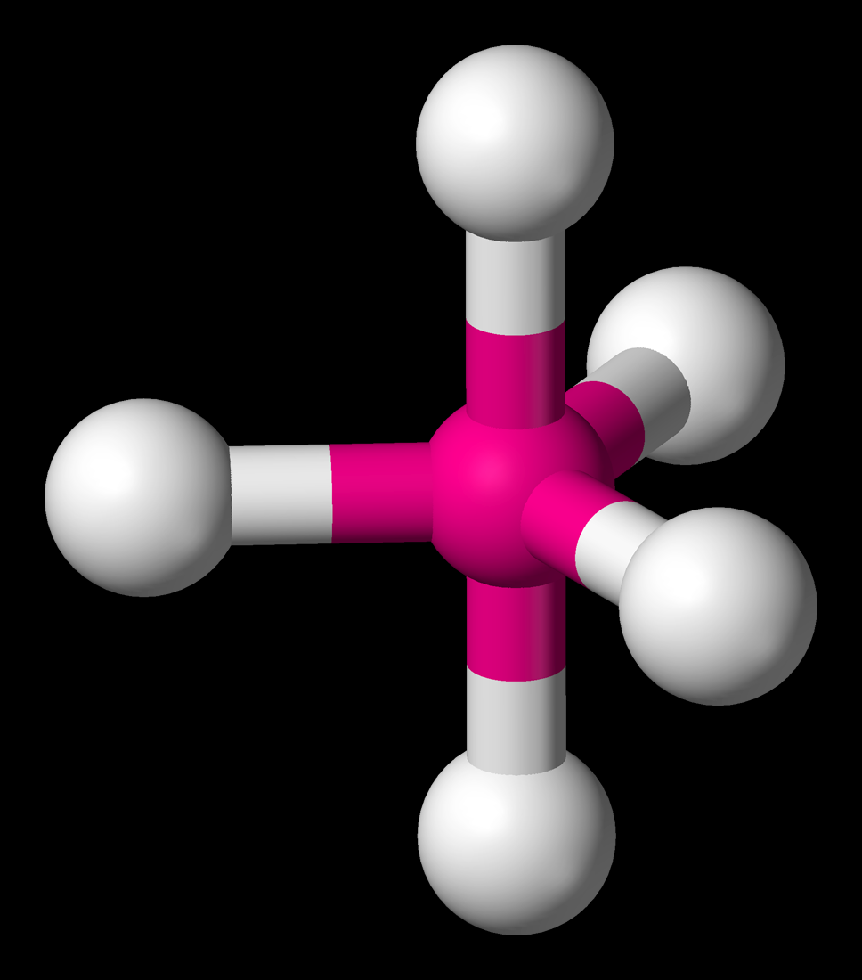
Figure by
Benjah-bmm27
(Ben Mills)
http://commons.wikimedia.org/wiki/File:Trigonal-bipyramidal-3D-balls.png

Slide 20
Q14: The bonding in PBr₅ is:
ionic
nonpolar covalent
polar covalent
http://commons.wikimedia.org/wiki/File:Taula_peri%C3%B2dica_electronegativitat.png
Author: Joanjoc

Slide 21
Q15: As a compound, PBr₅ is:
ionic
nonpolar covalent
polar covalent

Slide 22
Q16: SCl₄ is:
pyramidal
see-saw shaped
square planar
tetrahedral
http://commons.wikimedia.org/wiki/File:Taula_peri%C3%B2dica_electronegativitat.png
Author: Joanjoc

Slide 23
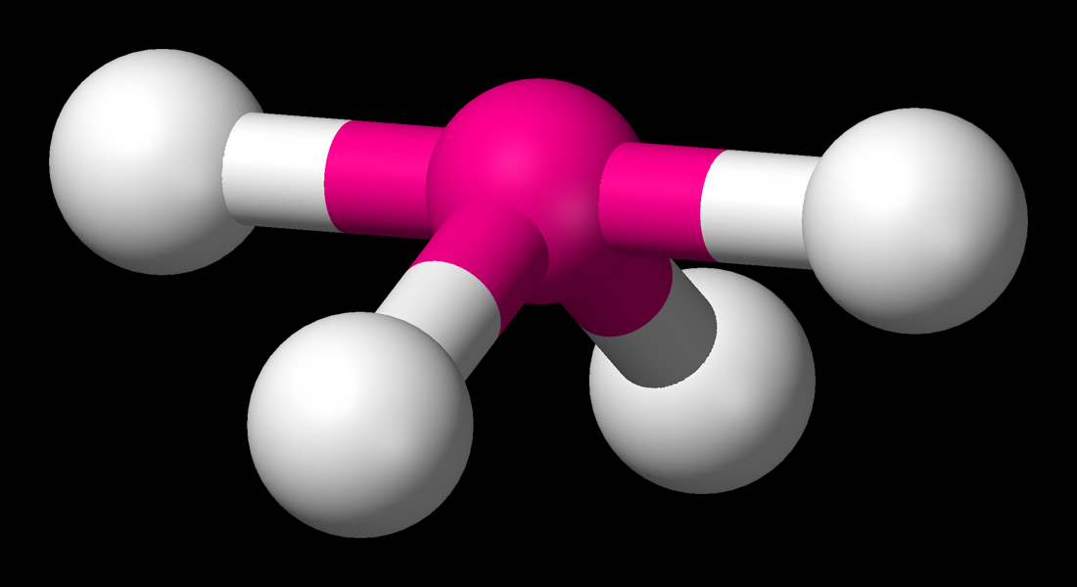
Figure by Benjah-bmm27 (Ben Mills)
http://commons.wikimedia.org/wiki/File:Seesaw-3D-balls.png

Slide 24
Q17: The bonding in SCl₄ is:
ionic
nonpolar covalent
polar covalent
http://commons.wikimedia.org/wiki/File:Taula_peri%C3%B2dica_electronegativitat.png
Author: Joanjoc

Slide 25
Q18: As a compound, SCl₄ is:
ionic
nonpolar covalent
polar covalent

