Slide 1
Strategies for Effective Scientific Writing
Anne M. LaPointe
Cornell University
lapointe@cornell.edu
Created by Anne LaPointe, Cornell University (lapointe@cornell.edu) and posted on VIPEr (www.ionicviper.org) on March22, 2017. This work is licensed under the Creative Commons Attribution Sharealike License. To view a copy of this license visit http://creativecommons.org/about/license/
Notes:
This was originally presented to the Center for Sustainable Polymers summer undergraduates in 2016. As part of their training, they were required to write a report on their summer research, as well as present a 15 minute research presentation and a 3 minute “pop talk” summarizing their work. It is geared towards upperclassmen writing research summaries and graduate students who are new to writing papers or research reports.
Some of the content of these slides was taken from journal articles and webinars – these are credited in the slide deck. Some of the content is drawn from my personal experience writing papers and editing papers from graduate students.

Slide 2
Scientific Writing
1. Getting started
2. Figures, Schemes and Tables
3. Results and Discussion
4. Abstract, Introduction and Conclusion
5. Experimental/Supplementary Information
6. Writing Style
Writing Stategies: Whitesides, Adv. Mater. 2004, 16, 1375-1377 DOI: 10.1002/adma.200400767
General Strategies for Writing Effective Papers: Kamat and Schatz J. Phys. Chem. Lett. 2013, 4, 1578−1581 dx.doi.org/10.1021/jz4006916
‘20 papers on writing papers’: Kamat, Buriak, Schatz, and Weiss J. Phys. Chem. Lett. 2014, 5, 3519−3521 dx.doi.org/10.1021/jz502010v and references therein
Notes:
There are a lot of resources available on-line. I especially like the “20 papers on writing papers” series (ACS journals) as well as the follow-up articles that occasionally appear.

Slide 3
Getting Started
Create an outline and prepare figures and schemes
Describe results + write experimental section
Write introduction, conclusion, and abstract
In many cases, you’ll have some parts already prepared before beginning the process
Figures, tables, schemes, graphs etc.
Experimental procedures
References
Notes:
This is my personal preference – I am prone to writers block and find this speeds things up.
Create an outline
Prepare preliminary schemes/figures/tables/graphs – doesn’t have to be polished.
Do not start writing until you have outline and rough figures.
Write body of paper
Write introduction, conclusion, abstract. Some people prefer to write introduction first, so you may want to try both approaches and see which you prefer.

Slide 4
The Outline
Prepare outline before writing anything
Start to prepare graphics early
Work with coauthors to agree on outline and general content
Identify any remaining experiments
Notes:
Even if you have the outline in your head, get it on paper.

Slide 5
Figures and Schemes
A picture is worth a thousand words
  Reduces the amount of text needed
  Many people will skim the paper and look at the figures
  Position figures at an appropriate spot
    Too early >> too late
Maximizing impact + saving space
  Add schemes to tables and graphs
  Use multipart figures when appropriate
  Consider adding schematics to figures
Notes:
Prepare rough figures and schemes before writing – it really makes it a lot easier to write
Short communications will be more challenging to write – good graphics will help you save a lot of space.

Slide 6
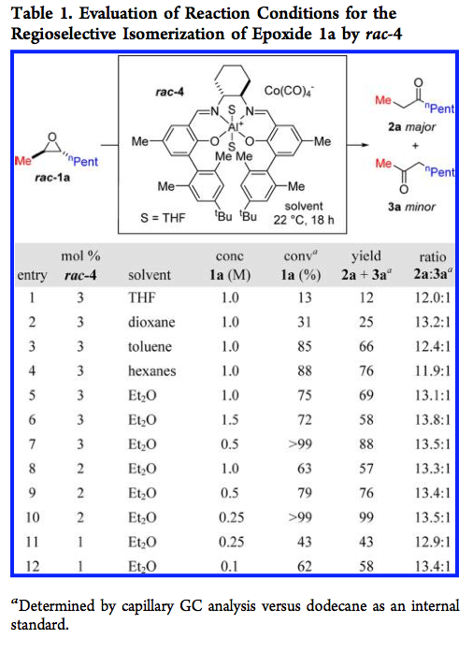
Tables
Combine with graphics to increase impact
Color coding
All structures shown
All conditions listed
All catalysts and products labeled
Table is easy to read

Slide 7
Graphs
Combine with graphics to increase effectiveness
Maximize visual impact and readability
Effective use of color and shading
Effective use of space
Visible units and major and minor tic lines
Use bolded/larger font in axis title
dx.doi.org/10.1021/jz4006916 | J. Phys. Chem. Lett. 2013, 4, 1578−1581
Notes:
Caption things and add enough description for people who are skim-reading
Make sure colors are distinct from one another.
For presentation, double check colors on a projector - sometimes things look different than on screen. (yellows and some greens are problematic)
If you’re using color to distinguish two things, don’t use red and green – some people are color blind. Use a different pair of colors if possible

Slide 8
Multipart Figures
Introductory figures
Combine both background information and new results
Place near introduction for maximum impact
Notes:
Both single part and multipart figures are used.
Sometimes it is useful to put a multipart figure in/near the introduction
Better to have figures too early rather than too late.

Slide 9
Schematics
Not always needed
Can help visualize concepts
May be combined with graphs or tables
Schematic “cartoons”
graph

Slide 10
Results and Discussion
Write this section after you’ve prepared the graphics and tables
Have most references ready
Get words on paper, then edit
  Results are easiest section to write
Refer to scheme/figure/table when appropriate
Modify figures/graphics if needed
Notes:
You’ll save time writing if you have tables/figures ready before writing – it’s much easier to just refer to Figure x than spend a paragraph describing it.
Add, edit or combine figures if necessary.

Slide 11
Abstract, Introduction and Conclusion
Write these last!
Abstract = “highlights reel”
  Summarize key results, minimal discussion
Introduction
  Why is this interesting
  What has already been done (highlights only)
  Describe your hypothesis at end of this section
Conclusion
  Summarize key results
  Put in context – why is it important?
  Describe future research strategies (1-2 sentences)
Notes:
Some people like to write the introduction first.
If you are prone to writer’s block, I recommend saving it for the end.

Slide 12
Experimental Section/SI
Describe so someone outside your group could repeat the experiment
  E.g. 1st year grad student in same subdiscipline
Include all characterization data
Include useful visual observations
List commercial sources of chemicals
Reference a good synthetic description for starting materials or write a new one
Remember – no page limit on Supplementary Information (SI)!
Buriak and Korgel, Chem. Mater. 2014, 26, 1765−1766 dx.doi.org/10.1021/cm500632c
Notes:
Experimental section used to be included in main body of paper. Now it’s usually in the SI.
Have one of your peers look at your experimental section to check if it’s clear and has enough detail
If you reference a synthesis of a starting material, make sure the reference actually describes the synthesis instead of just referencing another paper. This is unfortunately very common and very annoying.

Slide 13
Example: Incomplete Synthetic Procedure
Before – not enough detail!!!
Synthesis of 5. Deprotonation of L2 (0.73 g, 1.7 mmol) with BuLi (1.14 mL of a 1.6 M solution in hexanes) furnished the pyridylamidolithium salt which, after washing with pentane, was allowed to react with HfCl₄ (0.61 g, 1.9 mmol). The resultant pyridylamidohafnium trichloride was treated with MeMgBr (2.13 mL of a 3.0 M solution in Et₂O) to furnish, upon work up, the desired product as a yellow-orange crystalline solid in a 46% yield.
What solvents?
How long for each step?
Reaction temperature?
Color changes?
What isomer of BuLi? (VERY IMPORTANT!!!)
List # of moles for all reagents
How was it recrystallized?
Notes:
Put enough detail so someone else could repeat it without having to ask questions
If you’ve worked on a project for a while, it becomes very routine to you. Remember to add in all the useful details.
For good descriptive examples of synthetic procedures, see Inorganic Syntheses
For other types of experiments, the same considerations apply

Slide 14
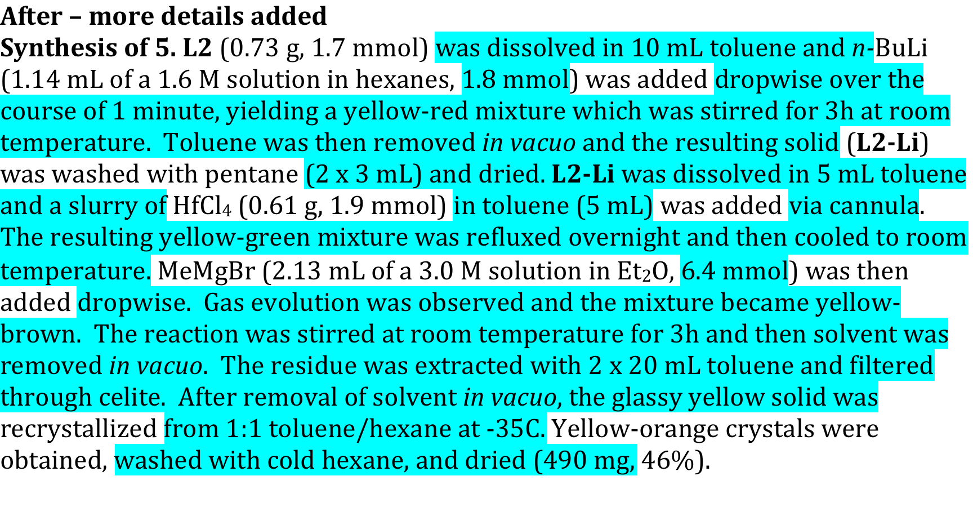
Example: More Detailed Synthetic Procedure
Notes:
New information highlighted in blue

Slide 15
Good Scientific Writing
Convey information clearly, concisely, and objectively
Clear writing promotes better understanding
Simple, straightforward writing
Be aware of page limitations
Direct, action verbs are usually better than flabby verbs of being, whatever the voice
Read lots of papers to see effective and ineffective styles + develop your own style
Notes:
You want people to notice the science, not the writing.
Page limitations may influence the style and amount of detail/discussion.
Consider giving students an example of a paper you think is well-written.

Slide 16
Scientific Writing Hints
See what styles work well in published papers
Get thoughts on paper, then edit
When editing, look for the following things
  Do not mimic spoken word
  Remove colloquialisms and idioms
  Aim to get message across
  Be specific and precise
  Remove filler words
  Shorten overly long sentences
  Avoid an overly complicated writing style
Be aware of page limitations
Practice, practice, practice!
Notes:
It’s often faster and easier to get words on paper, then edit.
Mimicking the spoken word is the most common mistake I see from new graduate students. The second most common mistake is using a very wordy writing style with complicated sentence structures. Scientific writing is different from writing papers for high school or college. Simple and clear is best.
Colloquialisms and idioms may not be understood by non-native English speakers (e.g. “holy grail” , “one-off experiment”, etc)
No one is born knowing how to be a good scientific writer – it takes practice and may feel awkward at first.

Slide 17
Active vs. Passive Voice
See ACS webinar for pros and cons https://www.acs.org/content/acs/en/acs-webinars/active-passive-free-preview.html)
Do what works best for you – ok to mix it up
  Strive for clarity and conciseness and let the voice take care of itself.
Passive voice traditionally used for experiments/results
  “The polymerization of epoxides in the presence of 1 was studied.”
Active/first person voice traditionally used in transitions and discussion of results/hypotheses.
  “The pyridylamidohafnium complexes had very high activity for propylene polymerization. Therefore, we tested additional examples of this class of catalysts.”
OK to use first person voice, but don’t let it distract from the science.
See ACS Webinar slides and references therein
Notes:
This is a matter of debate, as well as personal preference.
Papers used to be much shorter and the passive voice was frequently used.
In a well-written paper, you may not even notice this. It’s more obvious in poorly written papers.

Slide 18
Resources
ACS Style Guide
  Technical writing classes at your school
  Scientific writing lectures
    http://physics.illinois.edu/people/Celia/
Writing in the Sciences MOOC:
  https://class.stanford.edu/courses/Medicine/Sci- Write/Fall2014/about
Notes:
Many resources available on-line – these are just a few examples
Encourage students to take a technical writing class

