Slide 1
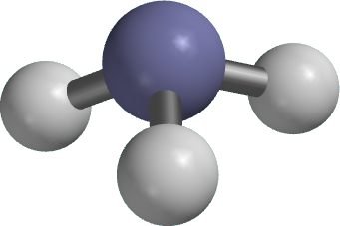
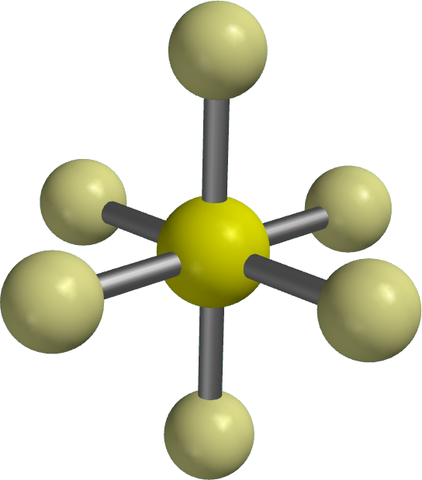
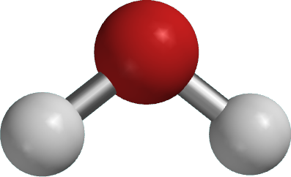
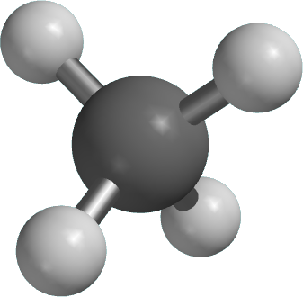
How Chemists Use Group Theory
Created by Anne K. Bentley, Lewis & Clark College (bentley@lclark.edu) and posted on VIPEr (www.ionicviper.org) on March 26, 2014. Copyright Anne K. Bentley 2014. This work is licensed under the Creative Commons Attribution Non-commercial Share Alike License. To view a copy of this license visit http://creativecommons.org/about/license/

Slide 2
Notes:
I included a variety of symmetrical images from nature on this slide – I found them all on the internet and cited them, but I wasn’t sure I could keep them in here when posting to VIPEr. So create your own “symmetry is beautiful” page if you like!

Slide 3
Why do chemists care about symmetry?
It allows the prediction of
chirality
IR and Raman spectroscopy
bonding

Slide 4
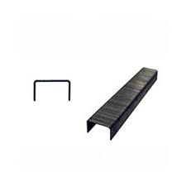

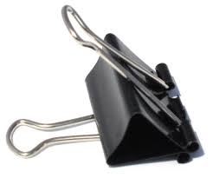

Which objects share the same symmetry as a water molecule?
Notes:
Each audience member had a set of the office supplies. I brought along a model of a water molecule. It was fun to get some initial votes from the audience.

Slide 5
How can we “quantify” symmetry?

Slide 6
Symmetry can be described by symmetry operations and elements.
rotation, C_{n}
reflection, σ
inversion, i
improper rotation, S_{n}
identity, E
Notes:
Refer to Otterbein’s symmetry site for a tutorial. I went to the site and showed them examples of each type of operation.

Slide 7
Objects that share the same set of symmetry elements belong to the same point group.
= C_{2v} (E, C₂, two σ_{v})

Slide 8
The operations in a group follow the requirements of a mathematical group.
Closure
Identity
Associativity
Reciprocality
if AB = C, then C is also in the group

Slide 9
The operations in a group follow the requirements of a mathematical group.
Closure
Identity
Associativity
Reciprocality
AE = EA = A

Slide 10
The operations in a group follow the requirements of a mathematical group.
Closure
Identity
Associativity
Reciprocality
(AB)C = A(BC)
The C_{2v} point group is an Abelian group – ie, all operations commute (AB = BA). Most point groups are not Abelian.

Slide 11
The operations in a group follow the requirements of a mathematical group.
Closure
Identity
Associativity
Reciprocality
AA⁻¹ = E
In the C_{2v} point group, each operation is its own inverse.

Slide 12
The operations in a group follow the requirements of a mathematical group.
Closure
Identity
Associativity
Reciprocality

Slide 13
Each operation can be represented by a transformation matrix.
–1 0 0
–x
–y
z
=
0 –1 0
0 0 1
original
coordinates
new
coordinates
transformation matrix
Which operation is represented by this transformation matrix?

Slide 14
The transformation matrices also follow the rules of a group.
–1 0 0
1 0 0
–1 0 0
0 –1 0
0 –1 0
=
0 1 0
0 0 1
0 0 1
0 0 1
C₂
σ_{xz}
σ_{yz}

Slide 15
Irreducible representations can be generated for x, y, and z
C_{2v} E C₂ σ_{v(xz)} σ_{v(yz)}
1
–1
1
–1
x
1
–1
–1
1
y
1
1
1
1
z
Notes:
Representations can be generated that demonstrate what happens to points along the x, y, and z axes when the operations are carried out.

Slide 16
A complete set of irreducible representations for a given group is called its character table.
C_{2v} E C₂ σ_{v(xz)} σ_{v(yz)}
1
–1
1
–1
x
1
–1
–1
1
y
1
1
1
1
z
?

Slide 17
A complete set of irreducible representations for a given group is called its character table.
C_{2v} E C₂ σ_{v(xz)} σ_{v(yz)}
1
–1
1
–1
x
1
–1
–1
1
y
1
1
1
1
z
1
1
–1
–1
xy
Notes:
Explain the significance of the xy irreducible representation by showing the mathematical function of xy – ie, an x and y coordinate system with positive values in two quadrants and negative values in two others. At this point I handed out sets of character tables for the audience to inspect. Two of my math colleagues were so excited that I had to shush them.

Slide 18
More complicated molecules…
ammonia, NH₃ C_{3v}
methane, CH₄ T_{d}

Slide 19
Applications of group theory
IR spectroscopy
Molecular orbital theory

Slide 20
Gases in Earth’s atmosphere
nitrogen (N₂) 78%
oxygen (O₂) 21%
argon (Ar) 0.93%
carbon dioxide (CO₂) 400 ppm
(0.04%)
Notes:
I included this slide to try to interest the audience in the question: “why is CO2 a greenhouse gas while all these other gases are not?”

Slide 21
carbon dioxide stretching modes
not IR active
IR active
Notes:
I included two Spartan videos here. I will upload them separately, because the powerpoint file becomes too large to upload when they are included.

Slide 22
Are the stretching modes of methane IR active?
T_{d} E 8C₃ 3C₂ 6S₄ 6σ_{d}
Γ
4 1 0 0 2
Γ = A₁ + T₂
Notes:
On the chalkboard, I very briefly showed how to generate this reducible representation. I did not show how to reduce it.

Slide 23
methane’s A₁ vibrational mode
not IR active
Notes:
Again, you should insert the appropriate video here.

Slide 24
methane T₂
stretching vibrations
all at the same energy
T₂ irreducible rep transforms as (x, y, z)
together, they lead to one IR band
Notes:
Three energetically equivalent stretching modes = three videos to insert.

Slide 25
Molecular Orbital Theory
How and why does something like this form?

Slide 26
Bonding Basics
Atoms have electrons
Electrons are found in orbitals, the shapes of which are determined by wavefunctions

Slide 27
Bonding Basics
A bond forms between two atoms when their electron orbitals combine to form one mutual orbital.
+
=
+
=

Slide 28
Bonding is Determined by Symmetry
+
=
no bond forms
+
=
bond forms
+
=
bond forms

Slide 29
Use group theory to assign symmetries and predict bonding.
A_{1g}
T_{1u}
T_{2g}
(and two more)
SF₆
E_{g}
and

Slide 30
Outer atoms are treated as a group.
A_{1g}
T_{1u}
E_{g}

Slide 31
Which types of bonds will form?
central sulfur six fluorine
A_{1g} A_{1g}
T_{1u} T_{1u}
T_{2g} E_{g}
E_{g}

Slide 32
Concluding Thoughts

Slide 33
Recommended Resources
Cotton, F. Albert. Chemical Applications of Group Theory, Wiley: New York, 1990.
Carter, Robert L. Molecular Symmetry and Group Theory, Wiley: 1998.
Harris, Daniel C. and Bertolucci, Michael D. Symmetry and Spectroscopy, Dover Publications: New York, 1978.
Vincent, Alan, Molecular Symmetry and Group Theory, Wiley: New York, 2001.
http://symmetry.otterbein.edu

Slide 34
Please return your office supplies!

