Slide 1
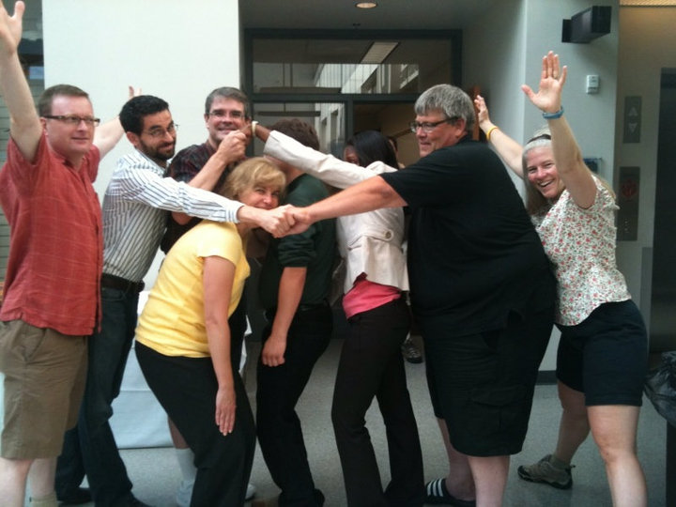
developing effective student learning groups
Created by Joanne L. Stewart and posted on VIPEr on 5/21/2015, Copyright 2015. This work is licensed under the Creative Commons Attribution, Non-Commercial, Share CC BY-NC-SA License. To view a copy of this license visit http://creativecommons.org/about/license/.
Joanne Stewart
Department of Chemistry
Hope College

Slide 2
The main points
Setting up student groups should be intentional – we know some things about this
Students need to learn how to be good group members
Group activities should be designed in order to maximize group success

Slide 3
Why do group work?
Students practice giving and receiving explanations, which leads to better learning
Students interact with people who are different from them, which promotes social development
Students can feel connected, engaged, and included, thus promoting retention
Two heads are better than one
More hands makes lighter work
Students learn to plan and manage time

Slide 4
Setting up student groups should be intentional
Spontaneous group formation (counting off, turn to your neighbor, choosing cards)
  Advantages – It's quick, more students can meet each other
  Disadvantages – Groups may be too homogeneous and not have the range of skills and experiences needed
Student self-selection
  Advantages - student satisfaction is usually higher
  Disadvantages – groups may be very homogeneous, students won't learn how to work with people they don't know

Slide 5
Setting up student groups should be intentional
Instructor-selected groups
  Much of what is known is anecdotal but common-sensical: Heterogeneous is better than homogeneous, avoid singling out students (e.g., avoid putting one man in each group in a female- dominated class)
  Some instructors use personality profiles (Myers-Briggs) or learning style profiles to make heterogeneous groups
  One study showed that students of all abilities (as determined by GALT, a logical thinking test) improved their problem solving abilities by about 10% by working in groups
    EXCEPT when a low scorer was paired with a low scorer
    AND middle scorers paired with low scorers improved twice as much
“An assessment of the effect of collaborative groups on students’ problem-solving strategies and abilities,” M.M. Cooper, C.T. Cox, Jr, M. Nammouz, E. Case, J. Chem. Educ., 2008, 85, 866-872.

Slide 6
Students need to learn how to be good group members
Team building
  Ice breakers, games, choosing a team name, team expectations agreements (tons of stuff on the internet)
Roles
  Assigning roles clarifies expectations and encourages students to practice prosocial behaviors they might not usually engage in (see handouts)
Group reflection
  Individual and group self-evaluation promotes the development of effective group skills (see handouts)
“Turning student groups into effective teams,” B. Oakley, R. Felder, R. Brent, I. Elhaaj, J. of Student Centered Learning, 2004, 2, 9-34http://www4.ncsu.edu/unity/lockers/users/f/felder/public/Papers/Oakley-paper%28JSCL%29.pdf
“POGIL: Roles in a POGIL Classroom” (links to interpersonal effectiveness videos): https://pogil.org/resources/implementation/roles-in-a-pogil-classroom

Slide 7
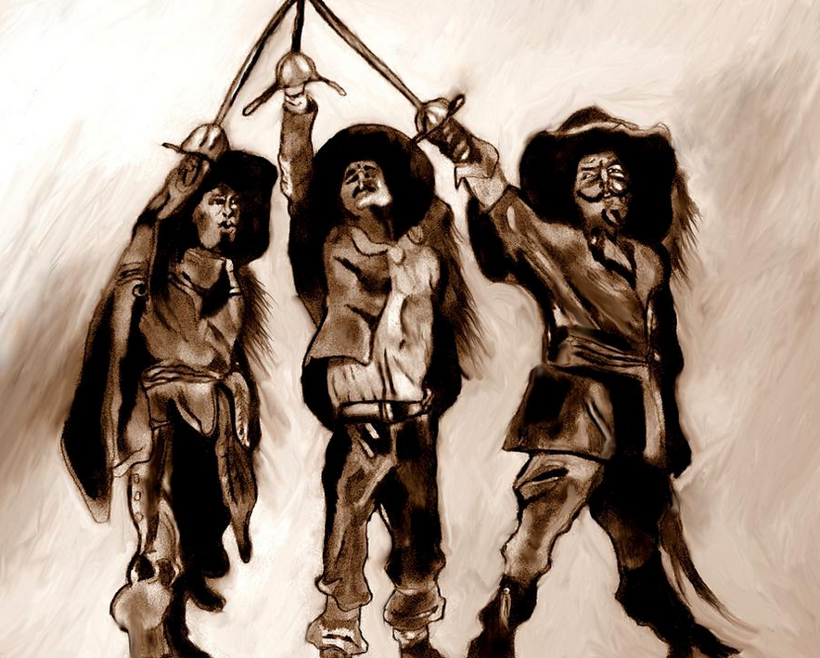

Designing group activities for success
Positive interdependence
    Students believe that they can attain their goals only if all of the members achieve their goals. Techniques include assigning roles, giving limited information to each student so that they need to come together, and more.
Individual accountability
    Reduces “social loafing” or slacking. Techniques include keeping group size small, testing students individually, observing groups, asking group members to peer evaluate.
“Active Learning: Cooperation in the Classroom” D.W. Johnson, R. T. Johnson, K. A. Smith, Interaction Book Company, Edina, MN 1998

Slide 8
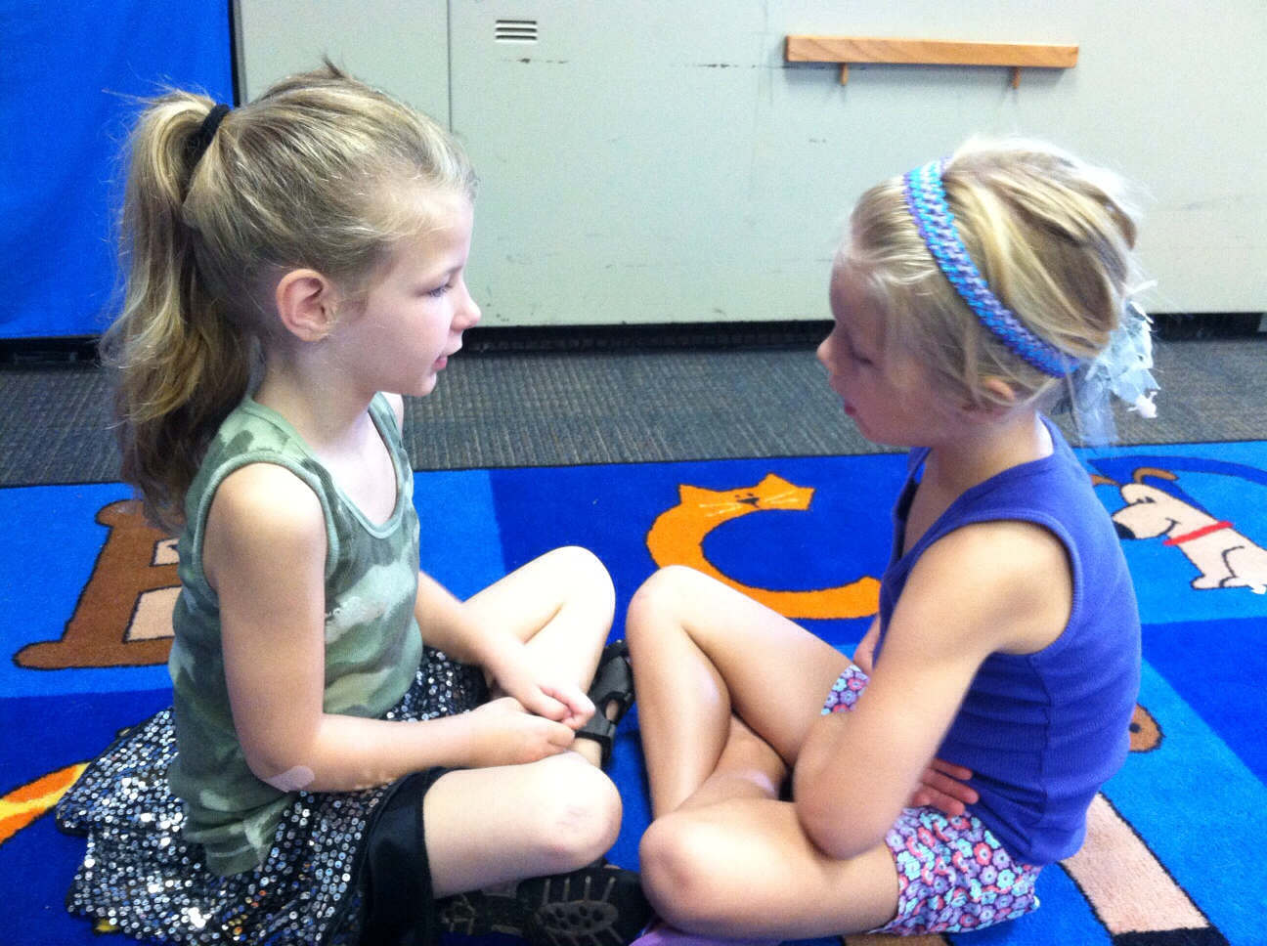

Designing group activities for success
Face-to-face promotive interaction
    Groups need to be physically together “eye-to-eye, knee-to-knee” and they need opportunities to promote and celebrate one another’s success.
Interpersonal and small group skills
    Team building, roles, group reflection (see videos from POGIL for great examples: https://pogil.org/resources/implementation/interpersonal-effectiveness-videos)
Group processing
    Assess the quality of interaction among group members, give groups feedback, help groups set goals to “get better,” celebrate success!

Slide 9
Review of main points
Setting up student groups should be intentional – we know some things about this
Students need to learn how to be good group members
Group activities should be designed in order to maximize group success

