Slide 1
Facilitator Notes
Description: These slides accompany the activity “Exploring Interactions of Matter with Light” which is intended to be used before the activity “Spectroscopy in Inorganic Chemistry.” Both of these activities accompany the advanced inorganic laboratory “Linkage Isomerism.”
Road Map: 1) Instructor outlines the class with slide #1
2) Students complete parts 1 – 5
3) Instructor assigns each group a molecules on slide #2
4) Students complete part 6
5) Instructor leads discussion with slide #3
Facilitator notes for each slide: Comments can be viewed by selecting “Show comments” under the review tab. To print comments, be sure to select “Print comments and ink markup” in the print setting menu.
Created by Alycia M. Palmer, The Ohio State University (palmer.475@osu.edu) and posted on VIPEr (www.ionicviper.org) on April 25, 2014. Copyright Alycia M. Palmer 2014. This work is licensed under the Creative Commons Attribution Non-commercial Share Alike License. To view a copy of this license visit http://creativecommons.org/about/license/.

Slide 2
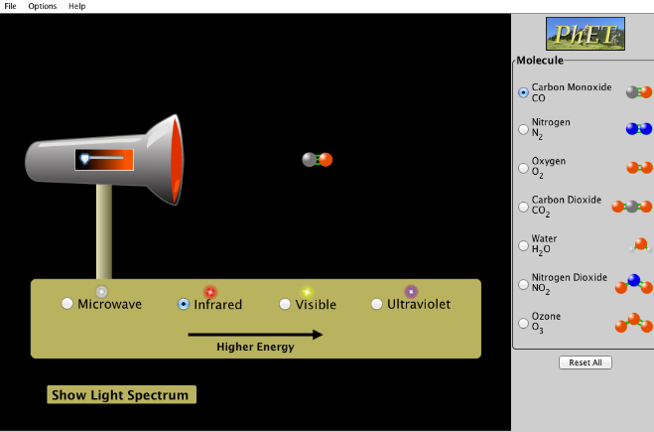
PhET simulation “Molecules and Light”
Form groups of 2—3 so that each group has at least one computer
Work through Parts #1—5
Ask the instructor to be assigned a molecule for Part #6
Slide #1

Slide 3
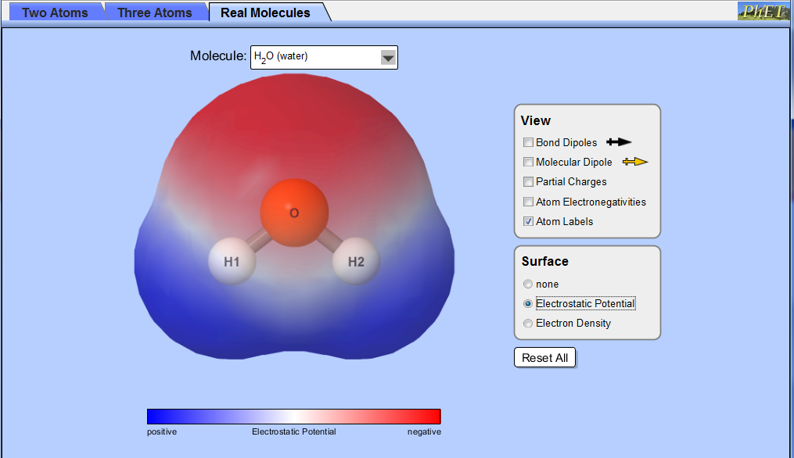
PhET simulation “Molecule Polarity”
Molecules for question #6
NH₃ (ammonia)
HCN (hydrogen cyanide)
CH₂O (formaldehyde)
CH₄ (methane)
CF₄ (carbon tetrafluoride)
CH₂F₂ (fluoromethane)
CCl₃F (Freon-11)
Slide #2

Slide 4
Atmospheric gases
O₂ and N₂ are inert
Ozone (O₃) absorbs UV, protecting the earth’s surface
CFCs react with UV light and catalyze the breakdown of ozone
  CCl₃F → CCl₂F· + Cl·
CH₂F₂ is the approved alternative to CFCs
  Zero ozone depletion potential (why?)
  However, it is considered a greenhouse gas (why?)
Slide #3

