Slide 1
5 Slides About:
Dioxygen Activation in Non-Heme Iron Enzymes
Gerard Rowe
University of South Carolina - Aiken

Slide 2
Dioxygen Activation
In general, the biological utilization of dioxygen is a 4-electron process
Metabolic Utilization
(Cytochrome c oxidase)
Monooxygenase Activity
(Methane Monooxygenase)
Dioxygenase Activity
(Intradiol Ring Cleaving Dioxygenase)
Notes:
The 4 electrons needed to reduce oxygen can come from external sources, such as NADH, FADH₂, pterin, or the Quinone Pool, or they can be provided by the substrate.

Slide 3
Heme vs. Non-Heme Oxidases
General Heme Protein Environment
X = S_{Met/Cys}, N_{His}, O_{Tyr}
Porphyrin ligand is redox active
Usually nonspecific oxidases
Taurine α-Ketoglutarate Dioxygenase
Utilizes an α-ketoacid cofactor as a source of electrons
Usually tailored to one substrate

Slide 4
Mononuclear Non-Heme O₂ Activation
Aromatic Amino Acid Hydroxylases Use a Pterin Cofactor that Provides Two Reducing Equivalents
Notes:
Pterin itself reacts with oxygen to make a 4a-hydroperoxypterin species (2-electron reduction of O₂) that interacts with the iron center to generate a reactive intermediate species (drawn here as an Fe(IV)=O species, but the iron-peroxo species has not been definitively ruled out as the active species) that hydroxylates the aromatic ring of the substrate.

Slide 5
Binuclear Non-Heme O₂ Activation
Binuclear iron enzymes generally do not utilize a cofactor, receiving their electrons from a reductase subunit, instead.
Notes:
This slide may be seen as a little controversial, as the identity of the active intermediates in the various binuclear non-heme iron enzymes is still debated. Some believe that the diferryl-di-mu-oxo species shown on top is capable of hydrogen atom abstraction, while others believe that it lies along an auto-decay pathway.

Slide 6
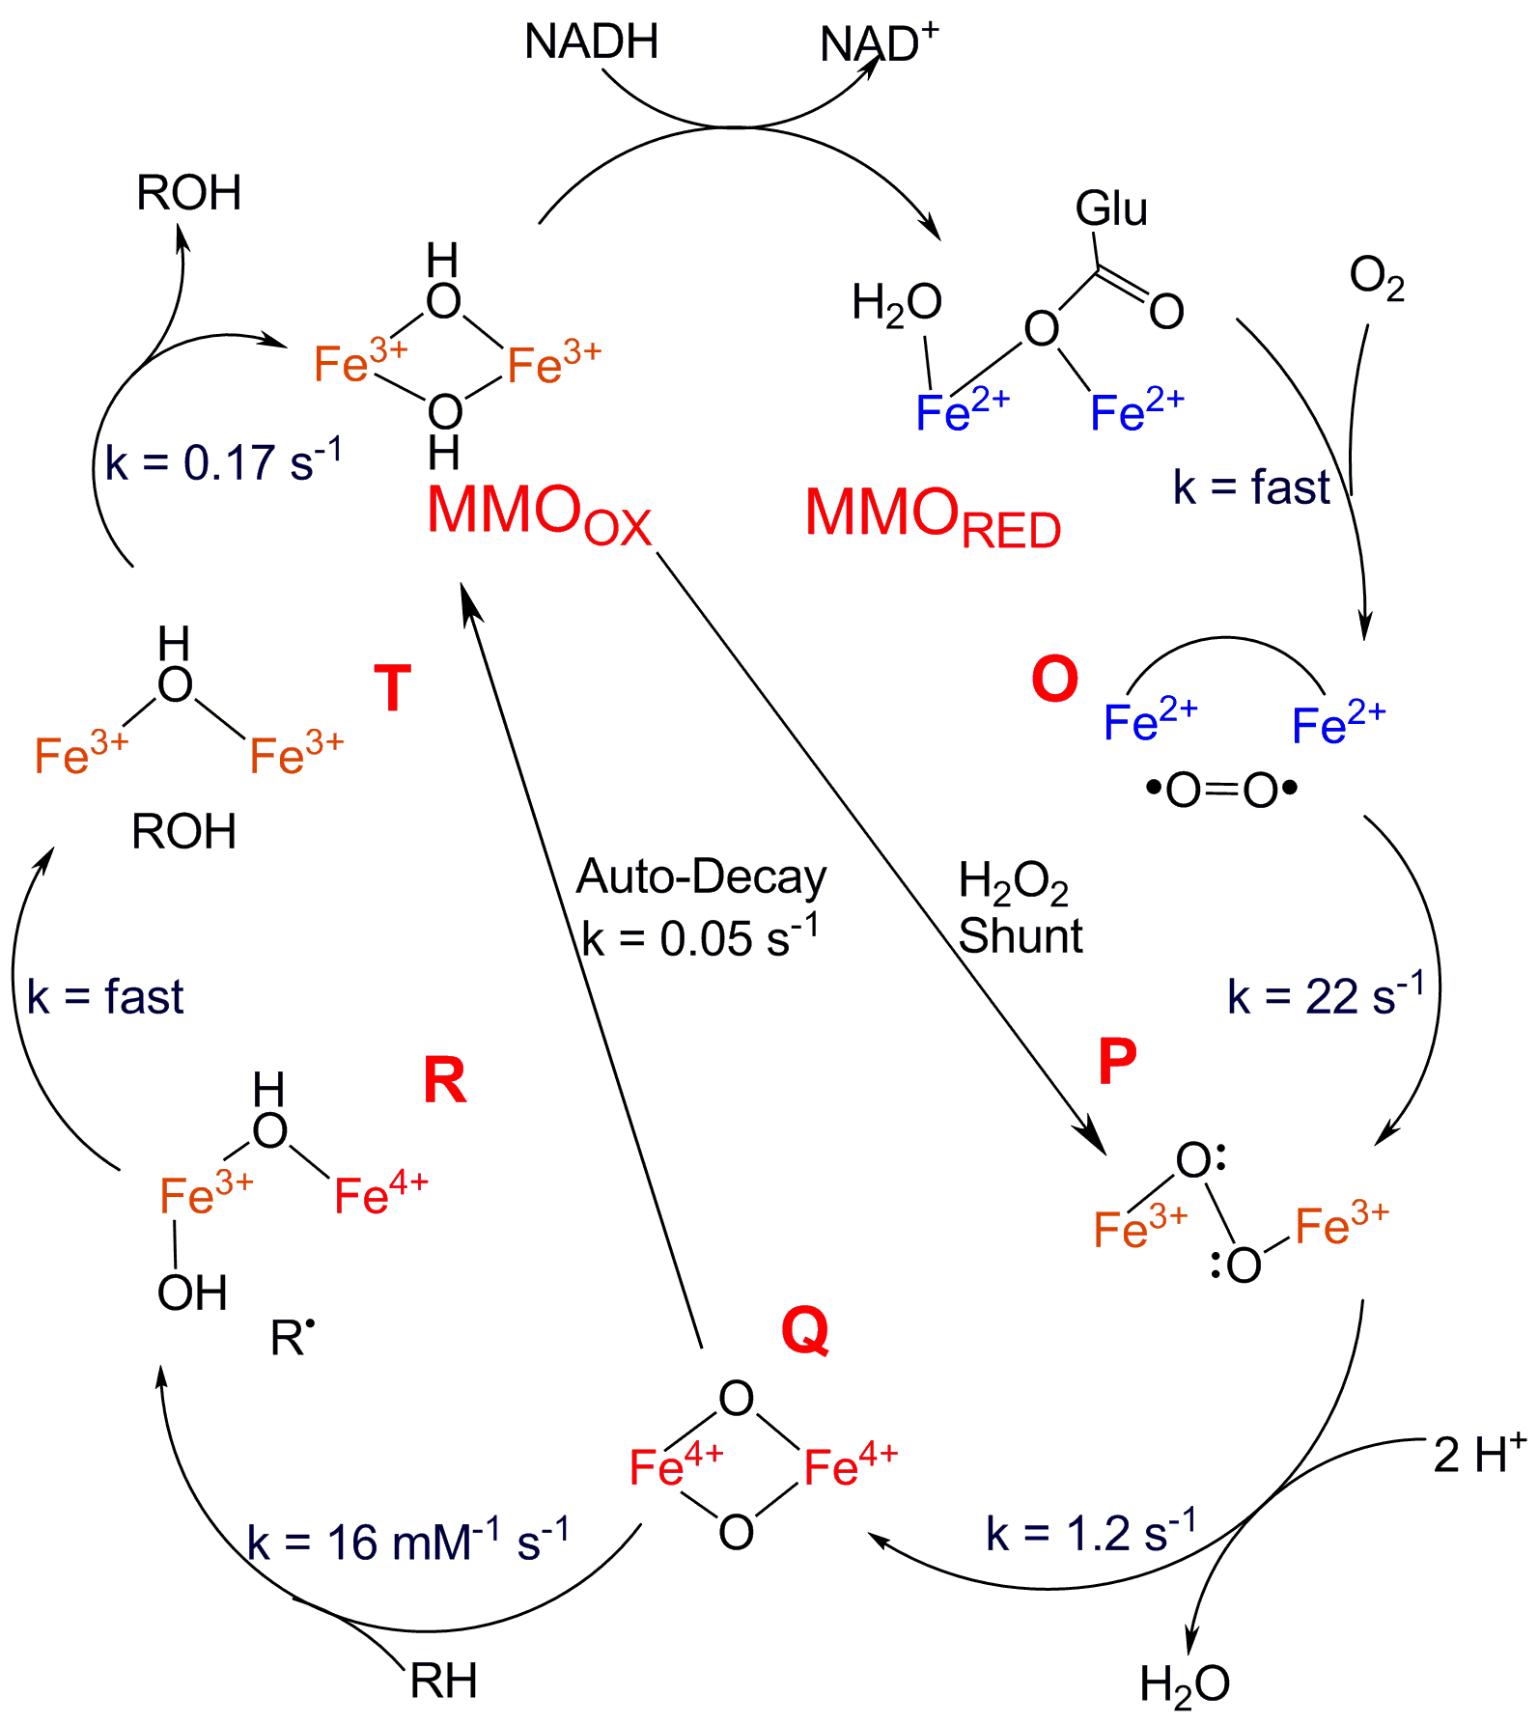
Detailed Look at Activation Mechanism
Addition of O₂ to MMO_{Red} results in an unobserved, but kinetically implicated species O
Heterolytic Cleavage of peroxo bond (P → Q) forms a Fe(IV)Fe(IV)-oxo species, termed Q.
sMMO_{Ox} can directly convert to P by the addition of peroxide.
*Rates reported at 4ºC
Notes:
This is the general catalytic cycle followed by one member of the family, soluble methane monooxygenase. There's a lot here, but the important thing to take from this slide is that the active oxidant of the enzyme is the so-called compound Q, which I have labelled here as a di-iron(IV) terminal oxo compound, which it was suspected to be for quite a while. This species can be generated either by reaction with molecular oxygen, or by adding peroxide directly to the unreduced enzyme through what is known as the peroxide shunt pathway

Slide 7
Why Use Non-Heme Oxygenases?
Oxygen is dangerous. One misfire of the enzyme can hydroxylate the active site, rendering it useless. Heme oxygenases like P450 can hydoxylate nearly anything, but lack control and tunability. Non-heme oxygenases are customizable, and the potency of the intermediate can be reduced.

Slide 8
References for Further Study
Mononuclear Enzymes:
Kappock, T. J.; Caradonna, J. P. "Pterin-dependent amino acid hydroxylases." Chem. Rev. 1996, 96, 2659.
Glickman, M. H.; Klinman, J. P. "Lipoxygenase reaction mechanism: Demonstration that hydrogen abstraction from substrate precedes dioxygen binding during catalytic turnover." Biochemistry 1996, 35, 12882.
Riggs-Gelasco, P. J.; Price, J. C.; Guyer, R. B.; Brehm, J. H.; Barr, E. W.; Bollinger, J. M.; Krebs, C. "EXAFS spectroscopic evidence for an Fe = O unit in the Fe(IV) intermediate observed during oxygen activation by taurine :alpha-ketoglutarate dioxygenase." J. Am. Chem. Soc. 2004, 126, 8108.
Bertini, I.; Briganti, F.; Mangani, S.; Nolting, H. F.; Scozzafava, A. "Biophysical investigation of bacterial aromatic extradiol dioxygenases involved in biodegradation processes." Coord. Chem. Rev. 1995, 144, 321.
Wackett, L. P. "Mechanism and applications of Rieske non-heme iron dioxygenases." Enzyme Microb. Technol. 2002, 31, 577.
Binuclear Enzymes:
Baik, M. H.; Newcomb, M.; Friesner, R. A.; Lippard, S. J. "Mechanistic studies on the hydroxylation of methane by methane monooxygenase." Chem. Rev. 2003, 103, 2385.
Wallar, B. J.; Lipscomb, J. D. "Dioxygen activation by enzymes containing binuclear non- heme iron clusters." Chem. Rev. 1996, 96, 2625.

