Slide 1
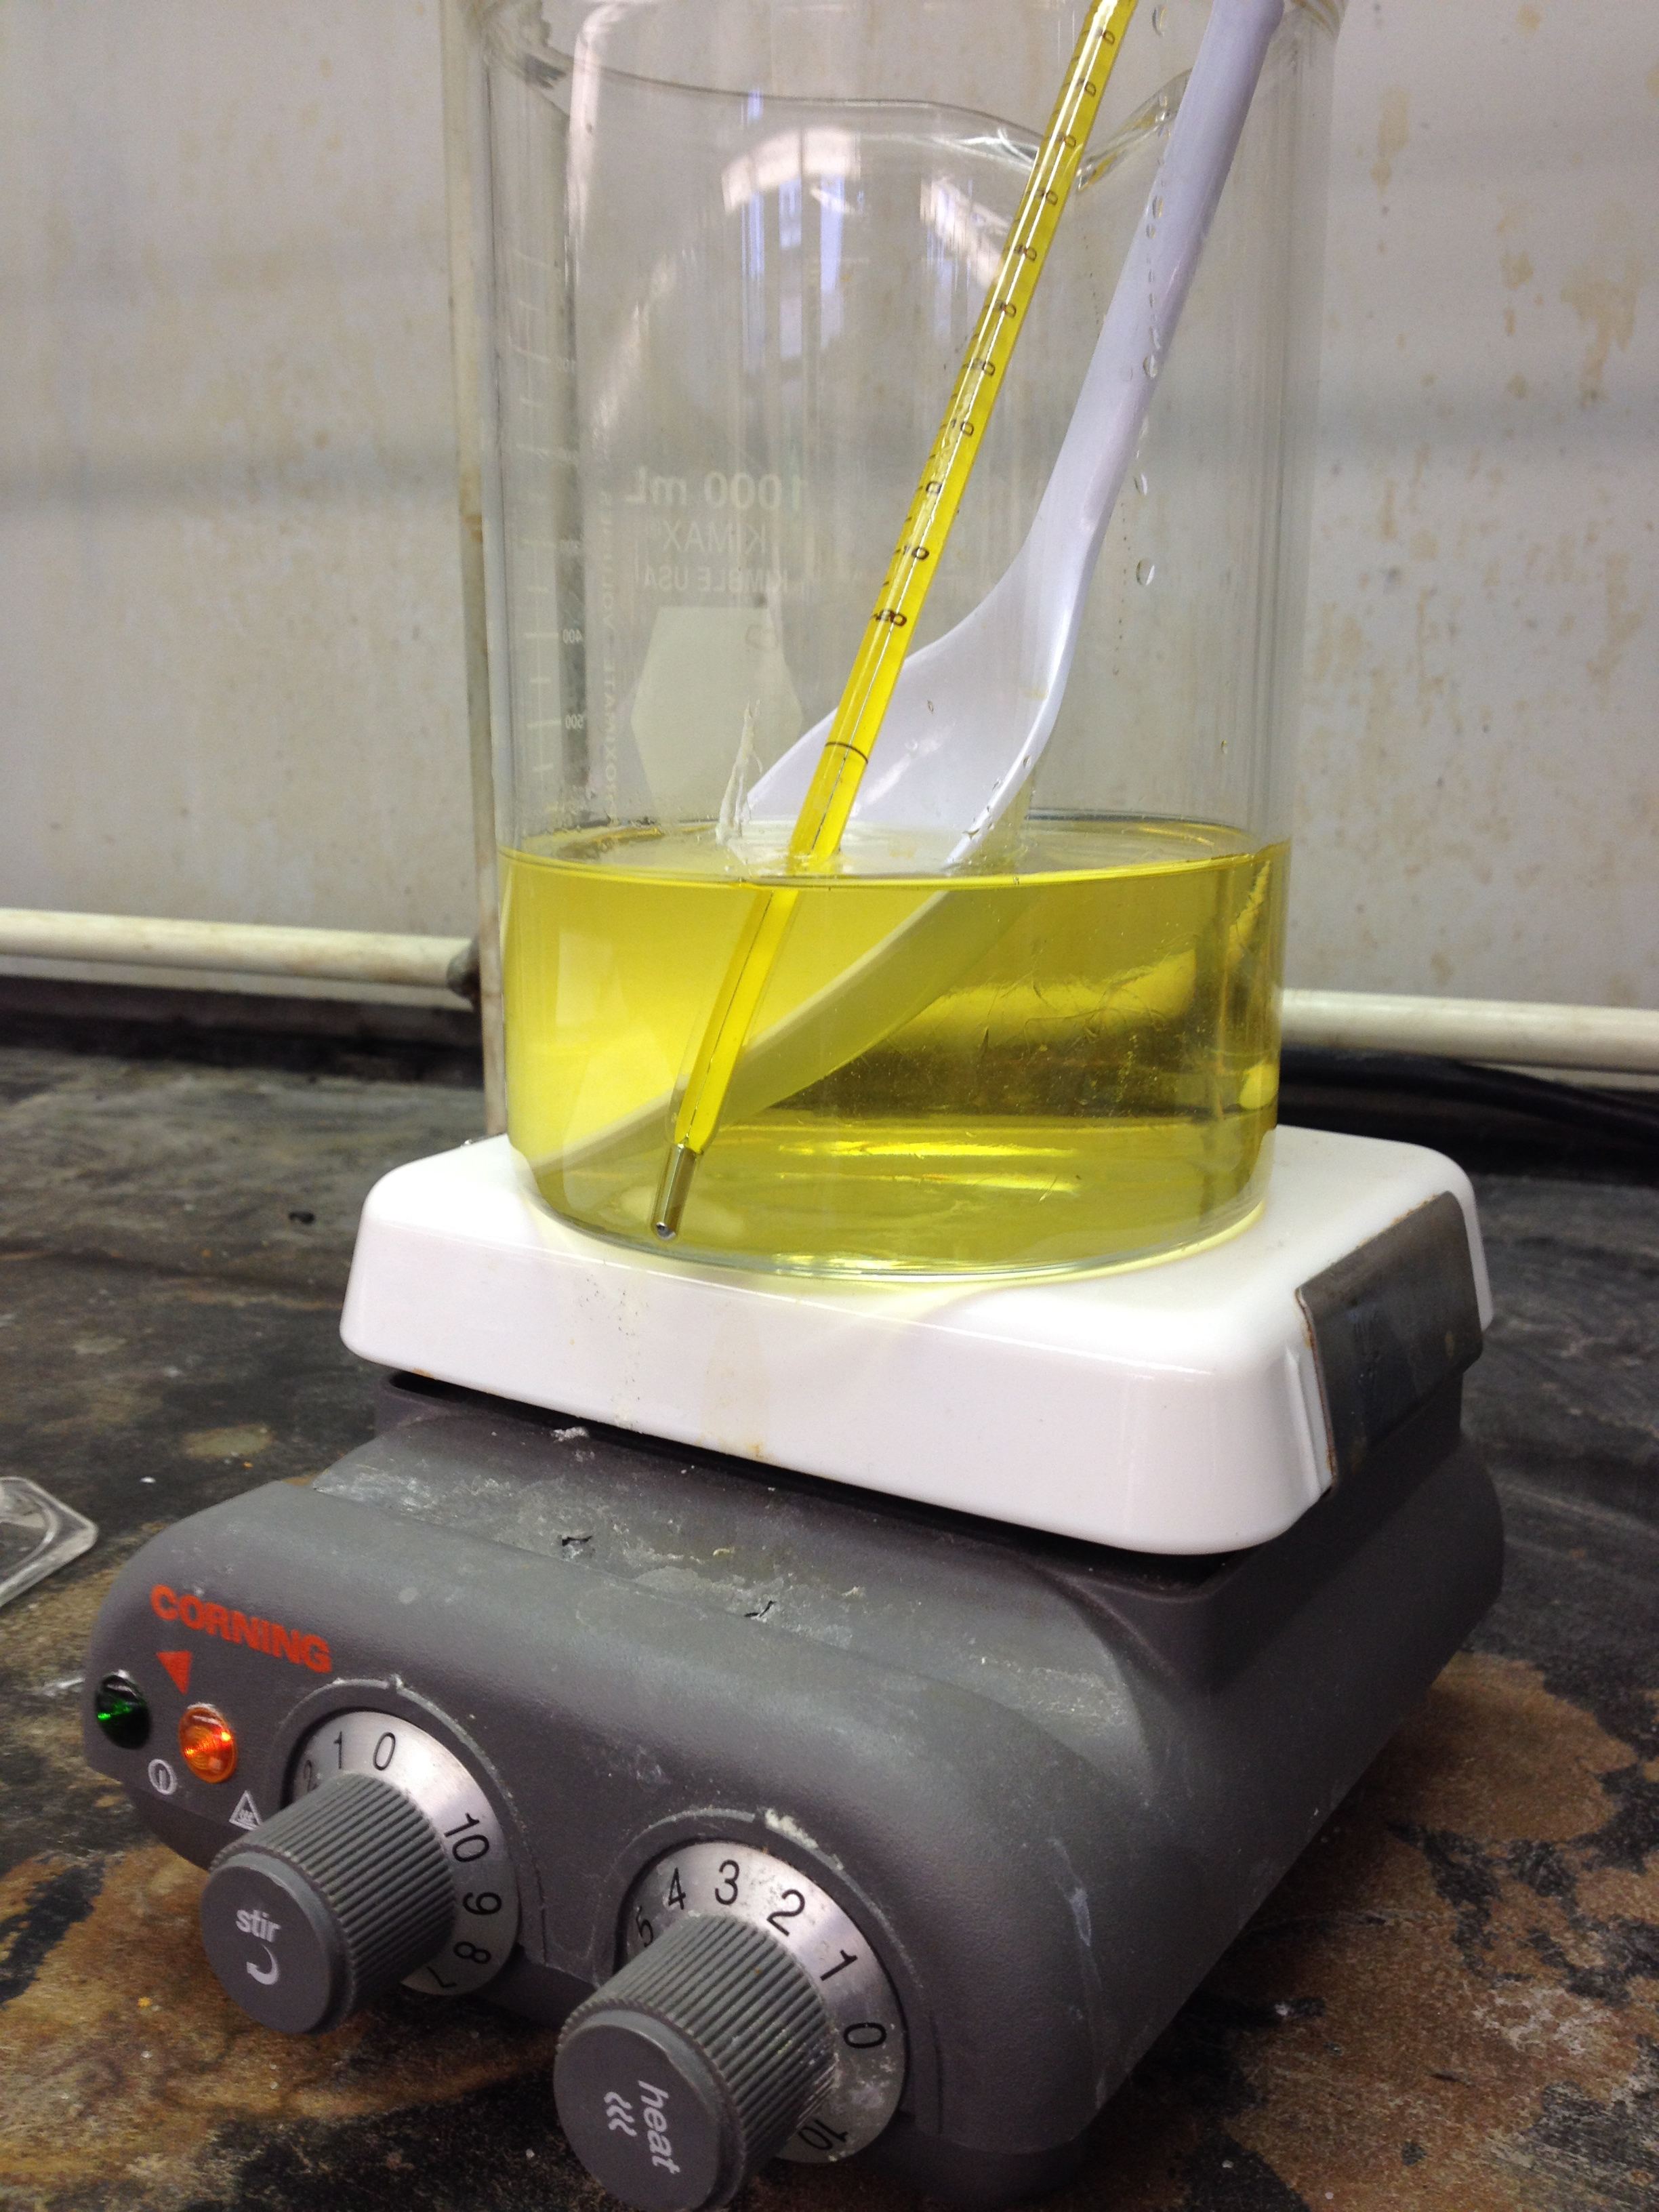
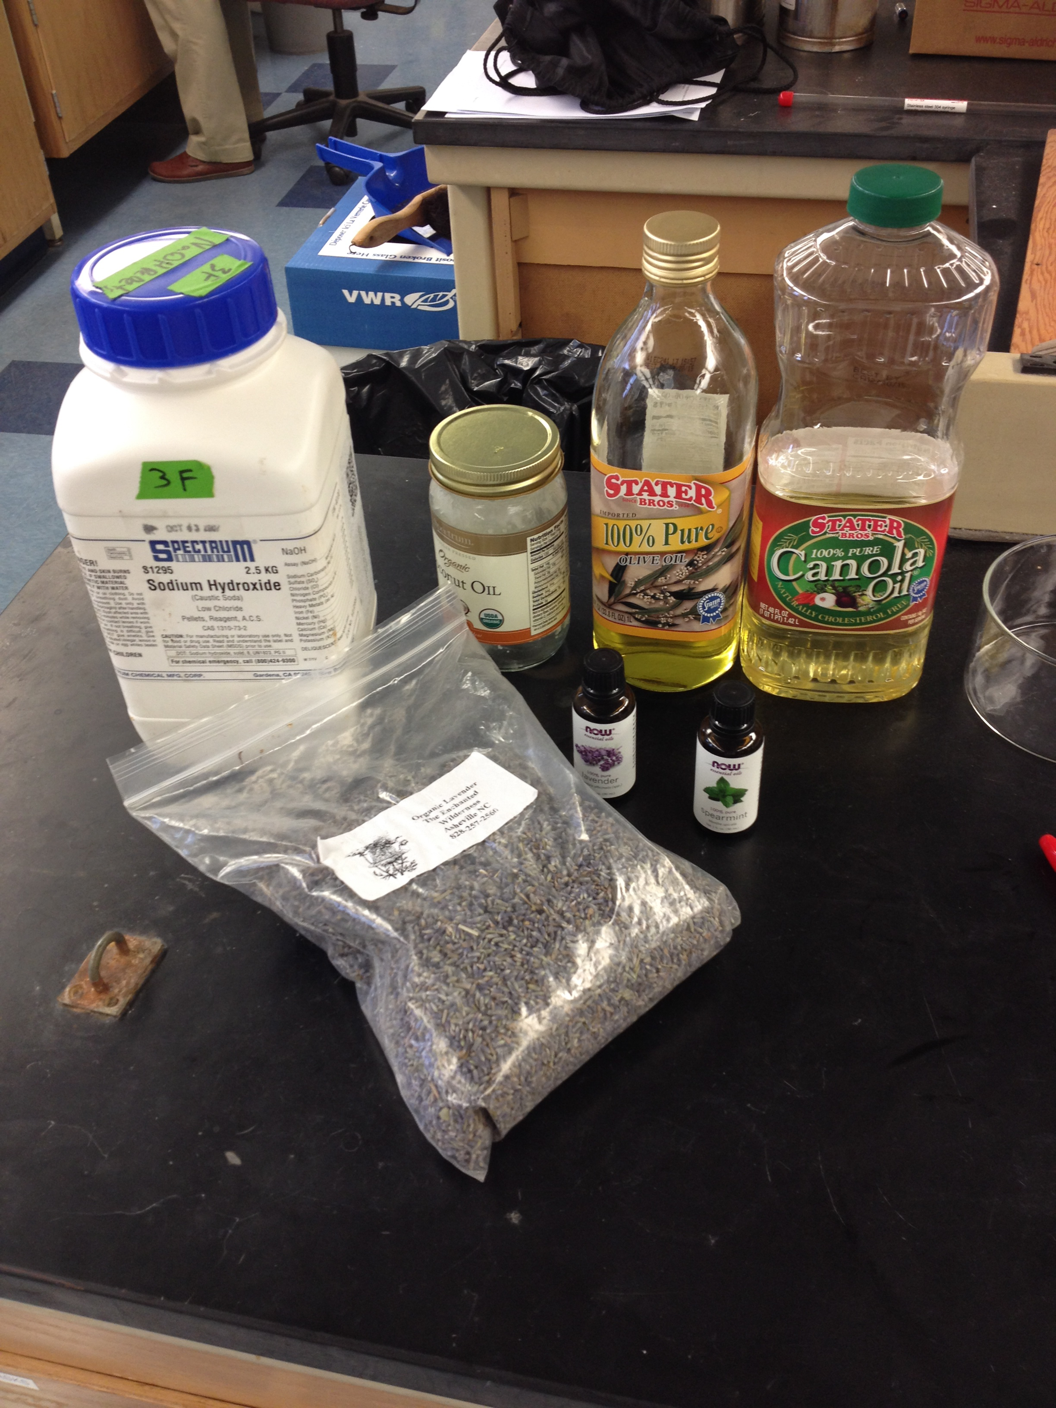
SOAPMAKING
The chemistry of soap
Notes:
These pictures were taken by Adam Johnson at Harvey Mudd College during Spring 2015 “Chemistry of Cooking” laboratory

Slide 2
Organic chemistry review
Alkane
  C_{n}H_{2n+2}
  saturated
Alkene
  C_{n}H_{2n}… or is it?
  Unsaturated, or, ring
Alcohol
  ROH
  primary = RCH₂OH
Carboxylic acid
  RCO₂H
Ester
  Product of an alcohol and a carboxylic acid (dehydration/esterification)
  RCO₂R’
Notes:
Review or introduction to nomenclature; focusing on the ending. In our class, we had an introduction to organic chemistry earlier in the semester, so this was review.

Slide 3
The chemical reaction of soap – saponification (deesterification!)
Notes:
Show and discuss the major chemical reaction of soap making

Slide 4
The many fatty acids in nature
Coconut oil: 91%
Canola oil: 93%
Notes:
We will be comparing soaps made with canola vs. coconut oil. Coconut oil is a solid at room temperature. This slide is designed to show that straight chain alkyl tails on the R groups allow for more efficient packing, higher intermolecular forces, and a higher melting point

Slide 5
The chemical reaction of soap – saponification (deesterification!)
Procedure (canola oil):
313 g oil, warm to ~45 °C
39 g NaOH + 85 g water, warm to ~45 °C
Mix to “trace”
Add scent oil and colorant: pink + spearmint
Pour and let set overnight
Test for pH!
Notes:
Making soap is not difficult, though doing it live does involve a fair amount of risk… sometimes the soap is slow to reach trace and you might have to stick blend it for longer than you might want in front of an audience. There are good soapmaking websites online. IDefinitely test this one first. Bonus, you get some nice soap to give away as prizes later in the semester. I used spearmint oil for this soap, but you could use any flavoring you wanted… just change the slide!

Slide 6
The chemical reaction of soap – saponification (deesterification!)
Procedure (coconut oil):
313 g oil, warm to ~45 °C
53g NaOH + 85 g water, warm to ~45 °C
Mix to “trace”
Add scent oil and colorant: orange + lavender
Pour and let set overnight
Test for pH!
Notes:
If you only have one section, you can practice with one soap before hand, and then do the other live. The 2 soaps have very different hardnesses. I used lavender oil for this soap, but you could use any flavoring you wanted… just change the slide!

Slide 7
Calculating molecular weight
Mixture of substances
No single measure of molecular weight
Different experimental techniques give different values
Number average, Mn (arithmetic mean of individual MWs)
  Total weight of all the samples divided by total # of moles/sample
  ∑N_{i}M_{i} = number of moles·MW = mass; this is the mass of the sample
  ∑N_{i}M_{i}/∑N_{i} = mass/moles
Weight average, Mw
  Find weight fraction of each molecule, WF_{i} = N_{i}M_{i}/∑N_{i}M_{i} (unitless)
  This value is given as weight %
  Weight of that fraction, W_{i} = WF_{i}·M_{i} (mass/moles)
  ∑W_{i} = sum of all molecular weights
Notes:
This unit was before a unit on polymers so we introduced some molecular weight terminology here. This could be skipped easily. Different experimental techniques give different measures of MW; a good reference website is: http://www.pslc.ws/macrog/average.htm or https://en.wikipedia.org/wiki/Molar_mass_distribution

Slide 8
Example calculation
Sample 1: mixture of hydrocarbons expressed as weight %
  A: 45%, 100 g/mol
  B: 35%, 110 g/mol
  C: 15%, 120 g/mol
  D: 5%, 200 g/mol
Mn=∑N_{i}M_{i}/∑N_{i}=?
  Total weight not given, but we can set it to 100g; this is the total mass
  How many moles are present?
  Moles A = 45g·(1 mol/100 g) = 0.45 moles
  Moles B = 35g·(1 mol/110 g) = 0.32 moles
  Moles C = 15g·(1 mol/120 g) = 0.12 moles
  Moles D = 5 g·(1 mol/200 g) = 0.025 moles
  Total moles: 0.92 moles
  MW = 100 g/0.92 moles = 109 g/mol

Slide 9
Example calculation
Sample 1: mixture of hydrocarbons expressed as weight %
  A: 45%, 100 g/mol
  B: 35%, 110 g/mol
  C: 15%, 120 g/mol
  D: 5%, 200 g/mol
Mw=∑W_{i}=∑WF_{i}·M_{i} =?
  W_{A} = 0.45·100 g/mol = 45 g/mol
  W_{B} = 0.35·110 g/mol = 39 g/mol
  W_{C} = 0.15·120 g/mol = 18 g/mol
  W_{D} = 0.05·200 g/mol = 10 g/mol
  Mw = 112 g/mol
  Mn = 108 g/mol
  Mw is larger; it slightly favors the higher MW species

Slide 10
Reminder of Wednesday exercises and reading
a) Verify that the two soaps in class are overfatted. Turn in your work, clearly demonstrating how you arrived at your answer, at the beginning of the next class. The molecular weight to use for coconut oil and canola oils are 698 g/mol and 932 g/mol respectively. I used 313 g of each oil, and 39.0 g (canola) or 53.0 g (coconut) of NaOH.
b) draw a picture or cartoon that explains how soap works at the molecular level. Include several sentences of description.
I calculated these molecular weights using one of the two techniques; the other technique gives a different value!
Notes:
These are the exercises assigned for the 2nd day of this two-part activity. The key is provided.

