Slide 1
Review: Two unit conversion factors
Moles of one substance ↔ moles of another substance
If 0.29 moles of CH₃OH reacts completely with O₂ how many moles of CO₂ form?
2 CH₃OH + 3 O₂ → 2 CO₂ + 4 H₂O
2 mol CO₂
0.29 mol CH₃OH
x
= 0.29 mol CO₂
2 mol CH₃OH
Mass of a substance ↔ moles of the same substance
A sample contains 3.1 g CH₃OH, How many moles of CH₃OH are in the sample?
Molar mass CH₃OH = 1 mol CH₃OH = 32.04 g CH₃OH
1 mol CH₄
3.1 g CH₃OH
x
= 0.097 CH₃OH
32.04 g CH₄
Notes:
This slide reviews the essential calculations for a basic stoichiometry problem. After this slide I’ll do a quick ABCD card question on each type of calculation if it’s been more than a day or two since students last practiced these calculations in class.

Slide 2
A series of unit conversions
If 3.1 g of CH₃OH reacts how many grams of CO₂ form?
2 CH₃OH + 3 O₂ → 2 CO₂ + 4 H₂O
moles
measurable quantity | given |  | find
Vertical moves:
convert to or from moles
Horizontal moves:
Moles row- convert using coefficients from the balanced equation
Measurable quantity row- horizontal moves not permitted
-unit conversion factors not readily available
Notes:
Introduction of the scaffolding
Draw a map that shows which calculations to do and in what order.

Slide 3
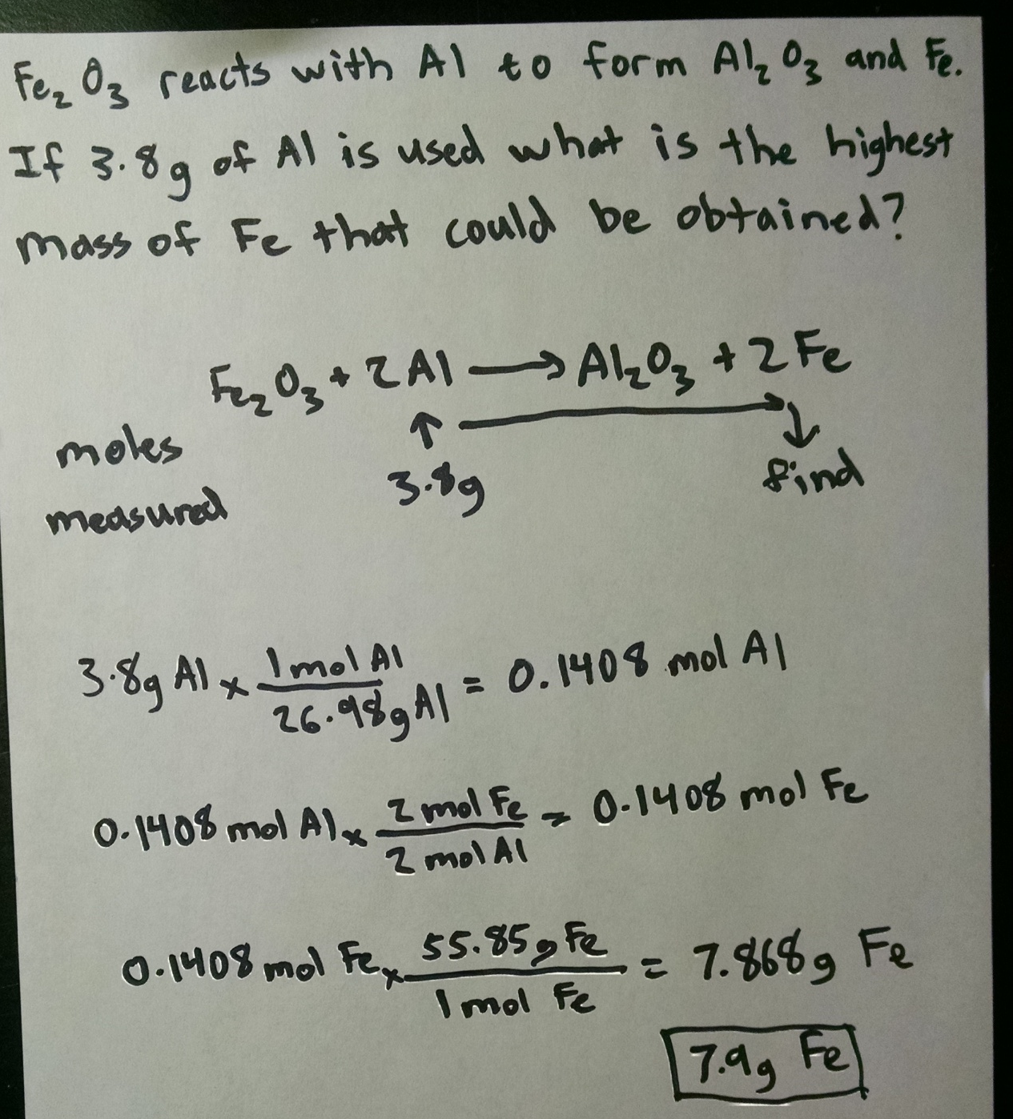
Notes:
Example problem from doc cam

Slide 4
The measured quantity doesn’t have to be grams.
Lots of quantities can be converted to moles.
moles
measurable quantity | given |  |  | find
molar mass
moles
grams
kg, mg, lbs etc.
molar mass
density
moles
grams
L, cm³, etc.
moles
concentration
moles
pressure, volume, and temperature
Notes:
Extension to stoichiometry problems when given quantities are not in grams. Depending on the number of example problems and/or practice problems the instructor uses, this slide can be used in a second class period.
If gases and/or concentration have not yet been discussed, deleted these lines.

Slide 5
Comparing CH₄ and O₂
If 4.2 g of CH₄ reacts with 5.1 g O₂ how many grams of CO₂ form?
CH₄ + 2 O₂ → CO₂ + 2 H₂O
moles
measurable quantity | given | given | find
compare
Before comparing quantities, get them in the same unit
Once the quantities are compared proceed with the smaller (limiting) number
Notes:
New class period.
Before introducing limiting reagent calculations I first discuss the topic visually. A visual example similar to the one I use is here.
https://www.ionicviper.org/webresources/limiting-reagent

Slide 6
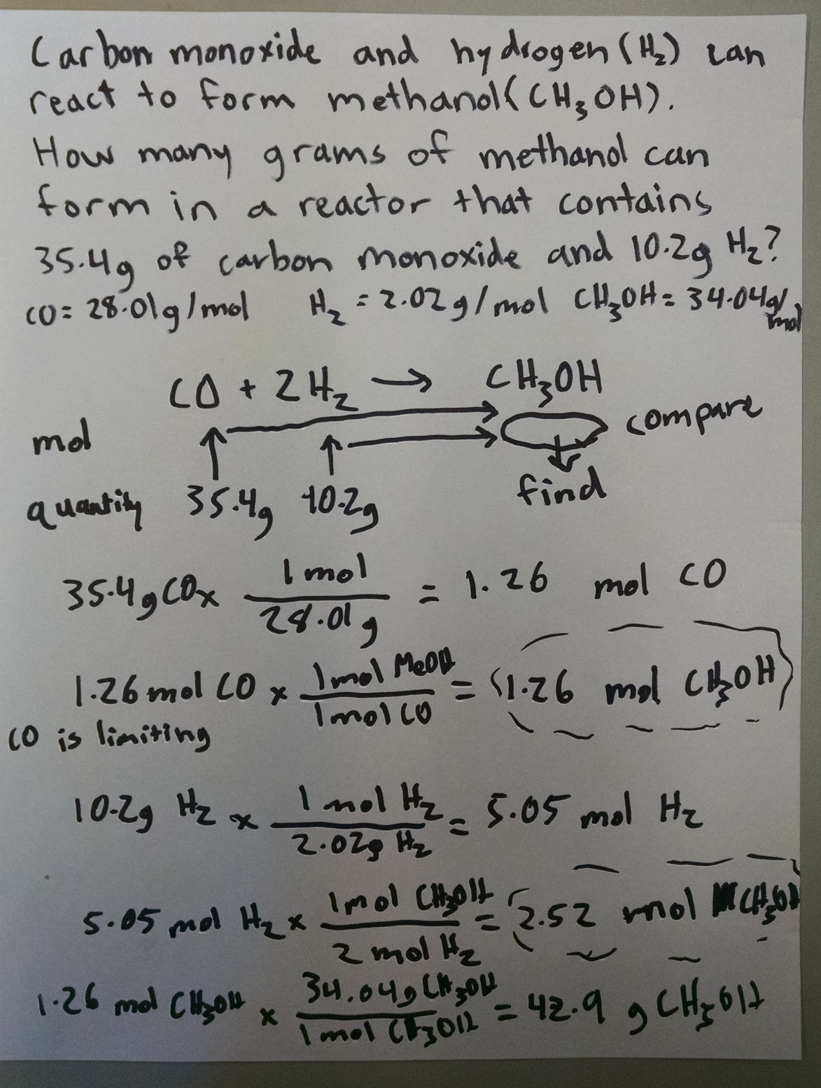
Notes:
Example of extension to a limiting regent question-
Get the two starting quantities into a common unit, compare them, and then proceed with the smaller quantity.

